Slide 1

FIFA WORLD CUP ANALYSIS
5-Tournament Historical Analytics (2002–2018)
Executive Portfolio Case Study & Dashboard Presentation
Data Analyst: Oodo Janefrances Chinaza
Stack: Power BI, DAX, Power Query, Star Schema
Date: July 2026

Slide 2
PROJECT SCOPE & CONTEXT
• Comprehensive data analysis across 5 FIFA World Cup editions
(2002 to 2018).
• Utilized Microsoft Power BI for cleaning, modeling, and interactive
visualization.
• Engineered star schema data model connecting fact tables and
team/date dimensions.
• Formulated dynamic DAX measures for real-time aggregation and
filtering.
PROJECT MISSION STATEMENT
To evaluate tournament scoring efficiency, team
performance trends, historical win/loss distributions, and
targeted national performance profiles (focusing
specifically on France and Nigeria) to empower sports
analysts and federations with centralized historical
intelligence.

Slide 3
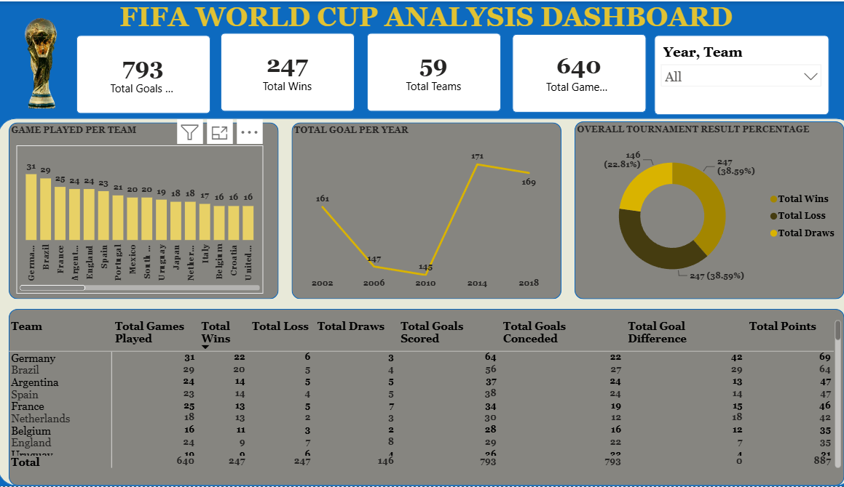
Power BI Dashboard Overview & Visual Layout

Slide 4
Dashboard Layout & Visual Components
• KPI Summary Cards: Displays high-level aggregates: 793 Goals, 247 Wins, 59 Teams, 640
Games.
• Interactive Slicers: Multi-select filters for Year (2002–2018) and Team drill-down.
• Bar Chart (Games Played): Ranks countries by total matches led by Germany (31) & Brazil
(29).
• Line Chart (Goals Trend): Tracks tournament scoring evolution from 2002 (161) to peak
2014 (171).
• Donut Chart (Outcomes): Breaks down total results: 38.6% Wins, 38.6% Losses, 22.8%
Draws.
• Granular Table View: Full matrix displaying Wins, Losses, Draws, Goals, GD, and Points.
Key Data Highlights
Top Performer
Germany leads overall with 69 Points, 64 Goals Scored, and
+33 Goal Difference.
Runner Up
Brazil follows closely with 63 Points, 56 Goals Scored across
29 games.
Outcome Distribution
Draws constitute 22.81% (146 matches), reflecting tight
group stage competition.

Slide 5
Goal Trend Analysis Across Tournaments (2002–2018)
2002 World Cup
161 Goals
2.52 goals/match baseline
across 64 matches in
Korea/Japan.
2006 World Cup
147 Goals
Defensive tactical setups
dominated early group
phase matches.
2010 World Cup
145 Goals
Lowest scoring output in
modern era during South
Africa tournament.
2014 World Cup
171 Goals
Peak offensive tournament
output, tying all-time
historical records.
2018 World Cup
169 Goals
Sustained high offensive
productivity across Russia
tournament fixtures.

Slide 6
Target Profile: France
• Peak Tournament (2018): World Cup Champions with 6 Wins, 1
Draw, 0 Losses (19 Points, 14 Goals).
• Historical Trajectory: 2002 Group exit (1 pt) ➔ 2006 Finalists (15
pts) ➔ 2010 Exit (1 pt) ➔ 2014 QF (10 pts) ➔ 2018 Champions.
• Key Characteristic: High ceiling with significant performance
variance between tournament cycles.
Target Profile: Nigeria
• Qualification Consistency: Qualified for 4 out of 5 tournaments (2002,
2010, 2014, 2018).
• Overall Metrics: 13 Games | 2 Wins | 3 Draws | 8 Losses | 9 Points | -8
GD (12 Scored, 20 Conceded).
• Peak Campaign (2014): Reached Round of 16 in Brazil with 4 Group Stage
Points.
• Special Performance Effect: Win rate (~15.4%) vs global qualifier average
(~38.5%) highlights conversion gaps and defensive strain in close fixtures.

Slide 7
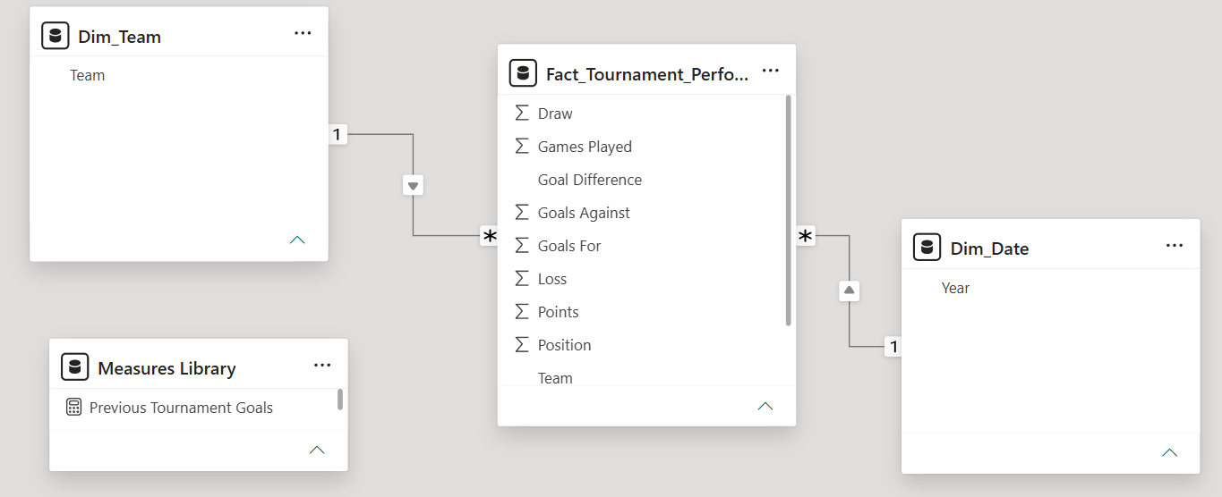
Star Schema Structure (ERD)
• Fact Table (Fact_Tournament_Performance): Contains granular match records,
goals, results, and outcome scores.
• Dimension Table (Dim_Team): 39 unique teams enabling clean row-level filtering
and slicing.
• Dimension Table (Dim_Date / Year): Dedicated calendar dimension enabling Time
Intelligence functions.
• Centralized Measures Library (_Measures): Dedicated container for DAX metrics
ensuring maintainability.

Slide 8
Core DAX Formulae
Total Points Calculation
Total Points =
([Total Wins] * 3) + ([Total Draws] * 1)
Goal Difference Measure
Total Goal Difference =
SUM(Fact[Goals Scored]) - SUM(Fact[Goals Conceded])
Win Rate Percentage
Win Rate % =
DIVIDE([Total Wins], [Total Games Played], 0)
Actionable Recommendations
1. Game Management Optimization
National federations (e.g., Nigeria) facing defensive strain should optimize defensive
transition strategies to convert draws into decisive victories.
2. Advanced Tactical BI Integration
Incorporate real-time opponent modeling into pre-tournament preparation using star
schema analytics.
3. Predictive Telemetry Expansion
Expand future Power BI iterations with player-level telemetry (xG, distance, pressing
efficiency).

Slide 9
THANK YOU

