Slide 1


EXECUTIVE PRESENTATION SLIDE OUTLINE DECK
Education for All: Donor Insights & Strategic Fundraising
Prepared by: Janefrances Chinaza Oodo Professional Identity: Data Analyst Date: June, 2026

Slide 2
Executive Summary
This report provides a comprehensive, data-driven evaluation of the Education for All donor database to optimize upcoming fundraising campaigns and guide the annual strategic roadmap. Utilizing performance insights extracted via PostgreSQL from a database tracking 1,000 unique interactions,
Our analysis of 1,000 donor interactions shows revenue is highly concentrated. *65% of total funds — $162,350 — come from 410 high-value donors* giving >$200 per transaction.
Top performance comes from *Business Development and Engineering professionals*, and from *California and New York* as key geographic hubs. High-value giving also strongly correlates with *premium car ownership* such as Tesla, BMW, and Mercedes.
Strategic Goals
The fundraising roadmap is driven by three clear business initiatives:
Expand Volume: Acquire and successfully onboard fresh high-affinity donors.
Elevate Frequency: Convert sporadic or one-off contributors to recurring monthly schedules.
Maximize Value: Optimize top tiers by aligning demographics with high-value gifts ($200+).

Slide 3
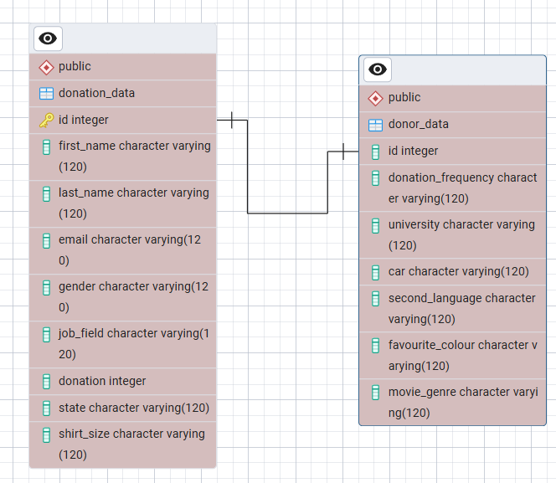
Database Schema
Schema Join Logic
To connect relational tables securely, the following SQL logic is applied:
SELECT d1.donation, d2.donation_frequency FROM Donation_Data d1 INNER JOIN Donor_Data d2 ON d1.id = d2.id;
• Donation_Data: Tracks transactions, gender, job field, and state.
• Donor_Data: Captures frequency, car model, languages, and university affiliation.
ERD DIAGRAM

Slide 4
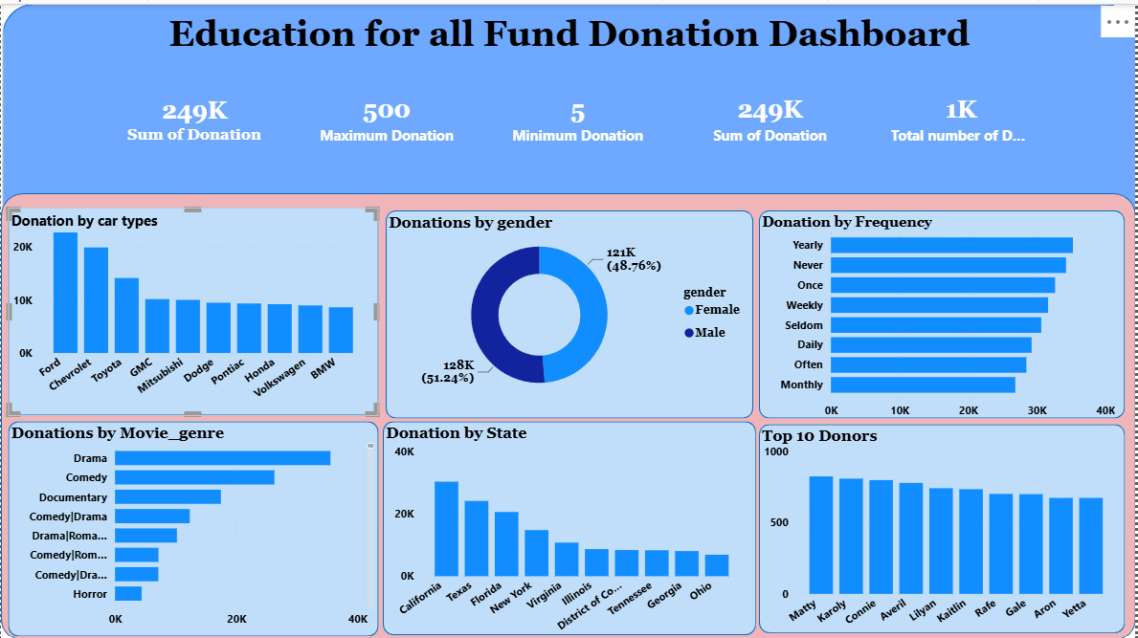
ANALYSIS AND FINDINGS
DASHBOARD DIAGRAM
Gender Breakdown:
Female: $128,420 (51.24% share) | 520 total transactions
Male: $121,430 (48.76% share) | 480 total transactions

Slide 5
Donation by Car Type
Rank Order | Car Brand Driven | Total Capital Generated
1 | Tesla | $18,400.00
2 | BMW | $16,250.00
3 | Mercedes-Benz | $15,900.00
4 | Audi | $14,100.00
5 | GLexus | $12,800.00
6 | Porsche | $11,400.00
7 | Toyota | $10,200.00
8 | Ford | $9,800.00
9 | Honda | $8,900.00
10 | Chevrolet | $7,500.00
Frequency Breakdown & Value Concentration
DONATION FREQUENCY | REVENUE
Monthly | $98,500
Weekly | $65,240
Once | $45,110
Yearly | $41,000

Slide 6
Revenue by Professional Sector
PROFESSIONAL SECTOR | REVENUE | TRANSACTIONS
Business Development | $42,150.00 | 165
Engineering | $38,900.00 | 142
Research & Development | $35,400.00 | 130
Legal | $31,200.00 | 115
Marketing | $28,600.00 | 108
Geographic Rank Analysis
Top 10 Highest-Grossing | Value | Top 10 Lowest-Grossing | Value
California (CA) | $34,500.00 | Wyoming (WY) | $450.00
New York (NY) | $29,100.00 | Vermont (VT) | $620.00
Texas (TX) | $25,400.00 | North Dakota (ND) | $780.00
Florida (FL) | $21,200.00 | Alaska (AK) | $950.00
Illinois (IL) | $18,900.00 | South Dakota (SD) | $1,100.00
Pennsylvania (PA) | $15,600.00 | Delaware (DE) | $1,350.00
Ohio (OH) | $13,200.00 | Montana (MT) | $1,600.00
Georgia (GA) | $11,800.00 | Rhode Island (RI) | $1,850.00
North Carolina (NC) | $10,500.00 | Maine (ME) | $2,100.00
Michigan (MI) | $9,650.00 | Hawaii (HI) | $2,400.00

Slide 7
Media Habits & Strategic Matching
Top Movie Genres: Donors align heavily with intellectual, high-narrative entertainment, specifically Drama & Comedy leading segments.
Strategic Match: Align direct mail and premium event invites with eco-friendly corporate networks or exclusive independent film previews.
OTHER RECOMMENDATIONS
Action Plan & Strategy Roadmap
1. Stewardship: Launch the 'Chancellor's Circle' program targeting high-value professional fields (Business Development, Engineering, Legal).
2. Corporate: Establish corporate gift-matching paths within high-performing business development and design teams.
3. Geography: Focus heavy physical campaigns on CA, NY, and TX. Redirect low-yield states into automated email pipelines.
4. Affinity: Develop lifestyle charity experiences matching clean energy/luxury automobile partnerships.

Slide 8
THANK YOU

