Slide 1
About 50 million people worldwide live with epilepsy.
Detecting seizures from EEG with machine learning:
a Random Forest vs an SVM compared on two datasets
- Janeika Jeyakanthan

Slide 2
WHY THIS PROBLEM?
Seizures hide in the signal - and a miss is the costly error
EEG review is slow and specialist-heavy, and in clinical care a missed seizure is far more serious than a false alarm.
This mirrors the role I’m interested for: a Junior Data Scientist using machine learning on complex healthcare datasets to support epilepsy research.
That is why the whole analysis is framed around a simple yes/no clinical question: is this recording a seizure or not?

Slide 3
ABOUT THE DATASET
Two public EEG datasets
BEED - Bangalore EEG Epilepsy Dataset, UCI
ESR - Epileptic Seizure Recognition, Kaggle
Bangalore EEG Epilepsy Dataset (UCI): 8,000 recordings, 16 channel-summary features, 4 classes (healthy + 3 seizure types).[1]
Epileptic Seizure Recognition (Kaggle): 11,500 recordings, 178 raw EEG time points, 5 classes (seizure + 4 non-seizure).[2]
One gives clean engineered features the other raw noisy signals, so they represent two ends of real EEG analysis.

Slide 4
WHAT I DID
Two Different Machine Learning models
1
Frame the question
Recode both datasets to a yes/no seizure target using documented class meanings.
2
Models
Random Forest (200 trees) and an RBF SVM - two genuinely different approaches.
3
Test and Train Phase
80/20 stratified split with fixed seed 42 and scaler fitted on training data only.
4
Evaluation
Accuracy, balanced accuracy, precision, recall, F1, AUC and confusion matrices

Slide 5
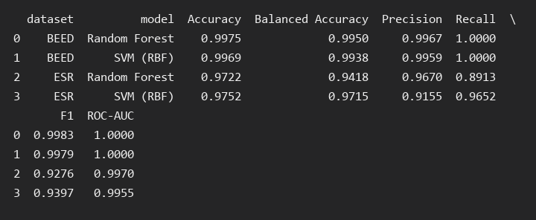
RESULTS - BEED DATASET
OUTPUT
≈99.7%
Random Forest accuracy 0.9975, SVM 0.9969
False negatives: 0 in both models
Confusion matrix output: caught all 1,200 of 1,200 seizure recordings; only 4-5 false alarms.

Slide 6
RESULTS - ESR DATASET
The dataset showed a real trade-off
SVM (RBF)
Random Forest
Recall 0.965
Recall 0.891
Missed 16 seizures / 41 false alarms (code output)
Missed 50 seizures / 14 false alarms (code output)
On raw EEG signals the SVM catches more seizures but raises more false alarms and the Random Forest does the reverse.

Slide 7
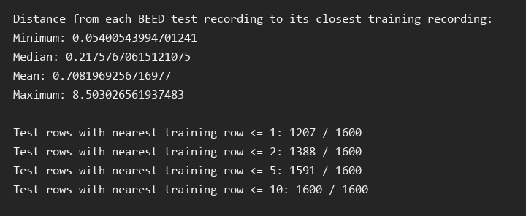
TEST THE BEED NUMBER
Two Different checks
Near-duplicate check
Whole-block split
1,207 of 1,600 test rows sit within distance 1 of a training row - very similar recordings.
Held out whole 200-row blocks - accuracy stayed 0.9962 (RF) / 0.9969 (SVM).
So the score is not a random-split artefact - but it also confirms BEED has many repeat recordings.

Slide 8
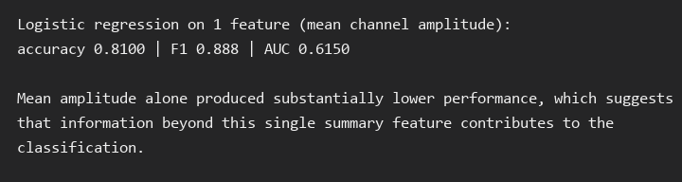
WHAT DRIVES THE BEED SCORE - ONE MORE CONTROL
A single easy feature cannot explain it
81.0% AUC 0.615
A logistic regression on mean channel amplitude alone
The near-perfect result needs the combination of channel features, not one amplitude shortcut.
Single-feature baseline (the 81% check)

Slide 9
WHAT ACTUALLY HAPPENED ?
The Insights
Feasible
On both datasets both models separated seizure from non-seizure (AUC 0.996-1.000).
Trade-off is real
On ESR the code shows the SVM missed 16 while the RF missed 50 seizures - fewer misses, more false alarms.
Near-perfect needs proof
BEED's ~99.7% survives the block split but close neighbours (1,207/1,600) explain part of it.
Interpretation is dataset-bound
BEED: engineered features. ESR: raw signal.
One score cannot be generalised to the other.

Slide 10
LIMITATIONS
What these numbers do not claim
Not patient-level
BEED has no subject IDs and only 20 subjects per class - the CSV cannot prove it generalises to new patients.
Leakage risk
Very similar recordings appear across the split, so the score is optimistic vs unseen patient data.
No external validation
Both datasets are public and self-contained, no independent hospital data was used.
Two models only
No hyperparameter tuning and no deep learning were explored - scope of this case study.
The scores describe this dataset's test set, not unseen patients.

Slide 11
WHAT HAPPENS?
From a benchmark to something testable
1
Validate at patient level
Get subject IDs or use BEED's documented 200-row subject blocks as a true subject split.
2
Test new patients
Fit on one release, score on untouched subjects - the only realistic measure for clinical use.
3
Extend the pipeline
Add tuning, error analysis and integration work
4
Keep it reproducible
Fixed seed and documented transforms

Slide 12
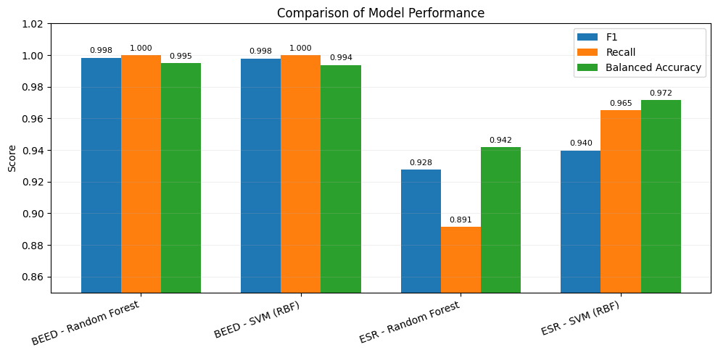
SUMMARY
▪ A yes/no EEG question is learnable with both a Random Forest and an SVM.
▪ The code caught all 1,200 BEED seizures and reached 97%+ accuracy on both datasets.
▪ On harder ESR data, the model choice is a real trade-off between misses and false alarms.
▪ Scores are dataset-bound proving, clinical value needs patient-level testing next.

Slide 13
Acknowledgement of GenAI use: I used Gemini to help me understand the requirements and data analysis. This tool supported me in drafting an outline of the key requirements and suggesting a possible flow. I applied my logic to develop the overall work and I did not copy any content from Gemini’s result
References
Datasets
[1] N. Najmusseher and P. K. N. Banu, "BEED: Bangalore EEG Epilepsy Dataset," UCI Machine Learning Repository, 2024. [Online]. Available: https://archive.ics.uci.edu/dataset/1134/beed:+bangalore+eeg+epilepsy+dataset
[2]M. Harun-Ur-Rashid, "Epileptic Seizure Recognition," Kaggle Datasets, 2018. [Online]. Available: https://www.kaggle.com/datasets/harunshimanto/epileptic-seizure-recognition.
Apart from this, I also referred to course lecture videos and slides to understand the requirements.

