Slide 1
Session 1
Tree basics
Email = oscar.lao@cnag.crg.eu
Skype = oscar.lao

Slide 2
Before we start
Some basic rules
Please, if you want to contact me, use the oscar.lao@ibe.upf-clisc.es email (I also check the ESCI one, but less).
Classroom dynamic
Each session is divided in two parts of ~55 minutes.
Two hours of theory. Two hours of practical (bring your own laptop!)
Assessments
Project shared with ASAB
To be done in groups of ~four people.
Exams
Midterm and final exam

Slide 3
Before we start
Weekly Assignments are individual, NOT BY PAIRS.
Plagiarism
Python
Comment your code

Slide 4
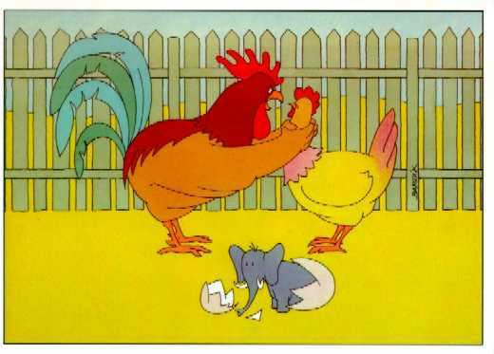
WHY IS THIS A JOKE?
Notes:
Concept of gene duplication
Concept of parents
Concept of Species
Concept of heritability

Slide 5
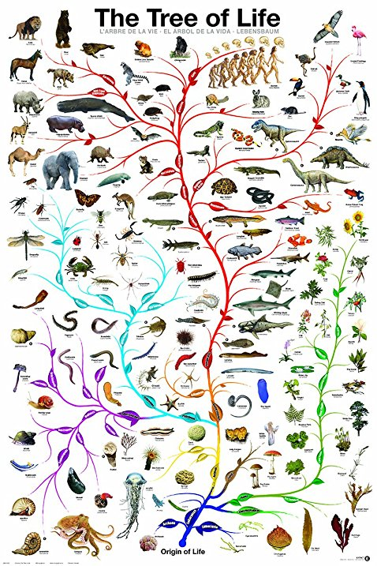
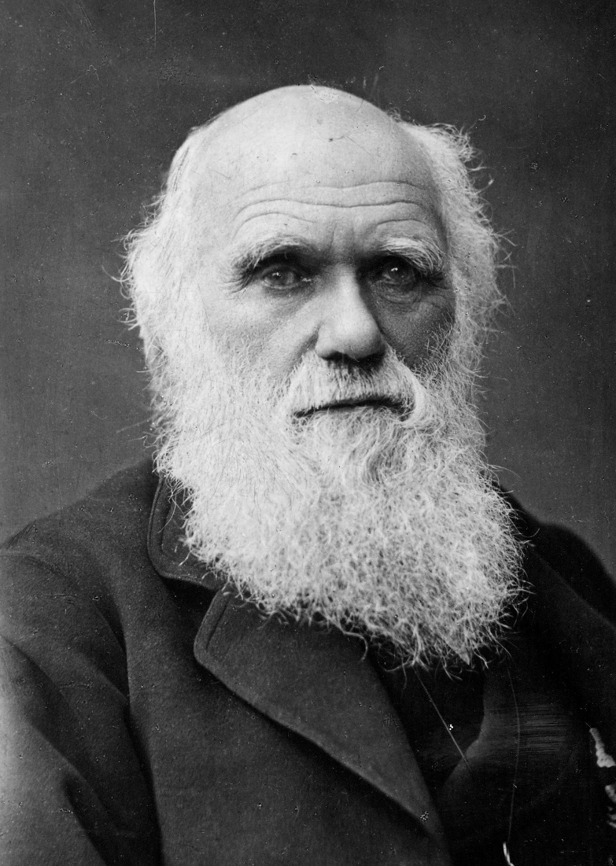
Why do we have to think in trees?

Slide 6
Why do we have to think in trees?
Ne

Slide 7
Why do we have to think in trees?
Now, we can say that observing such genealogy does not imply that there was ONLY one person

Slide 8
Why do we have to think in trees?
Ancestor of all the chromosomes of present

Slide 9
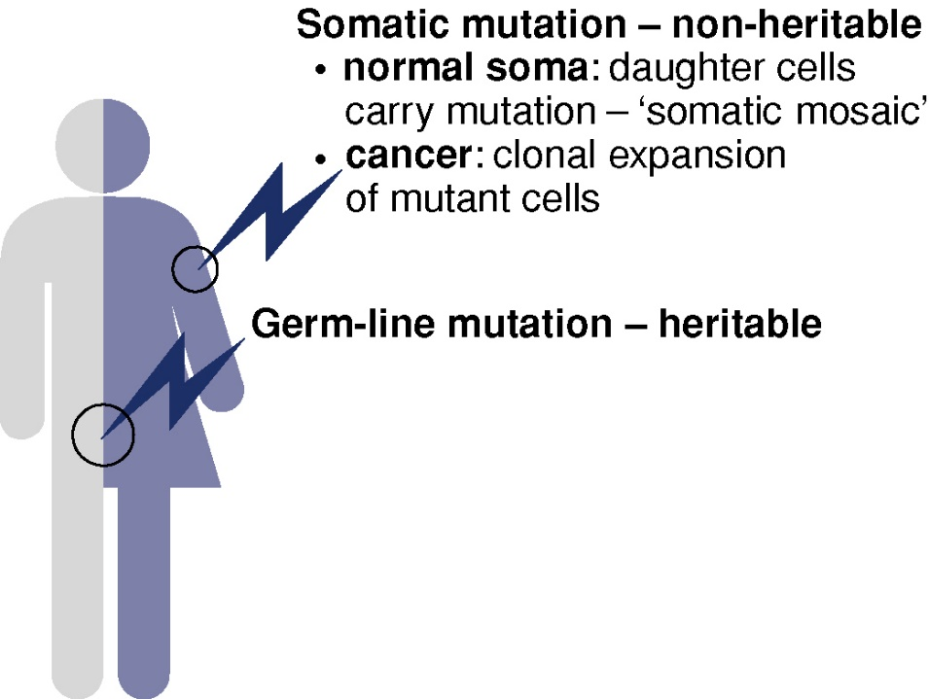
Why do we have to think in trees?
From an evolutionary point of view these are the important ones!
Human evolutionary genetics

Slide 10
Why do we have to think in trees?
A mutation occurs at random in one nucleotide that does not influence reproduction

Slide 11
Why do we have to think in trees?
AAAAAAAA
Ancestral sequence
1 -> G
GAAAAAAA
AAAAAAAA
2 -> C
AAAAAAAA
AAAAAAAA
3 -> G
ACGAAAAA
4 -> C
5 -> C
AAACCAAA
AAACCAAA
6 -> T
AAACATAA
7 -> G
8 -> T
Notes:
Which are the implications in a culture cell?

Slide 12
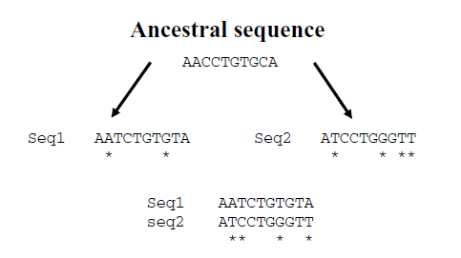
Why do we have to think in trees?
P-distance = 4

Slide 13
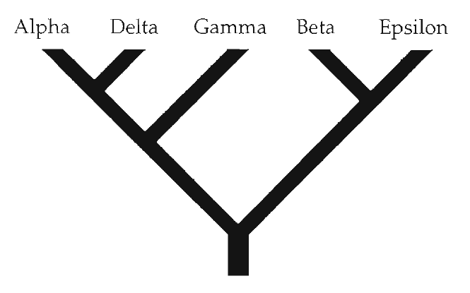
What is a tree?
Leaf (vertex)
Node (vertex)
Branch (edge)
Is this a tree? Why?
Root

Slide 14
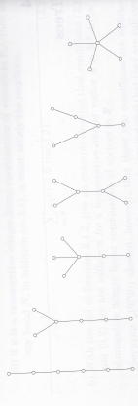
What is a tree?

Slide 15
What is a tree
Type of graph
Connected acyclical graph
Leaf: vertex of degree one
Depicts the relationship between Operational Taxonomic Unit (OTUs)

Slide 16
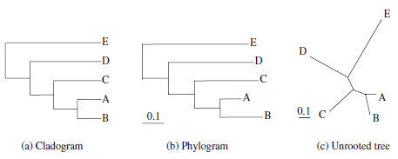
Ways of describing a tree

Slide 17
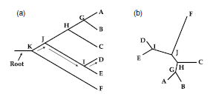
Ways of describing a tree
Rooted
Unrooted

Slide 18
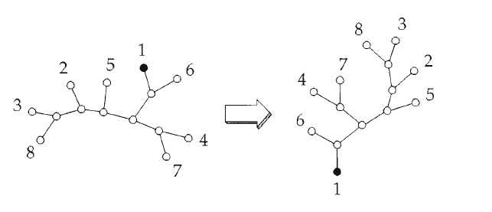
How do we root a tree?

Slide 19
How do we root a tree?

Slide 20
In the context of graph theory, what is a root?
In the context of a tree, what does a root mean?

Slide 21
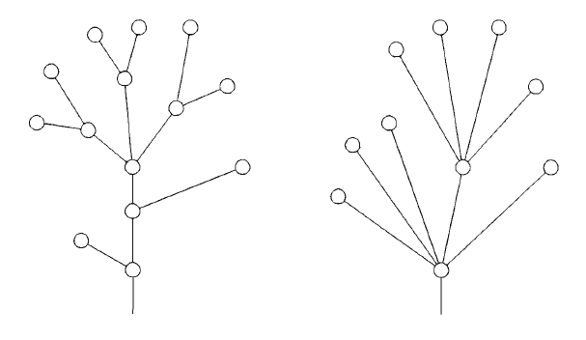
Bifurcated vs multifurcated

Slide 22
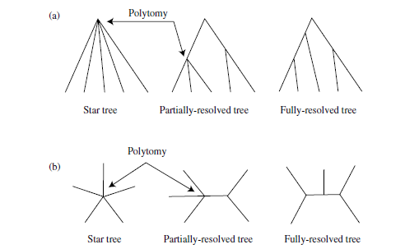
Resolved vs unresolved

Slide 23
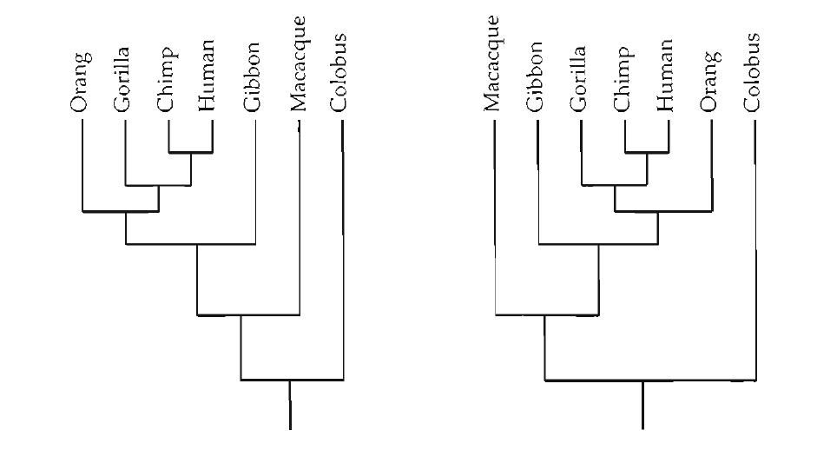
How do we interpret a tree?
Tree topology

Slide 24

How do we interpret a tree?
Distance between trees
(1,2,3),(4,5,6,7,8)
(1,2,3),(4,5,6,7,8)
total number of bipartitions that are in one tree but not in the other

Slide 25
How do we interpret a tree?
Distance between trees
(1,2),(3,4,5,6,7,8)
(1,3),(2,4,5,6,7,8)

Slide 26
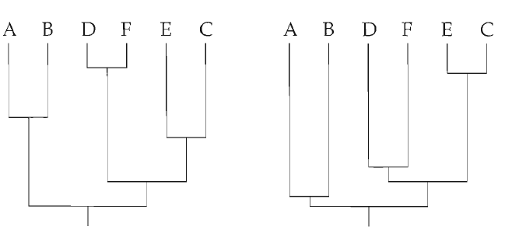
How do we interpret a tree?
Branch length

Slide 27
Ways of describing a tree
Newick format
Each internal node is
defined by the connections
( , )
Length between nodes is
defined by
:
B
C
A
L2
L1
N1
L4
(A:L1,B:L2)
L3
N2
(N1:L3,C:L4)
((A:L1,B:L2):L3,C:L4)
(C:L4,(A:L1,B:L2):L3)

Slide 28
Ways of describing a tree
C
L6
B
D
A
L2
L5
L1
L3
L4

Slide 29
Ways of describing a tree
(A:L1,((C:L6,B:L3):L2,D:L5):L4)

Slide 30
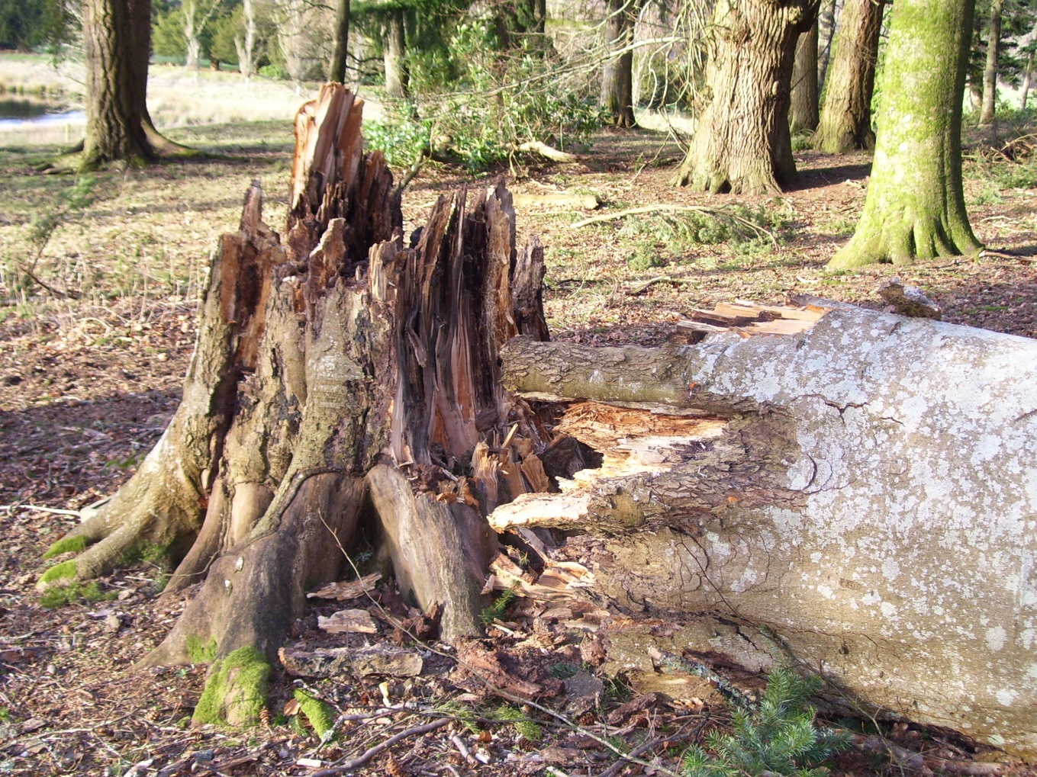
Trees vs reality
When a tree is not reflecting reality?

Slide 31
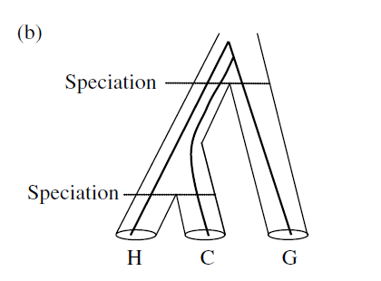
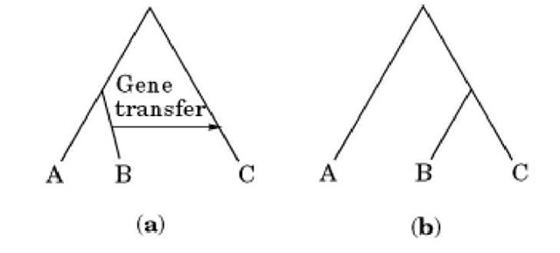
Trees vs reality
Horizontal gene transfer
Recent speciation

Slide 32
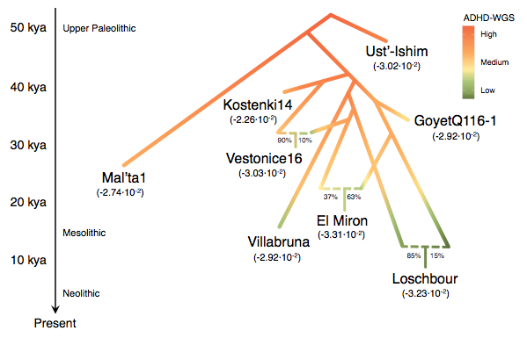
Trees vs reality

Slide 33


Slide 34
Remember: each locus observed in all current sequences comes from a single ancestor
AAAAAAAA
Ancestral sequence
1 -> G
GAAAAAAA
AAAAAAAA
2 -> C
AAAAAAAA
3 -> G
AAAAAAAA
4 -> C
ACGAAAAA
5 -> C
AAACCAAA
AAACCAAA
6 -> T
AAACATAA
7 -> G
8 -> T
Notes:
Which are the implications in a culture cell?

Slide 35
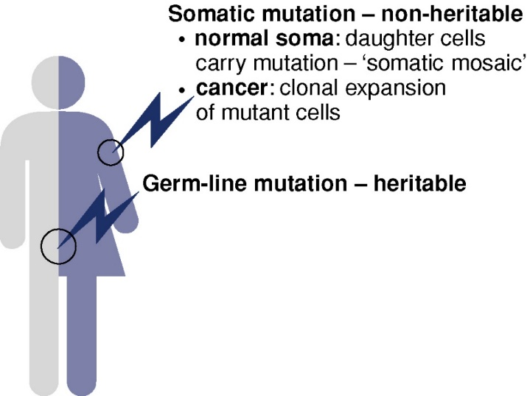
More than just substitutions
ACGTACTGACTG
Substitution
ACGGACTGACTG
Human evolutionary genetics

Slide 36
More than just substitutions
ACGTACTGACTG
Insertion
ACGTGACTGACTG
Human evolutionary genetics

Slide 37
More than just substitutions
ACGTACTGACTG
Deletion
ACG_ACTGACTG
Human evolutionary genetics

Slide 38
More than just substitutions: gene duplications and deletions

Slide 39
Genetic divergence is a measure of TIME divergence
AACCTGTGCA
1
1
AATCTGTGCA
AACCTGTGCT
1
2
GATCTGTGCA
ATCCTATGCT
1
2
GATCTGTGTA
ATCCTAGGTT
1
1
AATCTGTGTA
ATCCTGGGTT

Slide 40
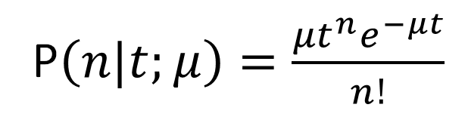
How to model the relationship between mutation and time
Assume t, an amount of time
Assume μ, a mutation rate
Which is the probability that n mutations occur in a branch of t length with μ mutation rate?
P$\left(n|t;μ\right)=\frac{{μt}^{n}e^{−μt}}{n!}$
Why is this formula right?
Why is this formula wrong?

Slide 41
Recurrent mutations blur everything!
Original sequence
From Phylogenetic Handbook: “The proportion of different homologous sites is called observed distance, sometimes also called p-distance, and it is expressed as the number of nucleotide differences per site.
The p-distance is a very intuitive measure. Unfortunately, it suffers from a severe shortcoming: if the degree of divergence is high, p-distances are generally not very informative with regard to the number of substitutions that actually occurred”
Split of populations
After k generations
Final sequence

Slide 42
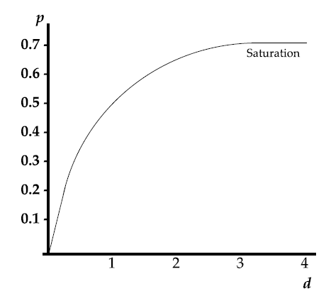
Recurrent mutations blur everything!
Once we reach this point, the genetic distance is no more a proxy for the time of separation

Slide 43
How to model this process?
For each nucleotide at generation t
Substitution matrix
T
C
 | A | C | T | G
A
C
T
G
Q=
Comes from
Rate at which one nucleotide change to another
Transition matrix
A
G
 | A | C | T | G
A
C
T
G
P=
Comes from
Probability to change of one nucleotide from one generation to another

Slide 44
How to model this process?
For each nucleotide at generation t
Substitution matrix
T
C
 | A | C | T | G
A
C
T
G
Comes from
Q=
A
G
Instantaneous rate of substitution from nucleotide G to nucleotide C

Slide 45

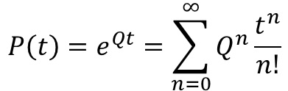
How to model this process?
For each nucleotide at generation t
Transition matrix
T
C
 | A | C | T | G
A
C
T
G
Comes from
P =
A
G
Probability that if I am at time t in G, I will move to C at t+1
$$P\left(t\right)=e^{Qt}=\sum_{n=0}^{∞}{Q^{n}\frac{t^{n}}{n!}}$$

Slide 46
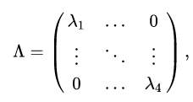
How to model this process?
For each nucleotide at generation t
Substitution matrix
T
C
A
G
$$P\left(t\right)=e^{Qt}=e^{U^{−1}\left(Λt\right)U}=U^{−1}e^{Λt}U$$

Slide 47
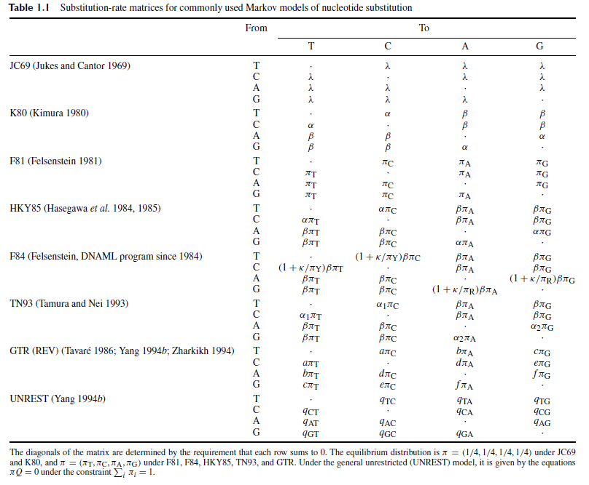
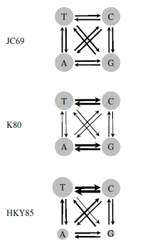
How to model the change over time?

Slide 48
Remember: divergence is a measure of TIME of divergence
AACCTGTGCA
The trajectory of a particular nucleotide follows a
Markov Chain
AATCTGTGCA
AACCTGTGCT
A -> G -> G -> A
GATCTGTGCA
ATCCTATGCT
GATCTGTGTA
ATCCTAGGTT
AATCTGTGTA
ATCCTGGGTT

Slide 49
Markov Chains
t0
t1
t2
t3
t4
t5
t6
Markov chain
A
A
C
A
G
G
T
A
C
Four possible states
P(t+1=C|t=A)
Probability transition matrix
G
T

Slide 50
Markov Chains
t0
t1
t2
t3
t4
t5
t6
Markov chain
A
A
C
A
G
G
T
$$P\left(AACAGGT\right)=P\left(AACAGG\right)P(T|AACAGG)$$
From P(X;Y) = P(Y)P(X|Y)
$$P\left(AACAGGT\right)=P\left(AACAG\right)P(G|AACAG)P(T|AACAGG)$$
$$P\left(AACAGGT\right)=P(A)P\left(A\left|A\right)P\left(C | A\right)P\left(A | C\right)P\left(G | A\right)P\left(G | G\right)P(T|G\right)$$
However, in a MC, the probability at a position depends ONLY on the previous state

Slide 51
Markov Chains
t0
t1
t2
t3
t4
t5
t6
Markov chain
A
A
C
A
G
G
T
v
v
$$P\left(AACAGGT\right)=P(A)P\left(A\left|A\right)P\left(C | A\right)P\left(A | C\right)P\left(G | A\right)P\left(G | G\right)P(T|G\right)$$
Prior probability
A
C
G
T

Slide 52
Markov chains
time-homogeneous time continuous stationary
Underlying assumptions:
(1) At any given site in a sequence, the rate of change from base i to base j is independent
from the base that occupied that site prior i (Markov property).
(2) Substitution rates do not change over time (homogeneity).
(3) The relative frequencies of A, C, G, and T (πA, πC, πG, πT) are at equilibrium
(stationarity).

Slide 53
How to compute the probability of changing from nucleotide i to j after t₁+t₂ times?
The Chapman-Kolmogorov theorem
t₁+t₂
i
j
i
j
k
r

Slide 54
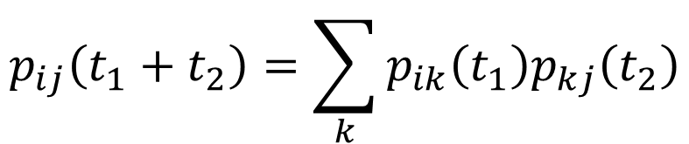
How to compute the probability of changing from nucleotide i to j after t₁+t₂ times?
The Chapman-Kolmogorov theorem
t₁
t₂
i
$$p_{ij}\left(t_{1}+t_{2}\right)=\sum_{k}{p_{ik}\left(t_{1}\right)p_{kj}\left(t_{2}\right)}$$
j
i
j
…
k

Slide 55
Can you propose an algorithm forward in time for simulating the evolution of a sequence over t generations?

Slide 56
Can you propose another algorithm forward in time for simulating the evolution of a sequence over t generations?
Imagine a single nucleotide and different s times
Which is the probability I stay A for s3 generations?
Which is the probability I stay T for s1 generations?
Which is the probability I stay C for s2 generations?

Slide 57
Can you propose another algorithm forward in time for simulating the evolution of a sequence over t generations?
Imagine a single nucleotide and different s times
When I am going to change in probability?
The exponential distribution

Slide 58


RANDOM VARIABLE GENERATOR
Transformation method
A function of a random variable is itself a random variable
$$u\sim U(0,1)$$
Random variable uniformly distributed in the range [0,1]
$${CDF}_{θ}\left(x\right)$$
Cumulative density function of variable X
How to get a random sample of x?

Slide 59
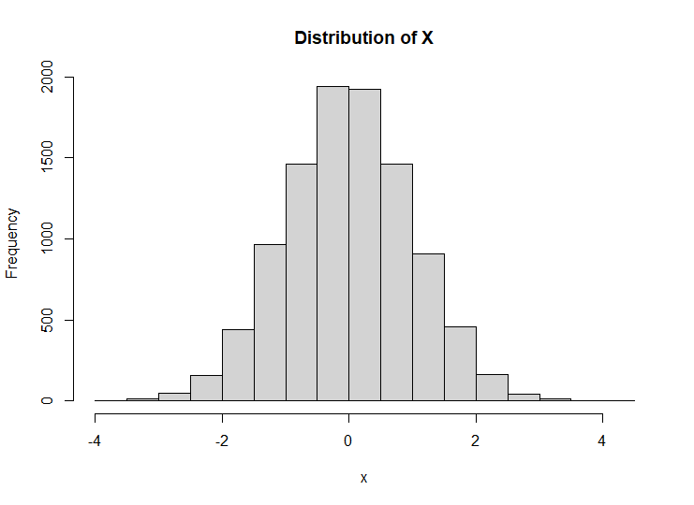
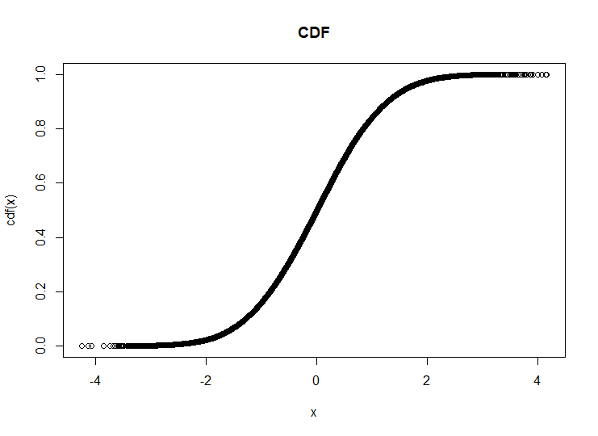


RANDOM VARIABLE GENERATOR
Probability density function f(x) from which I want to get random samples
Cumulative density function from which I want to get random samples
$$N(μ=0,σ=1)$$
$$θ∈\left\{μ,σ\right\}$$
Parameters that define a normal distribution

Slide 60




RANDOM VARIABLE GENERATOR
Inverse distribution of the cumulative density function using parameters θ from which we want to get random samples
Transformation method
Cumulative density function from which I want to get random samples
$$u\sim U(0,1)$$
$$x={CDF}_{θ}^{−1}\left(u\right)$$
$$u\sim U(0,1)$$
$$x\sim F_{θ}$$

Slide 61
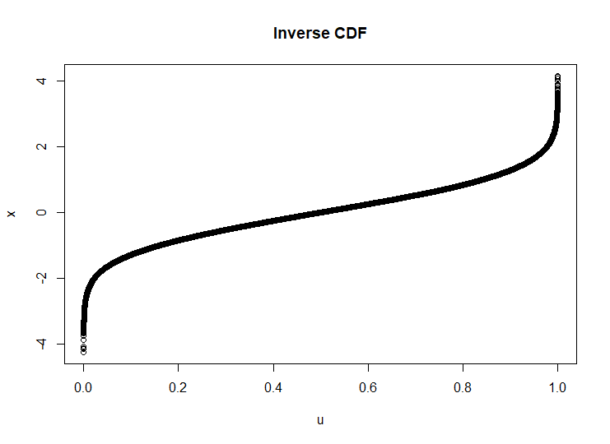
RANDOM VARIABLE GENERATOR
Inverse Cumulative density function from which I want to get random samples
Transformation method

Slide 62
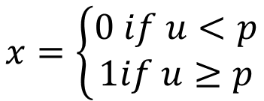

RANDOM VARIABLE GENERATOR
Bernoulli distribution with parameter p
$$u\sim U(0,1)$$
$$x=\left\{\begin{aligned}0 if u<p \\ 1if u≥p\end{aligned}\right.$$

Slide 63




RANDOM VARIABLE GENERATOR
Example: The Exponential distribution
$$f\left(x\right)=θ^{−1}e^{{−x}/θ}$$
$${CDF}_{θ}\left(x\right)=1−e^{{−x}/θ}$$
$$u=1−e^{{−x}/θ}$$
$$x=?$$

Slide 64




RANDOM VARIABLE GENERATOR
Inverse Cumulative density function from which I want to get random samples
For this particular case where the function is Normal
$$N(θ)$$
$$θ∈\left\{μ,σ\right\}$$
$$Φ^{−1}\left(u\right)=\sqrt{2}{erf}^{−1}\left(2u−1\right)$$
$${CDF}_{θ}^{−1}\left(u\right)=μ+σΦ^{−1}\left(u\right)$$
Not very easy to compute

Slide 65
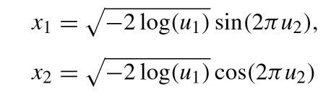


RANDOM VARIABLE GENERATOR
Approximations (for Normal distribution)
Box and Muller (1958)
$$u_{1}\sim U(0,1)$$
$$u_{2}\sim U(0,1)$$

Slide 66

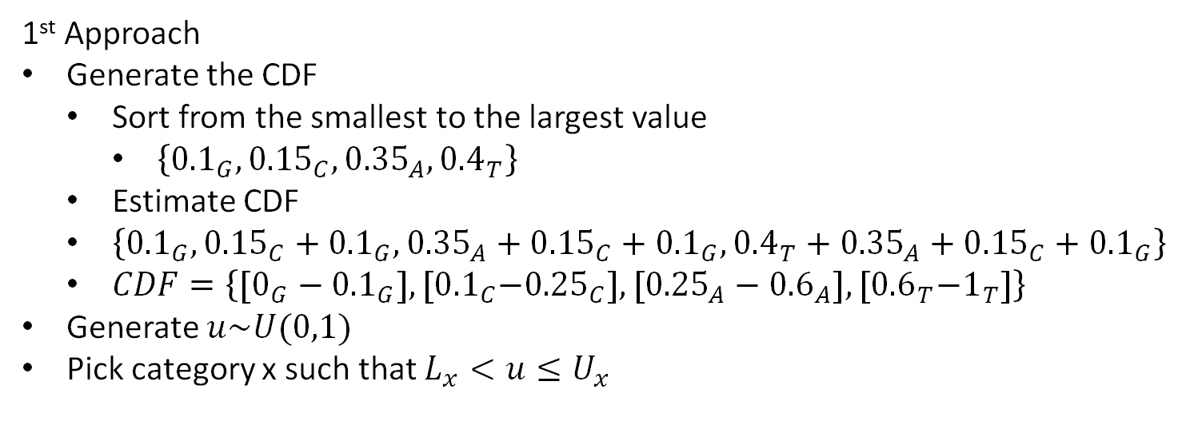
RANDOM VARIABLE GENERATOR
Simulating random variables from an arbitrary discrete distribution with a ﬁnite number of cells (categories)
$$p_{A,C,T,G}=\left\{0.35,0.15,0.4,0.1\right\}$$
1st Approach
Generate the CDF
Sort from the smallest to the largest value
$\left\{{0.1}_{G},{0.15}_{C},{0.35}_{A},{0.4}_{T}\right\}$
Estimate CDF
$\left\{{0.1}_{G},{0.15}_{C}+{0.1}_{G},{0.35}_{A}+{0.15}_{C}+{0.1}_{G},{0.4}_{T}+{0.35}_{A}+{0.15}_{C}+{0.1}_{G}\right\}$
$CDF=\left\{{[0_{G}−0.1}_{G}],{{[0.1}_{C}−0.25}_{C}],{[{0.25}_{A}−0.6}_{A}], {[0.6}_{T}−1_{T}]\right\}$
Generate $u\sim U(0,1)$
Pick category x such that $L_{x}<u≤U_{x}$

Slide 67
RANDOM VARIABLE GENERATOR
1st Approach
Problem: For each trial, it requires looking until we suffix the condition
$$CDF=\left\{{[0_{G}−0.01}_{G}],{{[0.01}_{C}−0.02}_{C}],{[{0.02}_{A}−0.03}_{A}], {[0.03}_{T}−1_{T}]\right\}$$
Unlikely events, but I have to check them

Slide 68
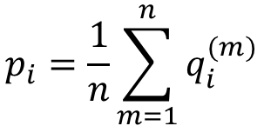
RANDOM VARIABLE GENERATOR
2nd Approach: The alias method (Walker 1974; Kronmal and Peterson 1979)
“Any discrete distribution with n cells can be expressed as an equiprobable mixture of n two-point distributions”
$$p_{i}=\frac{1}{n}\sum_{m=1}^{n}{q_{i}^{(m)}}$$
Probability of cell i
Point distribution

Slide 69
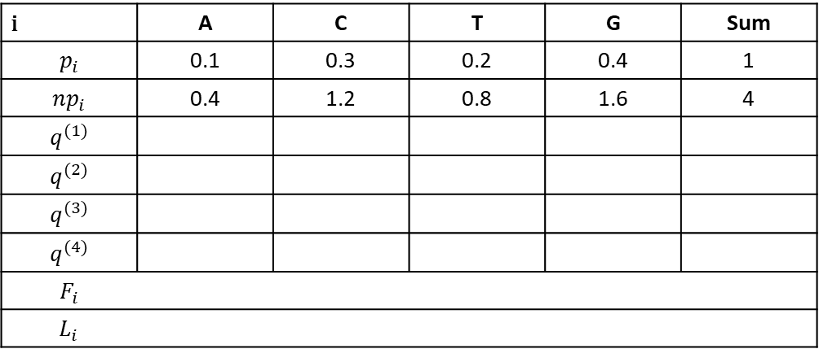
RANDOM VARIABLE GENERATOR
2nd Approach: The alias method (Walker 1974; Kronmal and Peterson 1979)
i | A | C | T | G | Sum
$$p_{i}$$ | 0.1 | 0.3 | 0.2 | 0.4 | 1
$${np}_{i}$$ | 0.4 | 1.2 | 0.8 | 1.6 | 4
$$q^{(1)}$$
$$q^{(2)}$$
$$q^{(3)}$$
$$q^{(4)}$$
$$F_{i}$$
$$L_{i}$$
Each row must add to 1
Maximum value of the column
To which row the other cell refers to (“alias”)

Slide 70
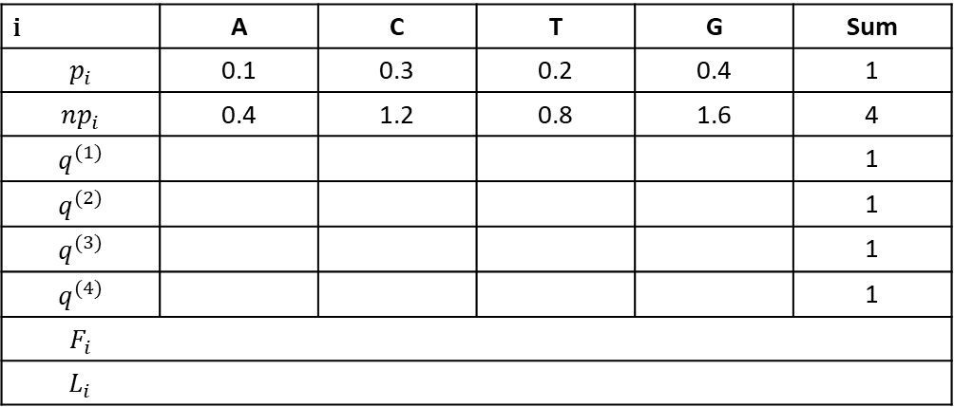
RANDOM VARIABLE GENERATOR
2nd Approach: The alias method (Walker 1974; Kronmal and Peterson 1979)
i | A | C | T | G | Sum
$$p_{i}$$ | 0.1 | 0.3 | 0.2 | 0.4 | 1
$${np}_{i}$$ | 0.4 | 1.2 | 0.8 | 1.6 | 4
$$q^{(1)}$$ |  |  |  |  | 1
$$q^{(2)}$$ |  |  |  |  | 1
$$q^{(3)}$$ |  |  |  |  | 1
$$q^{(4)}$$ |  |  |  |  | 1
$$F_{i}$$
$$L_{i}$$
From each row, only two cells can be occupied.
One of the cells must be a column with the same id as row
Maximum value of the column
To which row the other cell refers to

Slide 71
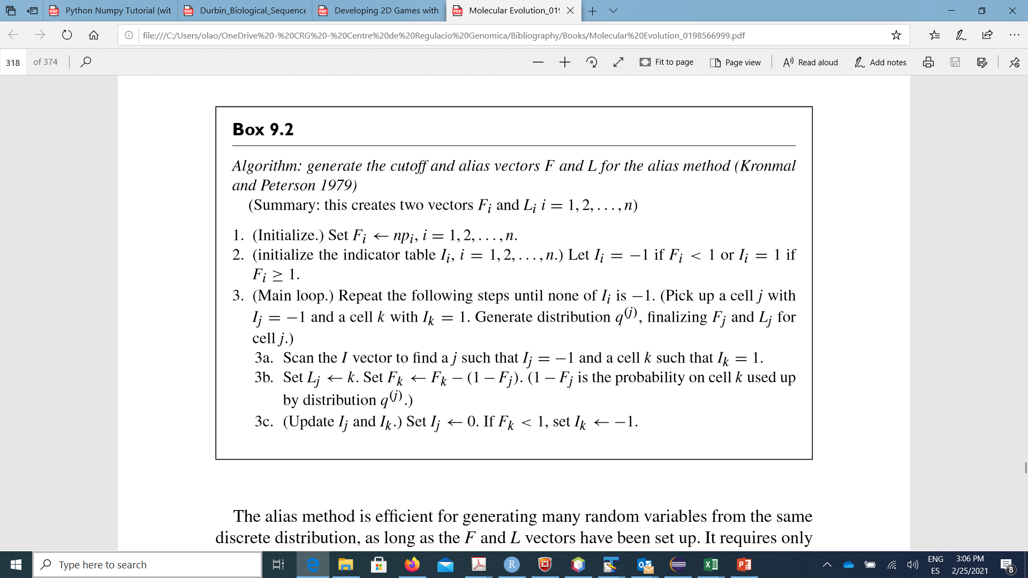
RANDOM VARIABLE GENERATOR
2nd Approach: The alias method (Walker 1974; Kronmal and Peterson 1979)

Slide 72
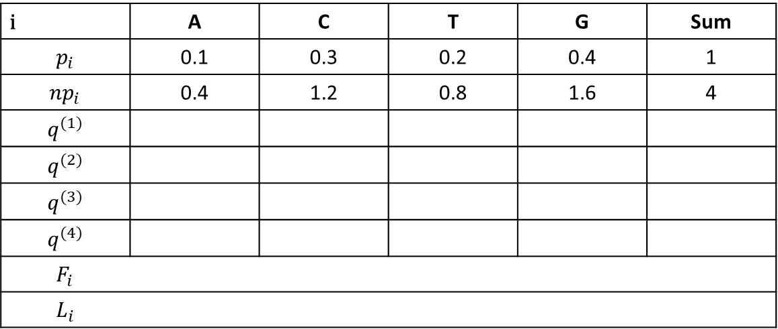
RANDOM VARIABLE GENERATOR
2nd Approach: The alias method (Walker 1974; Kronmal and Peterson 1979)
i | A | C | T | G | Sum
$$p_{i}$$ | 0.1 | 0.3 | 0.2 | 0.4 | 1
$${np}_{i}$$ | 0.4 | 1.2 | 0.8 | 1.6 | 4
$$q^{(1)}$$
$$q^{(2)}$$
$$q^{(3)}$$
$$q^{(4)}$$
$$F_{i}$$
$$L_{i}$$

Slide 73
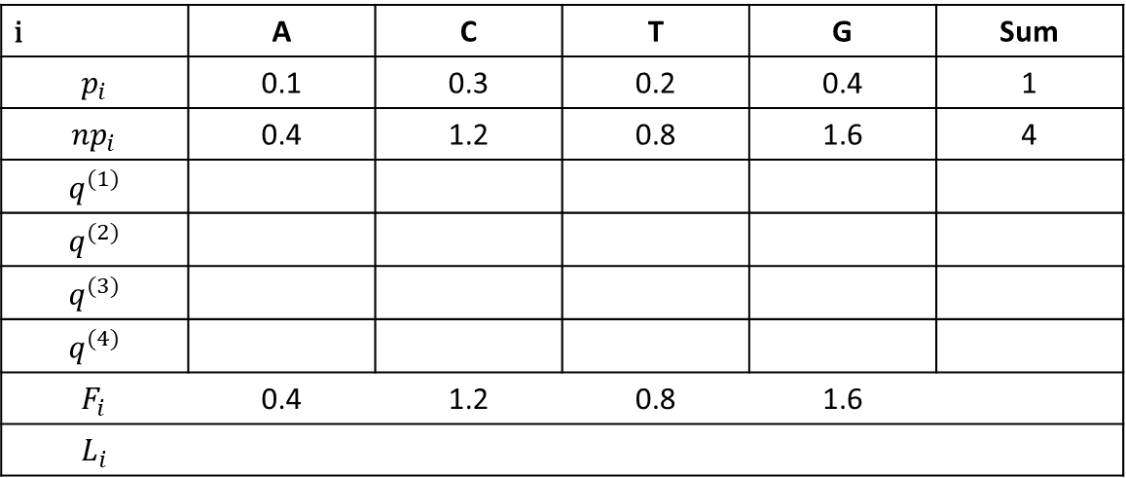
RANDOM VARIABLE GENERATOR
2nd Approach: The alias method (Walker 1974; Kronmal and Peterson 1979)
i | A | C | T | G | Sum
$$p_{i}$$ | 0.1 | 0.3 | 0.2 | 0.4 | 1
$${np}_{i}$$ | 0.4 | 1.2 | 0.8 | 1.6 | 4
$$q^{(1)}$$
$$q^{(2)}$$
$$q^{(3)}$$
$$q^{(4)}$$
$$F_{i}$$ | 0.4 | 1.2 | 0.8 | 1.6
$$L_{i}$$

Slide 74
RANDOM VARIABLE GENERATOR
2nd Approach: The alias method (Walker 1974; Kronmal and Peterson 1979)
i | A | C | T | G | Sum
$$p_{i}$$ | 0.1 | 0.3 | 0.2 | 0.4 | 1
$${np}_{i}$$ | 0.4 | 1.2 | 0.8 | 1.6 | 4
$$q^{(1)}$$
$$q^{(2)}$$
$$q^{(3)}$$
$$q^{(4)}$$
$$F_{i}$$ | 0.4 | 1.2 | 0.8 | 1.6
$$L_{i}$$
$$I_{i}$$ | -1 | 1 | -1 | 1

Slide 75
RANDOM VARIABLE GENERATOR
2nd Approach: The alias method (Walker 1974; Kronmal and Peterson 1979)
i | A | C | T | G | Sum
$$p_{i}$$ | 0.1 | 0.3 | 0.2 | 0.4 | 1
$${np}_{i}$$ | 0.4 | 1.2 | 0.8 | 1.6 | 4
$$q^{(1)}$$
$$q^{(2)}$$
$$q^{(3)}$$
$$q^{(4)}$$
$$F_{i}$$ | 0.4 | 1.2 | 0.8 | 1.6
$$L_{i}$$
$$I_{i}$$ | -1 | 1 | -1 | 1

Slide 76
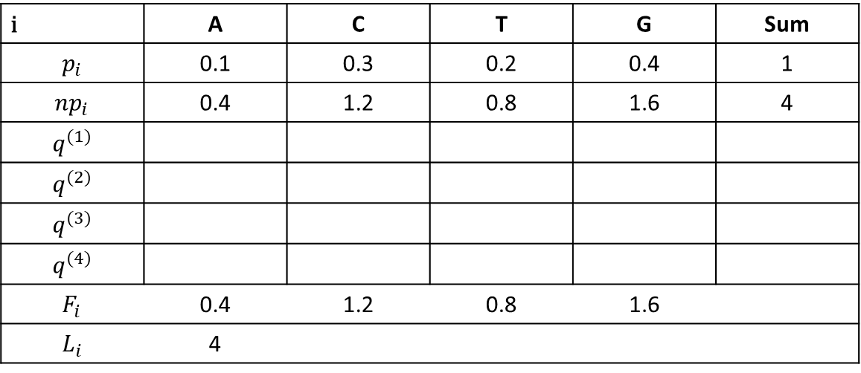
RANDOM VARIABLE GENERATOR
2nd Approach: The alias method (Walker 1974; Kronmal and Peterson 1979)
i | A | C | T | G | Sum
$$p_{i}$$ | 0.1 | 0.3 | 0.2 | 0.4 | 1
$${np}_{i}$$ | 0.4 | 1.2 | 0.8 | 1.6 | 4
$$q^{(1)}$$
$$q^{(2)}$$
$$q^{(3)}$$
$$q^{(4)}$$
$$F_{i}$$ | 0.4 | 1.2 | 0.8 | 1.6
$$L_{i}$$ | 4
$$I_{i}$$ | -1 | 1 | -1 | 1

Slide 77
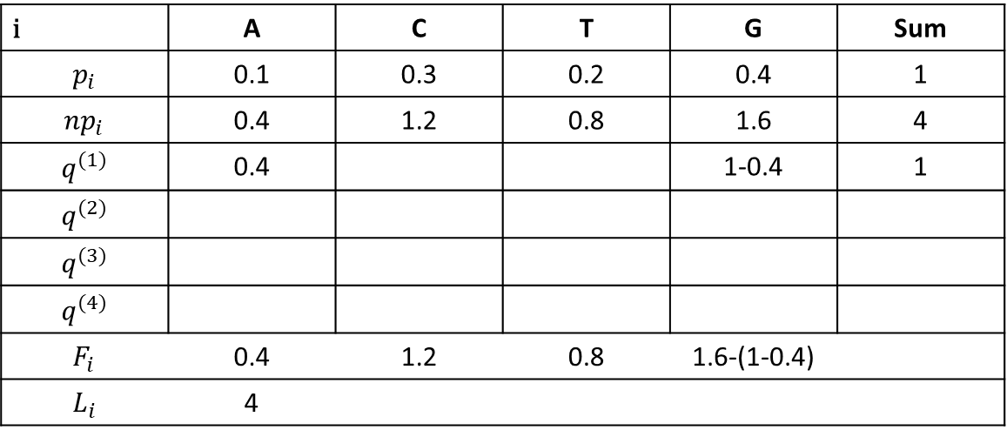
RANDOM VARIABLE GENERATOR
2nd Approach: The alias method (Walker 1974; Kronmal and Peterson 1979)
i | A | C | T | G | Sum
$$p_{i}$$ | 0.1 | 0.3 | 0.2 | 0.4 | 1
$${np}_{i}$$ | 0.4 | 1.2 | 0.8 | 1.6 | 4
$$q^{(1)}$$ | 0.4 |  |  | 1-0.4 | 1
$$q^{(2)}$$
$$q^{(3)}$$
$$q^{(4)}$$
$$F_{i}$$ | 0.4 | 1.2 | 0.8 | 1.6-(1-0.4)
$$L_{i}$$ | 4
$$I_{i}$$ | -1 | 1 | -1 | 1

Slide 78
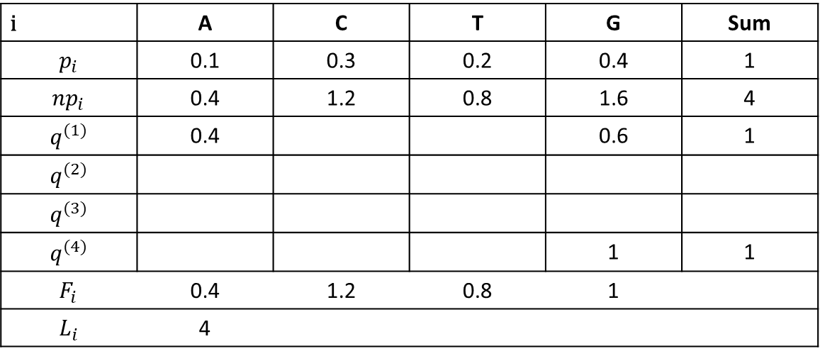
RANDOM VARIABLE GENERATOR
2nd Approach: The alias method (Walker 1974; Kronmal and Peterson 1979)
i | A | C | T | G | Sum
$$p_{i}$$ | 0.1 | 0.3 | 0.2 | 0.4 | 1
$${np}_{i}$$ | 0.4 | 1.2 | 0.8 | 1.6 | 4
$$q^{(1)}$$ | 0.4 |  |  | 0.6 | 1
$$q^{(2)}$$
$$q^{(3)}$$
$$q^{(4)}$$ |  |  |  | 1 | 1
$$F_{i}$$ | 0.4 | 1.2 | 0.8 | 1
$$L_{i}$$ | 4
$$I_{i}$$ | 0 | 1 | -1 | 0

Slide 79
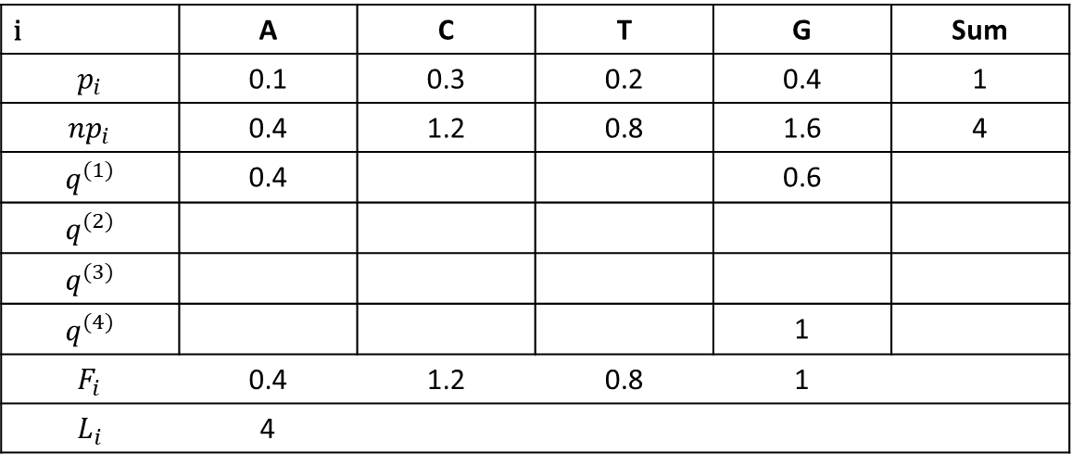
RANDOM VARIABLE GENERATOR
2nd Approach: The alias method (Walker 1974; Kronmal and Peterson 1979)
i | A | C | T | G | Sum
$$p_{i}$$ | 0.1 | 0.3 | 0.2 | 0.4 | 1
$${np}_{i}$$ | 0.4 | 1.2 | 0.8 | 1.6 | 4
$$q^{(1)}$$ | 0.4 |  |  | 0.6
$$q^{(2)}$$
$$q^{(3)}$$
$$q^{(4)}$$ |  |  |  | 1
$$F_{i}$$ | 0.4 | 1.2 | 0.8 | 1
$$L_{i}$$ | 4
$$I_{i}$$ | 0 | 1 | -1 | 0

Slide 80
RANDOM VARIABLE GENERATOR
2nd Approach: The alias method (Walker 1974; Kronmal and Peterson 1979)
i | A | C | T | G | Sum
$$p_{i}$$ | 0.1 | 0.3 | 0.2 | 0.4 | 1
$${np}_{i}$$ | 0.4 | 1.2 | 0.8 | 1.6 | 4
$$q^{(1)}$$ | 0.4 |  |  | 0.6 | 1
$$q^{(2)}$$
$$q^{(3)}$$
$$q^{(4)}$$ |  |  |  | 1 | 1
$$F_{i}$$ | 0.4 | 1.2 | 0.8 | 1
$$L_{i}$$ | 4
$$I_{i}$$ | 0 | 1 | -1 | 0

Slide 81
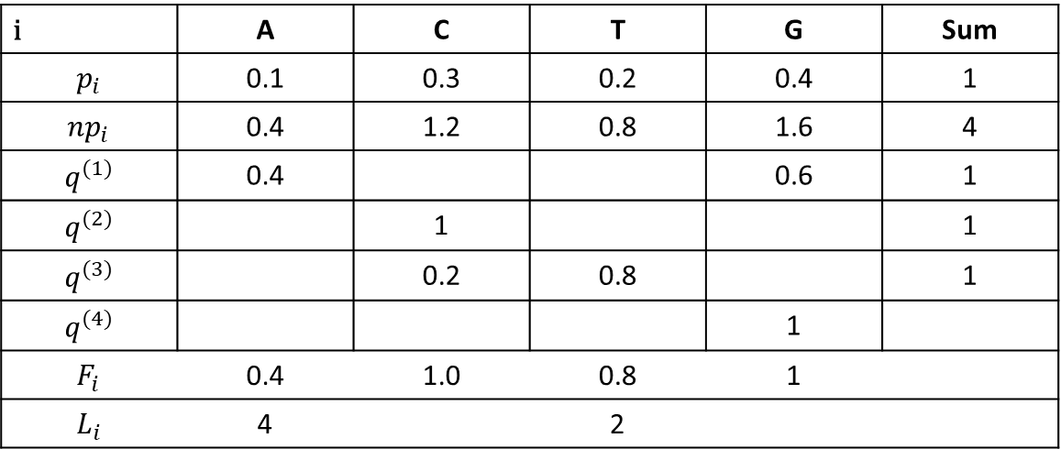
RANDOM VARIABLE GENERATOR
2nd Approach: The alias method (Walker 1974; Kronmal and Peterson 1979)
i | A | C | T | G | Sum
$$p_{i}$$ | 0.1 | 0.3 | 0.2 | 0.4 | 1
$${np}_{i}$$ | 0.4 | 1.2 | 0.8 | 1.6 | 4
$$q^{(1)}$$ | 0.4 |  |  | 0.6 | 1
$$q^{(2)}$$ |  | 1 |  |  | 1
$$q^{(3)}$$ |  | 0.2 | 0.8 |  | 1
$$q^{(4)}$$ |  |  |  | 1
$$F_{i}$$ | 0.4 | 1.0 | 0.8 | 1
$$L_{i}$$ | 4 |  | 2
$$I_{i}$$ | 0 | 0 | 0 | 0

Slide 82
RANDOM VARIABLE GENERATOR
2nd Approach: The alias method (Walker 1974; Kronmal and Peterson 1979)
i | A | C | T | G | Sum
$$p_{i}$$ | 0.1 | 0.3 | 0.2 | 0.4 | 1
$${np}_{i}$$ | 0.4 | 1.2 | 0.8 | 1.6 | 4
$$q^{(1)}$$ | 0.4 |  |  | 0.6 | 1
$$q^{(2)}$$ |  | 1 |  |  | 1
$$q^{(3)}$$ |  | 0.2 | 0.8 |  | 1
$$q^{(4)}$$ |  |  |  | 1
$$F_{i}$$ | 0.4 | 1.0 | 0.8 | 1
$$L_{i}$$ | 4 |  | 2
$$I_{i}$$ | 0 | 0 | 0 | 0

Slide 83
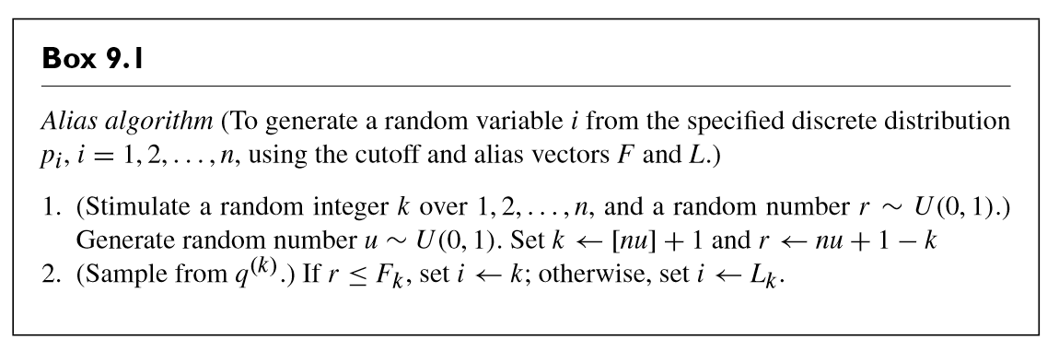
RANDOM VARIABLE GENERATOR
2nd Approach: The alias method (Walker 1974; Kronmal and Peterson 1979)

Slide 84
RANDOM VARIABLE GENERATOR
2nd Approach Bis: Extension of the Alias by Vose (A Linear Algorithm For Generating Random Numbers With a Given Distribution)
i | A | C | T | G | Sum
$$p_{i}$$ | 0.1 | 0.3 | 0.2 | 0.4 | 1
$${np}_{i}$$ | 0.4 | 1.2 | 0.8 | 1.6 | 4
$$q^{(1)}$$ | 0.4 |  |  | 0.6 | 1
$$q^{(2)}$$ |  | 1 |  |  | 1
$$q^{(3)}$$ |  | 0.2 | 0.8 |  | 1
$$q^{(4)}$$ |  |  |  | 1
$$F_{i}$$ | 0.4 | 1.0 | 0.8 | 1
$$L_{i}$$ | 4 |  | 2
$$I_{i}$$ | 0 | 0 | 0 | 0

Slide 85
A backward approach
Ne

Slide 86
A backward approach

Slide 87
A backward approach

Slide 88
Can you propose an algorithm backward in time for simulating the evolution of K sequences until complete coalescence?

