Slide 1
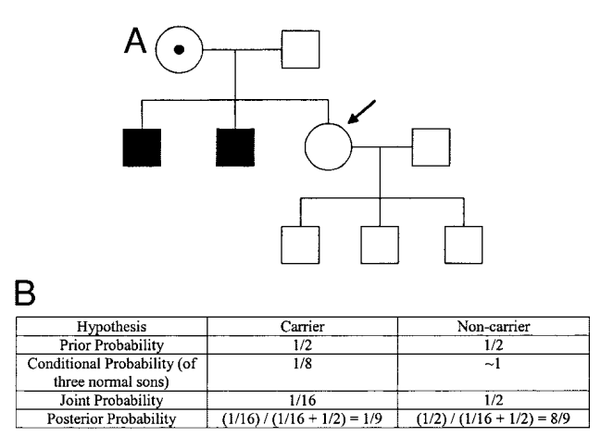

Slide 2
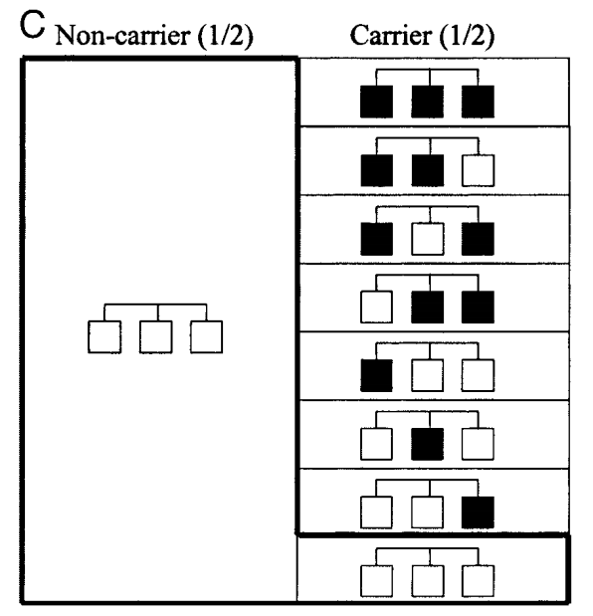

Slide 3
A
a
A
a
Aa x Aa
gametes
 | AA | Aa
 | Aa | aa
A
a
A
a
Notes:
Punnet squares are very useful to estimate the probability of being affected or a carrier. Just represent the gàmetes produced by each one of the parents (one in rows, the other in columns)

Slide 4
A
a
B
b
A
a
B
b
Aa Bb x Aa Bb
gametes
A
B
A
b
a
B
a
b
A
B
A
b
a
B
a
b
Notes:
Punnet squares are very useful to estimate the probability of being affected or a carrier. Just represent the gàmetes produced by each one of the parents (one in rows, the other in columns)

Slide 5
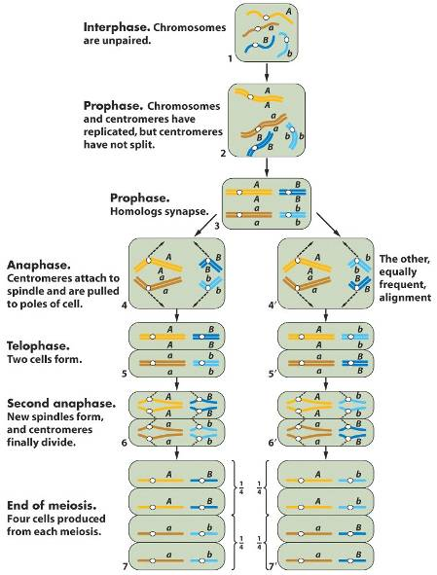
The Mendel’s law of independent transmission is explained by the independent segregation of non homologous chromosomes during meiosis
Meosis in a diploid cell
with genotype (A/a; B/b)‏
Genotipe AaBb
Gametes: AB ¼
Ab ¼
aB ¼
ab ¼
Notes:
5

Slide 6
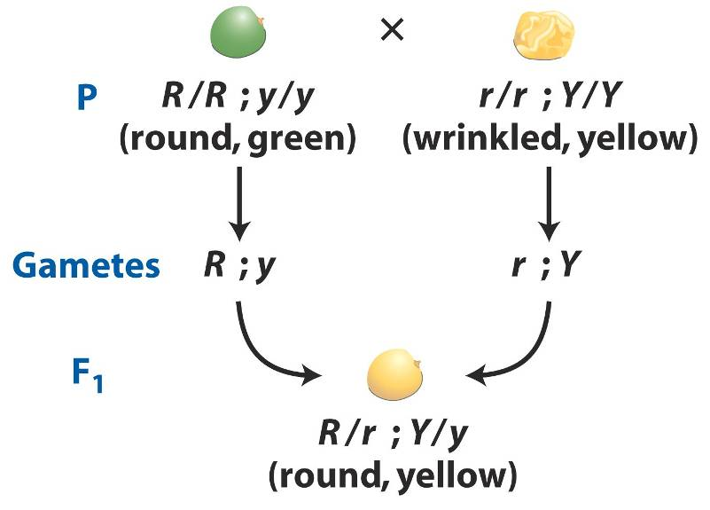
Dihybridism
R is dominant over r
Y is dominant over y

Slide 7
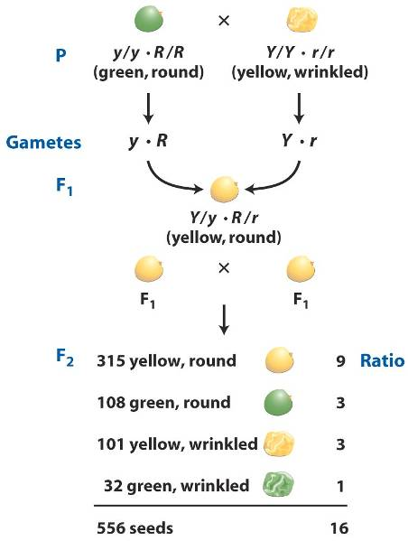
Dihybridism
Principle of independent transmission
Genes located in different chromosomes segregate independently during meisos.
F₂ Phenotypic proportions
9:3:3:1

Slide 8
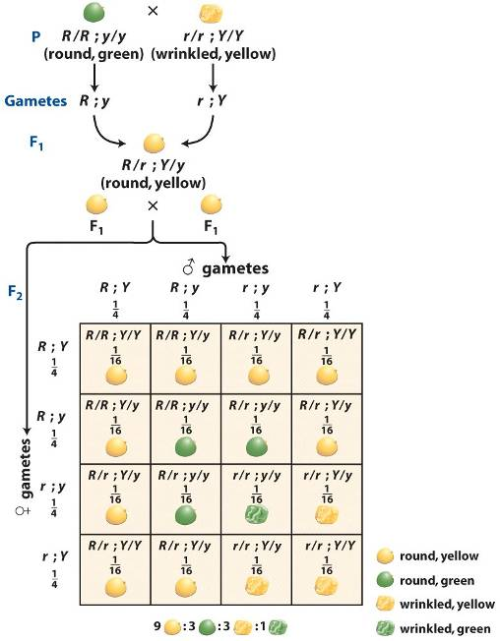
Dihybridism
Punnett square

