Slide 1
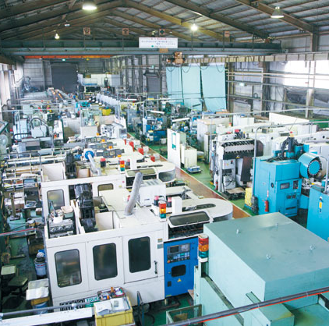
Optimization for a joint predictive maintenance and job scheduling problem in manufacturing industry
Ling-Chieh Kung
Zih-Yun Liao, Wen-Yu Kung, Kai-Hsiang Huang
Department of Information Management, National Taiwan University
MCAC 2021

Slide 2
Introduction
Maintenance is an integral component of operating manufacturing equipment.
Seldom or never
Bad yield rate
Production loss
Too often
Waste of time and resources
Notes:
In manufacturing industry, maintenance is an …
If we ignore the maintenance of the equipment, the yield rate should decline by time and lead to production loss.
However, if we maintain the machine too often, we also waste time and may due to high opportunity cost.
Therefore, how to tradeoff the maintenance schedule in manufacturing process become an important issue to discuss.
維修對於製造業中的機台設備而言，是不可或缺的存在。
若不針對機台設備進行維修保養，將受到良率下降而造成的產能損失。
然而維修本身也需要花費時間，因此在維修當下也會損失可以拿來生產的機會成本。
對於製造業而言，該如何權衡維修與否的決策將會是一項值得考慮的問題。
改成舉例

Slide 3
Introduction
To make the idea clearly, let’s take a simple example below.
A machine
Two jobs
The initial yield rate | Yield declining rate | Lower bound of the yield rate | Maintenance time
60/90 | 5 | 50 | 2
Job number | Workload | Due time | Weighted penalty
1 | 160 | 5 | 1
2 | 350 | 8 | 1
160
350
Initial yield rate | Total penalty
low | 50
After maintenance | 35
High | 0
Machine
60
55
50
50
50
50
50
50
50
Insert maintenance
time + 2
shortage: 50
Maintenance
160
350
Machine
M
M
100
90
85
80
75
70
95
shortage: 35
We consider the condition of a machine to determine when to place a maintenance, this is so call predictive maintenance.
160
350
Machine
90
85
80
75
70
65
60
shortage: 0
Notes:
So what we are doing is to looking at the condition of a machine to determine when to place a maintenance, this is so call maintenance.

Slide 4
Problem description
Multiple parallel machines
Multiple job with diﬀerent demand quantities ready to be processed on one machine
Each predictive maintenance requires certain amount of time to spent on
A machine’s yield rate effects by the declining rate and the lower bound
A machine’s yield rate will increased after maintenance
Allow shortage
Minimize weighted shortage penalty
A job scheduling problem considering predictive maintenance
Notes:
In our study, we consider a job scheduling problem
with multiple parallel machines,
2. all with yield rates declining in time.
There will be certain demand waiting to be fulfilled, but if the due date of the job was met, the last of this job will not be process and generate a weighted shortage cost.
a maintenance require certain time
the yield rate will improve after maintenance
The target of this problem is to minimize the weighted shortage.

Slide 5
Research Objective
MIP Model
A job scheduling problem considering predictive maintenance
Time-consuming but optimal
We are the first to formulate an MIP model
Heuristic Algorithm
Time-efficient but near optimal
Notes:
Regarding to this problem, we propose two solution methology.
One is the MIP model, and the other one is a heuristic algorithm

Slide 6
01
Model
03
Numerical Study
02
Algorithm
04
Conclusion and
Future Works
Agenda

Slide 7
Model

Slide 8
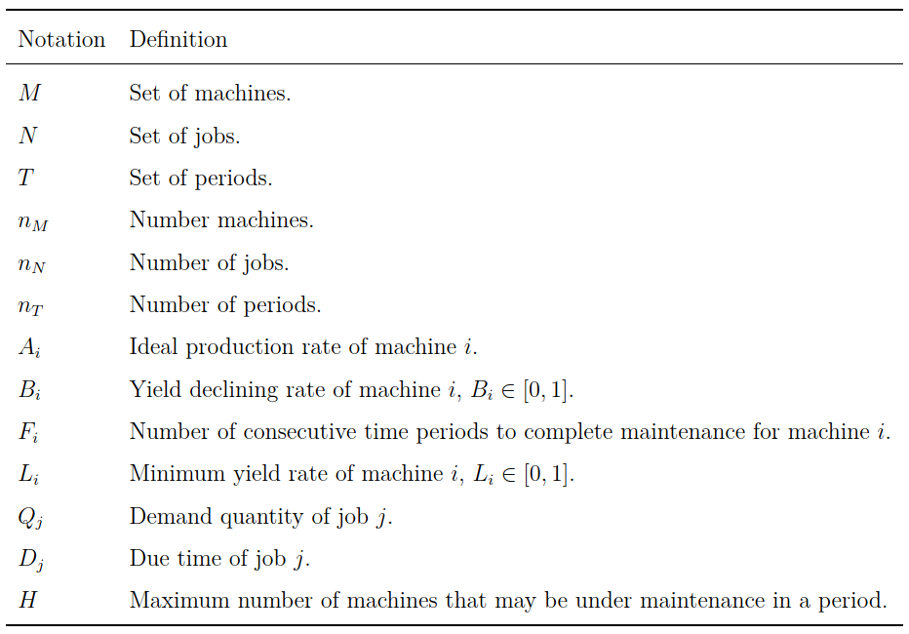
Sets and Parameters

Slide 9
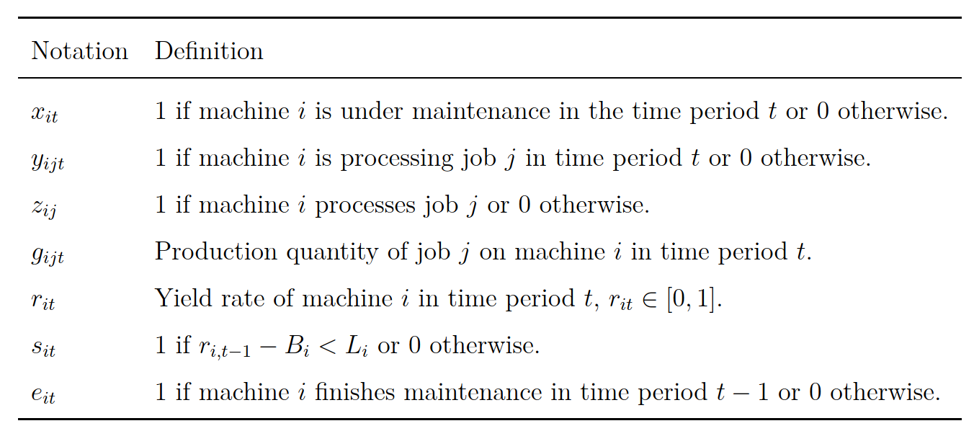
Decision variables

Slide 10
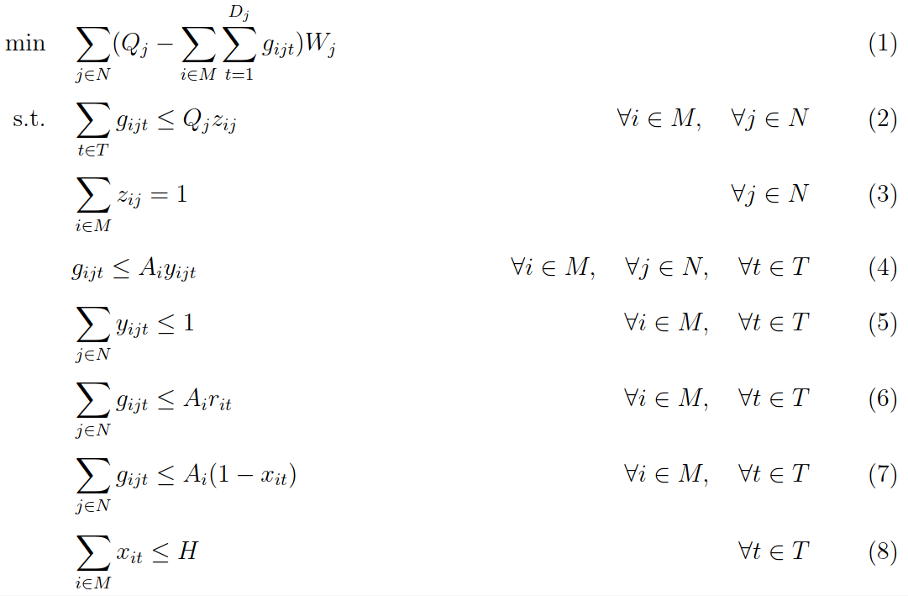
Model
Minimize the weighted shortage penalty
A job can only be processed by a machine
A machine can only process a job at a time period
Production quantity is subjected to yield rate
No production under maintenance
Number of simultaneous maintenance is limited
Notes:
Weighted shortage penalty
The production quantity should only exist when z_ij = 1
Each job can only be process by a machine
Production quantity exist when y_ijt = 1(the machine i is prcessing job j at time t)
Each time can only process one job
Production quantity can’t surplus the production rate multiply yield rate
production quantity will be zero if x_it = 1(machine is under maintenance)
The maintenance number of machine each time has limit

Slide 11
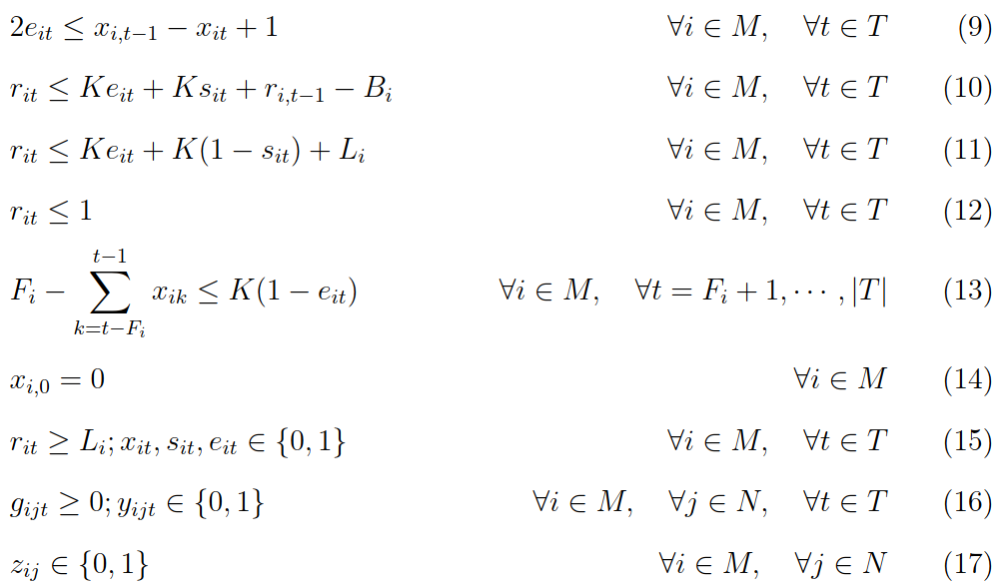
Model
Each yield rate is effected by the declining rate, lower bound, and maintenance.
Maintenance should be long enough
Notes:
According to whether we have maintenance in period t-1 but have no maintenance t in period t, we would know whether the machine is under a new condition in period t (which we set e_it to 1)
Suppose the machine is right after maintenance in period t, the constraint (11) (12) basically relax, and the model will set the yield rate r_it to 1 following by the constraint (13)
Otherwise, if e_it is zero, then either the yield rate is going to decrease by B_i or is going to reach the lowerbound and remain at L_i.
9. ensure that each job should be fulfilled.
10. e_it = 1 if the maintenance finish at t-1
11. The yield will stop decreasing if met lower bound
12. The yield will recover and rise to 1 immediately after maintenance
13. Yield rate can not over 1
14. The maintenance should be completed consecutive for certain time period
15. initial machine should not be after maintenance

Slide 12
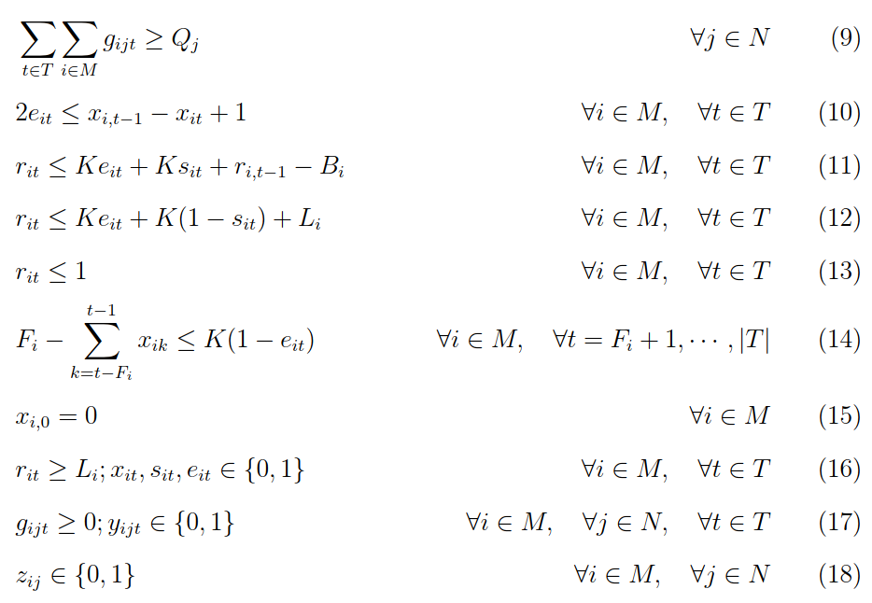
Model
Production quantity constraint
Each yield rate is effected by the declining rate, lower bound, and maintenance.
Maintenance should be long enough
Notes:
According to whether we have maintenance in period t-1 but have no maintenance t in period t, we would know whether the machine is under a new condition in period t (which we set e_it to 1)
Suppose the machine is right after maintenance in period t, the constraint (11) (12) basically disappear, and the model will set the yield rate r_it to 1 following by the constraint (13)
Otherwise, if e_it is zero, then either the yield rate is going to decrease by B_i or is going to reach the lowerbound and remain at L_i.
9. ensure that each job should be fulfilled.
10. e_it = 1 if the maintenance finish at t-1
11. The yield will stop decreasing if met lower bound
12. The yield will recover and rise to 1 immediately after maintenance
13. Yield rate can not over 1
14. The maintenance should be completed consecutive for certain time period
15. initial machine should not be after maintenance

Slide 13
Algorithm

Slide 14
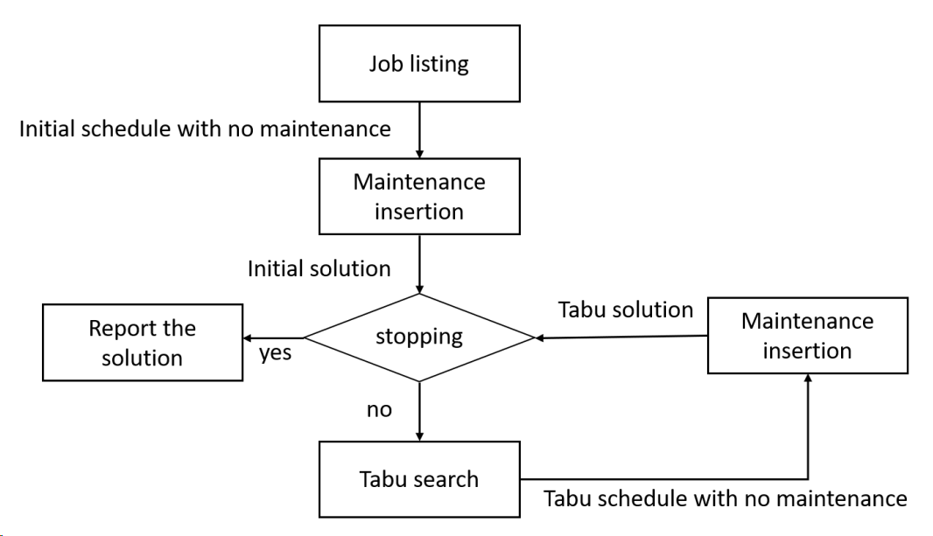
Algorithm
Our algorithm can be divided into three parts.
01
02
03

Slide 15
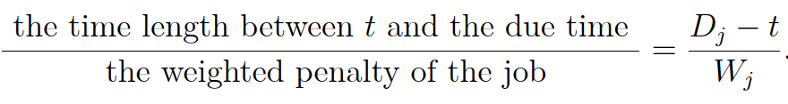
Algorithm – part 1. Job listing
To assign jobs to machines, we follow a listing rules below:
Calculate a ratio for each unscheduled job whose due time is not reached whenever a machine becomes available and assign the job with the smallest ratio to the available machine.
the emergency level of the job
Notes:
The last rule consider the recent time to choose the job, we can see the ratio formula below. The molecular not only consider due date, but consider the gap between recent and due date.

Slide 16
Algorithm
– part 2. A greedy maintenance insertion procedure
We iteratively try all the possible periods on all the machines to insert a maintenance and choose the best one.
We repeat this process until no more maintenance can improve the objective value.
Notes:
After selected the maintenance schedule by greedy based algorithm, we will have a initial solution.

Slide 17
Algorithm
– part 3. Job swapping based on Tabu search
We design a method to exchange the neighboring jobs in the solution and update the best solution if the new solution has lower weighted penalty.
The neighborhood of a jobs is defined by the order of each job and the scope of the neighborhood.
Order 1
Order 2
Order 3
1
2
4
Machine 1
2
Order 1
Order 2
Machine 2
3
5
Order 1
Order 2
Machine 3
6
7
Notes:
The definition of neighborhood can be describe as the figure below. Since job 1, 3 and 6 are both the first order on different machine, we define job 1 as a neighborhood of job 3 and job 6. similarly, job 2 is a neighborhood of job 5 and 7.

Slide 18
Algorithm
– part 3. Job swapping based on Tabu search
If the scope of the neighborhood is 1
The neighborhood of job 1 include job 2, job 3, job 5, job 6, and job 7
Order 1
Order 2
Order 3
Machine 1
1
2
4
Order 1
Order 2
Machine 2
3
5
Order 1
Order 2
Machine 3
6
7
Notes:
The definition of neighborhood can be describe as the figure below. Since job 1, 3 and 6 are both the first order on different machine, we define job 1 as a neighborhood of job 3 and job 6. similarly, job 2 is a neighborhood of job 5 and 7.
So in our tabu search, we will try to swap job 1 with its neighboring job to see if there is any better schedule solution.

Slide 19
Numerical Study

Slide 20
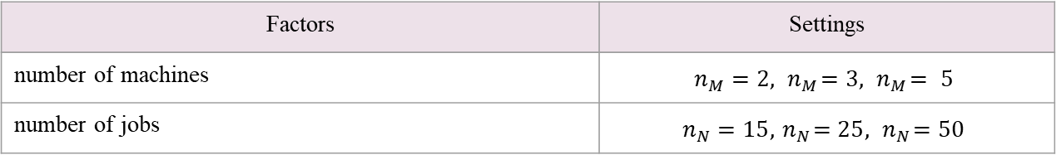
Experiment setting
Two factors, 9 scenarios
Factors | Settings
number of machines | $$n_{M}=2, { n}_{M}=3, { n}_{M}= 5$$
number of jobs | $$n_{N}=15, { n}_{N}=25, { n}_{N}=50$$

Slide 21
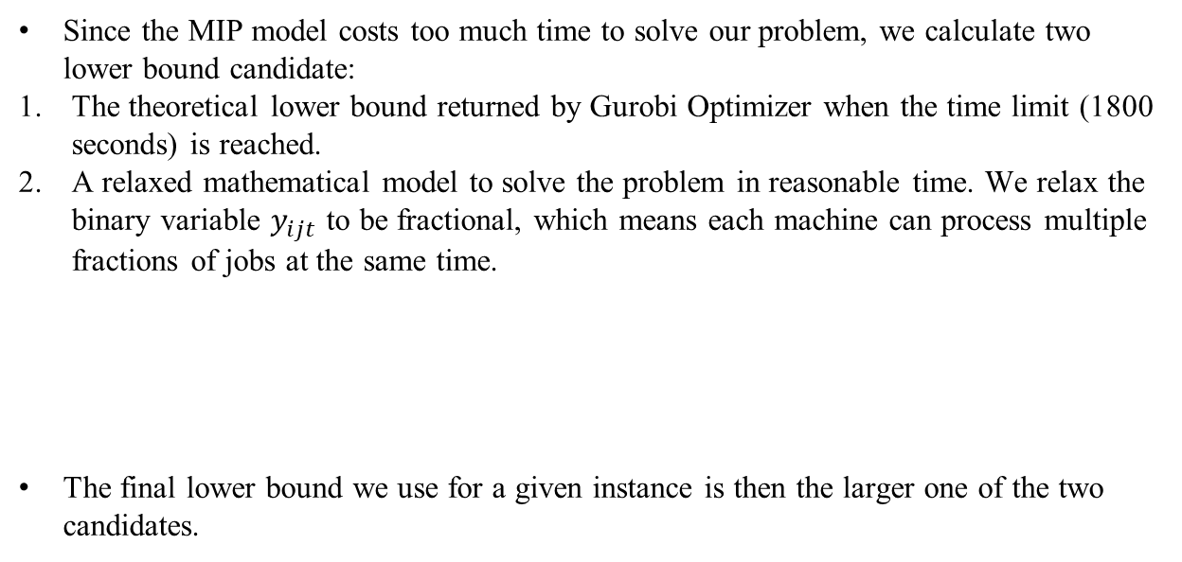
Experiment setting
Since the MIP model costs too much time to solve our problem, we calculate two lower bound candidate:
The theoretical lower bound returned by Gurobi Optimizer when the time limit (1800 seconds) is reached.
A relaxed mathematical model to solve the problem in reasonable time. We relax the binary variable $y_{ijt}$ to be fractional, which means each machine can process multiple fractions of jobs at the same time.
The final lower bound we use for a given instance is then the larger one of the two candidates.
Notes:
We relax the binary variable yijt to be fractional, which means each machine can process multiple jobs in one
time period.

Slide 22
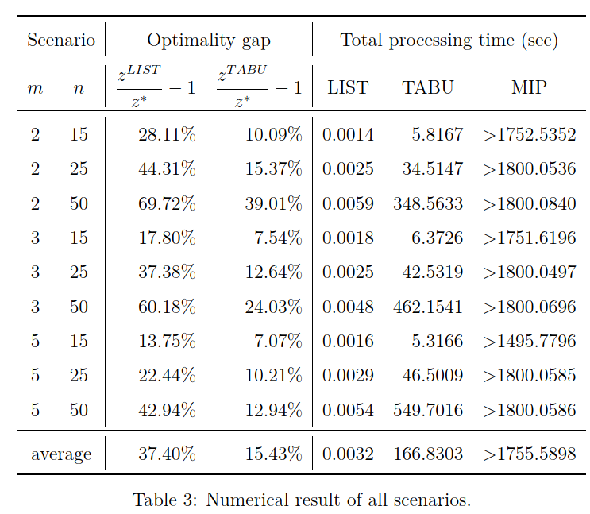
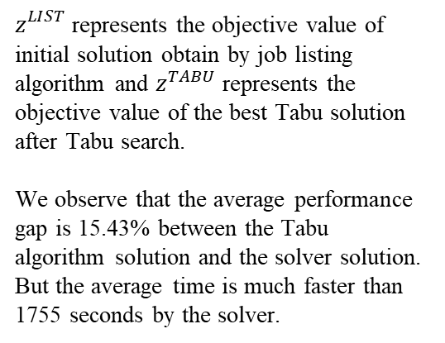
Solution performance
$z_{}^{LIST}$ represents the objective value of initial solution obtain by job listing algorithm and $z^{TABU}$ represents the objective value of the best Tabu solution after Tabu search.
We observe that the average performance gap is 15.43% between the Tabu algorithm solution and the solver solution. But the average time is much faster than 1755 seconds by the solver.
Notes:
The detail settings of our algorithm:
Tabu size: 100
The scope of neighboring jobs: 5
The number of iteration: 100

Slide 23
Conclusion and Future Works

Slide 24

Conclusion and Future Works
In this study, we consider a job scheduling problem with maintenance.
MIP model
Heuristic algorithm
Future work
Algorithm improvement
Different distributions of parameters
Yield rate prediction
Notes:
We proposed a MIP model that can solve the problem.
Since this is a NP problem, we also proposed a heuristic model and may find a near optimal solution within a reasonable amount of time

Slide 25
Thanks!
Any questions?

