Slide 1
Gipher App
Presented By:
Srinath
Veeresh
Noushad
Anitha

Slide 2
Problem Statement
Objective
Project Flow
Architecture
Project Overview
Technology and Tools Used
Conclusion

Slide 3
GIPHER APP
Problem statement:
We had a requirement to search, recommend, comment on gifs. We can find most of the gifs in GIPHY.com but wanted few customizations in the User Interface. Hence, we have decided to build GIPHER APP, Entire data set would be from GIPHY.COM, with customized UI and functionalities.

Slide 4
GIPHER APP
Objective:
Objective of Gipher App to provide best experience to user in with following features.
search for gifs
open the gif
add gif to user favorite list
comment on gif
recommend gifs.

Slide 5
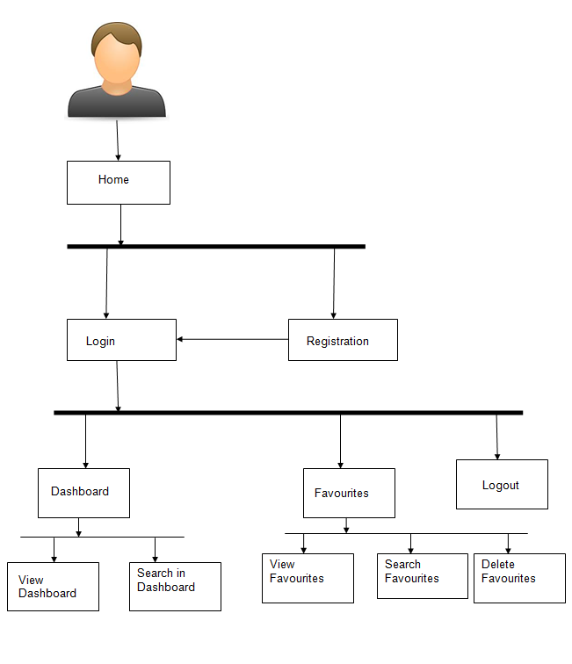
GIPHER APP
Project Flow:
Home/Browser
Forgot Password
Login
Register
Search
View comments
View Recommendations
Search gifs
Recommend
Favorite
Comments
Recommends
Add Recommendations
Delete Recommendations
View Favorite
Delete Favorite
Delete Comments
Post
Comments
Like Comments
Search Books

Slide 6
GIPHER APP
Application Architecture:
Login/Register
Authentication API
JWT validator
POST request
MYSQL
Token generated
Comment API
Add comments
Delete comments
Mongo DB
POST /GET/
DELETE
POST /GET/
DELETE
Front End
(Angular)
Gateway API
Request
POST /GET/
DELETE
Favorite API
Add favorite
Delete favorite
POST /GET/
DELETE
MYSQL
Response
Recommend API
Add recommend
Delete recommend
POST /GET/
DELETE
MYSQL
POST /GET/
DELETE
GET
External API
Search Gifs
GET

Slide 7
GIPHER APP
Project Overview:
User Auth API
Favourite API
Comments API
Recommend API
Favourite
Login
Recommend
Register
Home
Comments
Search
MYSQL
MYSQL
MYSQL
MongoDB
Search API

Slide 8





















GIPHER APP
Tools and Technologies used:

Slide 9
GIPHER APP
Conclusion:
The Gipher App helps the user to search though gifs online. It also helps user to
store gifs in their favorites and can delete them later.
Can recommend gifs and can delete them later
User can also add comments on any gif and can also view all comments

Slide 10
Thank you

