Slide 1
KEYLOGGER AND SECURITY
CAPSTONE PROJECT
Presented By:
1. Janet Inba - College Of Engineering, Guindy - Department of Computer Science and Engineering

Slide 2
OUTLINE
Problem Statement
Proposed System/Solution
System Development Approach
Algorithm & Deployment
Result
Conclusion
Future Scope
References

Slide 3
Problem Statement
In today's digital age, where cybersecurity threats loom large, one of the significant concerns is the proliferation of keyloggers, stealthy software tools designed to monitor and record keystrokes on a user's computer without their knowledge. Keyloggers pose a severe threat to individuals and organizations as they can capture sensitive information such as passwords, credit card details, and other personal data, leading to identity theft, financial loss, and privacy breaches.

Slide 4
Proposed Solution
The proposed system aims to address the challenge of effectively detecting and preventing keylogger threats. This involves the implementation of advanced detection mechanisms and response strategies to safeguard users' sensitive information. The solution will consist of the following components:
1. Detection Mechanism:
Develop sophisticated algorithms to continuously monitor system activities and identify suspicious behaviour indicative of keylogging activities.
Utilize machine learning and behavioural analysis techniques to establish baseline user behaviour and detect deviations that may signal the presence of a keylogger.
2. Real-time Alerting and Response:
Integrate a responsive alerting system to notify users and administrators upon detecting keylogging activities, enabling prompt investigation and mitigation of security threats.
Implement secure input handling mechanisms at the application level to prevent keylogger interception of sensitive information, including encrypting keystrokes during transmission and using secure password entry dialogs.
3. Continuous Monitoring and Updates:
Establish a framework for continuous monitoring and updating of the keylogger detection system to adapt to evolving threats and vulnerabilities.
Deploy regular updates and patches to enhance detection capabilities and effectively address emerging security challenges.
4. Evaluation:
Assess the system's performance using appropriate metrics such as detection accuracy, false positive rate, and response time.
Conduct thorough testing and validation to ensure the reliability and effectiveness of the keylogger detection system in real-world scenarios.

Slide 5
System Approach
System Requirements
Software Requirements
Python 3.x environment
tkinter library for GUI development
pynput library for capturing keyboard events
Hardware Requirements
Standard computer or laptop with compatible operating system (Windows, macOS, Linux)
Library Required
tkinter: Used for GUI development to create the application's user interface.
pynput: Required for capturing keyboard events and implementing keylogging functionality.

Slide 6
Algorithm & Deployment
Algorithm Selection:
Chosen Algorithm: Keystroke Logging.
Justification: Keystroke logging is selected as it effectively captures and records keyboard events in real-time, aligning with the project's objective of developing a keylogger application.
Data Input:
Input Features: The keylogger application captures keyboard events such as key presses, releases, and holds, serving as the input features for the system.
Training Process:
Training Data: The keylogger application does not require a training process as it operates by capturing keyboard events in real-time; hence, no specific training data is needed.
Prediction Process:
Prediction Method: The keylogger application continuously monitors keyboard activities and records them in real-time, providing insights into user input behaviour and patterns.
Real-Time Inputs: The keylogger application captures keyboard events instantly as they occur, enabling immediate monitoring and logging of user keystrokes.
By employing keystroke logging technology, the keylogger application effectively captures and logs keyboard events, offering valuable insights into user input behaviour and enhancing security monitoring capabilities.

Slide 7
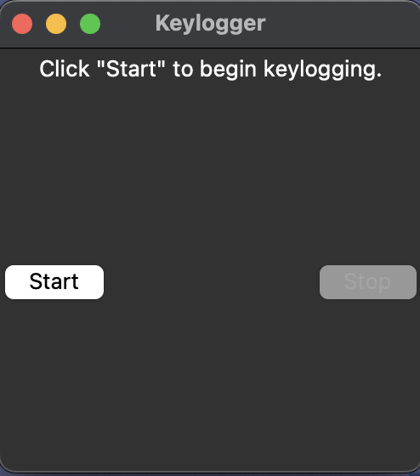
Result
The keylogger application successfully captures and logs keyboard events in real-time, providing insights into user input behavior and patterns.

Slide 8
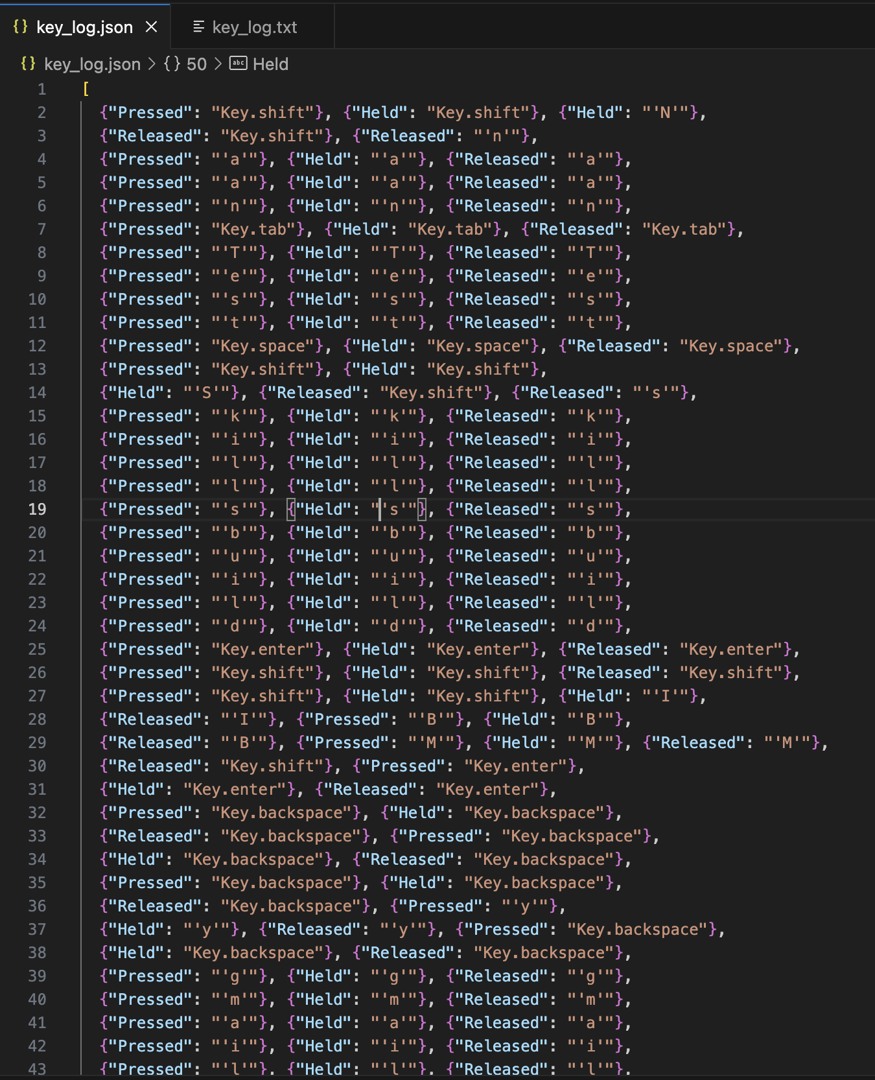
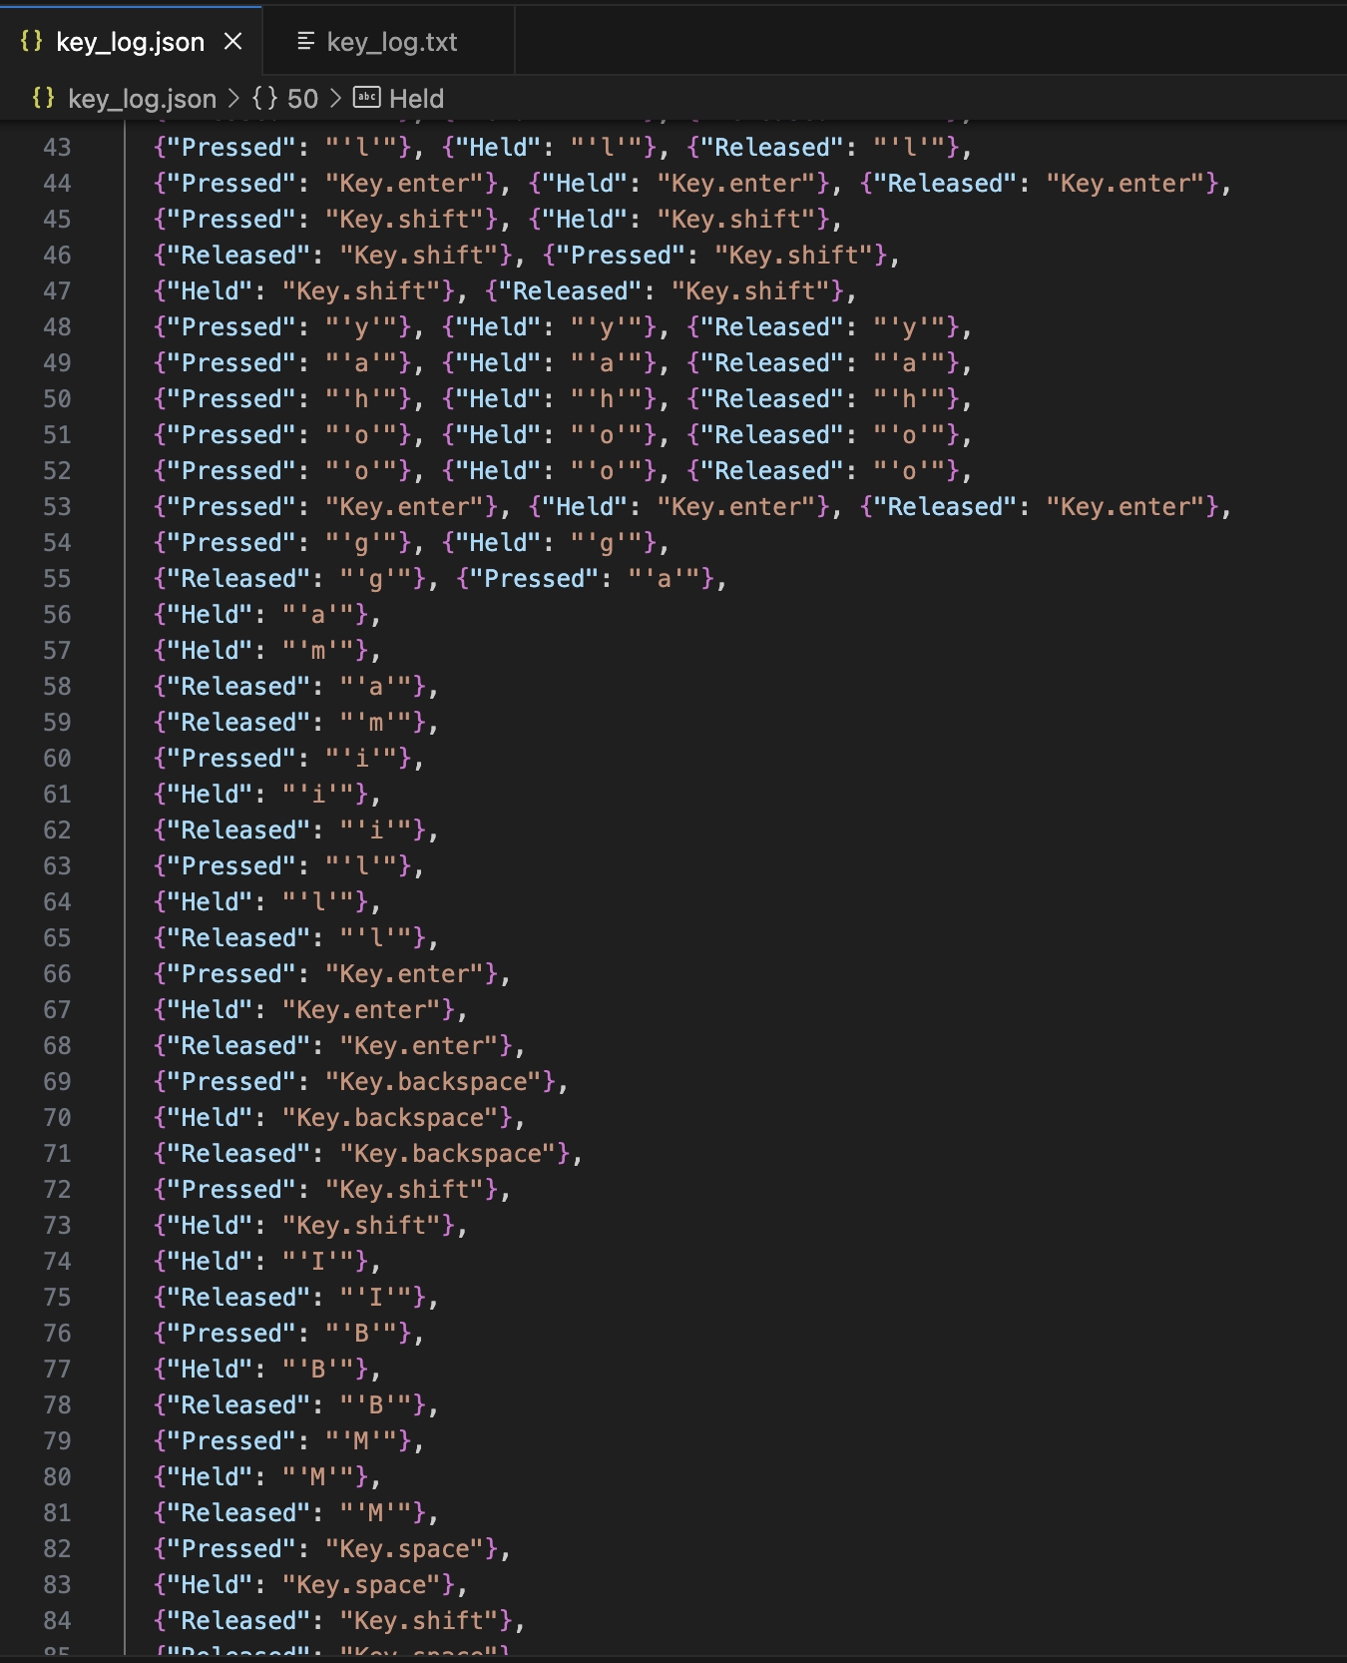
Key_log json file

Slide 9
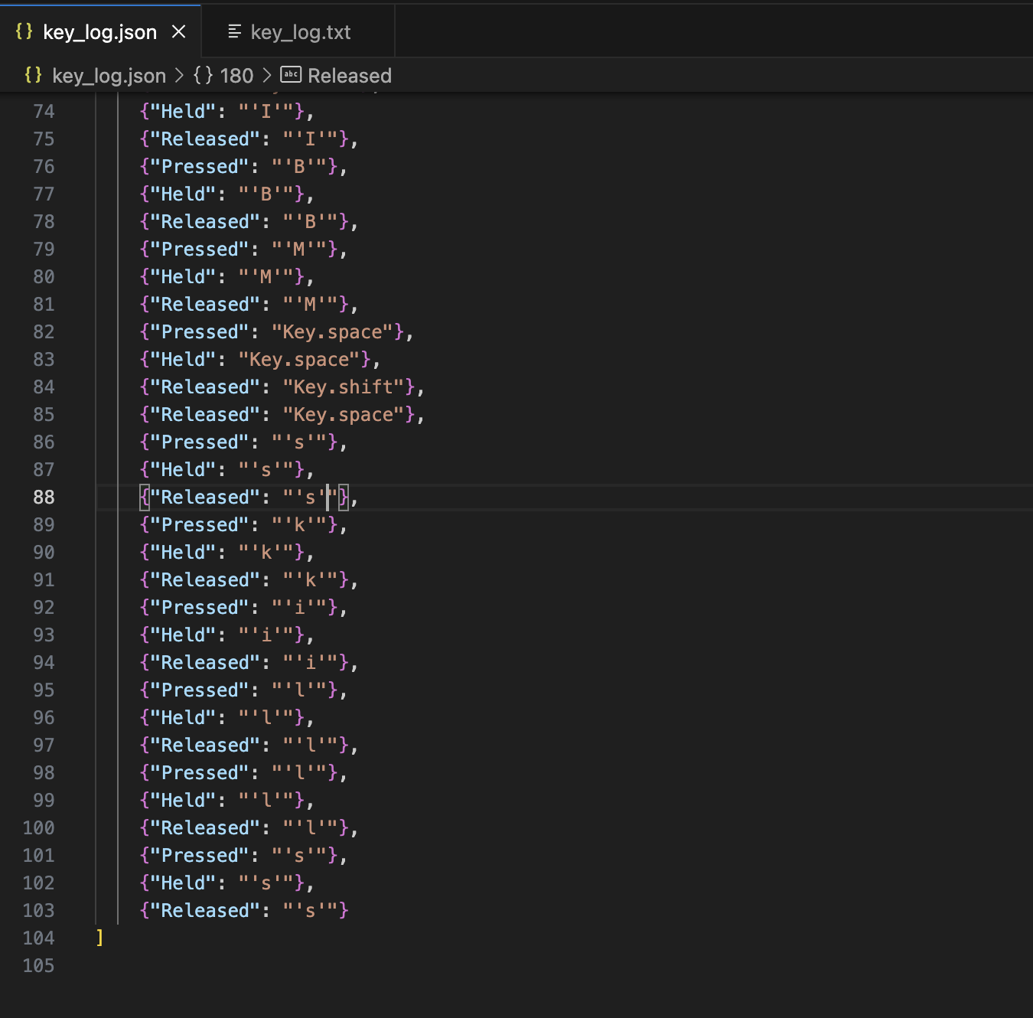

Slide 10
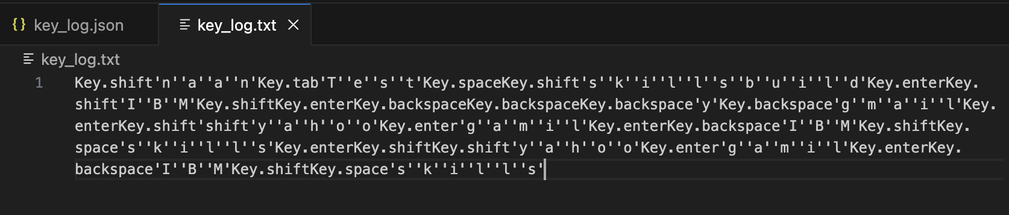
Key_log file

Slide 11
Conclusion
Key Points:
The keylogger software records and stores keystrokes as they occur, strengthening security monitoring endeavors.
Immediate monitoring enables quick identification of dubious key inputs, improving cybersecurity protocols.
Challenges Faced:
Ensuring functionality across diverse operating systems.
Mitigating privacy apprehensions linked to keystroke tracking.
Potential Improvements:
Augment logging capabilities by incorporating timestamps and categorizing events.
Enforce stringent privacy protocols to protect user data.
In summary, although the keylogger software provides beneficial security surveillance functions, addressing compatibility and privacy issues, and implementing essential enhancements are vital for its sustained effectiveness.

Slide 12
Future scope
Potential Enhancements:
1. Incorporation of additional data sources: Investigate integrating data from various origins such as network activity, application usage, or biometric data to offer thorough monitoring.
2. Algorithm refinement: Adjust the keylogger algorithm to optimize performance and efficiency, considering factors such as resource consumption and detection precision.
3. Expansion to multiple platforms: Broaden compatibility of the keylogger application to encompass a diverse array of operating systems and devices, ensuring comprehensive security oversight.
4. Integration of emerging technologies: Explore merging emerging technologies like edge computing or advanced machine learning techniques to bolster threat detection and analysis capabilities.
By pursuing these potential enhancements and expansions, the keylogger application can progress into a robust and adaptable security monitoring solution, adept at confronting evolving cybersecurity dilemmas effectively.

Slide 13
References
Brownlee, Jason. "How to Develop a Keylogger in Python." Machine Learning Mastery, 2020. [Online]. Available:.https://machinelearningmastery.com/how-to-develop-a-keylogger-in-python/
McKinney, Wes. "Python for Data Analysis." O'Reilly Media, 2017.
Pedregosa, F. et al. "Scikit-learn: Machine Learning in Python." Journal of Machine Learning Research, vol. 12, pp. 2825-2830, 2011.
Van Rossum, Guido, and Drake, Fred L. "Python 3 Reference Manual." CreateSpace, 2009.

Slide 14
THANK YOU

