Slide 1

Investigating Factors That Influence High IMDB Film Ratings

Slide 2
Background
Research Question
Movies are a common form of entertainment, many people look at online ratings before choosing what to watch.
IMDB is a well-known platform where viewers rate films from 0 to 10.
Different features of a film may influence how audiences rate them.
Which film characteristics influence whether a movie receives a rating higher than 7?

Slide 3
Missing Values
Missing Values Summary
Variable | Missing Count | Missing (%)
film_id | 0 | 0.00
year | 0 | 0.00
length | 127 | 4.23
budget | 0 | 0.00
votes | 0 | 0.00
genre | 0 | 0.00
rating | 0 | 0.00
Variable description:
Film_id: unique identifier
Year: release year
Length: film duration (minutes)
Budget :production budget (million USD)
Votes: number of votes received
Genre: film category
Rating: IMDB score (0-10)
2874 films, 7 variables
Only length has missing values

Slide 4
Exploratory Data Analysis
Descriptive Statistics of Film Variables
Variable | Mean | Median | SD | Min | Max
year | 1,975.71 | 1,983.00 | 24.27 | 1,895.00 | 2,005.00
length | 81.57 | 90.00 | 39.54 | 1.00 | 555.00
budget | 11.99 | 12.10 | 2.97 | 1.20 | 23.40
votes | 677.58 | 30.00 | 3,860.04 | 5.00 | 92,437.00
rating | 5.41 | 4.70 | 2.08 | 0.80 | 9.20
Most films in the sample have similar production budgets While votes variable shows extremely high variability
Most films in the data receive moderate ratings.

Slide 5
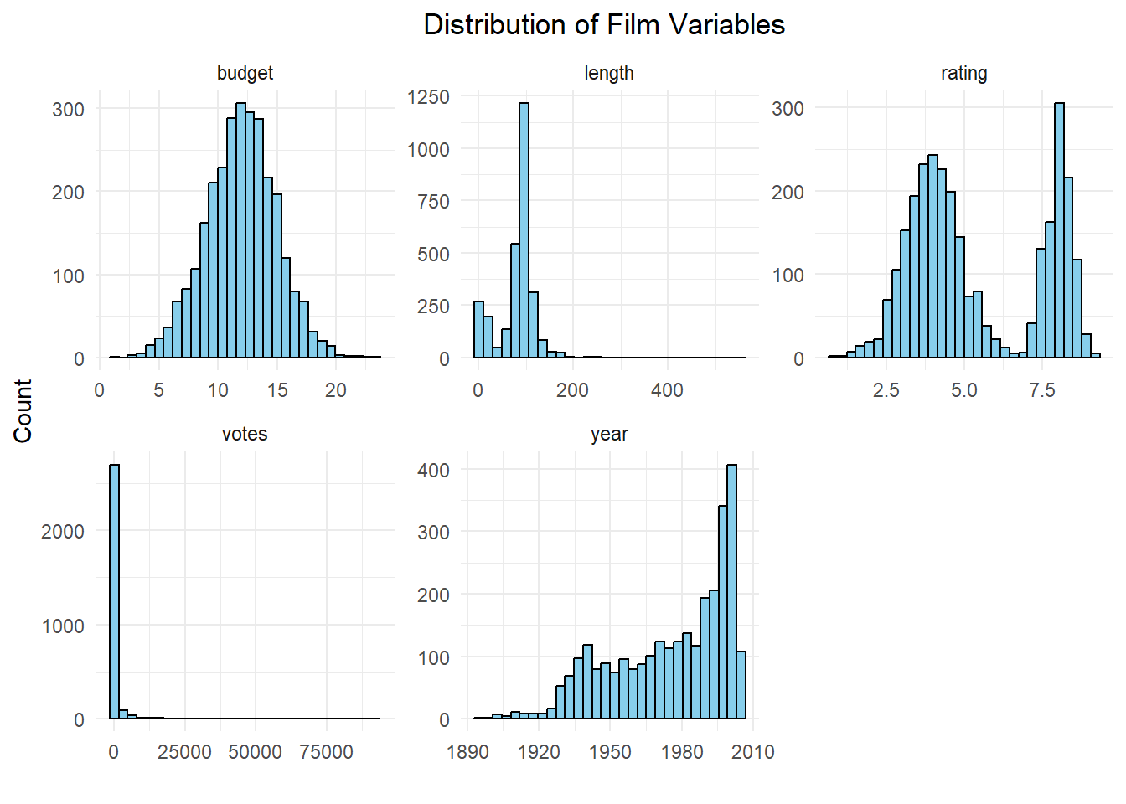
Variable Distributions
Budget follows a roughly symmetric distribution with small variation.
Length has large variation.
Rating shows a bimodal distribution.
Votes is right-skewed → Log-transform

Slide 6
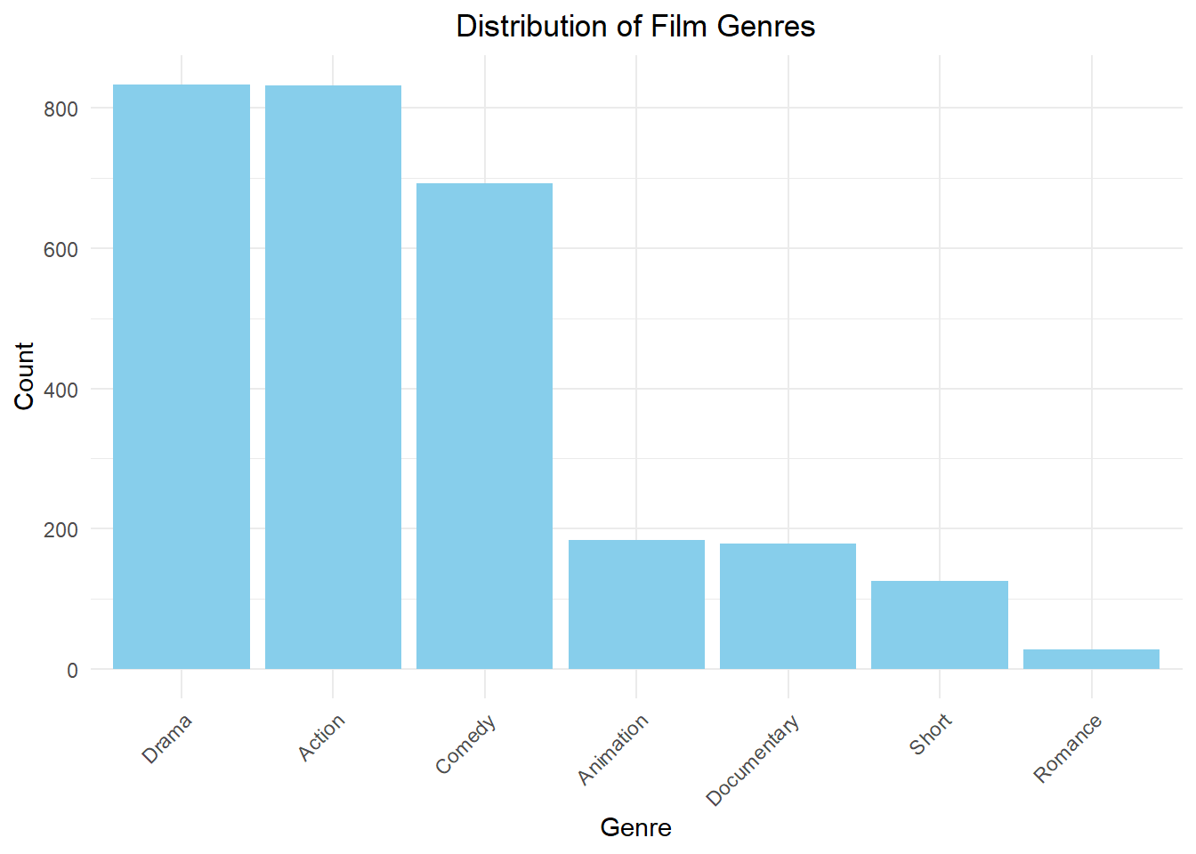
Variable Distributions
Drama and Action are the most common genres, with the highest number of films, followed by Comedy.
Animation and Documentary appear much less frequently, while Short films are relatively rare.
Romance has the smallest number of observations.
The distribution of genres is uneven, with most films concentrated in Drama, Action, and Comedy categories.

Slide 7
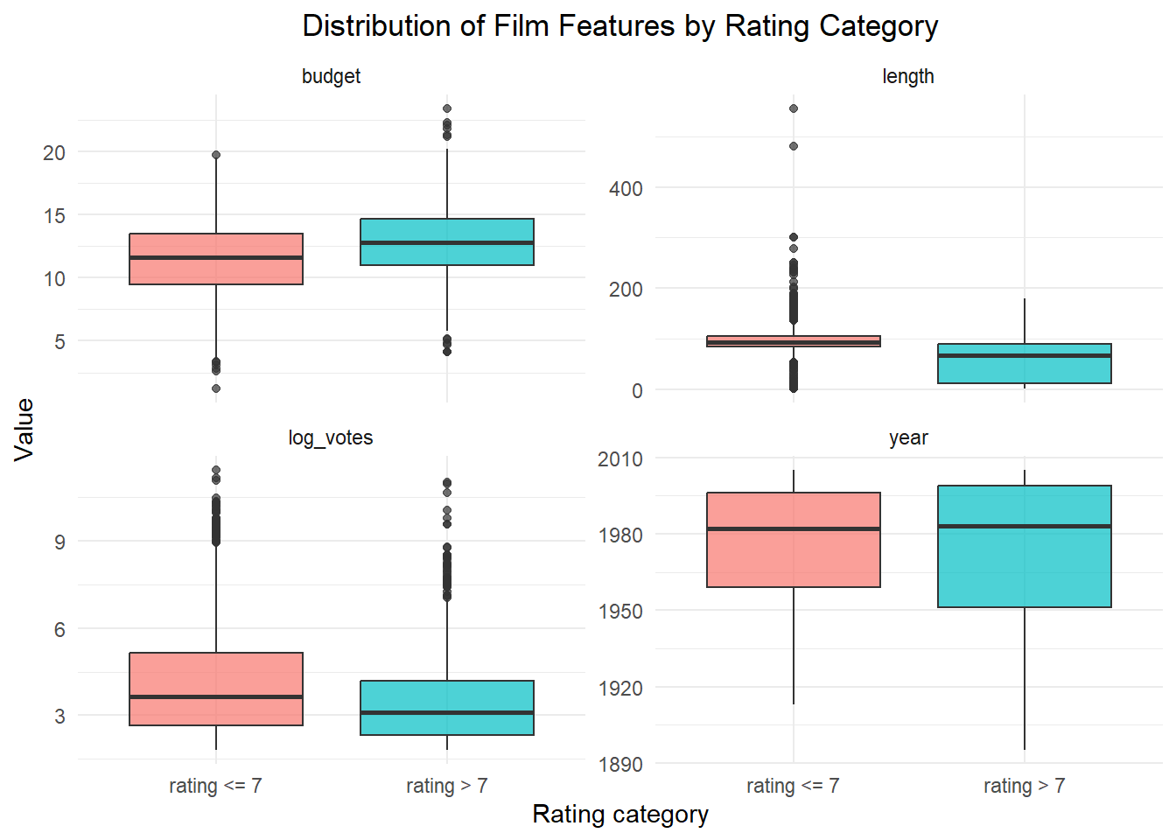
High-Rated vs. Low-Rated Films
Summary Statistics by Rating Category
Rating category | rating <= 7 | rating > 7
Count | 1867 | 1007
Mean year | 1,976.31 | 1,974.60
Mean length | 95.83 | 55.14
Mean budget | 11.47 | 12.95
Mean votes | 827.35 | 399.92
Mean rating | 3.99 | 8.03

Slide 8
Logistic Regression Result
Descriptive Statistics of Film Variables
Variable | Estimate | Std Error | z value | p-value
(Intercept) | −16.227 | 5.779 | −2.808 | 0.005
year | 0.006 | 0.003 | 2.157 | 0.031
length | −0.062 | 0.004 | −16.255 | 0.000
budget | 0.519 | 0.030 | 17.430 | 0.000
log_votes | 0.048 | 0.042 | 1.140 | 0.254
genreAnimation | −0.428 | 0.339 | −1.265 | 0.206
genreComedy | 3.338 | 0.182 | 18.328 | 0.000
genreDocumentary | 5.310 | 0.388 | 13.702 | 0.000
genreDrama | −1.411 | 0.231 | −6.119 | 0.000
genreRomance | −0.605 | 0.893 | −0.677 | 0.499
genreShort | 4.332 | 1.051 | 4.121 | 0.000
Films with larger budgets and more recent release years are more likely to receive ratings above 7.
Longer films are less likely to receive high ratings.
Film genre plays an important role.
$\log{(}\frac{P\left(high_rating=1\right)}{1−P(high_rating=1)})=$ $β_{0}+β_{1}⋅year+β_{2}⋅length+β_{3}⋅budget+β_{4}⋅log\left(votes\right)+β_{5}⋅genre$

Slide 9
Odds Ratios & Model prediction
Odds Ratios from Logistic Regression
Variable | Odds_Ratio
(Intercept) | 0.000
year | 1.006
length | 0.940
budget | 1.680
log_votes | 1.049
genreAnimation | 0.652
genreComedy | 28.170
genreDocumentary | 202.395
genreDrama | 0.244
genreRomance | 0.546
genreShort | 76.104
Films with larger budgets have higher odds of receiving high ratings.
Longer films are less likely to receive ratings above 7.
Films in genres such as Comedy, Documentary, and Short films are more likely to receive high ratings.
Ratings ≤ 7: 1733 films are correctly classified.
Ratings > 7: 837 films are correctly.
The model performs reasonably well.
Confusion Matrix
Predicted | rating <= 7 | rating > 7
rating <= 7 | 1733 | 170
rating > 7 | 134 | 837

Slide 10
Conclusions
Budget, film length, release year, and genre are important factors associated with high IMDB ratings.
Films with larger budgets and more recent release years are more likely to receive ratings above 7, while longer films are less likely to receive high ratings.
Comedy, Documentary, and Short films show a higher probability of receiving high ratings.
Misclassifications are relatively low, indicating the model performs well.

Slide 11

Thanks
Q&A

