Slide 1
CAPSTONE PROJECT
Unemployment statistics by ethnicity, gender and regions in UK
from 2004 to 2018
ALY 6140 – 21018
Analytics Systems Technology
Richard He
By:
Hoang Uyen Le

Slide 2
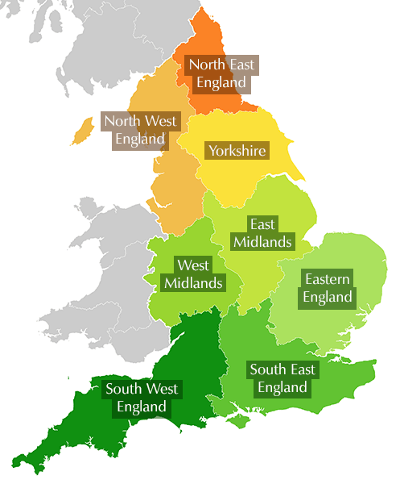
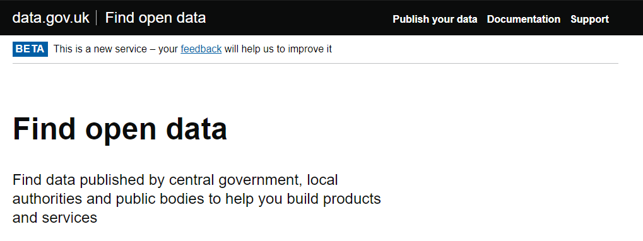
Data extraction
- Dataset source: https://data.gov.uk/dataset/fe6c83aa-62aa-4a8c-94cc-225f47287225/unemployment-by-ethnicity
- Dataset dimension: 35,100 x 15
Containing statistic on the percentage of working age people (from 16 to 64 years old) who are unemployed, broken down by ethnicity type, gender, age range from thousands investigations in different regions of the UK from 2004 to 2018.
Notes:
Forecast this event will deeply effect economy and labor force of both side EU and the UK

Slide 3
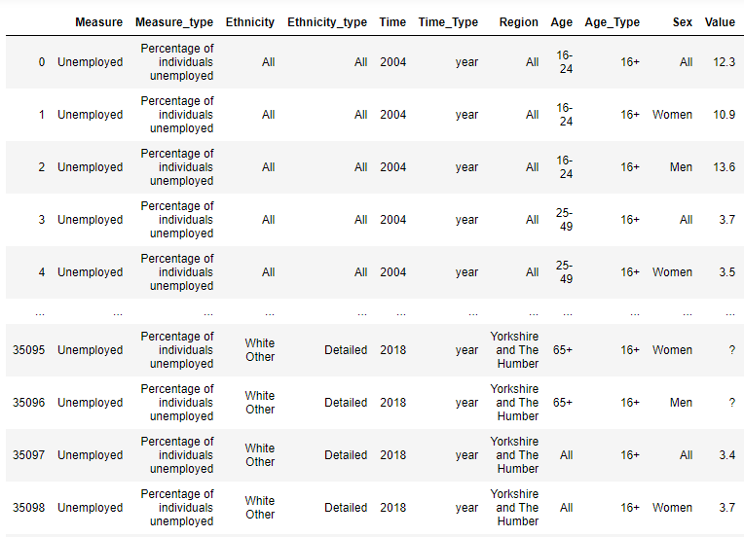
Data extraction
Measure 1 unique value: “ Unemployed ”
Measure_type 1 unique value“ Percentage of individual unemployed ”
Ethnicity 13 unique ethnicity types
Ethnicity_type 4 unique ethnicity classifications
Time 15 unique year values (from 2004 to 2019)
Time_Type 1 unique value “ Year “
Region 12 unique name of region in UK
Age 5 unique age ranges: 16 – 24, 25 – 49, 50 – 64, 65+, All
Age_Type 1 unique value: “ 16+ ”
Sex 3 unique genders: Women, Men, All
Value Percentage of individual unemployed in the investigation
confidence_interval Confidence interval of “Value” variable
Numerator Numerator of the equation to calculate unemployed percentage
denominator Denomination of the equation to calculate unemployed percentage
samp_size Sample size of the investigation

Slide 4

Learn about unemployment rate in the UK over last 15-year period
What demographic and geographic elements effect unemployment rate the most?

Slide 5

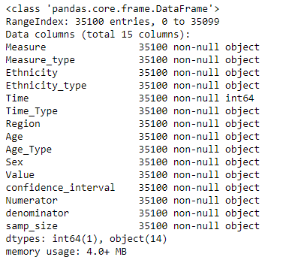
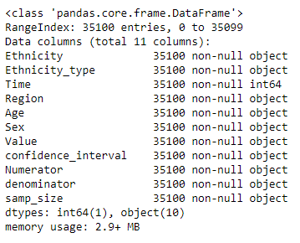
Data cleansing
Dropping columns

Slide 6
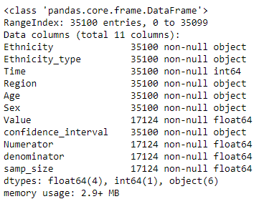

Data cleansing
Converting data types
? NaN
- NaN
object float
‘ Value ’
‘ Numerator ’
‘ denominator ’
‘ samp_size ’

Slide 7
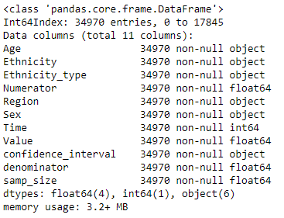

Data cleansing
all null values
dataset average values
non-null values
replace
Replacing missing values
calculate

Slide 8

Data visualization
Libraries used: matplotlib, seaborn

Slide 9
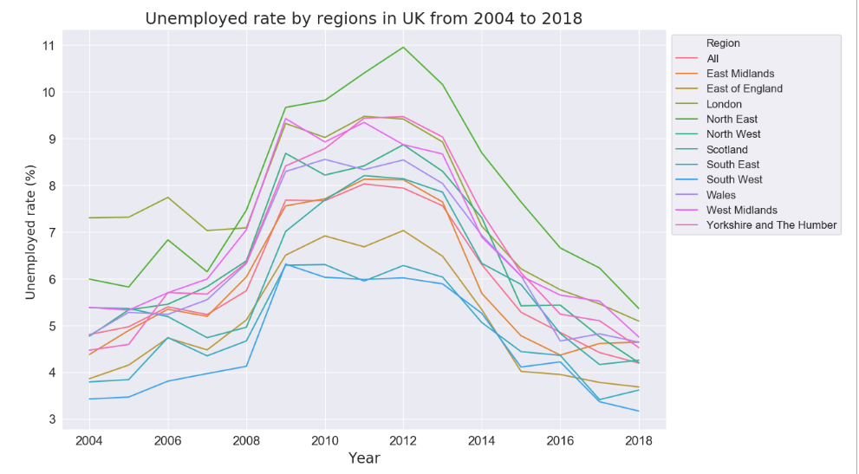
Data visualization
Notes:
2008: Global economic crisis

Slide 10
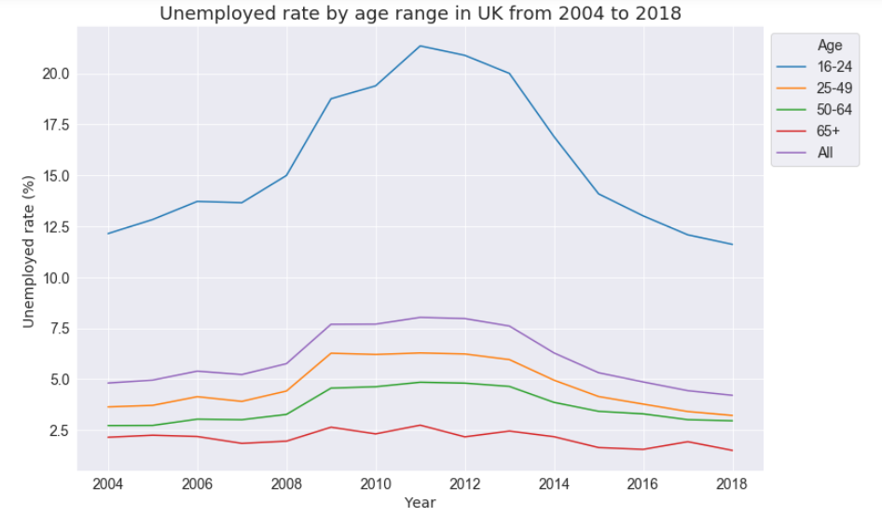
Data visualization

Slide 11
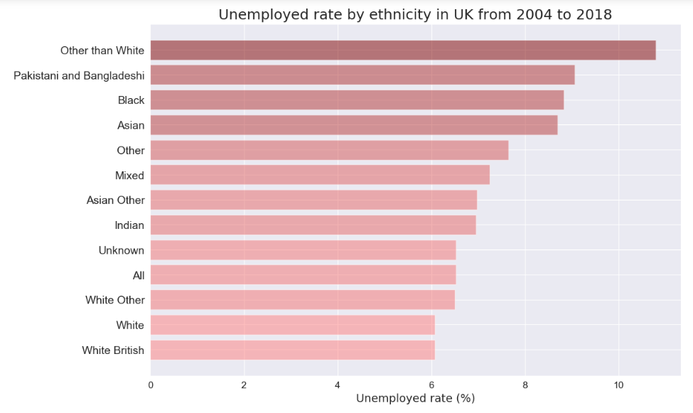
Data visualization

Slide 12


Predictive Analytics
Log transforming
Dummies variables
Random Forest Regression
Gradient Boosting Regression
Models’ accuracy and variable importance

Slide 13
Predictive Analytics
Predicted variable Value Percentage of individual unemployed
(Continuous)
Predictor Ethnicity 13 unique ethnicity types
(Categorical) Age 5 unique age ranges
(16 – 24, 25 – 49, 50 – 64, 65+, All)
Region 12 unique name of region in UK
Time 15 unique year values
(from 2004 to 2019)
Sex 3 unique genders: Women, Men, All

Slide 14
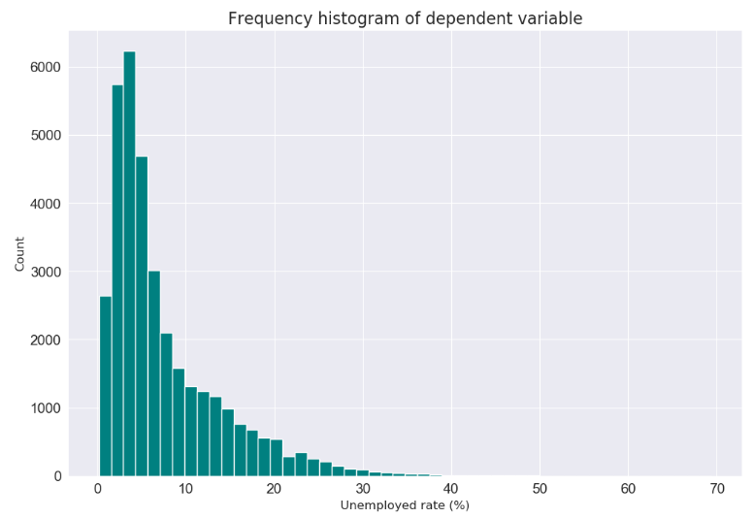
Predictive Analytics
Log transforming
data[‘Value’] = np.log (data[‘Value’])
Notes:
Non – normal distribution
Positive skew – long tail on the right
Log10

Slide 15
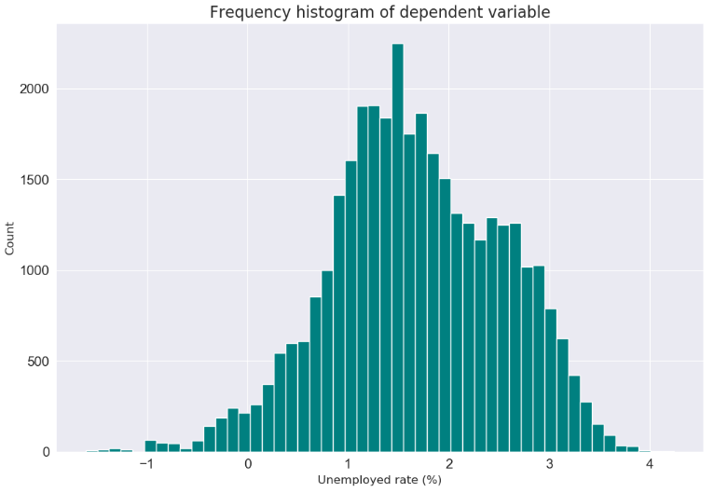
Predictive Analytics
Log transforming

Slide 16
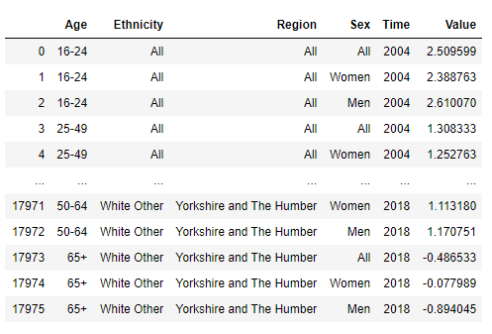
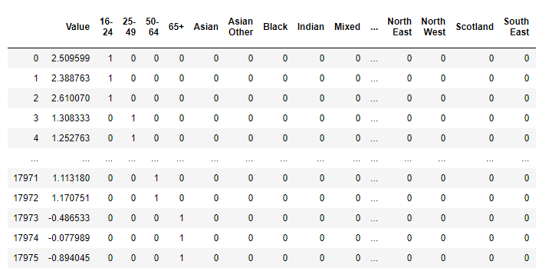
Predictive Analytics
Dummies variable
6
columns
30
columns

Slide 17

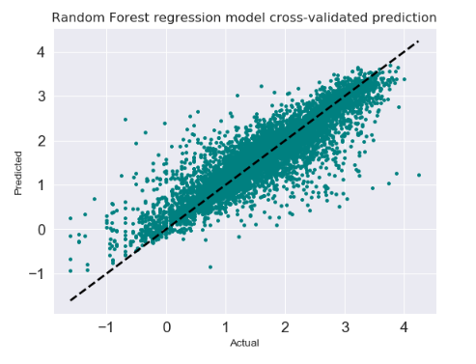
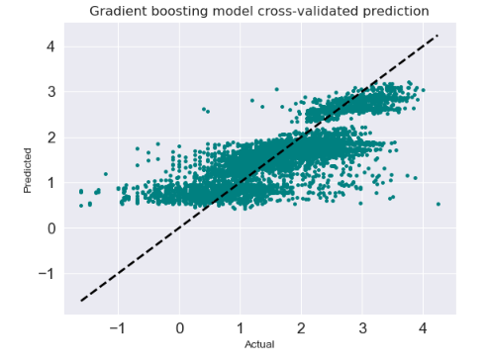
Predictive Analytics
Regression models
R² = 0.8429
MAE = 0.1994
MSE = 0.1146
RMSE = 0.3385
R² = 0.7043
MAE = 0.352
MSE = 0.2157
RMSE = 0.4644
Notes:
R2: 75% of the variance for Value variable is explained by the model
Mean absolute error
Mean square error
Root of mean square error

Slide 18
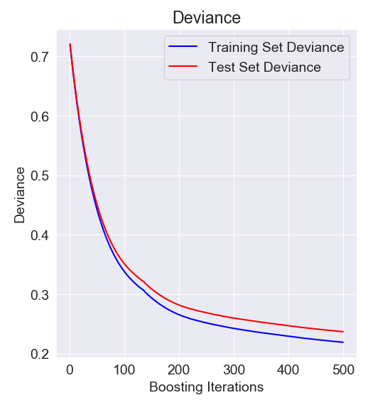
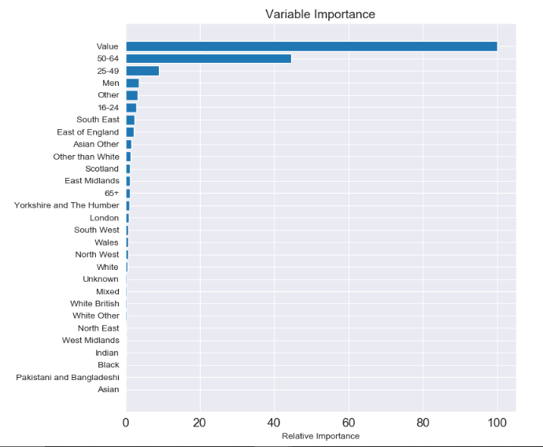
Predictive Analytics
Deviance &
variable importance
Notes:
Racism
Racist
History of racism is heavily linked to its relationship with former colonies and citizens under British Empire

Slide 19
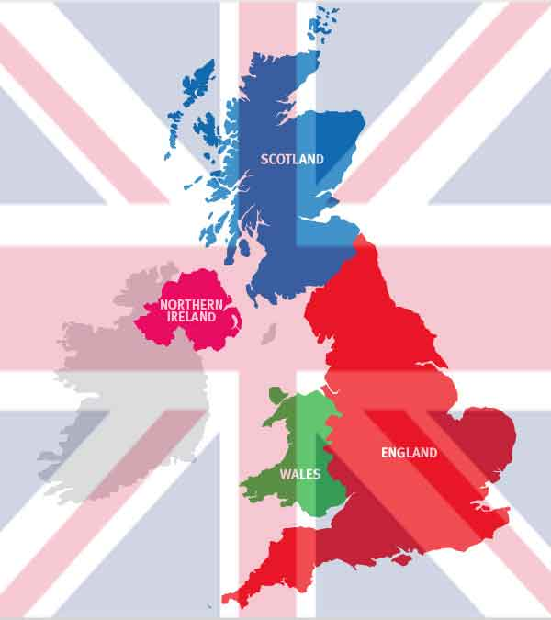
Thanks for listening!

