Slide 1
Hakan Erol
Joji Asako
Trivi Tran
Soheil Karimi

Slide 2
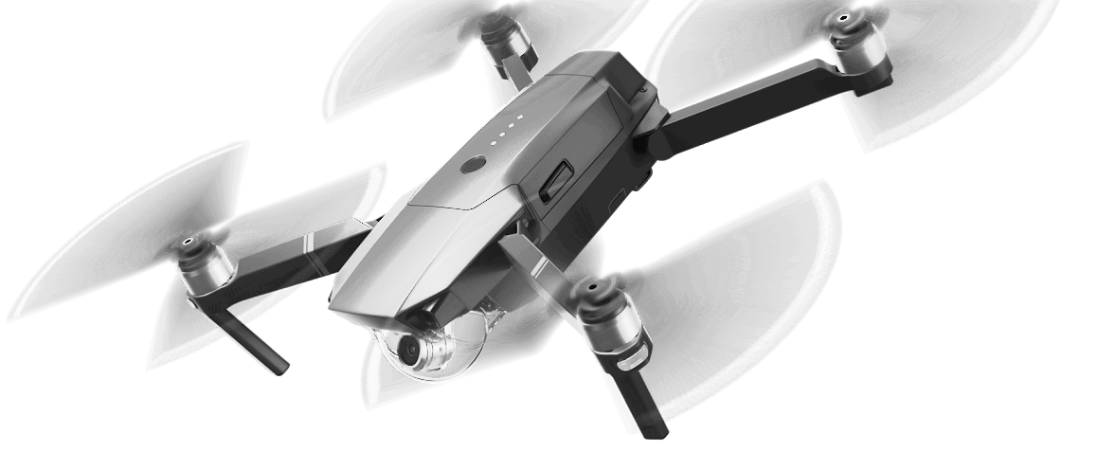
DRONE MOTION
fly with the force

Slide 3
Project Overview
Control using hand gestures
No sensors, only camera
Intuitive flying
Deep learning-Convolutional Neural Network Model (CNN)

Slide 4
Completed Work
Using pre-trained CNN model
Take videos for training
Save model to improve generalization
Introduce calibration
Discrete Bayes Filter
Hand Gesture Detection

Slide 5
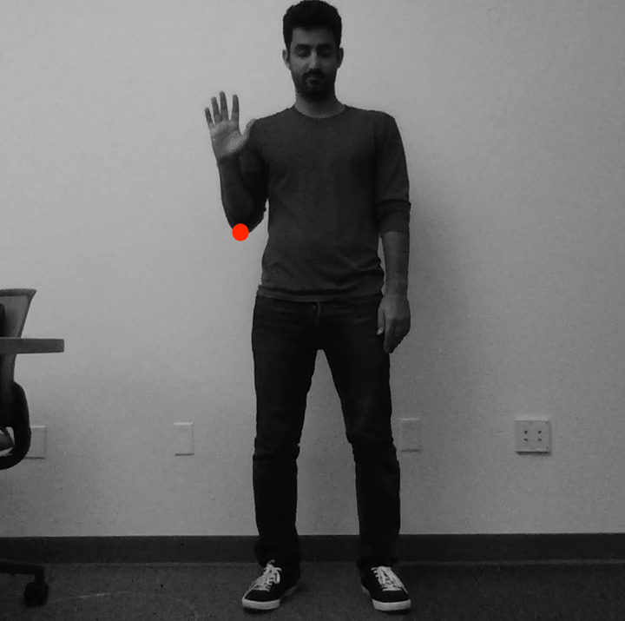
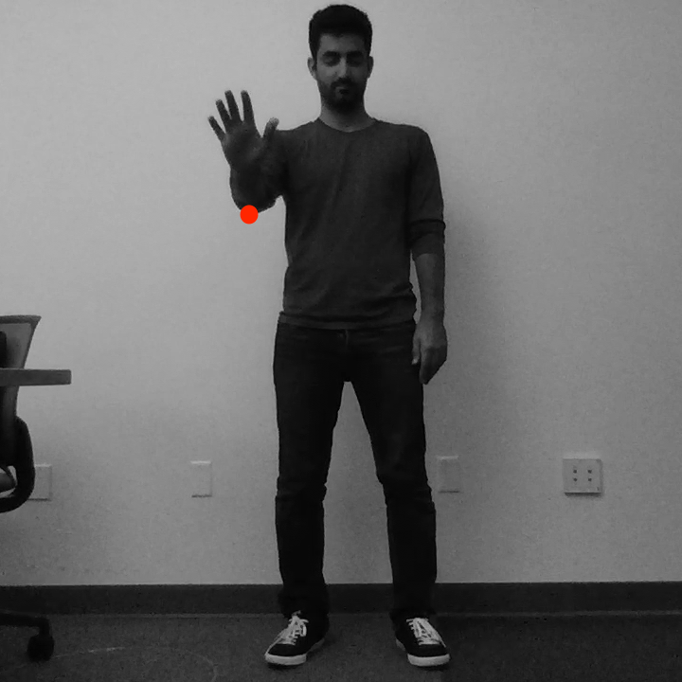
Hand Gestures

Slide 6
Current work
Use PS-Drone API
Control Drone with laptop
Improve upon current platform
Optimize flight
Piloting UAV

Slide 7
Implement RO
Connecting Classifier to API
Date | Assignee(s) | Task
5/18/17 | Hakan & Trivi | Call the command based on the output of classifier Verify that the movements are as expected, tweak as needed

Slide 8
Implement RO
Generalize the model
Date | Assignee(s) | Task
5/28/17 | Joji & Soheil | Gather varying training data Try different techniques

Slide 9
Project Recap
Control using hand gestures
No sensors, only camera
Intuitive flying
Compatible with a variety of drones
Deep learning

