Slide 1
A Skill Library for Reliable Data Analysis
All 52 tools implemented and tested, packaged as seven Claude skills

Slide 2
Contents
1
The tool library
52 deterministic tools in 10 categories
2
The skills
Seven Claude skills that decide when and how the tools are used
3
Next steps
2

Slide 3
The tool library

Slide 4
All 52 catalog tools are built and tested
WHERE THE LIBRARY STANDS
52
A Grounding & validation
7/7
B Loading & cleaning
9/9
C Descriptive
5/5
of 52 catalog tools
packaged as 7 Claude skills
D Hypothesis testing
10/10
E Regression & modelling
7/7
F Time series
3/3
G Survival
3/3
H Causal & Bayesian
3/3
I Visualization
3/3
J Interpretation
2/2
4

Slide 5
Design Principles
Pair every analysis with a check
1
Statistics alone reproduce the benchmark's failures. Grounding and validation tools guard what goes in and what comes out.
One result envelope, with warnings
2
Every tool returns ok, warnings and typed fields. A non-empty warnings list is something to surface, never swallow.
No LLM inside a tool
3
Tools are plain typed functions. The agent chooses and chains them; the tools stay deterministic and testable offline.
5

Slide 6
Analysis Pipeline
Load
Profile
Validate
Prepare
Analyse
Critique
Explain
load_dataset
detect_separator
profile_dataset
missing_report
validate_grounding
check_method
impute
scale
encode
outliers
bin
describe
tests
models
survival
time series
critique_findings
verify_numeric
interpret_result
recommend_chart
render_chart
explain_chart
›
›
›
›
›
›
6

Slide 7
A · Grounding & validation: all 7 tools built
TOOL
WHAT IT RETURNS
detect_separator_and_encoding
Sniffs delimiter and encoding; flags column-count mismatches
profile_dataset
Schema fingerprint: shape, dtypes, cardinality, missing %
validate_grounding
Every column and table a plan references must exist
check_method_appropriateness
Flags a method that does not fit its columns' types
verify_numeric_consistency
Recomputes a claimed number and names the mismatch kind
check_repair_scope
Did a 'fix' touch the failing region, or nothing that mattered?
flag_unmeasurable_dimension
Reports n/a with coverage instead of a misleading 0
7

Slide 8
B · Loading, profiling & cleaning: 9 tools
TOOL
WHAT IT RETURNS
load_dataset
CSV, Parquet or Excel with delimiter and encoding sniffed first
missing_value_report
Splits structurally missing (>50%) from sparse missing
impute_missing
mean, median, most-frequent or constant; warns on heavy imputation
scale_numeric
minmax, standard, robust, maxabs; skips zero-spread columns
encode_categorical
ordinal, one-hot, label, target-mean, k-fold target-mean
detect_outliers_iqr
Tukey fences; reports rows, never drops them
bin_continuous
Equal-width or quantile bins; flags merged duplicate edges
engineer_categorical_interactions
Count, cross and group-statistic features
polynomial_expand
Polynomial and interaction terms of chosen columns
9

Slide 9
C · Descriptive statistics: 5 tools
TOOL
WHAT IT RETURNS
describe_column
Numeric or categorical summary, dispatched on dtype
correlation_matrix
Pairwise matrix plus the single strongest pair
frequency_table
Counts and proportions, with the denominator reported
groupby_aggregate
Aggregate by group, with group sizes alongside
column_summary_for_viz
Column roles, ranges and samples for chart choice
10

Slide 10
D · Hypothesis testing: 10 tools (1 of 2)
TOOL
WHAT IT RETURNS
ab_test
Welch t-test with Cohen's d
chi_square_association
Independence test with Cramér's V
confidence_interval
One-sample t interval for a mean
two_sample_confidence_interval
Welch interval for a difference in means
ks_normality_test
Lilliefors-corrected KS, plus skew
11

Slide 11
D · Hypothesis testing: 10 tools (2 of 2)
TOOL
WHAT IT RETURNS
variance_equality_test
Mood's test, robust to non-normal data
nonparametric_test
Mann-Whitney, Wilcoxon or Kruskal, with effect size
bootstrap_ab_test
Seeded bootstrap interval and permutation p-value
ab_power_analysis
Solve for sample size or for power
multiple_comparison_correction
Bonferroni, Holm or Benjamini-Hochberg
12

Slide 12
E · Regression and modelling: 7 tools
COEFFICIENTS WITH THE CONTEXT TO TRUST THEM
TOOL
WHAT IT RETURNS
linear_regression
Simple OLS with standard error, p and 95% CI
multivariable_regression
OLS with CIs, VIF, dummy-coded categories
glm_fit
Logistic, Poisson, negative binomial, gamma; odds and rate ratios
robust_regression
Huber fit shown beside OLS
regularized_regression
Lasso, ridge or elastic-net; cross-validated R²
dimensionality_reduction
PCA or sparse PCA with named loadings
feature_selection
General, variance or correlation filter
13

Slide 13
F · Time series: 3 tools
ORDER FIRST, THEN TREND AND SEASONALITY, THEN FORECAST
TOOL
WHAT IT RETURNS
stationarity_test
ADF and KPSS together; sorts by a time column
seasonal_decompose
STL with trend and seasonal strength, tested against shuffled data
arima_forecast
Order by BIC, forecast with 95% intervals, residual check
14

Slide 14
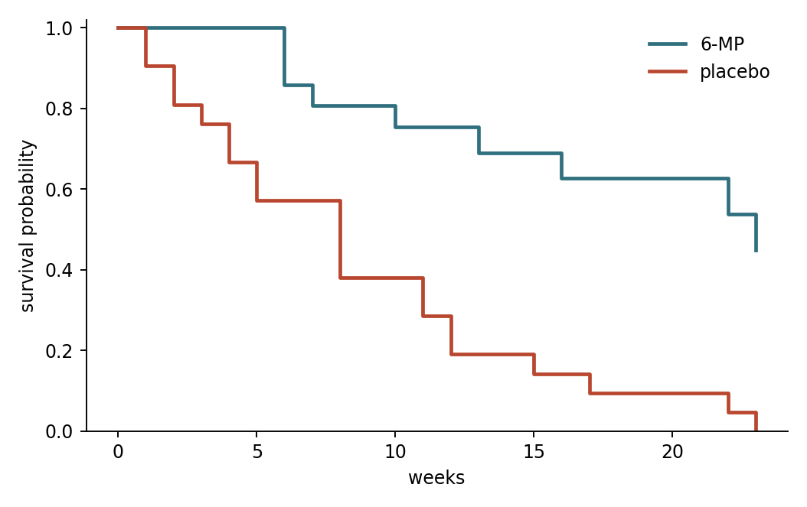
G · Survival analysis reproduces published results
KAPLAN-MEIER, LOG-RANK AND COX, CHECKED ON THE CLASSIC LEUKAEMIA TRIAL
kaplan_meier_curve
Survival curve, log(-log) interval and median survival.
logrank_test
Two-group comparison; warns when curves cross.
cox_regression
Hazard ratios with a proportional-hazards check.
OUR OUTPUT VS PUBLISHED
S(6 wks) 0.857 0.857
S(23 wks) 0.448 0.448
log-rank χ² 16.79 16.79
Cox coef 1.572 1.572
15

Slide 15
H · Causal and Bayesian estimation: 3 tools
EACH ESTIMATE STATES THE ASSUMPTION IT RESTS ON
TOOL
WHAT IT RETURNS
propensity_score_matching
Effect on the treated, with balance before and after matching
difference_in_differences
Policy effect with robust SEs and a pre-trend test
bayesian_estimate
Exact posteriors: proportions, means, partial pooling
16

Slide 16
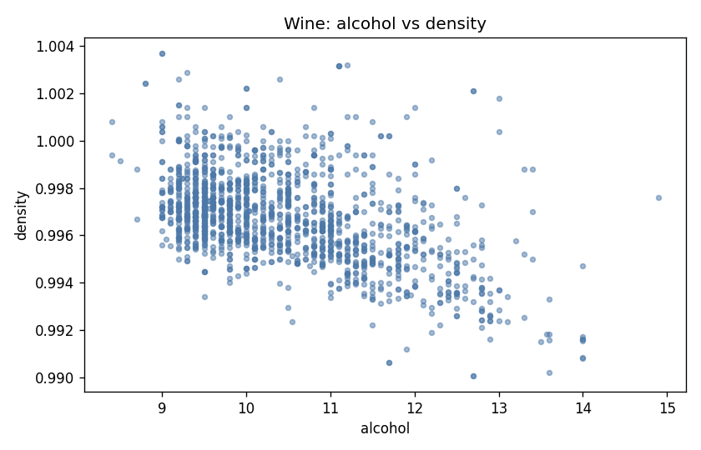
I · Visualization
recommend_chart
Rule-based on column roles, not a fixed grammar, so questions outside a chart language still get a chart.
render_chart
Histogram, bar, line, scatter, box and correlation heatmap; re-checks grounding at draw time.
explain_chart
States what the data shows, with every sentence backed by a computed number.
explain_chart output
alcohol and density show a moderate negative linear association (r = -0.50, n = 1599); correlation alone does not establish a causal link.
17

Slide 17
J · Interpretation
THE OTHER GAP THE BENCHMARK FOUND: NO SYSTEM SAYS WHAT A RESULT MEANS
interpret_result
critique_findings
Turns a statistic into a structured claim: effect-size bucket, statistical versus practical significance, and the caveats a result of that shape carries.
Keeps significance and size as separate fields, so one cannot be reported while implying the other.
Checks a result against its own assumptions before the claim is written, and ranks violations by severity.
EXAMPLE: t-test, n = 8, p = 0.03, one of 10 tests
HIGH
Sample size n=8 is small; estimates and p-values are unstable.
HIGH
p=0.03 is one of 10 tests; it does not survive Bonferroni correction (adjusted p=0.3).
MEDIUM
Normality is rejected (p=0.01) at modest n; consider a nonparametric alternative.
MEDIUM
Observational data: association is not causation; unmeasured confounders could explain the result.
18

Slide 18
PART 2
The skills

Slide 19
Seven skills to use the 52 tools
EACH SKILL SAYS WHEN TO USE A METHOD, WHAT TO CHECK, AND HOW TO INTERPRET IT
data-profiling
distribution-analysis
correlation-analysis
group-comparison
Load safely, schema, missing values, outliers
Shape, centre, spread, normality, intervals
Relationships, heatmaps, no causal overclaiming
Tests, effect sizes, power, survival curves
11 tools
12 tools
11 tools
17 tools
regression-analysis
time-series-analysis
visualization
Each skill = SKILL.md
+ generated tool reference
+ bundled tool library,
zipped for upload to
the Claude app
OLS, GLMs, Cox, matching, diff-in-diff
Trend, seasonality, stationarity, forecasts
Choose, draw and explain the chart
18 tools
10 tools
5 tools
20

Slide 20
Anatomy of a skill
WHAT IS UPLOADED, AND HOW CLAUDE USES IT
SKILL.md
group-comparison.zip
Name and description
Matched against the user's request to decide whether the skill applies
group-comparison/
SKILL.md
reference/tools.md (generated)
scripts/statkit/ (52 tools)
When to use / not to use
Scope, with pointers to the right skill for neighbouring questions
Procedure
Numbered steps, each naming the tool to call and what to read from its result
Assumptions and common errors
What must hold for the method, and the mistakes it must avoid
Interpretation and report format
How to state the result without overclaiming, and in what order
Worked example
Runnable code on a real dataset, tested on every build
21

Slide 21
Which tools each skill calls
EVERY SKILL USES THE GROUNDING AND INTERPRETATION TOOLS; THE REST FOLLOW THE QUESTION
A
B
C
D
E
F
G
H
I
J
Grounding
Loading
Descriptive
Testing
Regression
Time series
Survival
Causal / Bayes
Charts
Interpret
data-profiling
4
4
3
distribution-analysis
1
2
2
2
1
3
1
correlation-analysis
2
1
1
2
3
2
group-comparison
2
1
9
2
1
2
regression-analysis
2
4
7
1
2
2
time-series-analysis
1
2
3
3
1
visualization
1
1
3
Cells count the tools a skill documents from each catalog category. Every skill bundles the full library, so any tool is still available when a question needs it.
22

Slide 22
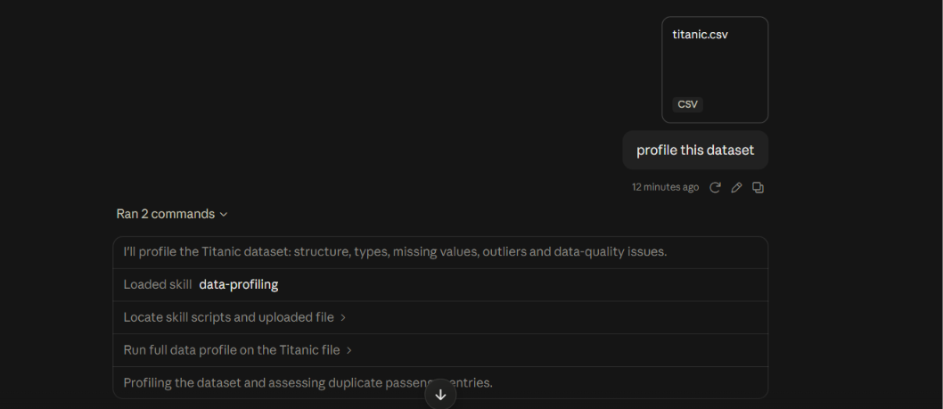
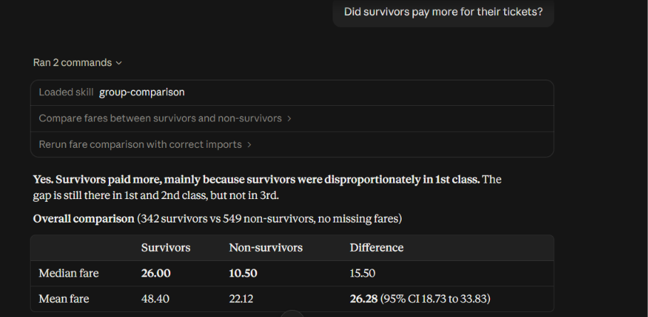
Answer: survivors paid £26.28 more on average (95% CI £18.73 to £33.83; n = 342 vs 549), a medium-sized difference. Fare tracks class, so this is an association, not an effect of paying more.
23

Slide 23
PART 3
Next steps

Slide 24
Next: measure what the skills add, then go multi-table
WHERE THE PROJECT GOES FROM HERE
1
Verify the results of all the different tools and skills using different scenarios
2
Build the harder benchmark
3
Extend to multiple tables
Reliable Data Analysis with LLM Agents · Skill library
27

Slide 25
Three benchmark failures, now caught before they matter
REAL OUTPUT FROM THE TOOLS
Unit error: 38.38 against ground truth 0.3838
relation = percent_vs_fraction
scale_factor = 100
ok = True (warns: state the unit)
verify_numeric_consistency(38.38, 0.3838)
Query on a table that does not exist
ok = False
unknown_tables = ['wine']
Known tables: ['wine_quality']
validate_grounding(..., code='SELECT * FROM wine', known_tables=['wine_quality'])
Wrong separator collapses 12 columns into 1
ok = False
warning: loaded 1 column, expected 12;
signature of a wrong delimiter
pd.read_csv(wine, sep=';') → profile_dataset(expected_columns=12)
Reliable Data Analysis with LLM Agents · Skill library
8

