Slide 1


Project proposal Meet-2
Nitya Innovations LLP
Problem Statement:- Driver’s driving pattern detector
Student Names | Contact information
Janhavi Adhau | janhavi.22010552@viit.ac.in / 9834449525
Deep Jadhav | deep.22010818@viit.ac.in / 8208124090
Rashi Waghmare | rashi.22010685@viit.ac.in / 9579031653
Industry Sponsored by:-Technology Nitya Innovations, LLP9769353315
Guided by – DR. Smita Bhagwat
BRACT’S, Vishwakarma Institute of Information Technology, Pune-48
(An Autonomous Institute affiliated to Savitribai Phule Pune University) (NBA and NAAC accredited, ISO 9001:2015 certified)

Slide 2
Introduction
Driver behaviors, driving styles or characteristics need to be recognized and predicted in order to design and develop intelligent and human-centered control systems in transportation
The aim of this study is to identify merge patterns of different drivers and characterize them based on age and gender
It is imperative to analyze the concepts of human driving behavior and pattern recognition methods as this study discusses possible driving behavior models based on merge positions.
The idea behind predicting driver behavior styles is to develop a driving model that takes into account basic driving actions such as lane keeping, lane changing and obstacle avoidance.

Slide 3
LITERATURE SURVEY
[1] N.Kapoor, et al., “Using mobile phone sensors to detect driving behavior”, Proceedings of the 3rd ACM Symposium on Computing for Development , 2013.
This application collects data from accelerometers, GPS and also record sounds with the help of microphone, and then data is combined and analyzed to detect rash driving patterns.
[2] Fazeen M. ,et al., “Safe Driving Using Mobile Phones”, IEEE Transactions on Intelligent Transportation Systems, 2012.
They have used the three-axis accelerometer of an Android-based smartphone to record and analyze various driver behaviors and external road conditions that could potentially be hazardous to the health of the driver. They have utilized x-axis and y- axis accelerometer
[3] Chigurupa S.,et al., “Integrated Computing System for measuring Driver Safety Index”, International Journal of Emerging Technology and Advanced Engineering,2012
They developed an android application which uses data from accelerometer sensor, GPS sensor and video recording is done with the help of camera to give rating to the driver. Whenever the accelerometer values exceed the safe limits it would be considered as an event.
[4] Johnson D.A.,et al., “Driving Style Recognition using a smartphone as a sensor platform” ,IEEE 14th International Conference on Intelligent Transportation system, 2011
They collect data from various sensors (accelerometer, gyroscope, magnetometer, GPS, video) and fused related data into a single classifier based on Dynamic Time Warping (DTW) algorithm. Their system is known as MIROAD: A Mobile-Sensor- Platform for Intelligent Recognition of Aggressive Driving, The system can provide audible feedback if a driver’s style becomes aggressive as well as the information leading up to an aggressive event

Slide 4
[5] “A survey of driving style analysis” by Leandro M. Villas, et al., Published in Expert Systems with Applications, 2016.
This comprehensive survey provides an overview of various techniques for driving style analysis, including data collection methods, feature extraction, and machine learning algorithms for pattern detection.
[6] “Driver behavior analysis in intelligent transportation systems” by Nauman Aslam, et al., Published in IEEE Transactions on Intelligent Transportation Systems, 2018.
This paper reviews the latest developments in driver behavior analysis, including studies on aggressive driving, drowsy driving, and distracted driving, with a focus on data sources and machine learning techniques.
[7] “A survey of smartphone-based sensing in vehicular environments” by Felipe Meneguzzi, et al., Published in Ad Hoc Networks, 2016.
While not solely focused on driving patterns, this survey covers smartphone-based sensors and data collection techniques that are often used in driving behavior analysis applications.
[8] “Machine learning-based driving behavior analysis for in-vehicle driver assistance” by Jingning Zhang, et al., Published in IEEE Transactions on Intelligent Transportation Systems, 2011.
This paper explores the use of machine learning algorithms to analyze driving behavior for in-vehicle driver assistance systems, focusing on features like lane deviation and velocity.

Slide 5
[9] "Driving Style Recognition Using Random Forests" by Kruize, et al. (2017)
This paper presents an approach to driving style recognition using random forests and discusses its effectiveness.
[10] "A Survey on Driving Style Analysis" by Montanari, et al. (2018)
This paper focuses on driving style analysis and discusses the various machine learning algorithms used for classifying driving styles.
[11] "A Review of Driving Style Recognition Systems" by Ayub, et al. (2018)
This review summarizes the state of the art in driving style recognition and discusses challenges and future directions.
[12] "Driver Behavior Profiling: An Investigation via Classification Algorithms and Evaluation Metrics" by Kezunovic, et al. (2019)
This study explores the use of classification algorithms for driver behavior profiling and evaluates their performance using various metrics.
[13] "Driver Behavior Analysis for Safety" by Gao, Shang, and Cao (2017)
This comprehensive survey provides an overview of various approaches to driver behavior analysis, including data sources, feature extraction, and modeling techniques.

Slide 6



Objective
It can analyze various inputs such as vehicle speed, acceleration, steering behavior, and other driving-related data to accurately detect and classify a driver's driving pattern.
This could include identifying aggressive driving, distracted driving, smooth driving and other driving behaviors.
By leveraging machine learning algorithms, the project aims to enhance driver safety, provide insights into driving behavior, and potentially contribute to the development of driver assistance systems or driver monitoring technologies.

Slide 7
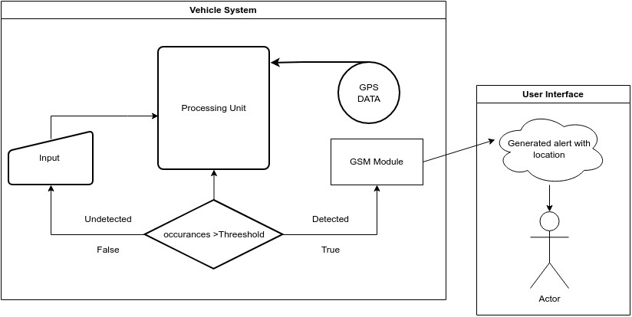
Work Flow Diagram

Slide 8
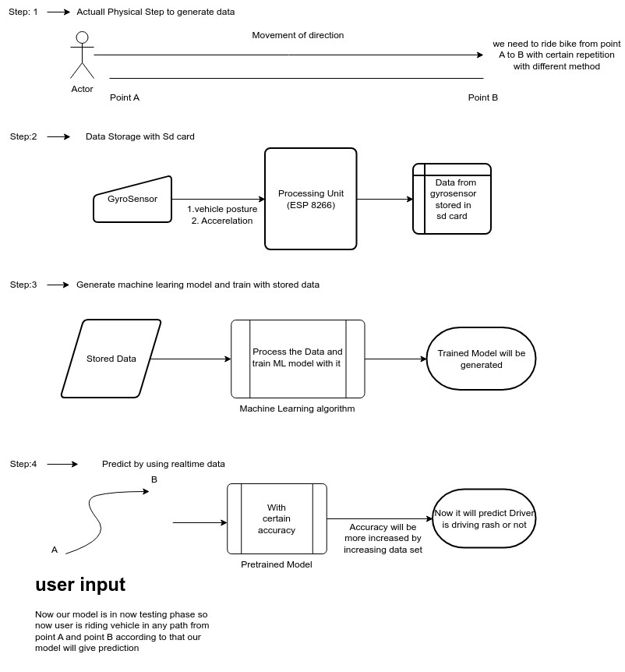

Slide 9
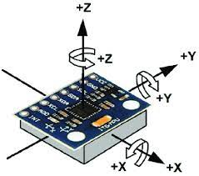
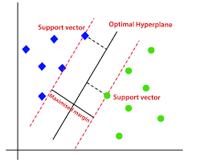
Algorithms
Analyzing axial movements with a speed –
Components required
ESP-8266
ADXL 345
GPS NEO-6M
SIM800L V2.0 5V Wireless GSM
Support Vector Machine (SVM)
Features
both classification and regression tasks.

Slide 10
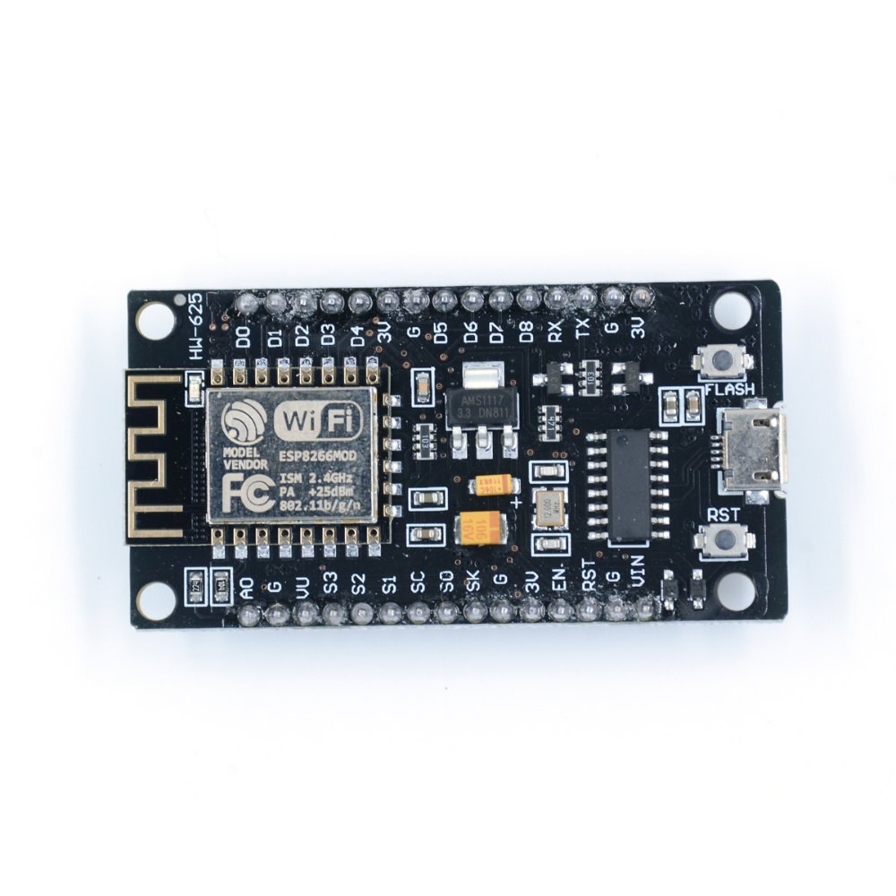
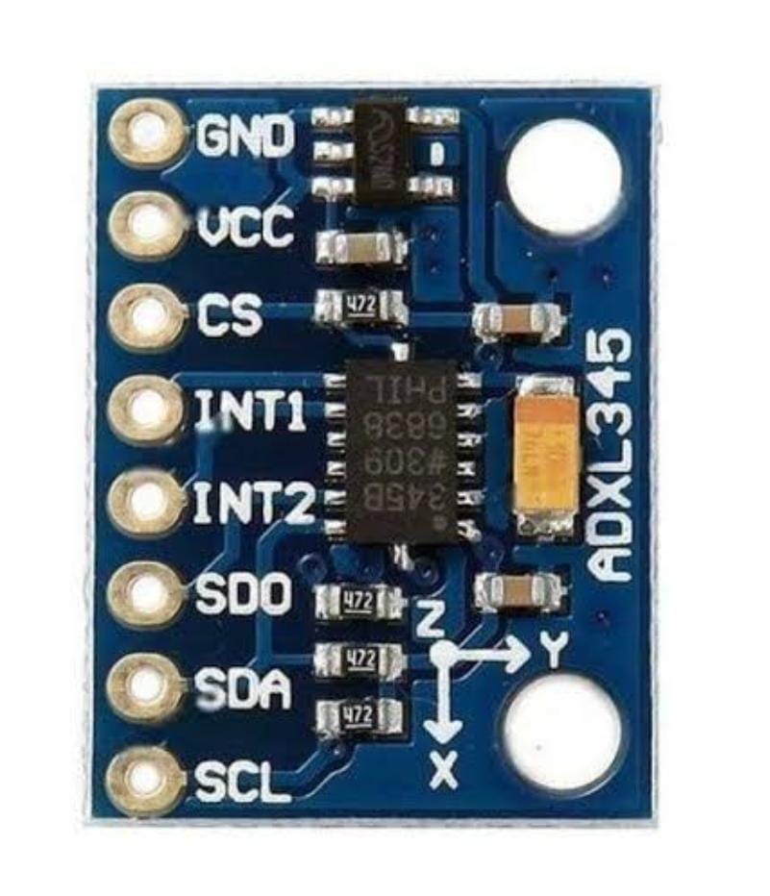
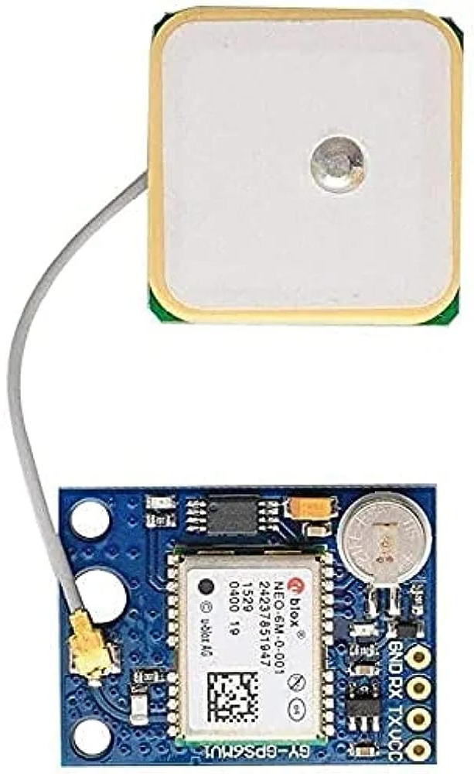
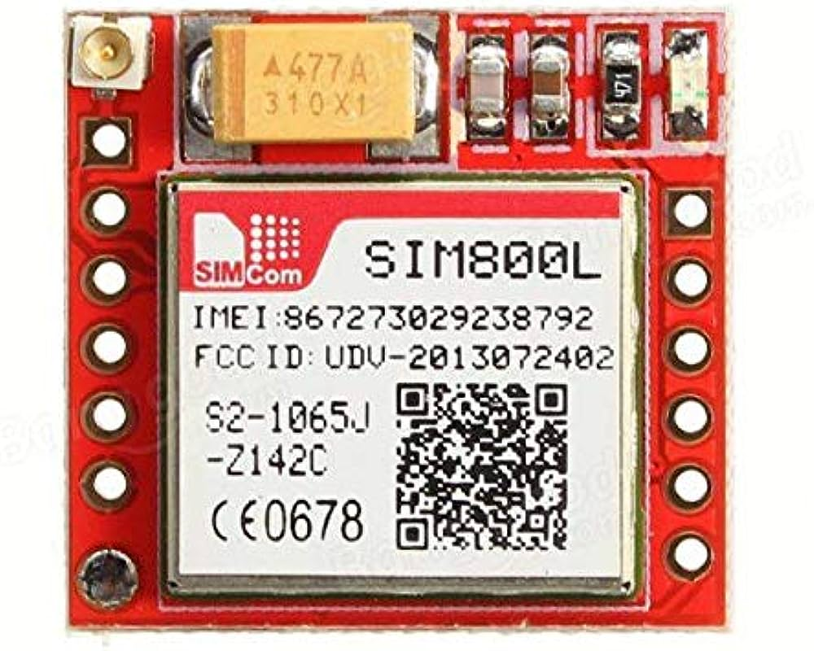
Hardware Used
ESP 8266
ADXL 345
GSM SIM800L
NEO 6M GPS

Slide 11
Software Requirement
1.Arduino
Programming of our project with the respective hardware is being done on the platform Arduino.
2.Cloud firebase
The created dataset is being computed on the cloud firebase.
3.Google Excel sheet
The data is being created and stored on the Google Exel sheet.

Slide 12
Execution of Project.
Initiation
Understanding the title of the project.
Initial research (sensor research) with project scope. (cost estimation)
Planning
Create a particular plan for the execution of the project.
Phase 1 dates – (1st sept to 3th sept) & Phase 2 dates – (7th sept to 29th sept)
Date – 25th Aug – 2nd Sept.
Required purchasing for the project and set goals.(Phase 1)
Execution of goals and determine the end results. (Phase 2)
Execution
Create tasks and assign them to team (programming, hardware connection/implementation, research and literature survey.)
Start work and Set timelines for the completion of tasks.
Initiate the creation of dataset(13th sept to 19th sept)
Reach the end goal of the project. ( Dates – 29th sept)
closure
Evaluate the results.
Check the quality of the product. ( Dates- 2nd oct)
Deliver them.
Execution of work to be done on basis of dataset created. Like using cloud and ML (17th sept to 24th sept)

