Slide 1

KOLHAPUR INSTITUTE OF TECHNOLOGY’S
COLLEGE OF ENGINEERING KOLHAPUR
(EMPOWERED AUTONOMOUS)
Department of Computer Science & Engineering
Algorithmic Study of Financial Market for Economic Development
Guide:
Mr. Sameer B. Patil
Project Group No: G46_
Name of Projectees
Mihir Patil – A77 Manas Sutar – A79
Yash Sawant –A76 Janhavi Patil- A86
Mrudula Satpute –A78

Slide 2
Contents
Introduction
Literature Survey
Objectives
Methodology with Block/Layout Diagram
Work plan
Progress Work Completed
Expected Result
References
Acknowledgement

Slide 3
Introduction
The Union Budget is one of the most important financial statements presented by the government, outlining revenue, expenditure, and policy priorities for the upcoming year.
Due to its complex structure, vast amounts of numerical and textual data, and wide-ranging implications for the economy, businesses, and citizens, analyzing it manually is time-consuming and challenging.
Leveraging Artificial Intelligence and Machine Learning (AIML) provides an opportunity to automatically extract insights, detect trends, and make predictive analyses from budget documents.
By applying AIML techniques, it becomes possible to understand the budget’s impact on sectors, forecast economic indicators, and support informed decision-making.
This project aims to harness AI for efficient, data-driven analysis of the Union Budget, transforming raw financial data into actionable insights.

Slide 4
Literature Survey
Sr. No. | Paper Title and Author | Details of Publication [Numer in Reference] | Findings
1 | Budget Document Summarization -Mihalcea & Tarau | Textrank, 2024 | Recent works use Transformer-based models (BERT, BART, T5) for abstractive summarization, enabling concise and human-like summaries of large policy texts such as budget speeches.
2 | Sentiment Analysis of Budget and Policy -Bo Pang and Lillian Lee | Proceedings of the 42nd Annual Meeting of the ACL, 2022 | Sentiment analysis has been extensively used in political science and economics to gauge public reactions. Deep learning models (LSTM, BERT) have shown higher accuracy in detecting fine-grained sentiments compared to classical models.
3 | Presents Union Budget -Nirmala Sitharaman | Hindustan Times 2024 Jul 23 | Provides Union Budget of 2024 and its live updates

Slide 5
Objectives
To extract meaningful insights from the Union Budget 2024 using machine learning techniques across four modules:
  Text Analytics (NLP)
  Sentiment Classification
  Numerical Forecasting
  Web Deployment
Analyze budget documents and public reactions
Forecast economic indicators
Present results via an interactive dashboard

Slide 6
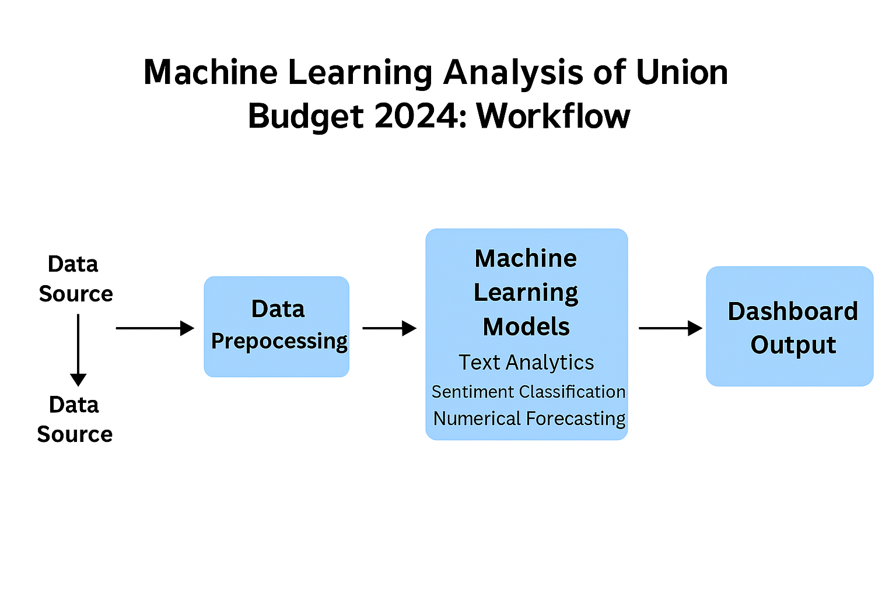
Methodology with Block/Layout Diagram

Slide 7
This AIML project on analyzing the Union Budget 2024 is organized into five interconnected modules, each addressing a specific aspect of data processing and insight generation.
1. Data Source & Preprocessing
Data Sources
For this project, data is collected from multiple reliable sources to capture both official budget information and public reactions:
Kaggle Datasets: Structured datasets containing past budget documents, sectoral allocations, and economic indicators.
News Articles & Tweets: Real-time public reactions, opinions, and commentaries related to the Union Budget.
Government Portals: Official budget speeches, reports, and notifications.

Slide 8
2. Text Analytics (NLP)
Purpose: Extract structured information from unstructured budget documents, speeches, and news articles.
Techniques: Natural Language Processing methods such as tokenization, named entity recognition, keyword extraction, and topic modeling.
Contribution: Converts textual data into analyzable formats, allowing the system to identify key policy areas, sector allocations, and emerging themes.

Slide 9
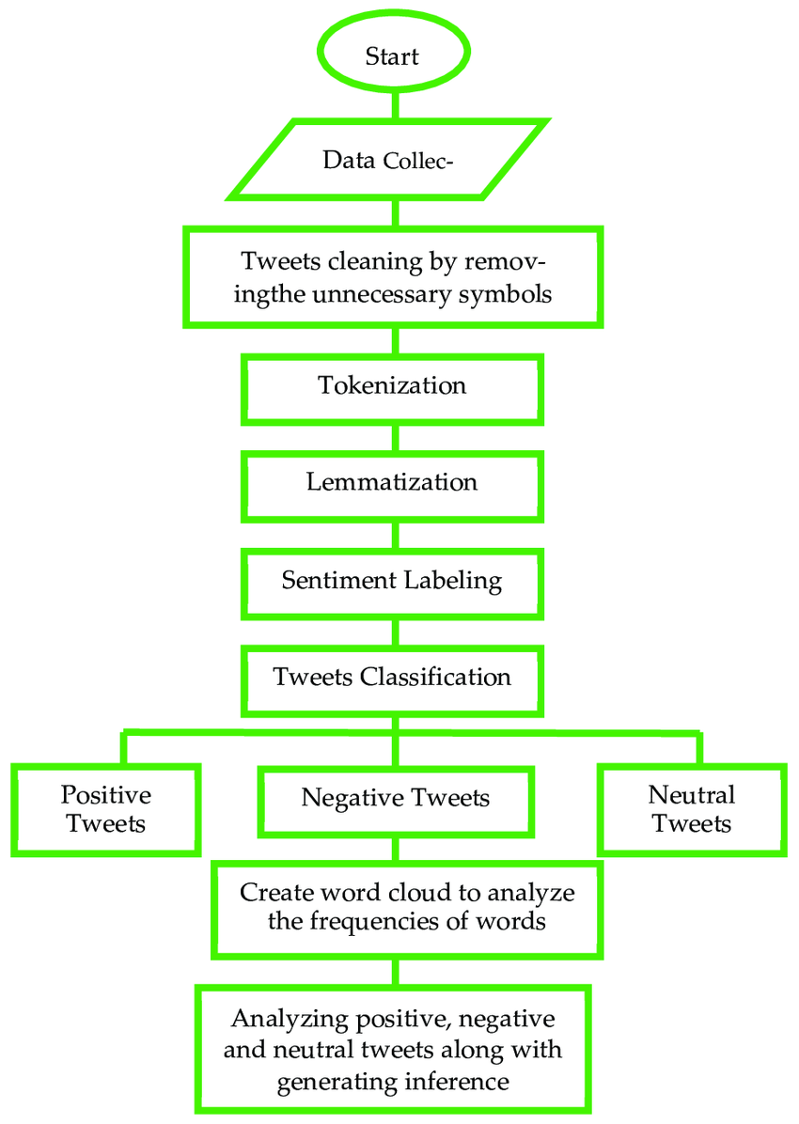

Slide 10
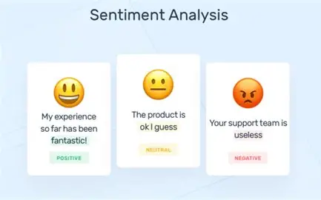
2. Sentiment Classification
Purpose: Analyze public reactions on social media, news, and opinion pieces to gauge sentiment toward budget announcements.
Techniques: Machine learning classifiers (e.g., Naive Bayes, SVM, or deep learning models) to label text as positive, negative, or neutral.
Contribution: Provides insight into public perception, investor sentiment, and social response, which complements numerical budget data.

Slide 11
3. Numerical Forecasting
Purpose: Predict economic indicators such as GDP growth, sectoral revenues, or fiscal deficits based on historical and current budget data.
Techniques: Regression models, time series analysis, or other predictive ML algorithms.
Contribution: Offers quantitative foresight, enabling policymakers, analysts, and businesses to make data-driven decisions.
4. Web Deployment
Purpose: Present the results through an interactive dashboard for easy exploration and decision-making.
Techniques: Web frameworks (e.g., Flask) with integrated charts, tables, and visualizations.
Contribution: Makes insights accessible to non-technical users and stakeholders, bridging the gap between AI analysis and actionable understanding.

Slide 12
Work – Plan
Months Activities | AUG’25 | SEP’25 | OCT’25 | NOV’25 | DEC’25 | JAN’26 | FEB’26 | MAR’26 | APR’26
Literature Reviews | √ | √
Component Identification & Selection |  | √
Data Collection and Processing |  | √ | √ | √
Text Analysis and Sentiment Classfication |  |  |  | √ | √
Numerical Forecasting |  |  |  |  | √ | √
Web Deployment |  |  |  |  | √ | √ | √
Thesis Writing |  |  |  |  |  | √ | √

Slide 13
Progress Work Completed
DATA COLLECTION & PREPROCESSING :
Collected data from multiple reliable sources to support budget analysis:
Government Portals : Official Union Budget 2024 speech, Budget documents (PDF / Excel).
Performed preprocessing steps to make data ready for ML/NLP:
Text Cleaning :
Removed unwanted characters, Lowercasing of all text.
Stopword removal (English + finance-specific words).
Removal of URLs, symbols, and punctuation.
Tokenization & Lemmatization :
Tokenized budget speeches and articles.
Applied lemmatization to reduce words to root form.

Slide 14
Progress Work Completed
Structured Dataset Preparation:
Converted PDF budget text into structured paragraphs.
Created CSV datasets for numerical forecasting.
Feature Extraction:
Generated TF-IDF vectors.
Extracted keywords for sector-wise classification
NLP MODULE :
Document Parsing & Text Extraction
Extracted text from PDF budget documents.
Parsed sections like allocations, policies, sector highlights.

Slide 15
Progress Work Completed
Named Entity Recognition (NER) :
Identified key entities such as: Sectors (Agriculture, Defense, Education, Health). Monetary values. Key policy names. Government ministries.
Topic Modeling :
Performed LDA-based topic modeling : Identified major policy areas in Budget 2024: Infrastructure. Tax reforms. Digital India. Green energy. Social welfare.
Keyword Extraction :
Used TF-IDF to extract high-priority keywords
Used for generating initial dashboard insights
Text Categorization :
Grouped budget data into meaningful categories: Sector allocations. Policy initiatives Investment areas

Slide 16
Expected Result
Automated system that analyzes budget documents using AI and ML
Sentimental model that captures real-world public to fiscal policies.
Forecasting engine that predicts economic trends based on past budgets.
Interactive dashboard that visualizes insights for users, policymakers and analysts.
Framework ready for extension into multi-year budget trend analysis and real-time data
streaming.

Slide 17
References
  Machine learning-based approaches for financial market prediction – A comprehensive review (ResearchGate).
  References 1. Budget 2024: FM prioritises affordable housing, Green growth, propels capex. LiveMint, September 7, 2024
  Decoding the digital blueprint: Analysing the upcoming Budget’s strategic investment in the digital economy, Financial Express. 2024 Jul 22.
  Education Budget 2024 Live Updates: Nirmala Sitharaman presents Union Budget 2024, Hindustan Times 2024 Jul 23

Slide 18
Acknowledgement
We would like to express my sincere gratitude to our project guide Mr. Sameer B. Patil for his valuable guidance and encouragement in selecting and introducing the project “Algorithmic Study of Financial Market”. His support and suggestions have been very helpful in understanding the fundamentals of this research area.
Thank you

