Slide 1
Robonox
Team IndiaPost

Slide 2
Our idea consists of two modules:
The first module would pick the packages from the truck and drop it in the specified basket.
The second module moves these baskets to the respective carts once they are full and returns these baskets to their station after dropping the packages into the carts.

Slide 3
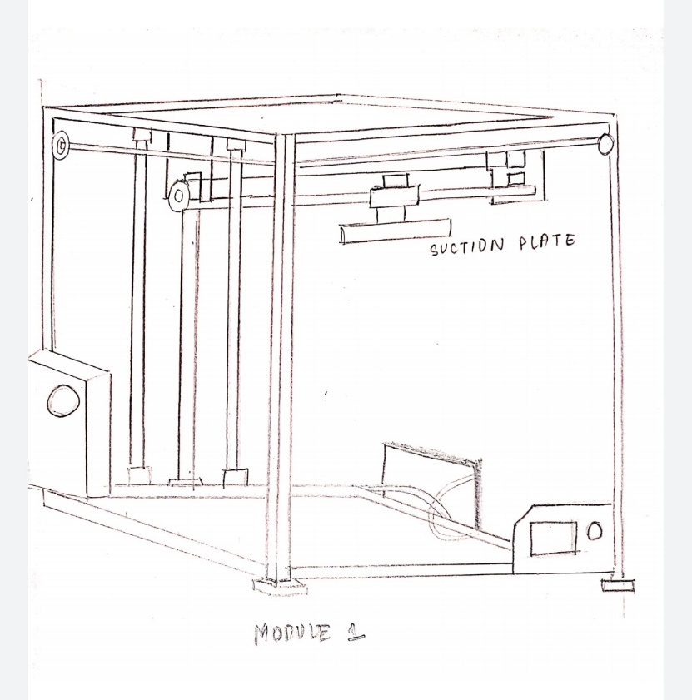
Process: UNLOADING
The first bot includes a robotic arm with suction pads detects and picks up packages and places it on a platform with barcode scanners.

Slide 4
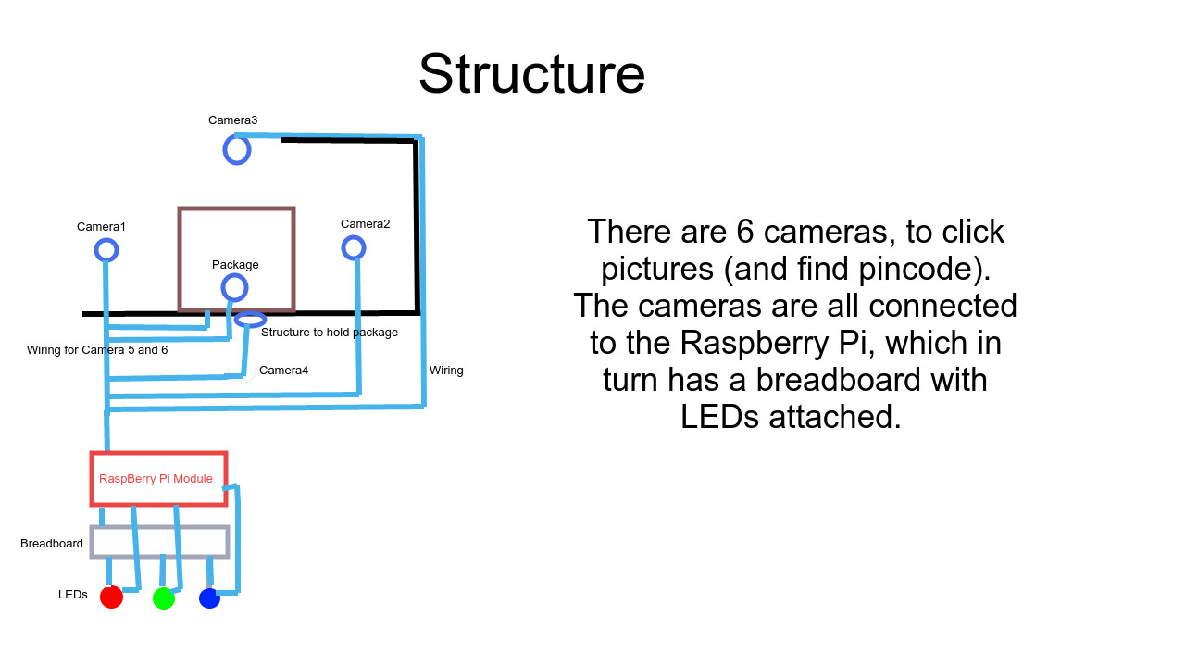
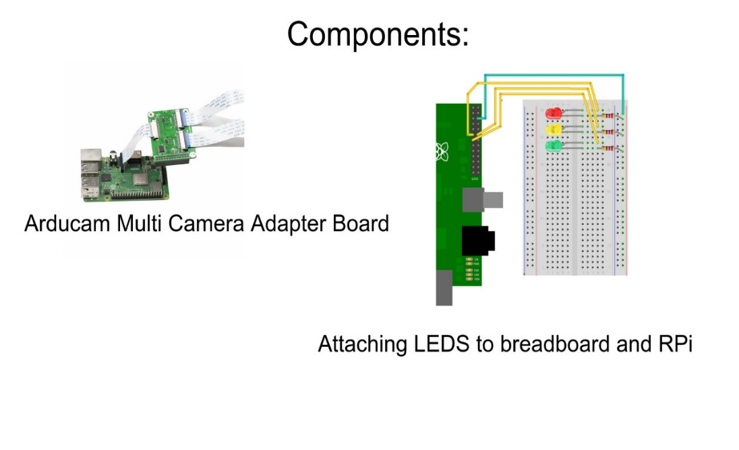
Process: scanning
The platform has 6 barcode scanners which would scan the package for its barcode. The bot would assign a colour to each package which denotes the basket in which it should be placed.

Slide 5
Process: separation
The robotic arm would then pick the package from the platform and drop it into the respective basket.

Slide 6
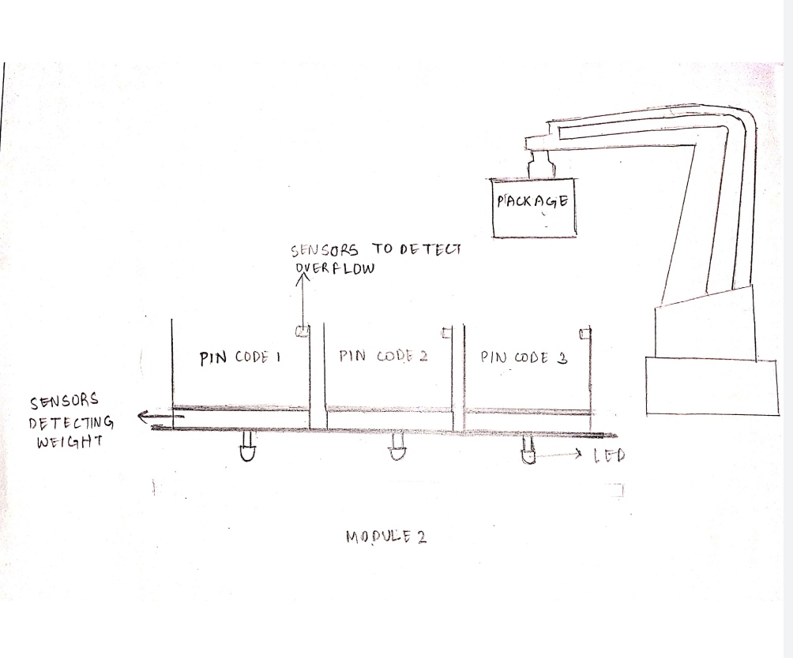
Process: Loading the baskets
Each basket is placed over a weighing plate and equipped with an IR sensor that would detect if the basket is full.
When either the specified weight limit or the basket capacity is reached, an LED placed near that basket would turn on.

Slide 7
Process: picking the baskets
The second bot, placed on a rotatable platform, includes IR sensors which would detect if the LEDs near the baskets are turned on. The bot would pick the filled basket and this basket would be replaced by another one and the process of separating the packages continues.
The rotatable platform would then rotate in the direction of the respective cart.

Slide 8
Process: delivering the baskets
The bot would move 50m straight in that set direction to reach the cart and unloads the basket.

Slide 9
Process: unloading the baskets

Slide 10
Process: returning the baskets
The bot would then move back to the platform and places the basket back at its station.

