Slide 1
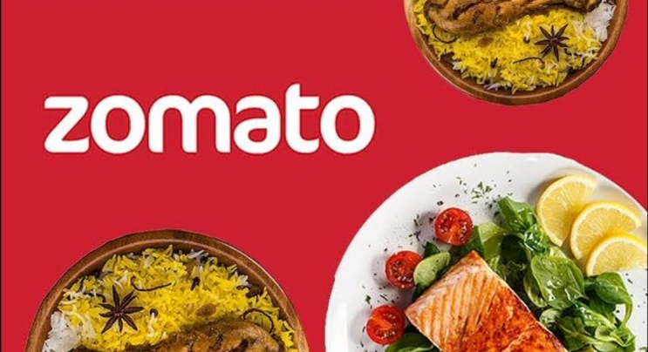
Zomato Data Analysis For Global Restaurant Expansion
-Janhavi Devare

Slide 2
Agenda
Introduction of zomato
Problem Statement
Data Overview
Methodology
Data Driven Insights
Interpretive Insights
Dashboard
Recommendations
Conclusion

Slide 3

Introduction of Zomato
Zomato is a leading restaurant discovery and food delivery platform that connects foodies with their favorite restaurants and cuisines. Founded in 2008, Zomato has grown to become one of the largest and most popular food tech companies in the world with :
- 100 million monthly users
- 1.5 million listed restaurants
- Presence in 24 countries
Zomato's mission is to 'ensure nobody has a bad meal' by providing users with personalized recommendations, honest reviews, and a seamless online ordering and delivery experience. With its user-friendly interface, robust search functionality, and trusted reviews, Zomato has become the go-to platform for food lovers everywhere."

Slide 4
Problem Statement
Objective:
To analyse the previous years sales performance of the zomato from the given dataset to give the suggestions for opening new restaurant in different countries for the expansion and future growth.
"Despite Zomato's vast user base and global presence, there exists a significant gap in the market for high-quality, Zomato-branded restaurants that offer a consistent and exceptional dining experience across different countries.Current challenges include:
1. Inconsistent dining experiences across locations
2. Limited brand visibility and recognition in new markets
3. Difficulty in maintaining quality control and standards across multiple locations
4. Inefficient use of Zomato's vast user data and insights for restaurant development

Slide 5

In today's competitive dining landscape, expanding restaurant operations into countries presents both exciting opportunities and complex challenges
To strategically navigate this expansion, we have meticulously analyzed data from various global markets to identify promising locations. Our approach focuses on targeting countries with lower competition and favorable conditions for new restaurant establishments.
By evaluating factors such as the number of existing restaurants, average customer ratings, dining expenditures etc. we have pinpointed key countries where Zomato can introduce new restaurants with a higher probability of success

Slide 6
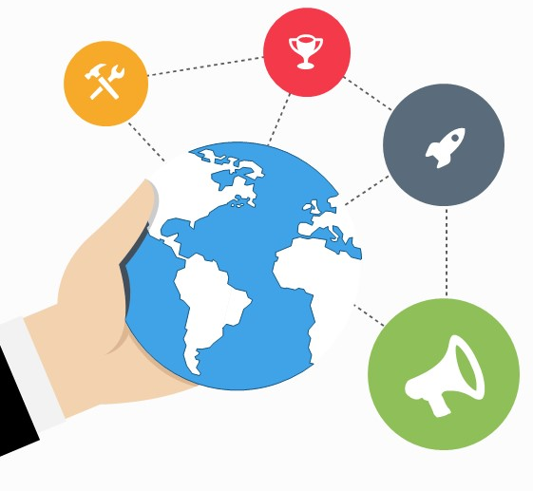
Data Overview
This project delves deep into Zomato’s vast global restaurant data, aiming to uncover key insights that can drive strategic decisions. By analyzing restaurant distribution, cuisine diversity, and pricing trends, we seek to identify potential areas for expansion and better understand the dynamics of the global food market.

Slide 7
Dataset Summary
Has_Online_delivery: Indicates whether the restaurant offers online delivery (Yes/No).
Is_delivering_now: Indicates whether the restaurant is currently delivering (Yes/No).
Switch_to_order_menu: Indicates whether users can switch to the order menu (Yes/No).
Price_range: A numeric value indicating the price range category of the restaurant.
Votes: The number of votes or ratings/(feedback) received by the restaurant.
Average_Cost_for_two: The average cost for two people dining at the restaurant.
Rating: The overall rating of the restaurant is based on user reviews.
Datekey_opening: The date when the restaurant was opened.
Restaurant ID: Unique identifier for each restaurant.
Restaurant Name: The name of the restaurant.
CountryCode: Country code of the location where the restaurant is situated.
City: The city where the restaurant is located.
Address: The specific address of the restaurant.
Locality: The locality or neighborhood where the restaurant is situated.
Locality Verbose: Detailed information about the locality.
Longitude: The geographical longitude coordinate of the restaurant.
Latitude: The geographical latitude coordinate of the restaurant.
Cuisines: The type of cuisine offered by the restaurant.

Slide 8
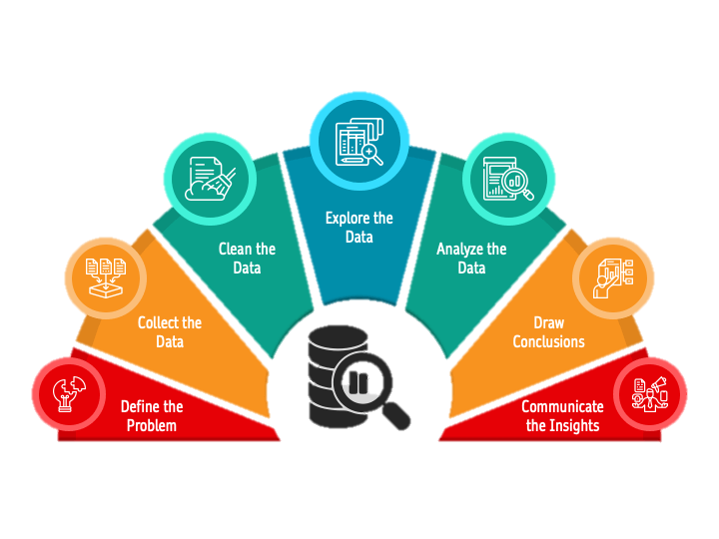
Methodology
Missing value treatment:- Using power query editor, pivot table, XLOOKUP functions, MAX function.
Data Enrichment:- Enhanced the data set with additional variables using VLOOKUP, MID, SEARCH, CONCAT, and connecting tables to cross reference with original data source.
Descriptive Analysis:- Employed Pivot tables for summarizing key metrices, conditional aggregation functions and normal excel functions (count, if, etc.) for analyzing objective questions.
Trend Analysis:- Cuisine Trends- Analyzed popular cuisines in different markets to uncover emerging food trends.
Executive Segmentations:- Applied year and country wise filters to analyse the various outcomes of ratings, prices etc. for different countries at a different timeline.
Data Visualization:- Created dynamic charts and Dashboard for data representation, enabling interactive data exploration.

Slide 9
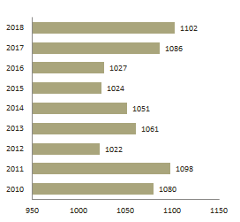
Data-Driven Insights :
In our dataset, we began by identifying the foundational elements. There are two primary tables: "Raw Data" and "Country Description." To dive deeper into the data, we focused on understanding its structure. We identified that there are 11 categorical columns in the "Raw Data," which categorize various aspects such as cuisine types and delivery options.
Cleaning the data was a crucial step. However, we encountered 9 missing values, predominantly in the "cuisines" column. We addressed this by filling the gaps with "North Indian," ensuring that our dataset remained complete and accurate for analysis.
No. of restaurant open each year

Slide 10
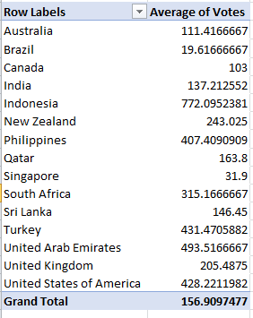
Next, we enriched our dataset by adding country names using the VLOOKUP function. This allowed us to integrate country information from the "Country Description" table into the "Raw Data”.
Focusing on specific regions, we found that India alone houses 388 restaurants in the highest price range (4). This was determined through targeted filtering based on price and location.
We also examined the average rating for restaurants with a price range below 4 that offer online delivery using a IF functions and logical operators which is 2.89126
Average number of voters for restaurants in each country. This analysis provided insight into customer interaction levels across different regions

Slide 11
Interpretive Insights
To identify optimal locations for new restaurant openings, we evaluated countries with lower competition and favorable conditions. Our analysis pinpointed Canada, Qatar, Singapore, Sri Lanka, and Indonesia as promising markets. These countries offer moderate competition, high customer satisfaction, and manageable expenditure levels.
Within these countries, specific cities and states stand out as prime candidates for new restaurants. For example, in Canada, Vineland Station and Chatham-Kent are notable, while Doha in Qatar and Bandung in Indonesia are also promising.

Slide 12

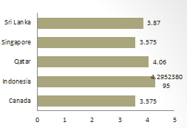
Examining the current restaurant ratings in these countries reveals varied levels of customer satisfaction. Qatar(4.06) and Indonesia(4.29) show particularly high ratings, suggesting that customers in these regions are highly satisfied. In contrast, Canada(3.5), Singapore(3.5), and Sri Lanka(3.8) have moderate ratings, indicating room for improvement and opportunities for new entrants to enhance the dining experience.

Slide 13
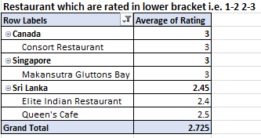
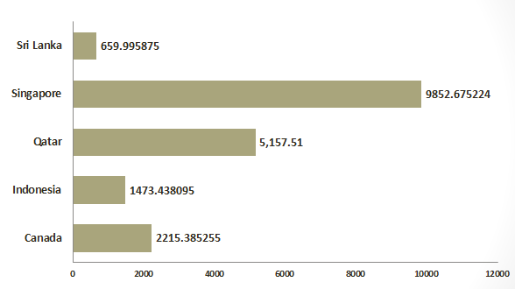
The analysis of food expenditure in these countries helps manage financial expectations. Singapore and Qatar have high dining costs, suggesting a focus on premium offerings, while Indonesia, Sri Lanka, and Canada are better suited for mid-range or budget-friendly options.
These low ratings indicate that certain restaurants in these regions struggle to meet customer expectations, which could be due to a variety of factors such as menu options, service, or price-value perception.
Average expenditure per country

Slide 14
Identifying key competitors in these markets revealed restaurants with high ratings and significant voter numbers, such as Lake House Restaurant in Canada and Talaga Sampireun in Indonesia. Understanding their success strategies can help Zomato differentiate its offerings and enhance market entry strategies.
Country | Restaurant Name | Average of Rating | Sum of Votes
Canada | Lake House Restaurant | 4.3 | 204
Indonesia | Talaga Sampireun Toodz House Lemongrass Skye | 4.9 4.6 4 4.1 | 5514 1476 1498 1159
Singapore | Fratini La Trattoria Cut By Wolfgana Puck | 4.1 4 | 35 33
Sri Lanka | Ministry of Crab Arabian Knights The Commons The Sizzle | 4.9 4.2 4 4.2 | 203 158 209 286
Quatar | Mainland China Restaurant Zaffran Dining Experinece Gokul Gujrati Restaurant Zaoq | 4.9 4.6 4.3 4.2 | 182 348 211 189

Slide 15
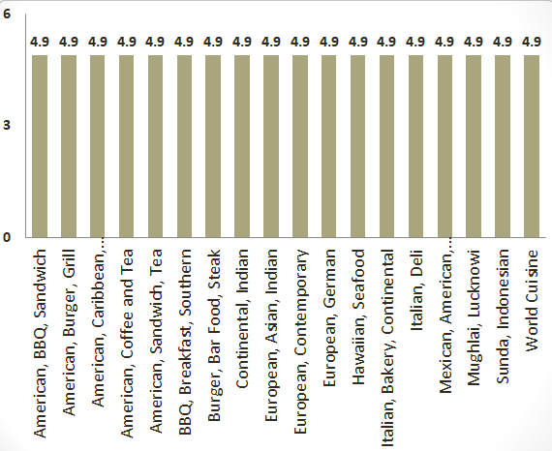
From cuisines analysis, we get top-rated cuisines like American, European, Italian, Mexican and BBQ which consistently receive high ratings across regions. By offering a mix of popular and locally preferred dishes, Zomato can enhance customer satisfaction, boost ratings, and build strong brand loyalty in new markets.
Top 10 Cuisines

Slide 16
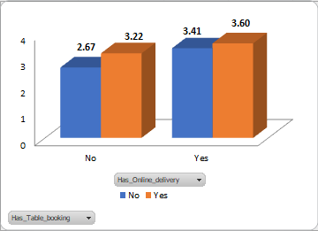
Regarding service features, restaurants offering online delivery and table booking tend to have higher ratings. This suggests that these services enhance customer satisfaction and should be emphasized in new restaurant offerings.

Slide 17
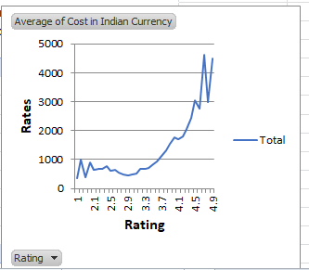
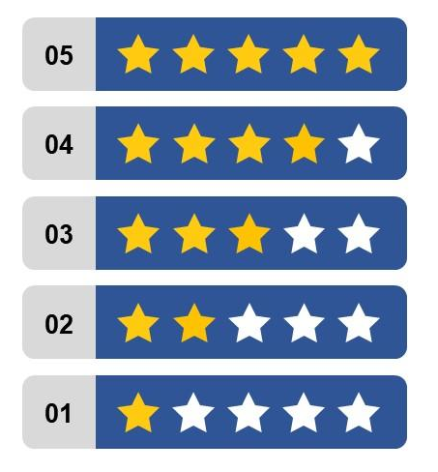
Finally, the relationship between cuisine pricing and ratings was explored, showing that higher prices are often associated with higher ratings. This suggests that maintaining or slightly increasing prices, if justified by quality, can positively impact feedback.

Slide 18
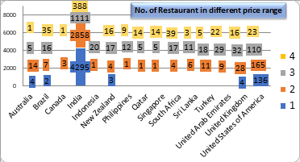
In terms of price range distribution, India dominates in the low-price segment, while other countries show a mix of mid-range and high-end dining options. Introducing mid to high-priced restaurants in markets with fewer such options could help capture new segments and cater to a broader audience.

Slide 19
Recommendation/ Suggestions :
1. Cuisine:
- Offer a unique fusion of local and international flavors.
- Cater to vegan, gluten-free, and other dietary preferences.
2. Menu Engineering:
- Optimize menu items, pricing, and portion sizes based on Zomato data.
- Offer signature dishes and limited-time offers to drive sales.
3. Marketing Strategies:
- Leverage social media, influencer partnerships, and loyalty programs.
- Offer online ordering, delivery, and takeaway options.
4. Location-Specific:
- Adapt restaurant concepts to suit local tastes, preferences, and regulations.

Slide 20
Conclusion :
Zomato new restaurant data analysis reveals a promising market with growing demand for online food ordering delivery. However, increasing competition and high density of restaurants in urban areas require strategic planning, menu engineering, and customers engagement for success. To stay ahead, zomato should focus on delivering exceptional customer experiences, continuously optimize operations, and develop a unique velur proposition. By doing so, zomato can capitalize on market opportunities and establish a strong presence in the competitive food delivery.
Based on the analysis, Zomato should consider expanding into countries like Canada, Qatar, Singapore, Sri Lanka, and Indonesia. These markets offer a favorable combination of lower competition, high customer satisfaction, and moderate costs, making them ideal for new restaurant openings. Additionally, popular cuisines like Brazilian, Indian, and American fare are well-received in these regions, offering a diverse range of opportunities. To enhance customer satisfaction and drive positive feedback, Zomato should consider offering both online delivery and table booking options, which have been shown to positively impact restaurant ratings. Finally, a focus on balancing price with perceived value will be crucial in optimizing customer satisfaction and maximizing market entry success.

Slide 21
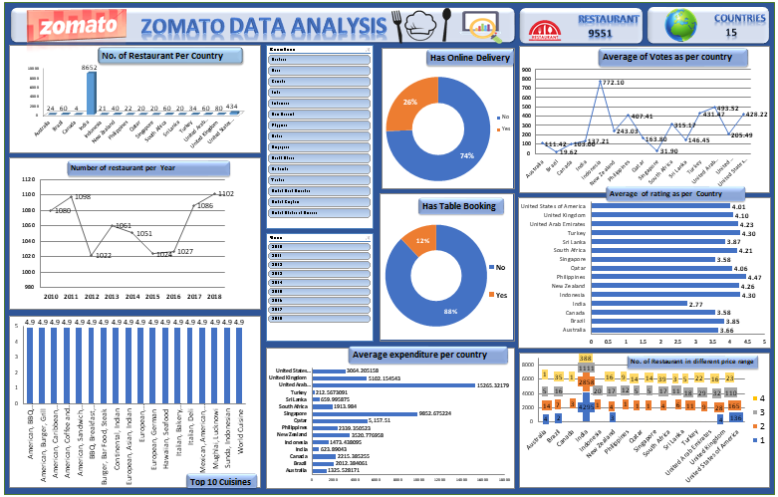
Dashboard :

Slide 22
Thank You

