Slide 1
Cyclone sensor analysis
and a documentation assistant
3.6 years of 5-minute process data, and a RAG system over 11 cyclone manuals, built entirely on open-source models
Janhavi Bhattad · ExactSpace data science take-home
Notes:
Two parts: Task 1 is analysis of the cyclone sensor export; Task 2 is a question-answering system over the cyclone PDFs. Everything runs locally and is reproducible with uv sync.

Slide 2
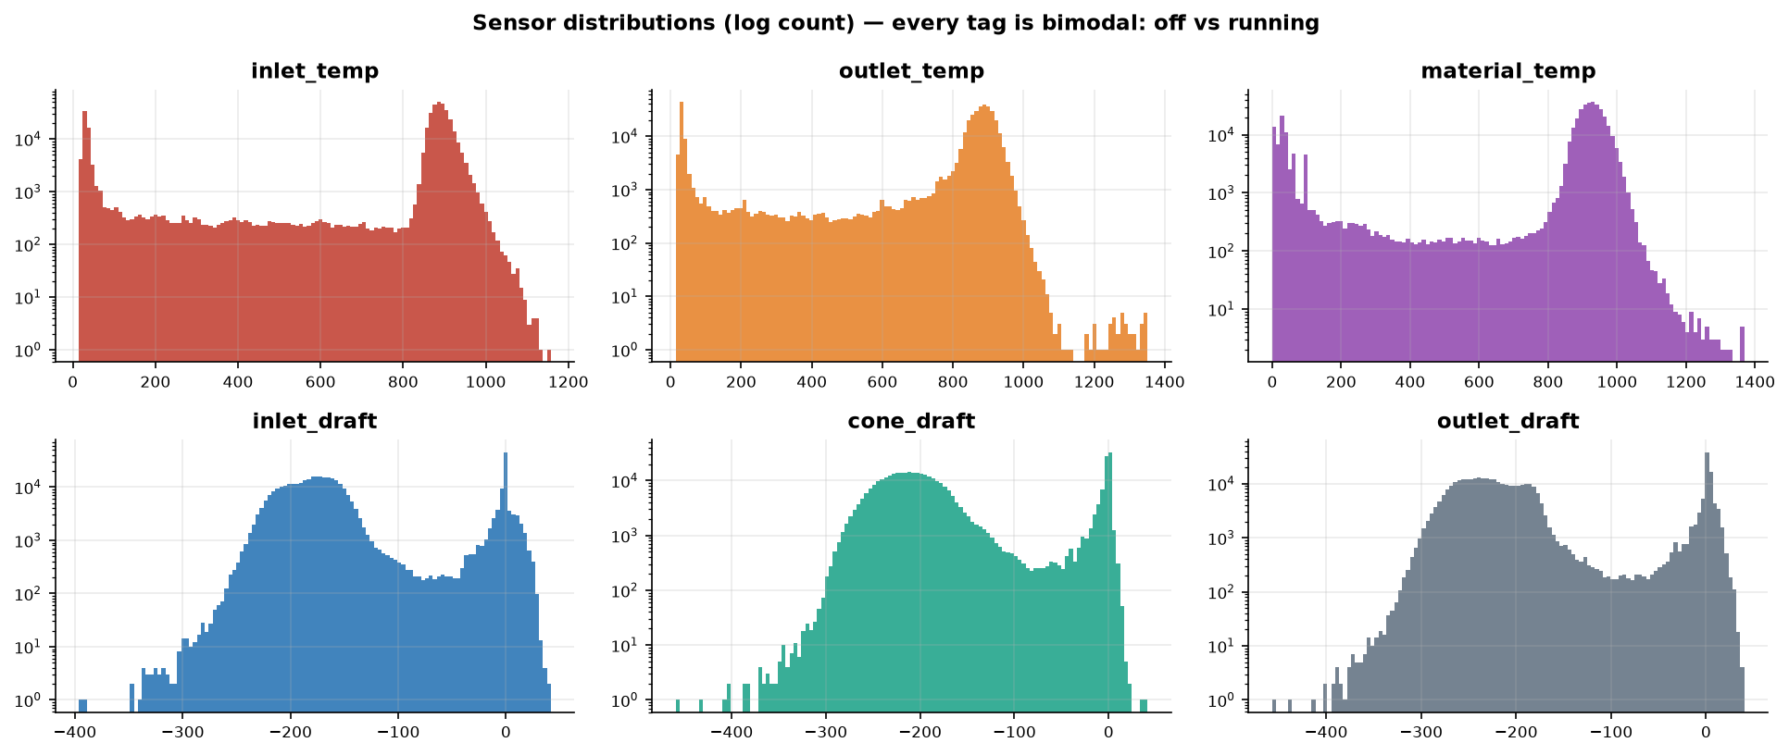
TASK 1 · DATA PREPARATION
Remove only what can't be real; keep the outliers for the anomaly step
377,719
rows, 6 tags, 2017-01 → 2020-08
~1,320
PI status codes per tag (I/O Timeout, Comm Fail …) → NaN
≤ 30 min
longest gap interpolated; 3 one-day holes left empty
Rules, not statistics: range caps (1375 °C), positive draft spikes, near-ambient dropouts while the gas is hot, stale values.
Inlet gas temperature is cleanly bimodal (off vs running). That shape is what the shutdown threshold is derived from. The material temperature transmitter is the weakest tag: nearly all 'Unit Down' codes, 1,146 dropouts and 2–4× the stale samples of the others.
Notes:
Why no outlier clipping: step 4 is anomaly detection, so clipping statistical outliers here would delete exactly the events we need to find. Only physically impossible readings are removed, and every rule is counted per sensor in data_quality.csv.

Slide 3
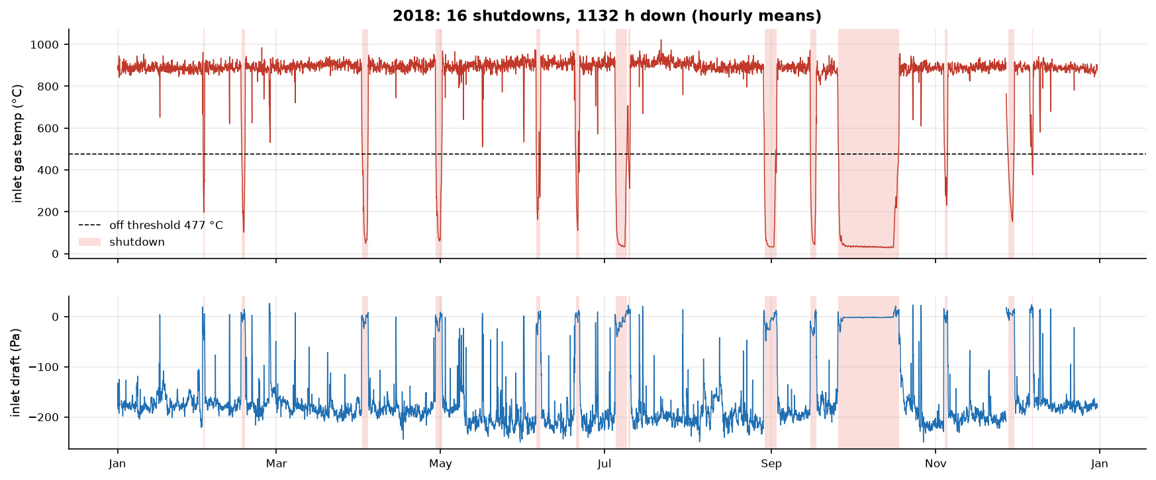
TASK 1 · SHUTDOWNS
39 shutdowns and 6,286 h of downtime: one in every five hours
19.9 %
of the record is shut down
26 + 13
short stops (< 2.5 d) and long outages (4–42 d)
< 2 %
change in downtime when the threshold moves ±50 °C
Method: Otsu threshold on inlet gas temperature (477 °C, from the data), +100 °C hysteresis, restarts under 1 h merged, stops under 30 min dropped.
Pattern: a 3–6 week stop every late September 2017–2019; 23 Mar – 1 May 2020 matches the COVID-19 lockdown.
Notes:
The threshold is not a guess: Otsu picks the valley between the two modes. Hysteresis stops ramps from flickering on and off. The sensitivity check is the evidence the result does not depend on the exact number.

Slide 4
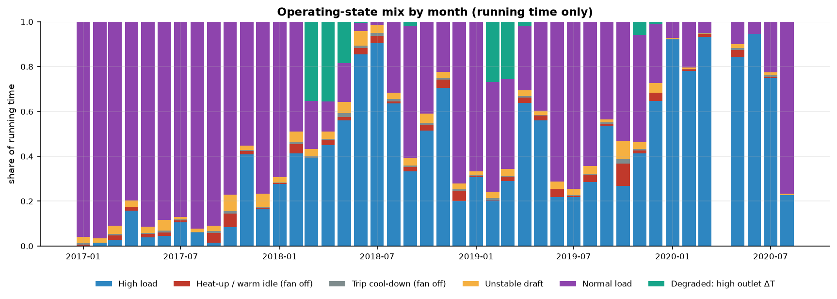
TASK 1 · OPERATING STATES
Six states with distinct physical signatures, not just statistical clusters
High / Normal load: the two steady bands; load shifts between them over months.
Unstable draft: draft swinging while temperature holds.
Degraded: outlet thermocouple drift, 4 % of running time.
Trip cool-down, Heat-up: fan off; transitions around trips and restarts.
Features: the six tags plus across-cyclone ΔT and Δdraft (heat transfer and pressure drop), 1-h rolling std, 30-min deltas → RobustScaler → PCA (95 %).
Why KMeans, k = 6: running data is a continuum, so HDBSCAN labels 100 % as noise; silhouette's k = 3 is one 96 % blob. k = 6 gives bands an operator can name.
Smoothing: rolling mode plus absorbing runs under 30 min, so states are episodes rather than sample-by-sample noise.
Notes:
Names come from cluster medians plus physics, e.g. fan-off states have draft near 0 Pa. clusters_summary.csv has mean, std and percentiles of every variable per state and episode-duration stats.

Slide 5
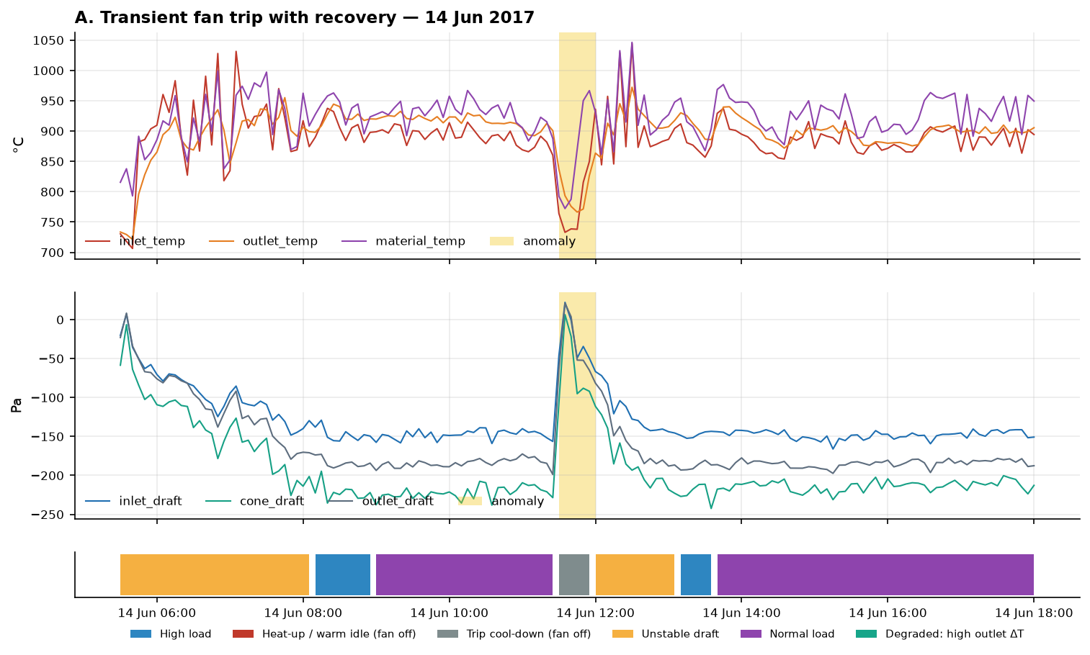
TASK 1 · CONTEXTUAL ANOMALIES AND ROOT CAUSE
ID-fan trips are the dominant incident and the usual start of a shutdown
123
23 / 39
recovered fan trips, one per 8.4 running days
shutdowns follow an extended trip within 12 h
Detector: Isolation Forest per state, so 'unusual' is judged against that state's own normal; flagged at the pooled 99.5th percentile (180 events).
Explanation: robust z-scores per state name the variables that moved and in which direction.
Blind spot fixed: frequent fan trips formed their own cluster and looked normal, so a draft-collapse rule adds 123 transient + 62 extended trips.
This case: all three drafts jump to ~0 Pa in one sample, then inlet temperature falls ~130 °C. Draft first means the fan, not the process. Confirm with fan current and interlock logs.
Notes:
Every root cause is stated as a hypothesis with the evidence that would confirm it. Five cases are worked in the notebook: fan trips (transient and extended), draft upset, and the 2019 thermocouple drift.

Slide 6
TASK 1 · 1-HOUR FORECAST OF INLET GAS TEMPERATURE
Gradient boosting wins, but the real story is steady vs disturbed operation
−21 %
−25 %
RMSE vs persistence, steady
RMSE vs persistence, disturbed
Setup: train 2017–2019, test Jan–Aug 2020 (includes the lockdown stop), a new forecast every hour, 5-min steps to 60 min ahead.
Models: persistence (the bar to beat), ARIMA re-filtered at every origin, and one gradient-boosting model per horizon on lags, rolling stats and the other tags.
Why split by regime: 4.5 % of windows are disturbed yet carry ~35 % of the error. A single average mostly measures how much of the test set was shut down.
MAE agrees: steady 12.7 / 10.2 / 10.0 °C, disturbed 38.7 / 35.3 / 27.9 °C (persistence / ARIMA / boosting).
Notes:
ARIMA nearly matches boosting when the process is steady; it falls behind exactly where the process changes, because it cannot use the other sensors. Only 12 test origins span a stop or restart, too few to rank models on transitions, which is stated as a limitation.

Slide 7
TASK 1 · INSIGHTS
Four findings, each with an action
1
2
3
4
Fan trips start most stops
Some 'process' is instrument
Restarts are the risky hours
Forecasts need the right yardstick
Alarm when inlet draft is above −60 Pa while inlet gas is above 600 °C for two samples. It fires hours before temperature shows the stop.
Outlet thermocouple drifts for weeks and reads hotter than the inlet in mid-2019. Monitor daily inlet−outlet ΔT; calibrate at planned stops.
136 anomalies per 1,000 h in the 2 h after a restart vs 6.9 elsewhere; only 1 of 180 precedes a shutdown. Watch restarts closely.
Report error per regime. Steady error is ~14 °C; transitions need extra signals (fan current, feed rate, damper position).
Highest-value next step: pull ID-fan motor current, vibration and interlock logs for the 185 trip timestamps in anomalous_periods.csv. One root cause behind most of them would remove the main source of downtime.
Notes:
Each number is computed in section 6 of the notebook. The single highest-value next step: pull fan motor current and interlock logs for the 185 trip timestamps.

Slide 8
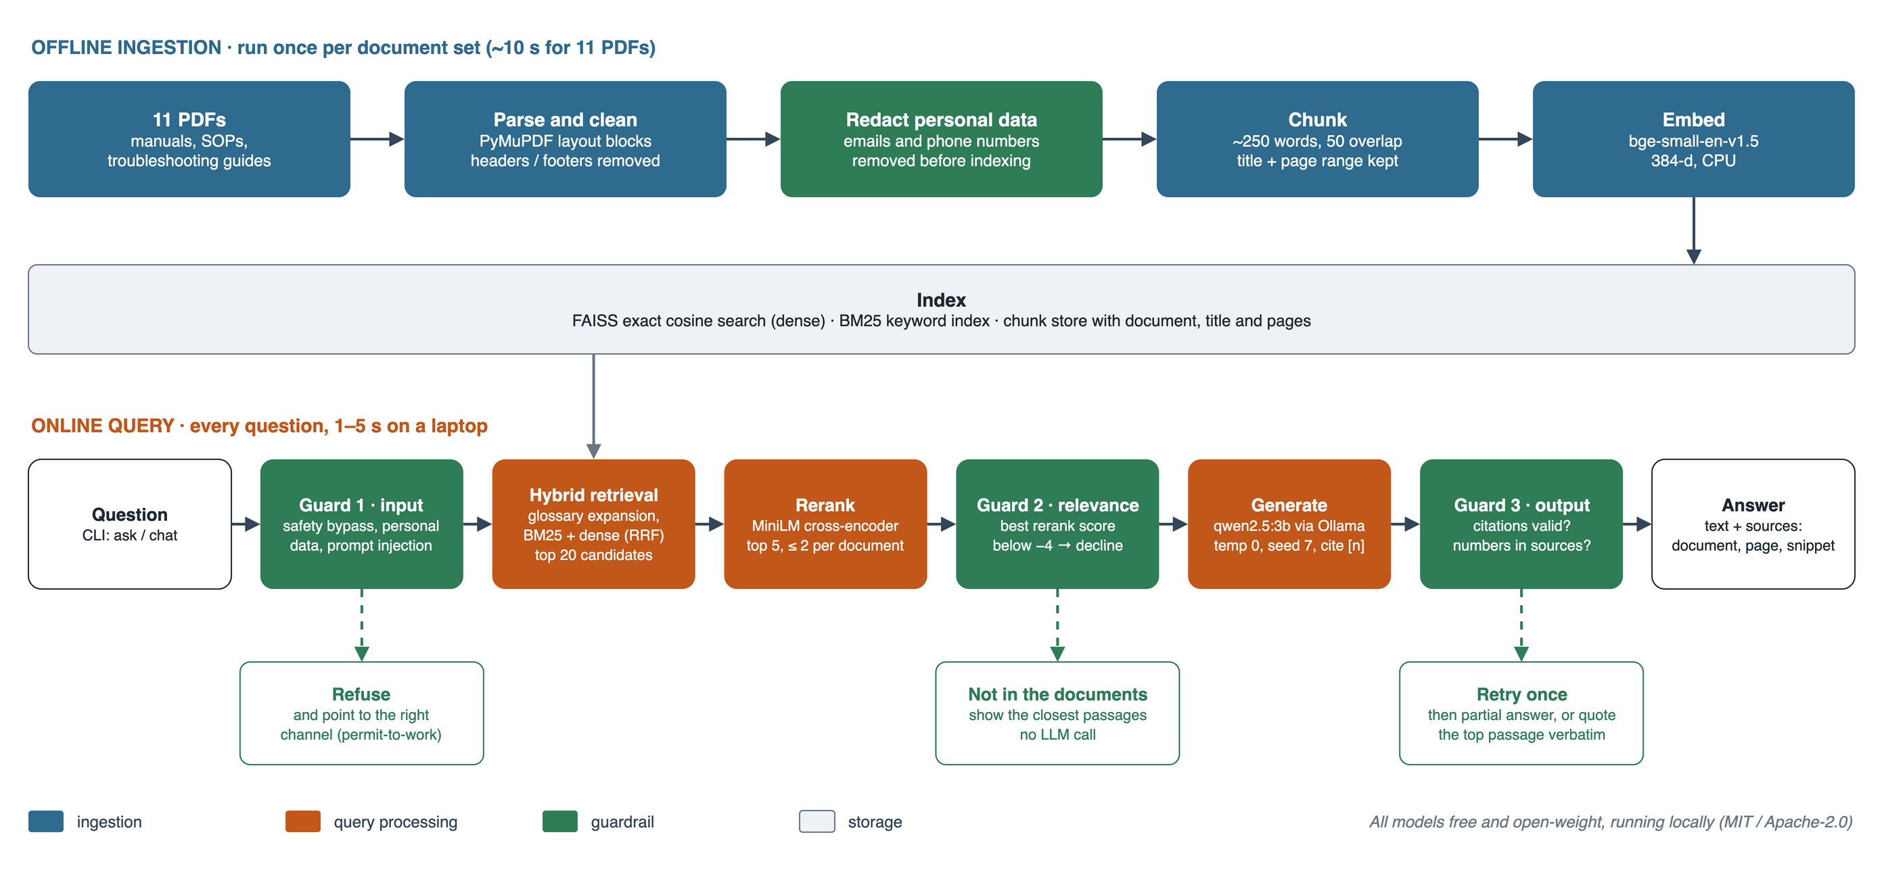
TASK 2 · RAG ARCHITECTURE
Hybrid retrieval, a reranker, and three guardrails around a local 3B model
Source: Task2/architecture/architecture_diagram.drawio (editable in draw.io). Production and scaling view: Task2/architecture_diagram.pptx.
Notes:
Ingest: PyMuPDF layout blocks, headers and footers stripped, phone numbers and emails redacted before indexing, ~250-word chunks that keep the document title and page range. Retrieve: BM25 catches exact terms like part names, bge-small embeddings catch paraphrases; Reciprocal Rank Fusion merges them and a MiniLM cross-encoder picks the top 5, at most 2 per document. Generate: qwen2.5:3b in Ollama at temperature 0, answering only from numbered sources. Three guardrails: the input check refuses safety bypass, personal data and prompt injection; the relevance gate says 'not in the documents' without calling the LLM; the output check verifies every citation and number, retries once, then falls back to a partial answer or the top passage. All models are open-weight and free: bge-small (MIT), MiniLM and qwen2.5 (Apache-2.0).

Slide 9
TASK 2 · EVALUATION AND SCALING
All 28 answerable questions cite a correct page; unsafe asks refused
28 / 28
4 / 4
5 / 5
answers cite a correct page
off-topic questions declined
unsafe asks refused, no false refusals
End to end: 37 questions, a median of 1–5 s per answer on a laptop; a fixed seed keeps outcomes and citations the same from run to run.
No hallucinated answers: every sentence must cite a source; the code checks each citation and every number against the cited text, retries once, then quotes the passage instead.
Monitor: recall@5 on the golden set, citation-check failure rate, not-found rate, p95 latency, user feedback.
Scale: 10× docs: incremental ingest by file hash, HNSW index. 100+ users: stateless API, vLLM with batching, cached embeddings.
Notes:
The one partial answer is the brief's own example, What does a sudden draft drop indicate: the documents never say what a draft drop means, so the system says so and reports what they do say about pressure differential and airflow. The reranker is what turns recall into MRR 1.0: the right page is always ranked first. Known limitation: one answer blends two manuals' cyclone types; catching that needs a semantic or NLI faithfulness check, which is the next improvement.

