Slide 1
FINAL PROJECT The Impact of Exercise and Cholesterol on Systolic Blood Pressure.
JANI SHARIFF SHAIK

Slide 2
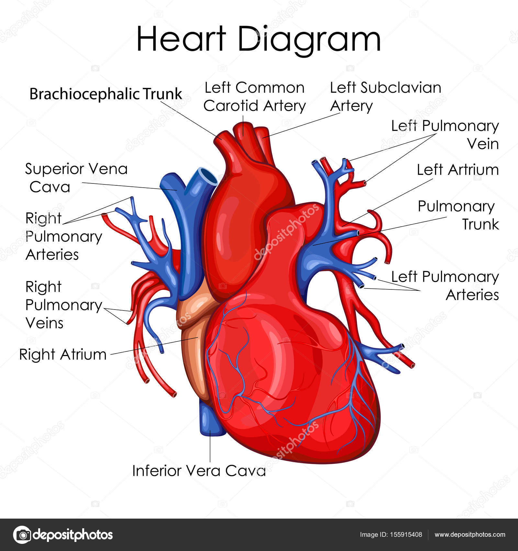
PROBLEM STATEMENT
The project aims to explore the influence of exercise and cholesterol levels on systolic blood pressure through a Two-Way Analysis of Variance (ANOVA). The investigation involves assessing how the interaction between exercise habits and cholesterol categories affects variations in systolic blood pressure, shedding light on potential relationships and providing insights into cardiovascular health.

Slide 3
Introduction
Cardiovascular health is a critical aspect of overall well-being, and understanding the factors that contribute to blood pressure variations is essential for preventive healthcare. This project delves into the intricate relationship between systolic blood pressure, exercise habits, and cholesterol levels using a Two-Way Analysis of Variance (ANOVA) approach. Systolic blood pressure, a key indicator of cardiovascular health, can be influenced by lifestyle factors such as physical activity and cholesterol levels. By investigating the combined impact of these variables, we aim to uncover valuable insights that may contribute to a more nuanced understanding of cardiovascular health determinants.

Slide 4
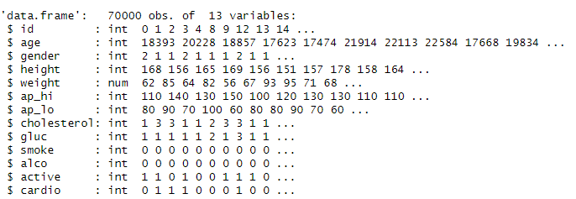
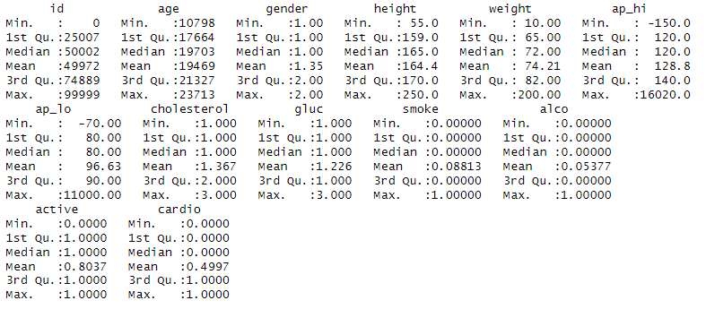
Data Exploration
Load the dataset and inspect its structure.
Check for missing values and handle them if necessary.
Convert relevant variables to appropriate data types.

Slide 5
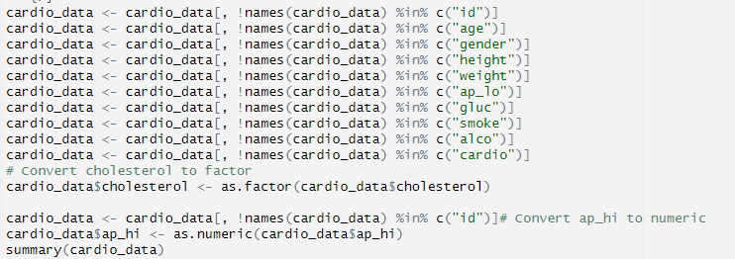
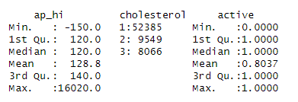
Data Transformation
Removal of all unnecessary variables
Convert categorical variables like cholesterol to factors.
Convert ap_hi to numeric

Slide 6
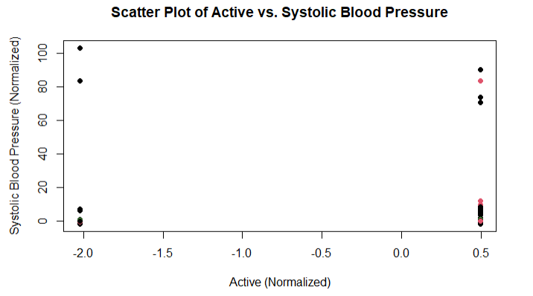
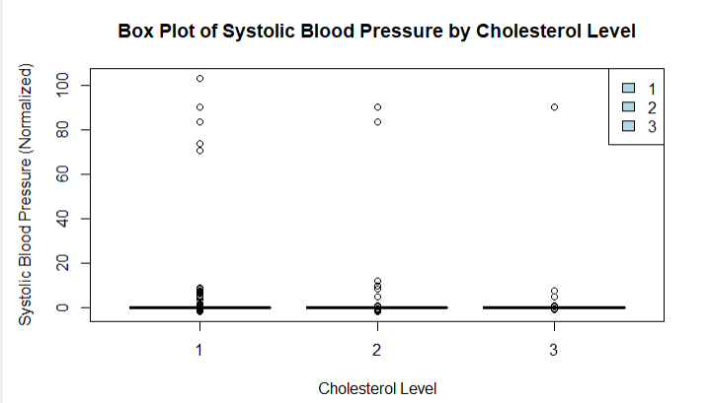
Exploratory Data Analysis

Slide 7
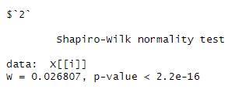
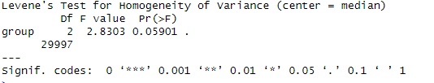
Statistical Testing
Test For Normality
The Shapiro-Wilk test is a statistical test used to assess whether a given sample comes from a normally distributed population.
As we have more rows in the dataset we are dividing into chunks so that we can perform Shapiro-wilk normality test.
Homogeneity of variance
This test is particularly useful when you have multiple groups and you want to determine if the variances of a continuous variable are significantly different among these groups.

Slide 8
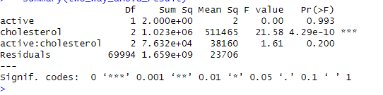
Two Way Anova
Two-way analysis of variance (ANOVA) is a statistical method used to assess the impact of two categorical independent variables (factors) on a continuous dependent variable. It extends the concept of one-way ANOVA, which analyzes the influence of a single factor, to situations where there are two factors that might interact with each other.

Slide 9
Interpretation
Active Factor (Exercise):
The F value for the "active" factor is very small (0.00), and the p-value is very high (0.993). This suggests that the factor "active" does not significantly contribute to the variability in systolic blood pressure.
Cholesterol Factor:
The F value for the "cholesterol" factor is 21.58, and the p-value is extremely small (4.29e-10). This indicates that the factor "cholesterol" has a significant effect on systolic blood pressure.
Interaction Effect (Active:Cholesterol):
The F value for the interaction between "active" and "cholesterol" is 1.61, and the p-value is 0.200. This suggests that the interaction effect is not statistically significant.
Residuals:
The residual degrees of freedom are associated with the unexplained variability in the model.

Slide 10
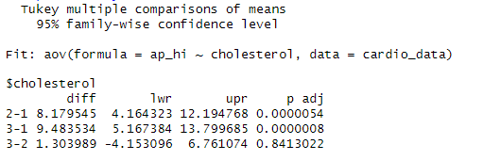
Post-Hoc Analysis
This output is from Tukey's multiple comparisons of means, which is used to determine which specific groups are significantly different from each other after conducting an analysis of variance (ANOVA). Let's interpret the results:
Diff: The estimated difference between the means of the compared groups.
Lwr (Lower): The lower bound of the confidence interval for the difference.
Upr (Upper): The upper bound of the confidence interval for the difference.
p adj (p Adjusted): The adjusted p-value after considering multiple comparisons.

Slide 11
Interpretation
The difference in means between groups 2 and 1 is estimated to be 8.18, with a 95% confidence interval from 4.16 to 12.19. The adjusted p-value is very small (p = 0.0000054), indicating a significant difference.
Similarly, the difference in means between groups 3 and 1 is estimated to be 9.48, with a 95% confidence interval from 5.17 to 13.80. The adjusted p-value is very small (p = 0.0000008), indicating a significant difference.
However, the difference in means between groups 3 and 2 is small (1.30), and the 95% confidence interval (-4.15 to 6.76) includes zero. The adjusted p-value is relatively large (p = 0.8413), indicating no significant difference.

Slide 12
Conclusion
Individuals with specific cholesterol concerns may need targeted interventions to manage systolic blood pressure effectively.
Further research could explore additional factors or interactions that contribute to blood pressure variations.
This comprehensive analysis sheds light on the nuanced relationship between exercise, cholesterol, and systolic blood pressure, offering valuable insights for healthcare professionals and individuals aiming to optimize cardiovascular health.

Slide 13
Thank you
Jani Shariff Shaik

