Slide 1
Internal Control Dashboard Project
Enhancing Risk Visibility & Compliance with SharePoint and Power BI
Prepared by Jani Begam Zahir Hussain

Slide 2
Project Overview
Objective:
- Centralize internal control tracking using SharePoint, Power BI, and Power Automate.
- Enable efficient risk identification, review scheduling, and compliance oversight.
Tools Used:
- Microsoft SharePoint Online
- Power BI & Power Automate
- Python for Data Preparation

Slide 3
Dataset Summary
Source: Audit Risk Dataset (Kaggle)
Rows: 776
Columns: 27
Key Fields Used:
- Risk, Audit Risk, Inherent Risk
- Control ID, Owner, Status
- Review Dates and Notes

Slide 4
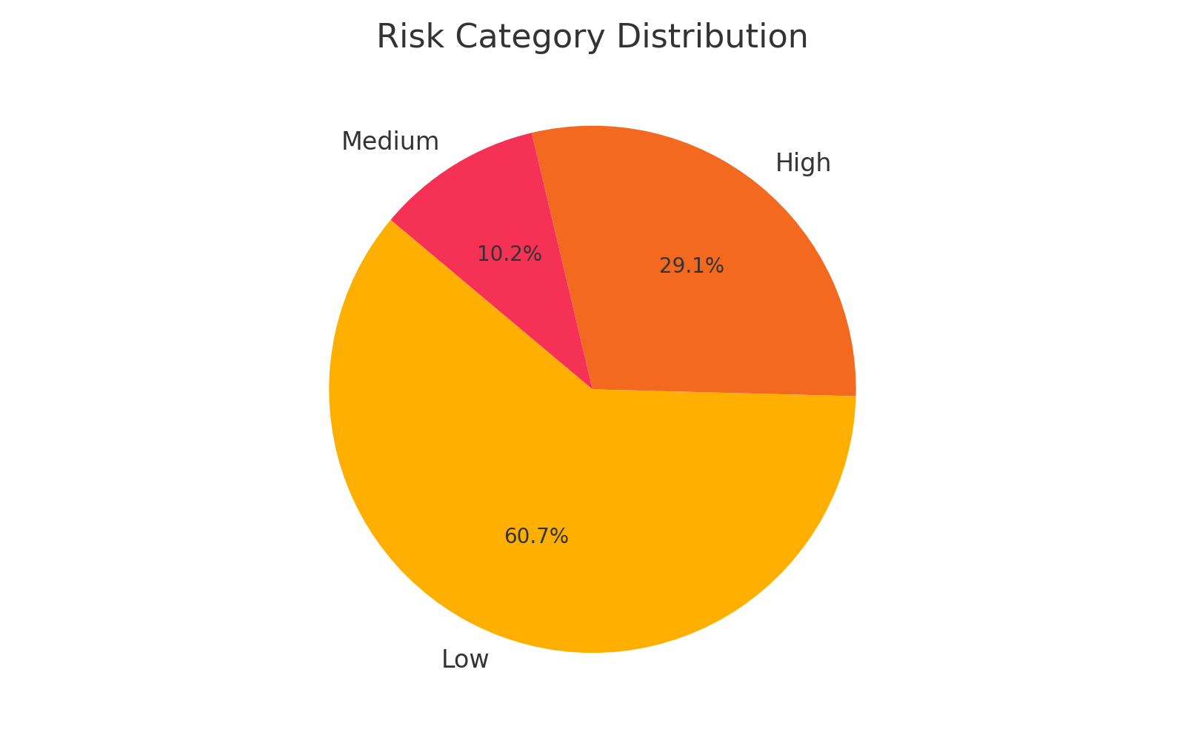
Risk Category Distribution

Slide 5
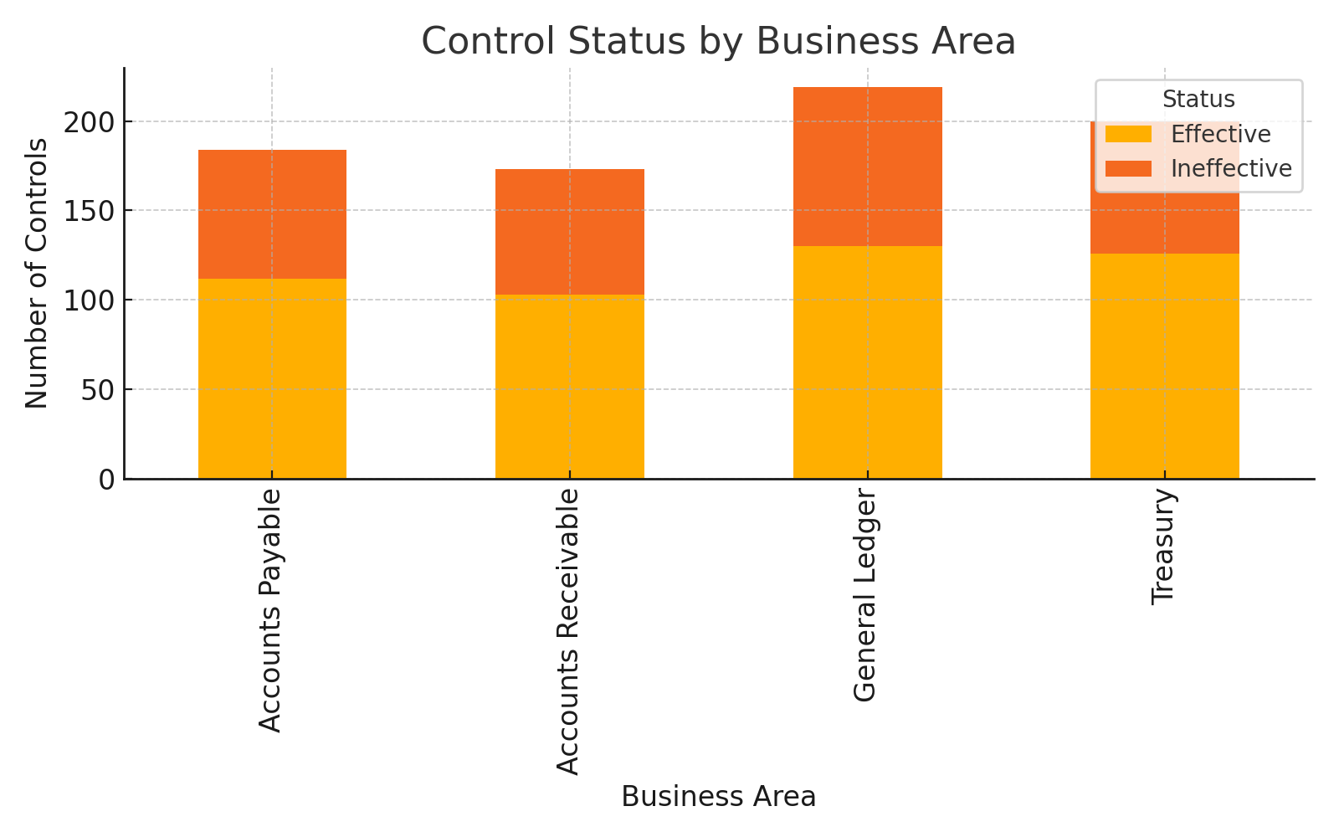
Control Status by Business Area

Slide 6
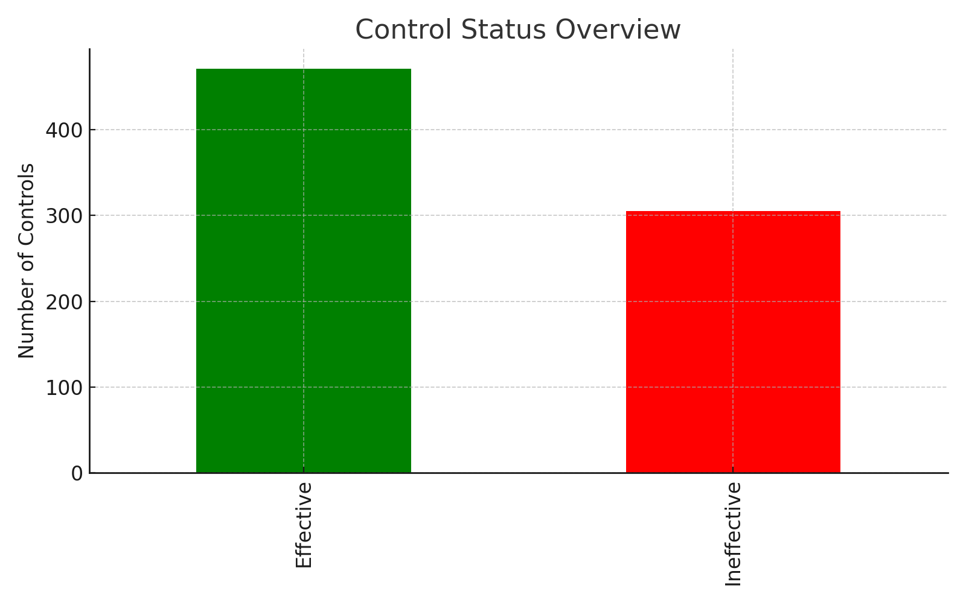
KPI: Control Status Overview

Slide 7
Upcoming Control Reviews
Top 10 Controls Due for Review:
CTRL-0152 - Risk Assessment - 29 - 2024-02-03 - Ineffective
CTRL-0177 - Risk Assessment - 32 - 2024-02-04 - Effective
CTRL-0652 - Risk Assessment - 5 - 2024-02-05 - Effective
CTRL-0523 - Risk Assessment - 18 - 2024-02-07 - Effective
CTRL-0122 - Risk Assessment - 27 - 2024-02-09 - Ineffective
CTRL-0238 - Risk Assessment - 9 - 2024-02-12 - Ineffective
CTRL-0699 - Risk Assessment - 12 - 2024-02-17 - Effective
CTRL-0309 - Risk Assessment - 8 - 2024-02-18 - Effective
CTRL-0321 - Risk Assessment - 2 - 2024-02-20 - Ineffective
CTRL-0363 - Risk Assessment - 19 - 2024-02-20 - Ineffective

Slide 8
Key Takeaways
- 776 controls analyzed for risk and effectiveness
- ~45% controls flagged as 'Ineffective'
- SharePoint used to manage documentation & review cycle
- Power BI enabled real-time visual insights
- High-risk areas need urgent remediation

