Slide 1
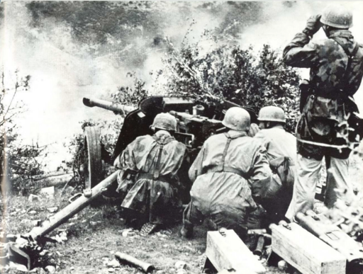
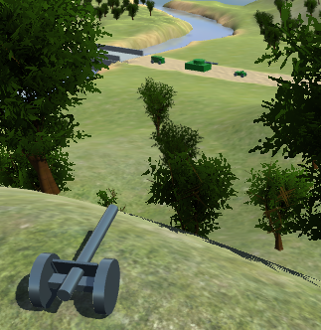
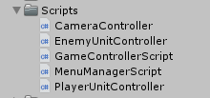
Title
Jani Aalto, TVT16SPO
Information Technology, Software Development
Introduction
The project was aimed at producing a video game with Unity 3D game development software by one developer.
FIGURE 1. A game scene
Objectives
The objective was to make a strategy game in a period of roughly eight weeks, and build a WebGL version of the game.
Methods
The game was made in Unity on a Windows PC from the developer’s home, with occasional project meetings with the instructor at the Kotkantie campus. The progress of the project was tracked with Trello.
FIGURE 2. The game’s scripts
Results
The project was finished on time, and most of the main planned features were implemented successfully, although there was too little time to finish some of the planned features and improvements. The challenges that arose during development were overcome.
FIGURE 3. The main menu graphic
Conclusions
The initial idea for the game was slightly too ambitious given the time available and the developer’s experience, but the project was an overall success and a valuable learning experience.
References
https://docs.unity3d.com/Manual/index.html
https://docs.unity3d.com/ScriptReference/index.html
Project
ECTS credits: 10
Date of publication: 2018, Autumn
Instructor: Pertti Heikkilä

