Slide 1
Final project Pitch
Mobile Information Systems
Jana Puschmann & Jonas Dorsch

Slide 2
Related Work
Boring S., Baur D., Butz A., Gustafson S. & Baudisch P. (2010). Touch Projector: Mobile Interaction Through Video. CHI 2010: Public Displays. 2287 – 2296.
Touch Projector: Mobile Interaction Through Video
Idea: allow users to manipulate content on displays that
do not allow Touch interaction
are unreachable
How: user points device at target display and touches an item of interest that then can be dragged to a different position or another screen

Slide 3
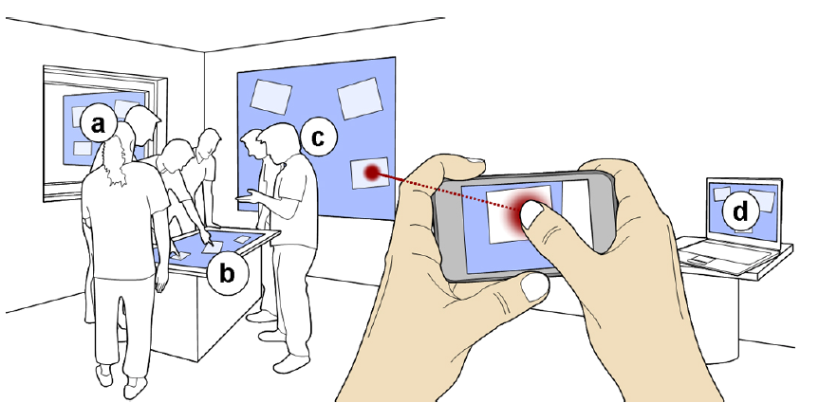
Boring S., Baur D., Butz A., Gustafson S. & Baudisch P. (2010). Touch Projector: Mobile Interaction Through Video. CHI 2010: Public Displays. 2287 – 2296.

Slide 4
Current status

Slide 5
Future Work
Map touch input on the client to mouse input on the server
Add zoom function to improve usability
Transfer files from server 1 to server 2 using the client
Decrease delay

