Slide 1
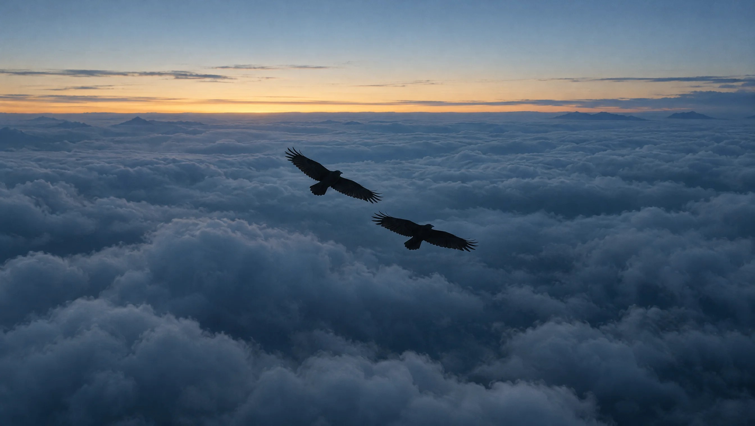

Understanding the
oldest conversation
on Earth
Morsis is building the translation layer between humans and animals: an instrument and a model that turn speech into signals animals understand, and their signals back into ours.
INVESTOR PRESENTATION · SEED ROUND · 2026
Notes:
Open on the line, not the product. Morsis is an interspecies signal lab: we record, decode and, under protocol, answer animal signals. Today we're raising a seed round to take a working prototype into the field at scale.

Slide 2
Animals already speak. Science just proved it
THE OPPORTUNITY
In the last 15 years, peer-reviewed field research has shown that animal signals carry names, descriptions and grammar.
Elephants
call each other by name-like calls.
Dolphins
answer to their own signature whistle.
Pardo et al., Nature Ecology & Evolution, 2024
King & Janik, PNAS, 2013
The gap
That knowledge lives in papers and hard drives. Nobody has turned it into an instrument that listens at scale and answers back, under protocol.
Prairie dogs
describe an intruder's size, shape and colour.
Songbirds
change meaning when call order changes.
Slobodchikoff et al., Animal Cognition, 2009
Suzuki et al., Nature Communications, 2016
Notes:
The science is no longer the question. Names in elephants and dolphins, descriptive alarm calls in prairie dogs, syntax in birds. What's missing is the instrument: a way to listen across species at scale and respond responsibly. That's the gap Morsis fills.

Slide 3
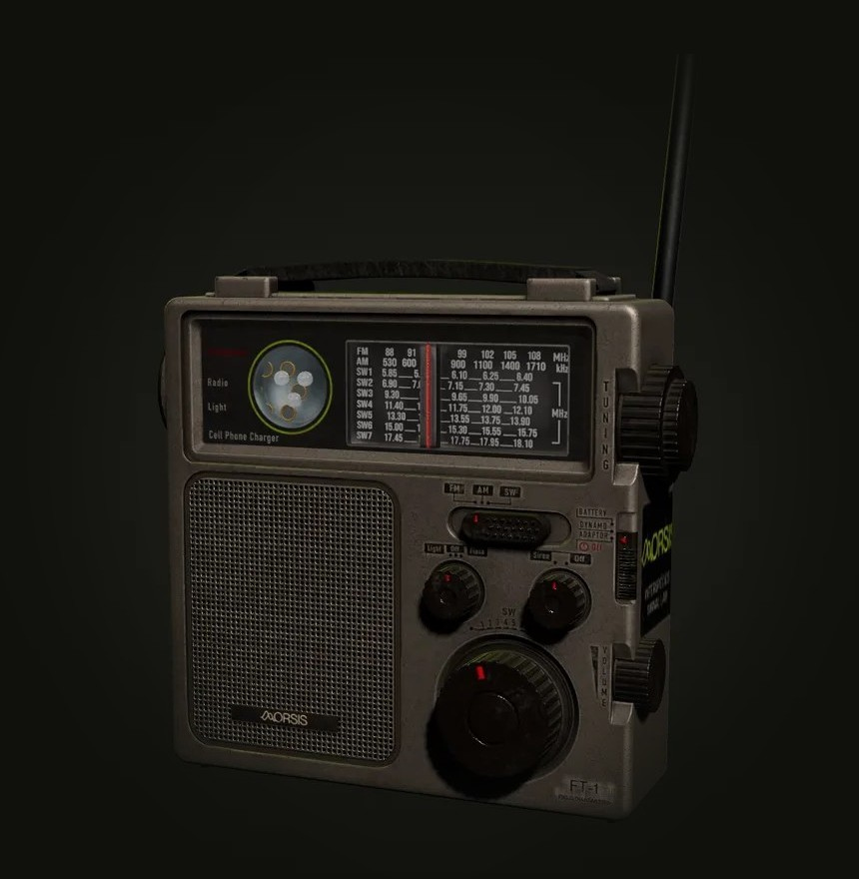
One instrument, four layers
THE SOLUTION
01
Listen
Mic arrays and hydrophones capture 1 Hz to 150 kHz, from elephant rumbles to dolphin clicks.
02
Segment
On-board DSP splits each signal into units (clicks, whistles, chirps) and strips noise.
03
Map meaning
Decode-3 links each unit to context: who was near, what happened next.
04
Emit
Your sentence is composed from the species' own call units, under research permits.
FT-1 field transmitter
Powered by Decode-3, our translation model
Notes:
FT-1 is the hardware; Decode-3 is the model. Listen, Segment, Map meaning, Emit. The emit layer is what makes this more than a recorder: replies are composed from units the species already uses, and only under permits and welfare review.

Slide 4
Say something. Something answers
THE PRODUCT IN USE
Open a channel
CHANNEL · PRAIRIE DOG · DECODE-3 LIVE
Type a sentence; FT-1 encodes it into a species' own call units.
You I'm walking toward your colony.
Alarm chirp series
12 units · 2.4 s
Read the reply
Decode-3 returns a decoded hypothesis with a confidence score, never a quotation.
“Tall one. Blue on top. Slow. Not a hawk. Everybody up, but do not run yet.”
Trust the source
Confidence
0.74
Every reply cites the field research behind it.
Field note Prairie dog alarm calls encode an intruder's size, shape and clothing colour. Slobodchikoff et al., 2009.
Notes:
This is a real reply shape from our console. The visitor speaks, the prairie dog answers, and Decode-3 shows its working: the signal, the decoded hypothesis, a confidence score and the published research it rests on. That honesty is the product.

Slide 5




Who pays to listen
MARKET & MODEL
CUSTOMER
WHAT THEY BUY
Conservation & wildlife agencies
Track populations by listening instead of tagging or trapping.
Field Console subscription
Offshore energy & shipping
Detect whales and dolphins before noisy operations begin.
FT-1 fleet leasing
Zoos, aquariums & sanctuaries
Read stress and welfare signals as they happen.
Console + FT-1 bundle
Universities & research labs
Build on our models and labelled field corpus.
Decode-3 API & data licence
Notes:
We sell to organisations that already spend money to understand animals: conservation agencies, offshore operators with marine-mammal obligations, zoos and aquariums, and research labs. Four revenue lines: software subscription, hardware leasing, bundles and API/data licensing. What we don't sell: collars, toys or pet apps.

Slide 6
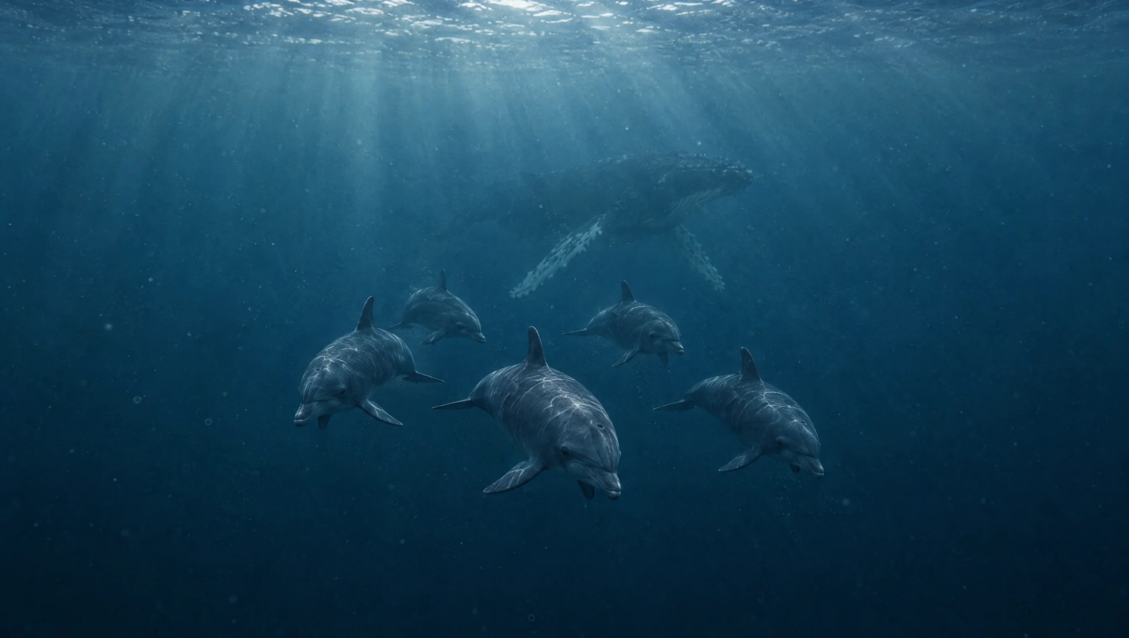

Early proof, built to compound
TRACTION & MOAT
112k
6
14
4
hours of field recordings
species across sky, land and sea
field stations
working FT-1 layers
Data flywheel
Every channel adds labelled context that sharpens Decode-3.
Protocol as product
Research permits and welfare review built into the emit layer.
A trusted name
One lab identity across every station, record and reply.
Interspecies Signal Lab
Notes:
Where we are today: 112,000 hours of field recordings across six species and fourteen field stations, and a working four-layer FT-1. The moat is the data flywheel: every channel opened adds context that improves Decode-3. Our ethics protocol is part of the product, which is what lets agencies and regulators say yes.

Slide 7
From six voices to every voice on Earth
VISION & THE ASK
Today
6 species, FT-1 prototype, public console preview
RAISING
$6M seed
Next 18 months
20 species, a field fleet with partner agencies, the Decode-3 API
45%
Field stations & FT-1 fleet
35%
Decode-3 research
Long term
An open standard for interspecies communication
20%
Partnerships & ethics board
lab@morsis.org
Notes:
The near-term plan is to go from six species to twenty and put an FT-1 fleet in the field with partner agencies, then open Decode-3 as an API. The long game is an open standard for interspecies communication. We're raising a $6M seed: most of it goes to field stations and hardware, then research, then partnerships and our ethics board. [Placeholder figures: confirm before presenting.]

