Slide 1


CSA1702-ARTIFICIAL INTELLIGENCE
AI-Based Eye Gesture Controlled Smart Communication
System for Physically Challenged People
Presented By:
Devi Shree.S(192511149)
Janikaa Sri.R(192511092)
Abinaya.U(192573023)
Department of Computer Science and Engineering

Slide 2


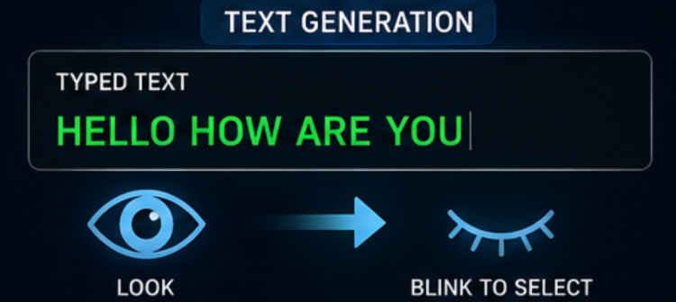
Introduction
Physically challenged individuals with conditions such as paralysis, ALS, or quadriplegia often lose the ability to speak or use their hands to communicate.
Traditional assistive devices rely on touch, switches, or specialized hardware that many patients cannot operate.
Eye movements remain functional in most such cases, making them a reliable and non-invasive input channel.
Artificial Intelligence and computer vision now allow real-time tracking of eye gestures using an ordinary webcam.
This project builds an affordable, camera-based system that translates eye gestures into text, speech, and alerts.
2

Slide 3
Abstract
A real-time, low-cost, camera-based assistive communication system that converts eye gestures into text, speech, and caregiver alerts using AI-driven computer vision.
The system captures live facial video through a standard webcam and detects the user's eyes using AI-based facial landmark detection. Eye Aspect Ratio (EAR) and gaze-direction features are extracted frame-by-frame to identify blinks, gaze shifts, and deliberate eye gestures. A trained classification model maps recognized gesture patterns to predefined communication commands (letters, words, or actions). Recognized commands are converted into on-screen text and natural speech output, and can trigger a caregiver alert when needed. The result is a hands-free, low-cost communication channel for users who cannot speak or use their hands.
3

Slide 4
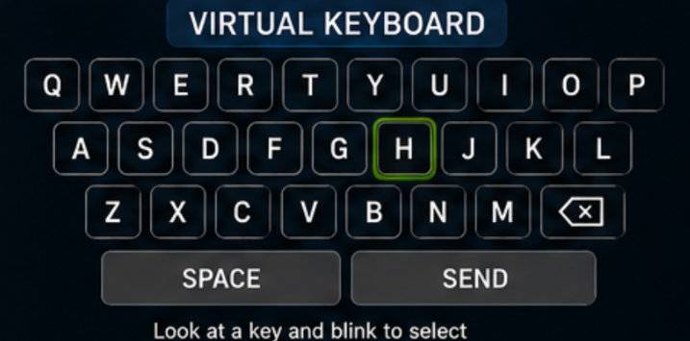
Objectives
Track eyes and extract facial landmarks in real time from webcam video
Classify blinks and gaze patterns into distinct, intentional eye gestures
Translate recognized gestures into letters, words, or predefined commands.
Convert selected commands into on-screen text and natural speech output.
Notify caregivers instantly for urgent needs through a lightweight alert system.
.
.
.
5

Slide 5

Problem Statement
Commercial eye-tracking communication devices are expensive, require specialized hardware, and are inaccessible to most patients.
Communication Barrier
Costly Existing Solutions
Physically challenged individuals with speech and motor impairments have no reliable way to express needs or communicate with caregivers.
Limited Accessibility
No Real-Time Response
Keyboard, touch, and switch-based assistive tools cannot be operated by patients with little to no limb or muscle control.
Caregivers are not immediately alerted to a patient's needs, delaying assistance in critical situations.
4

Slide 6
ALGORITHMS USED
Mediapipe FaceMesh (BlazeFace + landmark regression CNN)–real-time facial and eye landmark detection
Eye Aspect Ratio (EAR) algorithm – core blink and eye-closure detection technique
Convolutional Neural Network (CNN) – gesture pattern classification
Long Short-Term Memory (LSTM) / RNN – recognizing temporal gesture sequences (e.g., single vs. double blink)
Support Vector Machine (SVM) – lightweight classical alternative for gesture classification
Text-to-Speech (TTS) engine – converting recognized commands into speech output
.
.
.
5

Slide 7





System Architecture
→
→
→
→
→
Camera
Input
Face & Eye
Detection
Feature
Extraction (EAR)
AI Gesture
Classification
Command
Mapping
Speech / Text
& Alert Output
Input Layer
Processing Layer
Output Layer
Webcam captures continuous live video of the user's face.
AI models detect facial landmarks and classify eye gestures.
Text-to-speech, on-screen display, and caregiver alert notifications.
6

Slide 8

AI CONCEPTS
AI Concept | Purpose
Computer Vision | Detect face and eyes
Eye Gaze Tracking | Determine where the user is looking
Blink Detection | Detect blink as a selection command
AI Decision Making | Convert gestures into text and communication
10

Slide 9
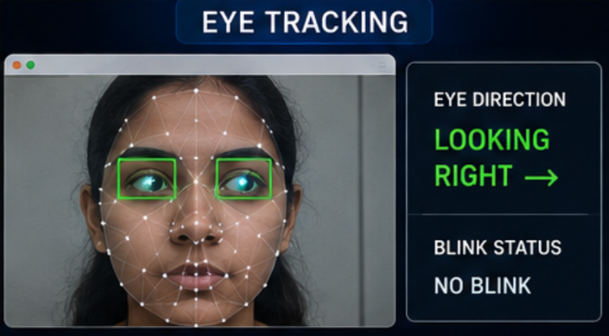
MODULE 1
Eye & Facial Landmark Detection
Capture continuous live video frames from a standard webcam.
Detect the user's face in each frame using an AI-based face-detection model.
Localize facial landmarks (eyes, eyelids, eyebrows) using a landmark-prediction model such as Mediapipe FaceMesh or Dlib.
Isolate the eye region and compute the Eye Aspect Ratio (EAR) to measure eyelid opening.
Track gaze direction by analysing pupil / iris position relative to the eye corners.
Filter noise and stabilize readings across frames for reliable downstream gesture recognition.
Key Technique
7

Slide 10
MODULE 2
Gesture Recognition & Command Mapping
Feed extracted EAR values and gaze-direction sequences into a trained AI classification model (CNN / ML classifier).
Distinguish between gesture types: single blink, double blink, long blink, and directional gaze shifts.
Apply a calibration step so the system adapts to each individual user's eye behaviour.
Map each recognized gesture to a predefined communication command using a configurable gesture dictionary.
Support a scanning/selection interface (e.g., row-column highlighting) so a small gesture set can select any letter or word.
Continuously validate predictions to reduce false triggers from natural blinking.
Sample Gesture Dictionary
Single Blink
Select item
Double Blink
Confirm / Enter
Long Blink (2s)
Trigger alert
Gaze Left / Right
Navigate options
8

Slide 11

MODULE 3
Communication Output & Alert Interface
Display a simple, high-contrast on-screen virtual keyboard / word board for gesture-based selection.
Convert selected letters, words, or commands into natural speech using a text-to-speech (TTS) engine.
Show live selected text on screen for caregivers and companions to read along.
Trigger an instant caregiver alert (sound / notification) for urgent needs such as pain or discomfort.
Log frequently used words and phrases to speed up future selections through predictive suggestions.
Provide an accessible, distraction-free interface designed for low mobility and limited attention span.
On-Screen Text
Speech Output
Caregiver Alert
9

Slide 12
Conclusion
The proposed system gives physically challenged individuals a practical, hands-free way to communicate using only their eyes.
AI-based facial landmark detection and gesture classification remove the need for costly specialized hardware.
Real-time speech and text output allow natural, immediate communication with caregivers and family.
The instant alert feature ensures urgent needs are addressed without delay.
Overall, the system demonstrates how affordable AI and computer vision can meaningfully improve quality of life and independence for physically challenged people.
10

Slide 13



Future Scope
IoT & Smart Home Integration
Mobile Application
Connect gesture commands to smart-home devices — lights, fans, and calling bells.
Extend the system to smartphone front cameras for greater portability and reach.
Improved Deep Learning Models
Predictive Communication
Enhance accuracy under varying lighting, angles, and diverse eye conditions.
Add word prediction and personalized phrase suggestions to speed up communication.
11

Slide 14
THANK YOU
AI-Based Eye Gesture Controlled Smart Communication System for Physically Challenged People

