Slide 1
Comments for the proposal and how we have addressed them
Comment from the panel | What we have done, and how we addressed it
No proper component breakdown | Four agents with one owner each. Every agent has a fixed input and output, and the app shows each agent’s step separately in a trace.
Novelty not explained: why a small model over a large one? | Companies with sensitive data can’t send it to cloud AI and have one GPU, so only a small model can be deployed. We measured where small models fail; each agent fixes one of those failures.
Need to think about practical usage | A staff member types a question in a chat page and gets the answer, the SQL and every step from their own read-only database, and can save it to a dashboard.
Implement a standalone application (Ekanayake) | Agent 1 runs on its own as a web page (Retrieval Explorer), an API and a command-line tool, and also plugs into the team app.
Notes:
[Lead, 0:35]
Good morning. We are group J26-DS-336: Distributed Multi-Agent SLM Framework for Privacy-Preserving Enterprise Data Intelligence. I'm [name], with Janiru Ekanayake, Tharushi Wathsala, Yuwani Thathsarani and Inushki Karunanayake. The panel gave us four comments at the proposal.
Row 1, No proper component breakdown: we now have four agents with one owner each. Every agent has a fixed input and output, and the app shows each agent's step separately.
Row 2, Novelty and why a small model: companies with sensitive data can't send it to cloud AI and have only one GPU, so only a small model can be deployed. We measured where small models fail, and each agent fixes one of those failures.
Row 3, Practical usage: a staff member types a question in a chat page and gets the answer, the SQL and every step from their own database, and can save it to a dashboard.
Row 4, Standalone application: Agent 1 now runs on its own as a web page, an API and a command-line tool.

Slide 2
Problem, who it affects, design of the solution, and video
27%
48%
35% → 71%
of organisations have banned generative AI over privacy risk (Cisco, 2024)
admit entering non-public company data into it anyway (Cisco, 2024)
correct SQL from a small model: full database vs only the right table (our test)
Who has this problem
Design of the overall solution
1–2 minute video
Mid-size companies with sensitive data and no data team: finance companies, microfinance companies, smaller insurers
Their staff who can’t write SQL
Sri Lanka’s PDPA No. 9 of 2022 makes sending customer data out a legal risk
Four small agents, each fixing one measured weakness of small models
Runs on one mid-range GPU; nothing leaves the company
Every answer shows its SQL and each agent’s step
One question going through the whole system, step by step.
▶ Watch on YouTube
Notes:
[Lead, 0:40, then the 2:00 video]
The problem: 27 percent of organisations have banned generative AI over privacy, and 48 percent admit putting company data into it anyway. A local small model avoids this, but a full database confuses it: 35 percent correct with three tables shown, 71 percent with only the right one.
Who has this problem: mid-size companies with sensitive data and no data team, like finance companies, microfinance companies and smaller insurers, and their staff who can't write SQL. In Sri Lanka, the Personal Data Protection Act makes sending customer data out a legal risk.
Our design uses four small agents, each fixing one measured weakness. It runs on one GPU, nothing leaves the company, and every answer shows its SQL and each step.
Here is our two-minute video. [Click "Watch on YouTube", play full screen, don't talk over it, then return to the slides.]
Sources: Cisco 2024 Data Privacy Benchmark Study (2,600 professionals); Sri Lanka PDPA No. 9 of 2022; our test on 33 simple questions with phi3 (3.8B).

Slide 3
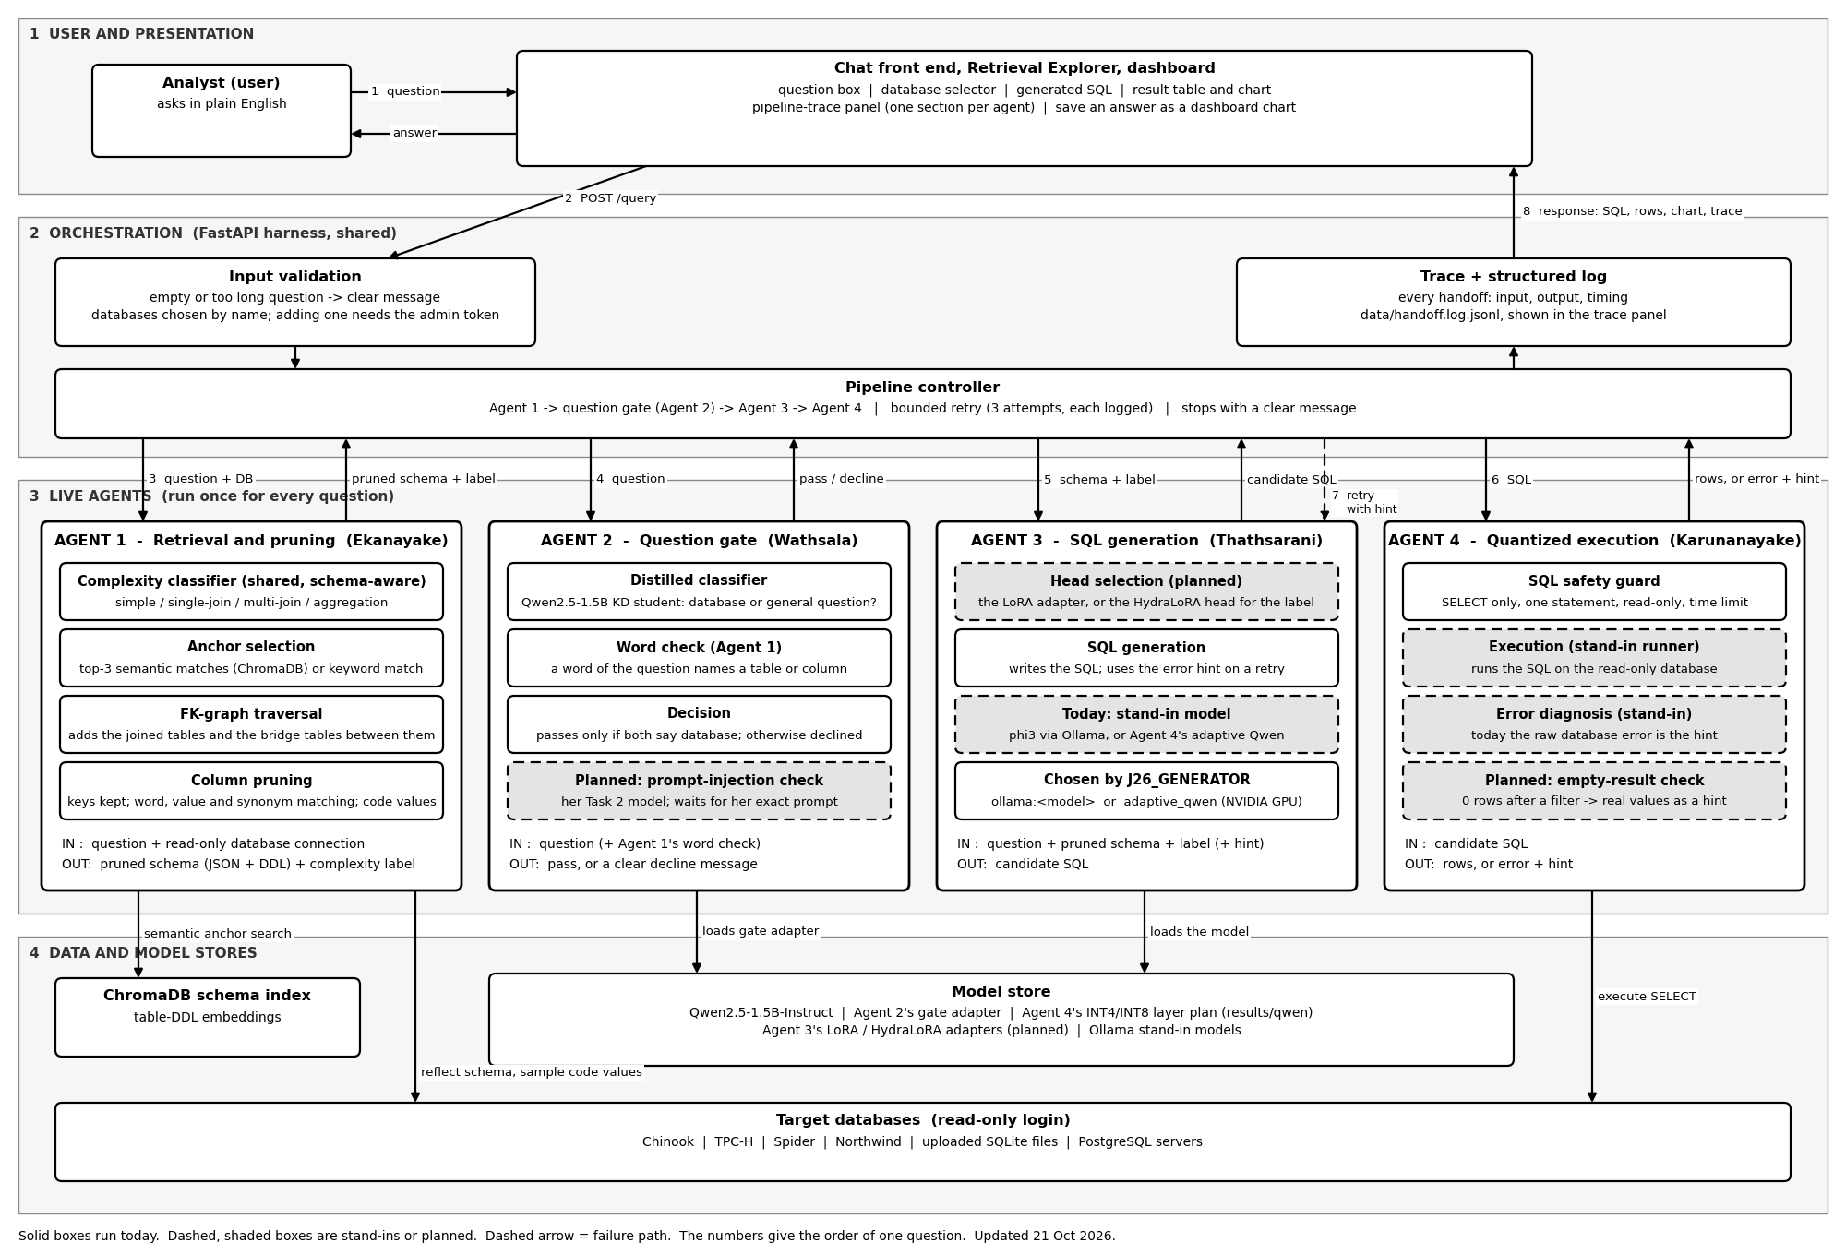
Design of the overall solution: how one question flows
Notes:
[Lead, 0:15]
Follow the numbers. The question goes to the harness. Agent 1 prunes the schema and labels it. Agent 2's gate passes or declines it. Agent 3 writes the SQL. Agent 4 runs it read-only, and on an error sends a hint back, up to three times. The answer, SQL and trace come back. Janiru.
Template note: diagrams must not be made with AI image tools. Redraw this one in draw.io if it was.

Slide 4
Add a professional photo here
Title of the individual component
Complexity-Adaptive Column-Level Schema Pruning for Small Language Models
Specialization: Data Science
Notes:
[Ekanayake, 0:10]
Thank you. I'm J.K.B. Ekanayake, IT23199262, Data Science. My component is Complexity-Adaptive Column-Level Schema Pruning for Small Language Models.

Slide 5
INDIVIDUAL COMPONENT · 1 OF 2
Complexity-Adaptive Column-Level Schema Pruning for Small Language Models
How the solution addresses the sub-problem (prototype)
User requirements addressed
Sub-problem: a small model gets confused when it sees the whole database: 35% correct with three tables, 71% with only the right one.
Reads any connected database automatically ✓
Labels each question’s complexity for Agent 3 ✓
Answers in under 0.5 s (median 0.28 s) ✓
Handles 20+ tables and missing foreign keys ✓
Explains why each column was kept ✓
Runs standalone: Retrieval Explorer, API, command line ✓
Classify the question: simple, single-join, multi-join or totals
Find the top 3 starting tables
Add the tables needed to join them
Keep only the needed columns, with value hints (“Canada” → Customer.Country)
Size the schema to the question; pass it and the label to Agent 3
Notes:
[Ekanayake, 0:55]
Left box: my sub-problem is that a small model gets confused when it sees the whole database: 35 percent correct with three tables, 71 percent with only the right one. My prototype fixes this in five steps. Classify the question as simple, single-join, multi-join or totals. Find the top three starting tables. Add the tables needed to join them. Keep only the needed columns, with value hints, so "Canada" points to Customer.Country. Size the schema to the question and pass it, with the label, to Agent 3.
Right box: it reads any connected database automatically, labels each question's complexity for Agent 3, answers in 0.28 seconds against a 0.5-second target, handles twenty-plus tables and missing foreign keys, explains why each column was kept, and runs standalone.

Slide 6
INDIVIDUAL COMPONENT · 2 OF 2
Complexity-Adaptive Column-Level Schema Pruning for Small Language Models
Design excellence / contribution
User feedback on prototype
What we measured | Result
Needed columns still kept (4 databases) | 95–99%
Prompt size vs full schema | 16–24% smaller
Question type labelled correctly | 59% → 68% *
Correct SQL on coded columns (value hints) | 12% → 56% *
Correct SQL when schema fits the question | 44% → 52% *
Add real feedback: who tried the prototype, which task, where they struggled, and what you changed. Do not invent it.
* Real gain, very unlikely to be chance (p < 0.05). Pruning alone keeps accuracy the same (43% vs 41%) with smaller prompts. 66 automated tests pass.
Notes:
[Ekanayake, 0:55]
Reading the table from the top: 95 to 99 percent of needed columns are still kept, with prompts 16 to 24 percent smaller. The three starred rows are real gains, very unlikely to be chance: question type labelled correctly, 59 to 68 percent; correct SQL on coded columns with value hints, 12 to 56 percent; and correct SQL when the schema fits the question, 44 to 52 percent. As the note says, pruning alone keeps accuracy the same with smaller prompts, and 66 automated tests pass.
User feedback: [fill: who tried it, which task, what they struggled with, what you changed].
Over to Tharushi for Agent 2.
(p-values: labels .029, value hints .016, schema size .003.)

Slide 7
Add a professional photo here
Title of the individual component
Knowledge-Distilled Small Foundation Model and Question Gate
Specialization: Data Science
Notes:
[Wathsala, 0:10]
Thank you. I'm W.A.T. Wathsala, IT23282704, Data Science. My component is a Knowledge-Distilled Small Foundation Model and Question Gate.

Slide 8
INDIVIDUAL COMPONENT · 1 OF 2
Knowledge-Distilled Small Foundation Model and Question Gate
How the solution addresses the sub-problem (prototype)
User requirements addressed
Sub-problem: small models are weak at harder judgements. Can a large teacher make a same-size small model better?
Teacher-generated training data ✓
Same-size model for a fair comparison ✓
Model delivered in a form the app loads ✓
Declines off-topic questions before any SQL: 0 of 224 real questions wrongly declined, about 0.2 s each ✓
Planned: prompt-injection check in the app
Planned: distilled SQL base model for Agent 3
Teacher: Qwen2.5-7B, fine-tuned on the tasks first
Training data: database or general question (4,000); attack prompt or safe (436)
Student: Qwen2.5-1.5B learns from the teacher
Control: the same 1.5B model trained without the teacher
Live: the student is the app’s question gate, with Agent 1’s word check
Notes:
[Wathsala, 0:55]
Left box: my sub-problem is that small models are weak at harder judgements. Can a large teacher make a same-size small model better? Teacher: a 7-billion-parameter Qwen, fine-tuned on the tasks first. Training data: 4,000 database-or-general questions and 436 attack-or-safe prompts. Student: a 1.5B Qwen that learns from the teacher. Control: the same 1.5B model trained without the teacher. Live: my student is the app's question gate, working with Agent 1's word check.
Right box: done are teacher-generated training data, a same-size model for a fair comparison, and a model the app loads. The gate declines off-topic questions before any SQL: on 224 real questions it wrongly declined none, in about 0.2 seconds each. Still planned: the attack check in the app, and the distilled SQL base for Agent 3.

Slide 9
INDIVIDUAL COMPONENT · 2 OF 2
Knowledge-Distilled Small Foundation Model and Question Gate
Design excellence / contribution
User feedback on prototype
Test (items) | Without teacher | With teacher | Real gain?
Database question? (1,200) | 98.8% | 99.4% | No (p = .12)
Attack prompt? (116) | 83.6% | 94.8% | Yes (p = .004)
Add real feedback: who tried the prototype, which task, where they struggled, and what you changed. Do not invent it.
% = items labelled correctly. Easy test: both near 100%. Hard test: 11 points better with the teacher, very unlikely to be chance. Distillation helps where the task is hard.
Notes:
[Wathsala, 0:55]
The table compares the model without and with the teacher. First row, is it a database question: 98.8 versus 99.4 percent, no real gain, because both are near 100. Second row, is it an attack prompt: 83.6 versus 94.8 percent, 11 points better with the teacher, and p equals 0.004, so very unlikely to be chance. Distillation helps where the task is hard.
User feedback: [fill].
Over to Yuwani for Agent 3.
(McNemar test on paired predictions. 94.8% comes from scoring the two labels, which is how the app uses it.)

Slide 10
Add a professional photo here
Title of the individual component
Complexity-Routed HydraLoRA versus Standard LoRA for SQL Generation
Specialization: Data Science
Notes:
[Thathsarani, 0:10]
Thank you. I'm K.G.Y.V. Thathsarani, IT23404250, Data Science. My component is Complexity-Routed HydraLoRA versus Standard LoRA for SQL Generation.

Slide 11
INDIVIDUAL COMPONENT · 1 OF 2
Complexity-Routed HydraLoRA versus Standard LoRA for SQL Generation
How the solution addresses the sub-problem (prototype)
User requirements addressed
Sub-problem: one shared adapter must learn simple lookups and multi-table joins alike.
LoRA and HydraLoRA on the same base, data and budget ✓
Routing by the shared complexity classifier ✓
Accuracy reported per complexity, with statistics ✓
Winner (LoRA) and runner-up (HydraLoRA) packaged for Agent 4 ✓
Planned: head selection inside the live app
Base: Qwen2.5-1.5B (Agent 2’s distilled base when it exists)
Data: Spider training questions labelled by complexity
Standard LoRA: one shared adapter, rank 16 (control)
HydraLoRA: one shared part plus a head per complexity type
Live: Agent 1’s label picks the head; Agent 4’s error hint used on retry
Notes:
[Thathsarani, 0:55]
Left box: my sub-problem is that one shared adapter must learn simple lookups and multi-table joins alike. Base: Qwen 1.5B, replaced by Agent 2's distilled base when it exists. Data: Spider training questions labelled by complexity. Standard LoRA: one shared adapter, the control. HydraLoRA: one shared part plus a separate head for each complexity type. Live: Agent 1's label chooses the head, and on a retry I use Agent 4's error hint.
Right box: done are LoRA and HydraLoRA on the same base, data and budget; routing by the shared classifier; accuracy reported per complexity with statistics; and the winner, LoRA, and runner-up, HydraLoRA, packaged for Agent 4. Still planned: head selection inside the live app. Today a stand-in model writes the SQL there.

Slide 12
INDIVIDUAL COMPONENT · 2 OF 2
Complexity-Routed HydraLoRA versus Standard LoRA for SQL Generation
Design excellence / contribution
User feedback on prototype
Model (128 questions) | Correct SQL
Base model, no training | 41%
LoRA: one trained adapter | 55% (real gain)
HydraLoRA, perfect labels | 52% (same as LoRA)
HydraLoRA, live labels | 39%
Add real feedback: who tried the prototype, which task, where they struggled, and what you changed. Do not invent it.
LoRA lifts one-join questions 29% → 68%; multi-join stays near 16% for all. Each 10 points of routing error costs about 3 points of accuracy.
Notes:
[Thathsarani, 0:55]
The table shows correct SQL out of 128 questions. The base model with no training: 41 percent. LoRA: 55 percent, a real gain. HydraLoRA with perfect labels: 52 percent, the same as LoRA. HydraLoRA with live labels: 39 percent. As the note says, LoRA lifts one-join questions from 29 to 68 percent, multi-join stays near 16 for all, and every 10 points of routing error costs about 3 points of accuracy.
User feedback: [fill].
Over to Inushki for Agent 4.
(LoRA vs base p = .012; HydraLoRA vs LoRA not significant. Next: parameter-matched LoRA.)

Slide 13
Add a professional photo here
Title of the individual component
SQL-Sensitive Mixed-Precision Quantization and Safe Query Execution
Specialization: Data Science
Notes:
[Karunanayake, 0:10]
Thank you. I'm K.M.I.N. Karunanayake, IT23179912, Data Science. My component is SQL-Sensitive Mixed-Precision Quantization and Safe Query Execution.

Slide 14
INDIVIDUAL COMPONENT · 1 OF 2
SQL-Sensitive Mixed-Precision Quantization and Safe Query Execution
How the solution addresses the sub-problem (prototype)
User requirements addressed
Sub-problem: the model must shrink to fit a small GPU, but shrinking every layer to 4-bit breaks SQL names (59% → 51% correct).
Fits a mid-range GPU: 1.29 GB instead of 2.97 GB ✓
Accuracy, memory and speed reported per setting ✓
Only safe SQL runs: SELECT only, one statement, read-only, time limit ✓
Retry stops after 3 attempts ✓
Writes the SQL in the team app today ✓
Planned: separate test questions; llama.cpp and random-layer controls
Sensitivity: set each of the 28 layers to 4-bit alone and measure the accuracy drop
Allocation: the 6 most sensitive layers stay 8-bit, the other 22 become 4-bit
Build the mixed model; compare with full size, all 8-bit and all 4-bit
Live: SQL safety check, read-only execution, error hint back to Agent 3
Notes:
[Karunanayake, 0:55]
Left box: my sub-problem is that the model must shrink to fit a small GPU, but shrinking every layer to 4-bit breaks SQL names, from 59 to 51 percent correct. Sensitivity: I set each of the 28 layers to 4-bit on its own and measured the accuracy drop. Allocation: the six most sensitive layers stay 8-bit, the other 22 become 4-bit. Build the mixed model and compare it with full size, all 8-bit and all 4-bit. Live: a safety check, read-only execution, and an error hint back to Agent 3. This replaced my original QAT versus PTQ plan, agreed with the team.
Right box: it fits a mid-range GPU, 1.29 instead of 2.97 gigabytes; accuracy, memory and speed are reported per setting; only safe SQL runs; the retry stops after three attempts; and it writes the SQL in our app today. Still planned: separate test questions and comparison controls.

Slide 15
INDIVIDUAL COMPONENT · 2 OF 2
SQL-Sensitive Mixed-Precision Quantization and Safe Query Execution
Design excellence / contribution
User feedback on prototype
Setting (100 questions) | Correct | Memory
Full size (FP16) | 59% | 2.97 GB
All 8-bit (INT8) | 61% | 1.74 GB
All 4-bit (INT4) | 51% | 1.20 GB
Mixed: 6 × 8-bit, 22 × 4-bit | 64% (25 q) | 1.29 GB
Add real feedback: who tried the prototype, which task, where they struggled, and what you changed. Do not invent it.
Mixed is not yet proven better: 25 questions, the same ones used to choose the layers. Next: separate test questions.
Notes:
[Karunanayake, 0:55]
The table shows correct SQL out of 100 questions and the memory used. Full size: 59 percent, 2.97 gigabytes. All 8-bit: 61 percent, 1.74. All 4-bit: 51 percent, 1.2. My mixed model: 64 percent in 1.29 gigabytes. But as the note says, that 64 is on only 25 questions, the same ones used to choose the layers, so it's not proven better yet.
User feedback: [fill].
Back to [Lead].

Slide 16
Commercialization and sustainability of the solution
Customer persona
Market size
Mid-size companies with sensitive data and no data team
Users: operations managers, credit and risk officers, compliance staff
They can’t write SQL and have no BI team to ask
Sri Lanka first: 32 licensed finance companies and 4 microfinance companies (CBSL), plus the smaller of 29 insurers
Then the same segment across South Asia
What is unique in our solution
How will the cost be recovered?
Runs fully on the company’s own hardware: no data goes to an AI vendor
One mid-range GPU instead of a data team or cloud contract
Every answer shows its SQL and steps, so it can be checked
Licensed on-premise appliance plus a yearly support contract
Privately hosted tier for smaller firms
Open-weight models: no per-question fees
Notes:
[Lead, 0:40]
Customer persona: our customer is a mid-size company with sensitive data and no data team. The users are operations managers, credit and risk officers and compliance staff, who can't write SQL and have no BI team to ask.
Market size: in Sri Lanka first, 32 licensed finance companies and 4 microfinance companies, plus the smaller of 29 insurers. Then the same segment across South Asia.
What is unique: it runs fully on the company's own hardware, so no data goes to an AI vendor; one mid-range GPU replaces a data team or cloud contract; and every answer shows its SQL and steps so it can be checked.
Cost recovery: a licensed on-premise appliance with a yearly support contract, and a privately hosted tier for smaller firms. Because the models are open-weight, there are no per-question fees.
Thank you. We'll now show the demonstration.
(Sources: CBSL list of licensed finance companies as at 31.12.2025; CBSL Annual Economic Review 2024. If asked why not big banks: they already have BI teams and budgets.)

