Slide 1

Trending Topic Analysis of Twitter Dataset using Latent Dirichlet Allocation (LDA) and ChatGPT
Christoffer Tan & Janis Joplin
(Group 7)

Slide 2

Problem: Identify Trending Topics
Goal: Identify trending topics in social media (Twitter)
Usage: Provide insights into public sentiment and guides marketing strategies.
Challenges:
dynamic nature of trends
noise and bias within the discussions.

Slide 3
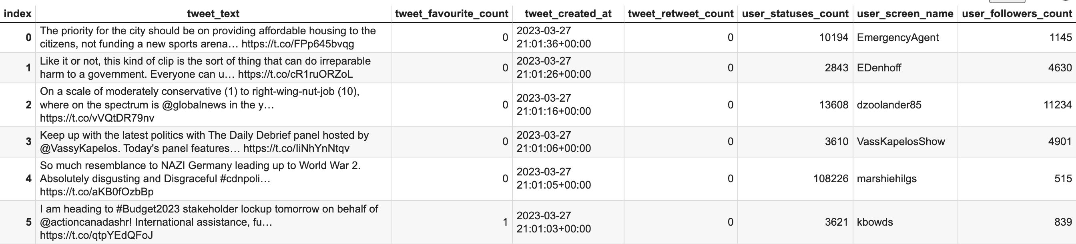
Overview of Data (Tweets)
Sample of 10,000 tweets that are created on 23-27 March 2023.
No missing values
Used feature: tweet text (truncated)

Slide 4
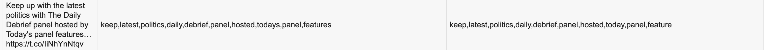
Tweet Pre-Processing
Expand contractions
e.g. don't (do not)
Remove mentions (@) and tags (#)
Tokenize the tweet (Tweet Tokenizer)
Remove URLs, punctuation (non-alphanumeric and whitespaces), and stopwords (e.g. 'a', 'is', 'the')
Convert tokens into lowercase
Lemmatize tokens into their base forms:
preserve the semantic meaning of the words

Slide 5
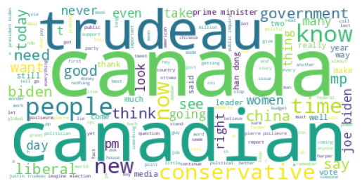
Exploratory Data Analysis (WordCloud)

Slide 6
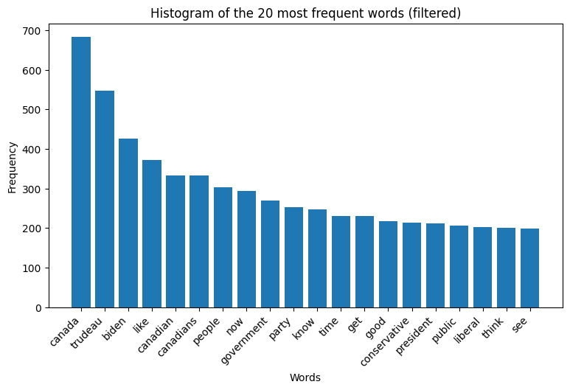
Exploratory Data Analysis (Word Frequency)

Slide 7
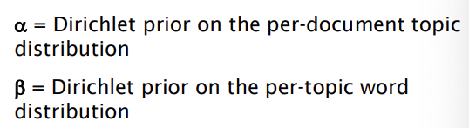

What is Latent Dirichlet Allocation (LDA)?
An unsupervised clustering model to uncover latent topics within a collection of documents (tweets)
Assumption: "each document is made up of various words, and each topic also has various words belonging to it"
How does LDA works?
The prior distribution of the words that belong to a tweet
The probability of words belonging to a topic

Slide 8
Building Model: Tune Hyperparameters
Hyperparameters: α, β, num_topics
Split training (60%), validate (20%), and test dataset (20%)
For loop (validate dataset) to choose num_topics
Aim for high coherence score

Slide 9
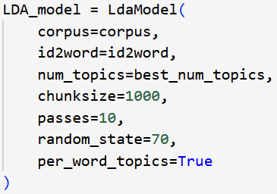
Building Model: Training the Model
Default values for α and β
Train the model with best_num_topics = 13

Slide 10
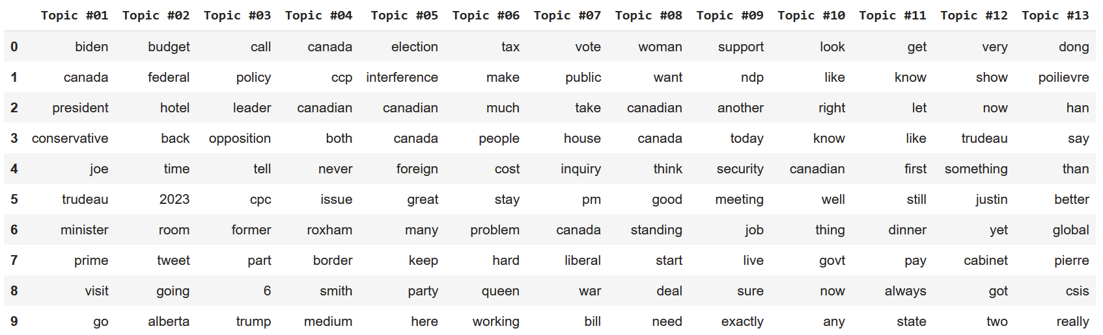
Building Model: LDA Output
Generate 13 topics with 10 words each

Slide 11
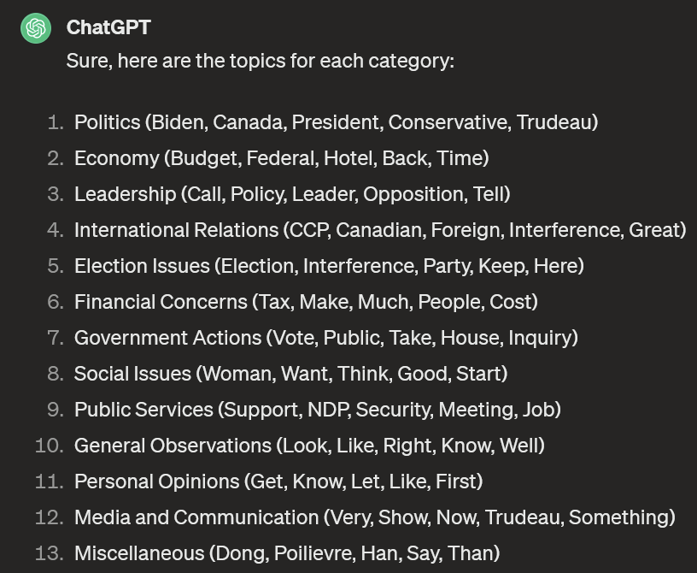
Building Model: Labelling
Utilize Generative AI (ChatGPT) to label each topic

Slide 12
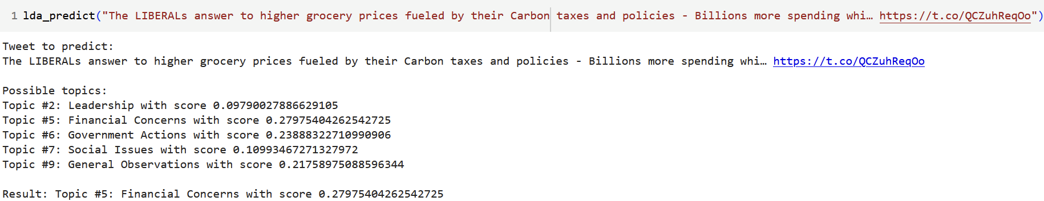
Result: Topic Generator
Choose the topic with largest score

Slide 13
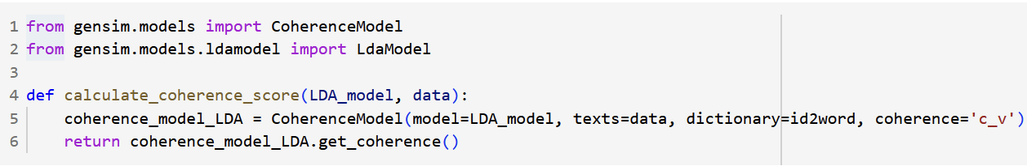
ML Model Evaluation
Coherence Test

Slide 14
Conclusion
The model generate a topic for a tweet
Significance and Usage:
Fast generation
Labelling for supervised ML
Semantic meaning for clustering
Limitation and potential improvement:
Irrelevant topics for short tweets
Topics generated are limited to training data
Limited to unigram interpretation

Slide 15

THANK YOU

