Slide 1

FinOclik
Finance on Finger Clicks
Team a1

Slide 2
Agenda
Introduction
How FinOclik is useful?
Our target customers?
References
Summary
Demo
Q&A

Slide 3
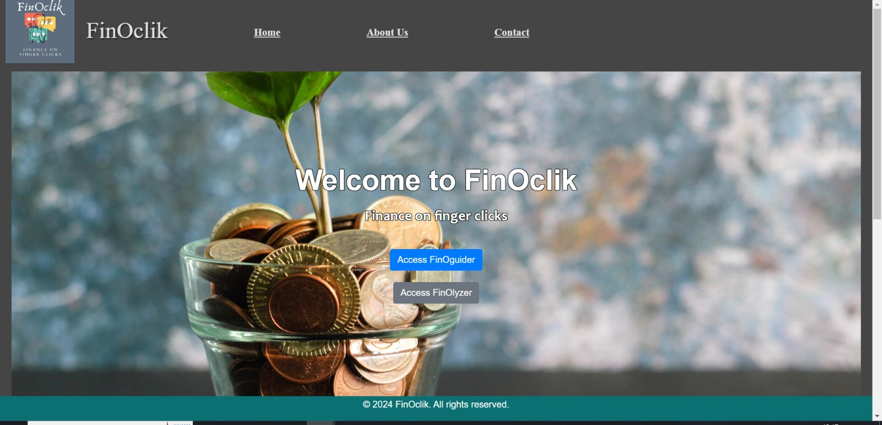
What is FinOclik?
A chatbot for enhancing knowledge in finance and stocks.
Platform where customers can get answers to their financial queries.
Queries can be related to:
investment tips
which stock is giving good returns etc.

Slide 4




Why FinOclik is useful?
Increasing knowledge of investment and how it can impact your life for good.
Enabling accessibility to get answers for any financial queries on a click of a button.
Building customers mindset to be analytical and informed about their investment decisions which can generate positive ROI.
Making them financially literate so that they can make their money work for them and not vice versa.

Slide 5

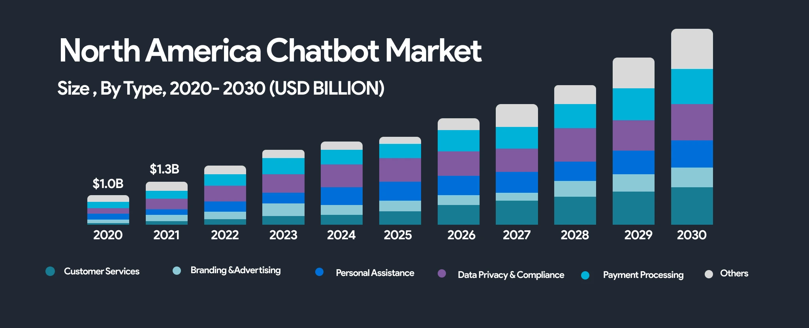
Where our product stands?
https://mindster.com/mindster-blogs/the-rise-of-chatbot-banking-understanding-its-potential/

Slide 6
Where our product stands?
Personal assistance
https://mindster.com/mindster-blogs/the-rise-of-chatbot-banking-understanding-its-potential/

Slide 7

Target customers
People who want to learn about financial market and be able to start building financial independence.
customers who want to:
earn some additional earnings.
invest in the market but don’t have idea where to start from.
have a first-hand advice before seeing a financial advisor.

Slide 8
Source/reference:
North America Chatbot Market: Ankitha PrasannanAnkitha is a professional content writer with more than four years of experience. She writes blogs relevant to the services that we provide and also about the various mobile app solutions that we provide. With strong research skills and c. (2023, November 22). The rise of chatbot banking: Understanding its potential. Mindster. https://mindster.com/mindster-blogs/the-rise-of-chatbot-banking-understanding-its-potential/
Top chatbots in financial services for 2022 | Botpress Blog. (n.d.). https://botpress.com/blog/top-chatbots-financial-services
S. (2024, January 3). How AI-Driven Chatbots are Transforming the Financial Services Industry. https://www.linkedin.com/pulse/how-ai-driven-chatbots-transforming-financial-services-industry-ugrmc/
Drozdov, A. (2023, September 1). Chatbots in Finance: Benefits, Examples, and Future. Yellow. https://yellow.systems/blog/chatbots-in-finance
Financial Terminology: 20 Financial Terms to Know. (2018, October 11). Business Insights Blog. https://online.hbs.edu/blog/post/finance-for-non-finance-professionals-finance-terms-to-know?c1=GAW_CM_NW&source=CA_GEN_PMAX&cr2=content__-__ca__-__gen__-__pmax&kw=general&cr5=&cr6=&cr7=c&utm_campaign=content__-__ca__-__gen__-__pmax&utm_term=general&gad_source=1&gclid=Cj0KCQjwq86wBhDiARIsAJhuphmuInQMO98mQGjGBlSGLvzQkfs3EUUOkyQkHus1cJrjuP4Lzgd8DNUaAhObEALw_wcB
O’Shea, A., & Voigt, K. (2024, March 22). Stock Market Basics: What Beginner Investors Should Know. NerdWallet. https://www.nerdwallet.com/article/investing/stock-market-basics-everything-beginner-investors-know
Investmint, T. (2023, October 20). 6 biggest stock market scams that shook the Indian investors. Investmint Blog. https://www.investmint.club/blog/6-biggest-stock-market-scams-that-shook-the-indian-investors/#:~:text=The%20Harshad%20Mehta%20scam%20was,interbank%20market%20for%20short%20periods.

Slide 9
Source/reference:
Five AI Technologies. (n.d.). SAS. https://www.sas.com/en_ca/insights/articles/analytics/five-ai-technologies.html
Financial Terminology: 20 Financial Terms to Know. (2018, October 11). Business Insights Blog. https://online.hbs.edu/blog/post/finance-for-non-finance-professionals-finance-terms-to-know
Financial Terms A-Z. (2019, September 10). Investopedia. https://www.investopedia.com/financial-term-dictionary-4769738
Glossary of Terms for Newcomers to Canada. (2023, May 9). RBC Royal Bank. https://www.rbcroyalbank.com/en-ca/new-to-canada/glossary-financial-terms/
N. (n.d.). Nasdaq: Stock Market, Data Updates, Reports & News. Nasdaq. https://www.nasdaq.com/
Yahoo is part of the Yahoo family of brands. (n.d.). https://finance.yahoo.com/quote/%5EIXIC/
Bloomberg - Are you a robot? (n.d.). https://www.bloomberg.com/quote/CCMP:IND
Financial Times. (n.d.). Financial Times. https://www.ft.com/
Strickland, K. (n.d.). Customer Service AI Chatbots - Freshchat by Freshworks. https://www.freshworks.com/customer-service-suite/lp/ai-conversational-chatbots/?tactic_id=5587714&utm_source=GoogleAdwords&utm_medium=Fchat-Search-US-East-Generic-BOFU-Chatbot&utm_campaign=Fchat-Search-US-East-Generic-BOFU-Chatbot&utm_term=chatbot%20in%20software&device=c&matchtype=p&network=g&gclid=Cj0KCQjwlN6wBhCcARIsAKZvD5gKElQPGgkMGOdcf9xuE73Mn9C1fwECFUuf31ahqqGG4cyuQfj850kaAo3BEALw_wcB&audience=kwd-1249032152042&ad_id=640030498218&gad_source=1
TIMESOFINDIA.COM. (2024, January 1). Pune man loses Rs 2.1 crore to investment scam: What is it and how to stay safe. The Times of India. https://timesofindia.indiatimes.com/gadgets-news/pune-man-loses-rs-2-1-crore-to-investment-scam-what-is-it-and-how-to-stay-safe/articleshow/106454523.cms

Slide 10

Summary
To provide impactful product where our customers can explore the world of finance and train minds to unlock analytical skills to make personalized investment decisions anytime and anywhere with a single click.
Project Portfolio Website ☺
Wix: https://meghaannmathew1996.wixsite.com/finoclik

Slide 11

Any Questions?

Slide 12
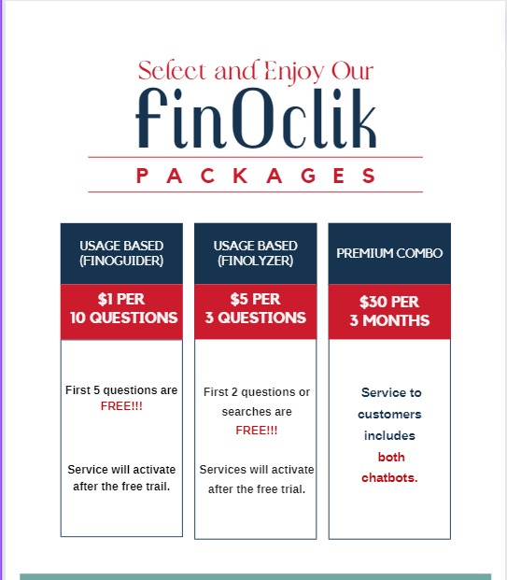
Our Revenue Model :

Slide 13
References for Functions and features :
Ozgor, B. Y., & Simavi, M. A. (2024). Accuracy and reproducibility of ChatGPT’s free version answers about endometriosis. International Journal of Gynaecology and Obstetrics: The Official Organ of the International Federation of Gynaecology and Obstetrics, 165(2), 691–695. https://doi.org/10.1002/ijgo.15309
Niszczota, P., & Abbas, S. (n.d.). GPT has become financially literate: Insights from financial literacy tests of GPT and a preliminary test of how people use it as a source of advice. Arxiv.org. Retrieved April 16, 2024, from https://arxiv.org/ftp/arxiv/papers/2309/2309.00649.pdf

Slide 14
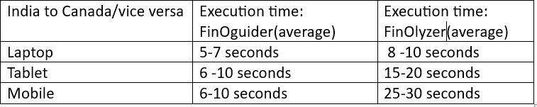
Testing Time

