Slide 1



Systematic Evaluation of Signal-to-Image Transformation Pipelines for Vision Transformer-based Sleep Stage Classification
BioMed Frontiers 2026
International Conference on Biomedical Innovation
Paper ID: 45
Janith R.R.H. Ramanayakage and Chandima N.P.G. Arachchige
Department of Statistics, Faculty of Science, University of Colombo, Sri Lanka

Slide 2




Why automate sleep staging?
BioMed Frontiers 2026 | International Conference on Biomedical Innovation
Sleep disorders (insomnia, apnoea, narcolepsy) are widespread
2–4 h
82.6%
Gold standard: manual scoring of polysomnography (PSG)
to score one full-night recording
inter-scorer agreement, experienced experts
Slow and subjective: hours per night; experts disagree
50–70 M
US adults living with a sleep disorder
Deep learning: CNN/RNN → Vision Transformers (ViTs)

Slide 3


Research gap and objectives
BioMed Frontiers 2026 | International Conference on Biomedical Innovation
The gap
Four experiments
Prior ViT work uses spectrograms or raw signals only
GASF, GADF and MTF never compared for ViTs
Best sampling rate before imaging unknown
Pre-training value on PSG images unclear
1
Image transformation: GASF, GADF, MTF, spectrogram
2
Sampling rate: 512 / 256 / 128 / 64 Hz, FFT vs DWT
3
Pre-trained vs from-scratch ViT, balanced vs imbalanced
4
Seven architectures incl. ResNet-50 baseline

Slide 4
Dataset: CAP Sleep Database
BioMed Frontiers 2026 | International Conference on Biomedical Innovation
80
80,667
recordings (6 healthy, 74 patients)
30-second epochs
16
6
channels at 512 Hz
stages: Wake, S1–S4, REM
Subject-wise 5-fold CV: no subject in both train and test

Slide 5
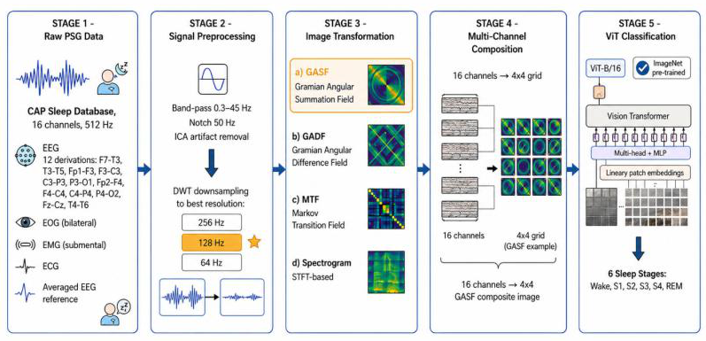
Proposed pipeline
BioMed Frontiers 2026 | International Conference on Biomedical Innovation
Figure 1. Overall five-stage pipeline

Slide 6




Four signal-to-image transformations
BioMed Frontiers 2026 | International Conference on Biomedical Innovation
GASF
GADF
MTF
Spectrogram
cos(φᵢ + φⱼ)
sin(φᵢ − φⱼ)
Markov transition probs
STFT, Hamming 256
Summed angles; preserves global temporal correlation
Difference of angles; less globally coherent
32 bins; quantisation loss, slow (5 s/epoch)
Fixed time–frequency resolution
16 images → 4×4 grid → 224×224×3 → ViT-B/16

Slide 7
GASF performs best
BioMed Frontiers 2026 | International Conference on Biomedical Innovation
EXPERIMENT
78.5%
GASF accuracy (macro-F1 0.773)
5.0 s
MTF time per epoch vs 0.2 s for GASF
GASF ≈ GADF; both clearly beat MTF and spectrogram

Slide 8
DWT at 128 Hz is optimal
BioMed Frontiers 2026 | International Conference on Biomedical Innovation
EXPERIMENT
80.3%
DWT @ 128 Hz (macro-F1 0.791)
+1.8 pp
over original 512 Hz signals
DWT beats FFT at every reduced rate; peak at 128 Hz

Slide 9
Pre-training adds 11+ points
BioMed Frontiers 2026 | International Conference on Biomedical Innovation
EXPERIMENT
+11.4 pp
balanced: 86.2% vs 74.8%
+12.2 pp
imbalanced: 80.5% vs 68.3%
Balancing (DCGAN, training folds only) adds ≈ 5.7 pp

Slide 10
ViT-B/16 beats other models
BioMed Frontiers 2026 | International Conference on Biomedical Innovation
EXPERIMENT
86.2%
ViT-B/16 (macro-F1 0.853)
+10.0 pp
over ResNet-50 CNN baseline
Transformers outperform the CNN; PVT-Small is the efficient option

Slide 11

Class-wise results and limitations
BioMed Frontiers 2026 | International Conference on Biomedical Innovation
Limitations
S1 (6.5% of data) is weakest
Single database; no cross-dataset test
R&K labels, not AASM
No formal significance tests
4×4 channel layout not ablated

Slide 12




Conclusions and future work
BioMed Frontiers 2026 | International Conference on Biomedical Innovation
Best pipeline
Future work
GASF image encoding
Multimodal fusion
DWT resampling to 128 Hz
Lightweight ViTs for edge use
Fine-tuned ImageNet ViT-B/16
Cross-dataset validation
86.2% accuracy, 0.853 macro-F1

Slide 13
Thank you
BioMed Frontiers 2026
International Conference on Biomedical Innovation
Paper ID: 45
Questions?
janithramanayake523@gmail.com

