Slide 1

Trade Report Forecast Update
June 2019
© Complete Intelligence2019

Slide 2

Trade
© Complete Intelligence2019
2

Slide 3
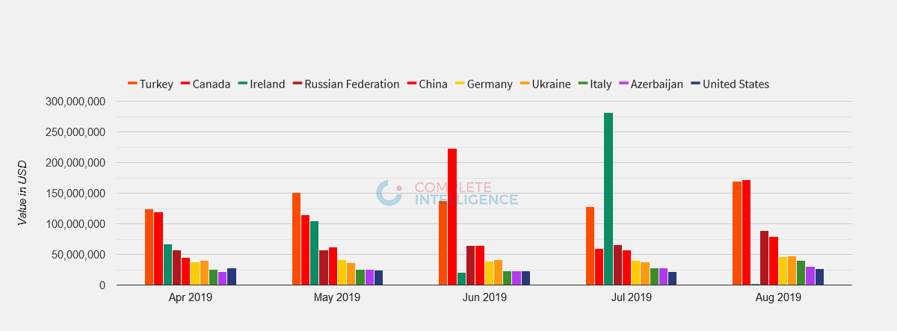
Georgia: Top 10 Import Partners
© Complete Intelligence2019
3

Slide 4
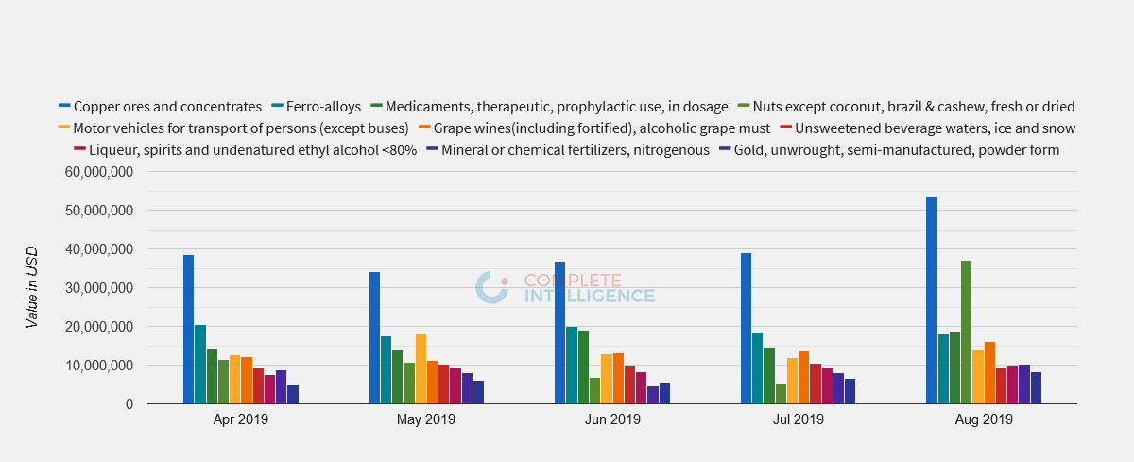
Georgia: Top 10 Export Commodities
© Complete Intelligence2019
4

Slide 5
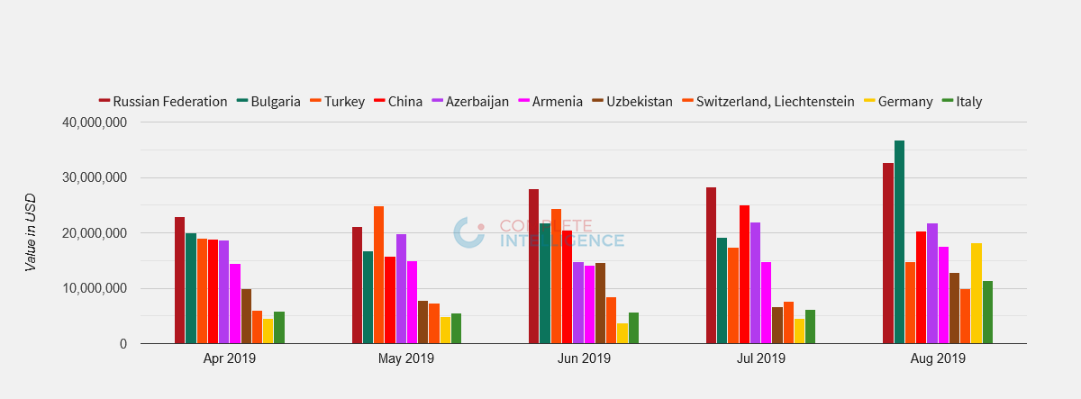
Georgia: Top 10 Export Partners
© Complete Intelligence2019
5

Slide 6
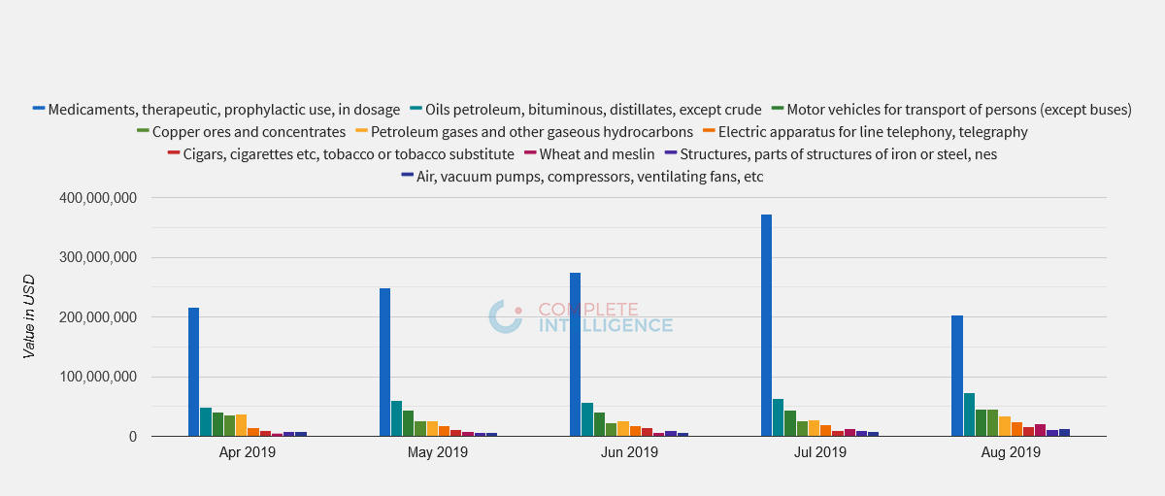
Georgia: Top 10 Import Commodities
© Complete Intelligence2019
6

Slide 7


