Slide 1

Market Report Forecast Update
June 2019
© Complete Intelligence2019

Slide 2
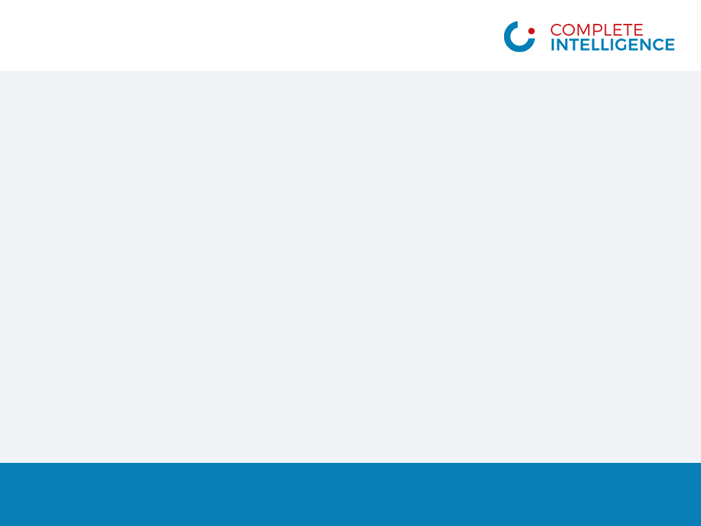
Equities
© Complete Intelligence2019
2

Slide 3
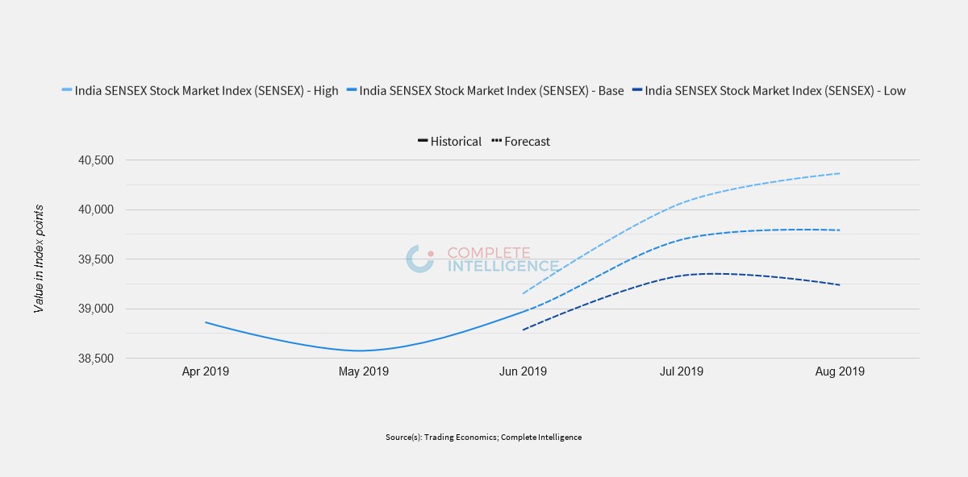
India SENSEX Stock Market Index (SENSEX)
© Complete Intelligence2019
3

Slide 4


