Slide 1

DENTAL CLINIC DATABASE

Slide 2
Purpose of project
01
Automation
02
Protection
03
Save Money
04
To save time

Slide 3
Automation
You can use it everywhere on the Internet
You can search for reports, appointments, and orders
You can take reports and appointments and orders to the full list.
you can use this database on websites and in clinics

Slide 4
Protection
Protects your data from unauthorized access using your Login and Password
You can work in a team only with user agreements
Separate SQL SERVER for databases and expiration

Slide 5
Save Money
Text Here !
* a lot of nerves
* lots of paper
* lots of pen
* a lot of time

Slide 6
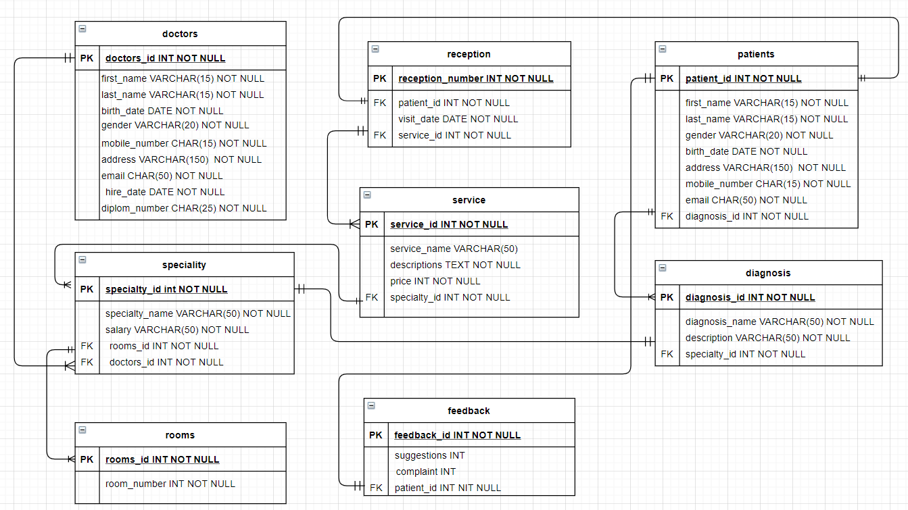
ER diagram

Slide 8
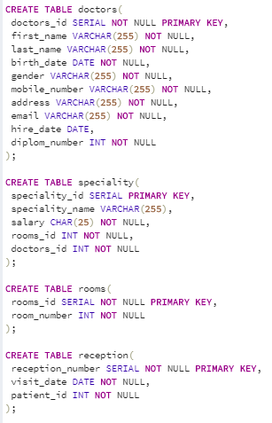
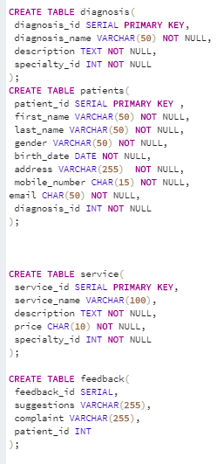
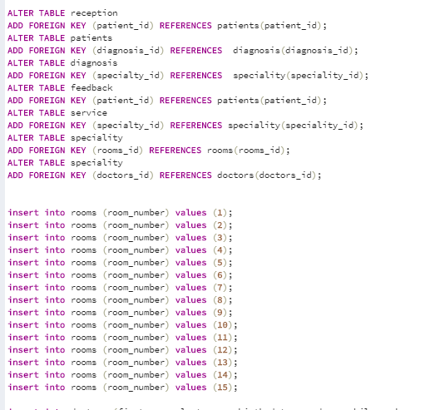

Slide 9
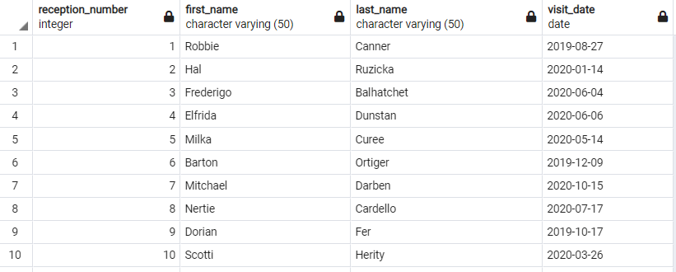

Slide 10
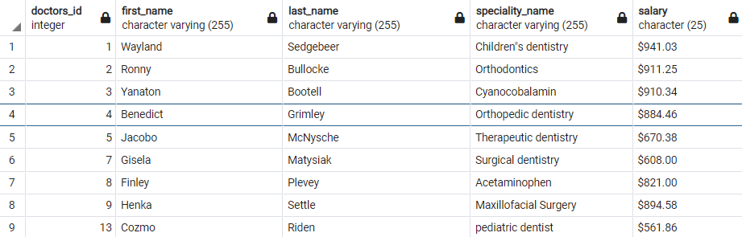

Slide 11
References list
Arsh Raziuddin The Truth About Dentistry MAY 2019 ISSUE https://www.theatlantic.com/magazine/archive/2019/05/the-trouble-with-dentistry/586039/
Boris Agami (Head of the Dental Center "Agami") 26.06.2012 https://rg.ru/2012/06/26/zubnoy.html
History of medicine in 2 volumes. Tatyana Sorokina http://bibliotekar.ru/423/33.htm
Tim Ford 07.12.2016 https://en.wikipedia.org/wiki/Dentistry
Sunday 5 November 2017 MEDICINE IN ANCIENT EGYPT PART 3 https://www.arabworldbooks.com/e-zine/medicine-in-ancient-egypt-part-3-of-3

Slide 12
THANK YOU
FOR YOUR ATTENTION

