Slide 1
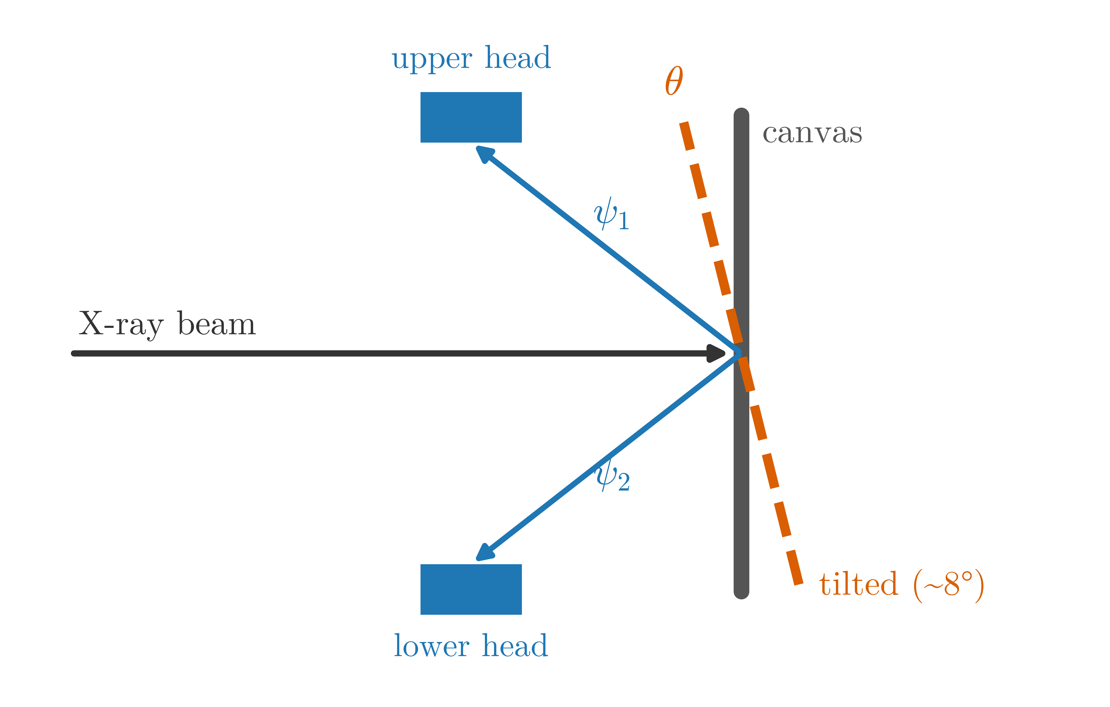
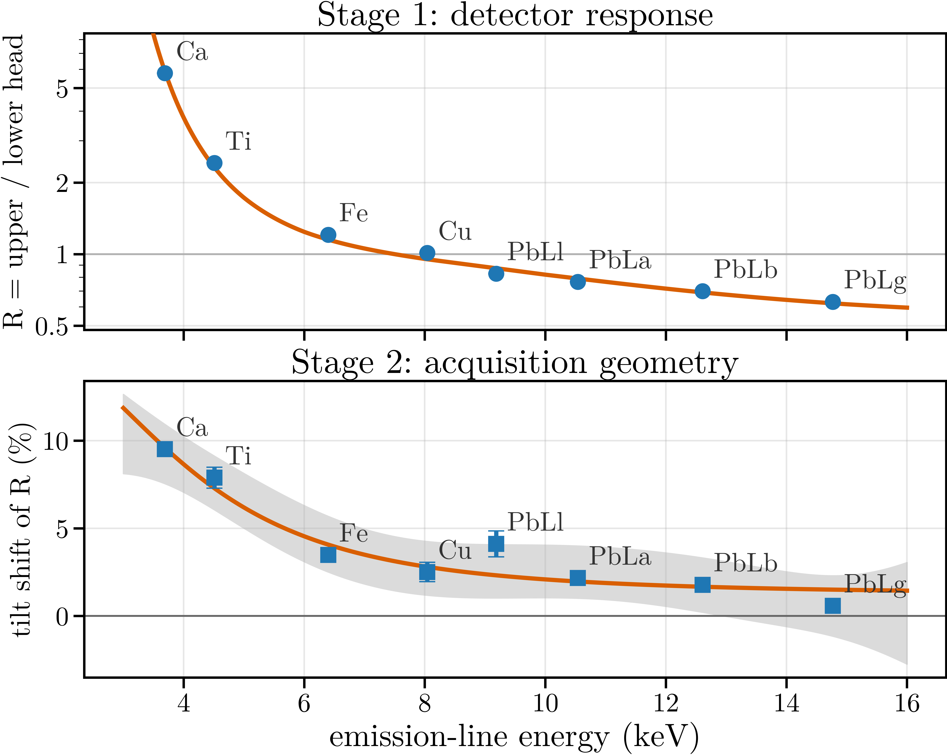
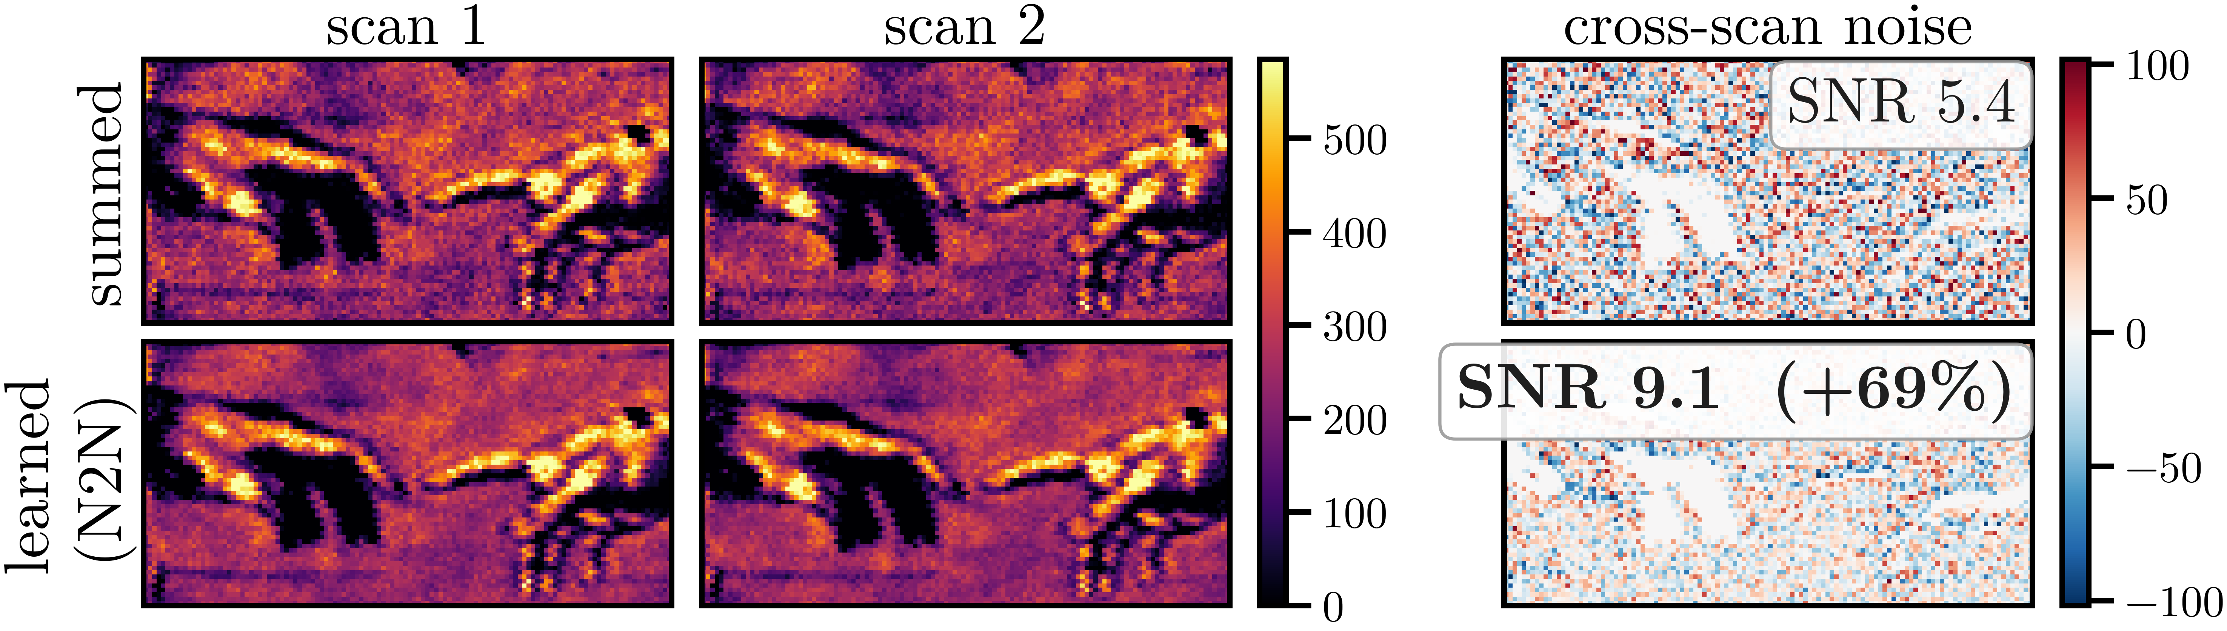
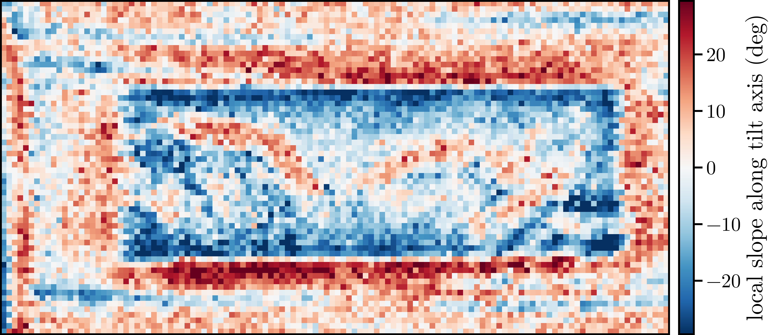
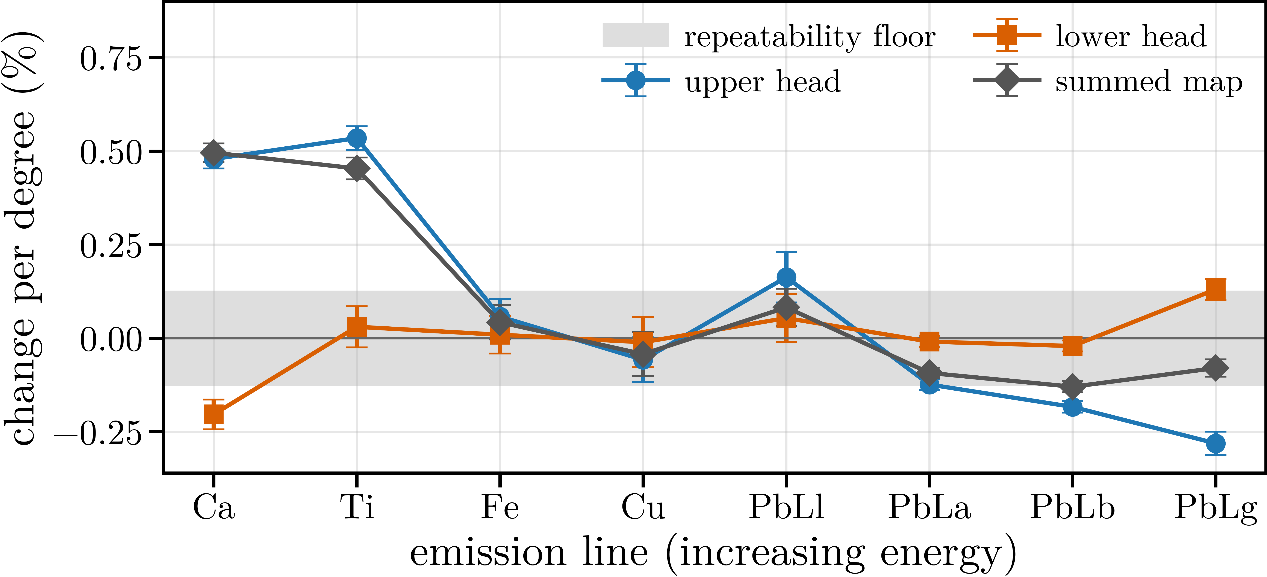
Geometry-resolved characterization of a dual-detector MA-XRF scanner
QR here
https://github.com/ADD-ME/repo
QR here
https://ADD-ME/paper.pdf
Dimitrije Pešić, Janko Vukobratović, Aleksandra Stojanović, Giulia Ristori, Stefano Ridolfi, Maja Gajić-Kvaščev, Goran Kvaščev
code + data
paper / abstract
School of Electrical Engineering, University of Belgrade · Ars Mensurae, Rome · IDArtScience Srl, Rome · VINARH Center, Vinča Institute of Nuclear Sciences, University of Belgrade
① One tilted scan separates detector from geometry
③ The two channels differ sixfold - and the model explains it
④ Learned fusion beats summing by 10–18 % SNR
Same signal, visibly calmer noise. Cross-scan difference (scan 1 − scan 2)/√2 on pixels the network never saw.
The two channels are conditionally independent Poisson views of the same spot, so Noise2Noise training needs no clean target.
A 1D U-Net with loss weights prescribed by the measured R(E) gains +17.7 % mean SNR over summing on held-out pixels (median +11.9 %); classical inverse-variance weighting gives +0.9 %.
Six of eight lines gain - Pb Lℓ +69 %, Pb Lγ +33 %, Fe +28 %, Cu +17 % - while Ca and Ti keep the plain sum (low-energy level bias).
Ablation: the same network with an unweighted loss gives −0.1 % - the gain comes from the measured variance structure, not the architecture. In acquisition time it is worth 39 % longer dwell.
Two detectors, opposite take-off angles; tilting the canvas moves the geometric part only.
Both heads see the same spot from opposite take-off angles, so their count ratio mixes a detector part with a geometric part.
Tilting the canvas changes the photon exit paths but not the detectors, so a second scan splits the ratio into a tilt-invariant and a tilt-dependent term.
No calibration standards, no extra hardware - two routine acquisitions.
Detector response and geometry separate cleanly, each reproduced by a small physical model.
R = det10264 / det19511 falls from 5.8 at Ca Kα to 0.63 at Pb Lγ: the same pigment gives a sixfold different signal depending on the channel.
A three-parameter detector model reproduces the frontal curve across two orders of magnitude. The fitted absorber, 973 ± 2 µm Be-equivalent, is 80–120× any entrance window: extra air path or collimation in front of det 19511, not a window.
Tilt shifts R monotonically: +9.5 % at Ca (24σ) down to +0.6 % at Pb Lγ. A thick-sample fluorescence model with antisymmetric take-off angles reproduces the shape (lever arm s = 0.53 ± 0.10, tilt ≤ 8°).
② Two SDDs, three scans, 7 200 pixels
⑤ The discarded difference is also a relief map
Ars Mensurae MA-XRF scanner, two Amptek X-123SDD heads (10264, 19511), 40 kV / 50 µA. Mock-up canvas, 60 × 120 pixels, 3.0 s dwell.
Three scans: two frontal seven days apart (the repeatability baseline) and one tilted forward by ≤ 8°.
All ratios are computed on the registered overlap (affine, NCC 0.965): full-frame ratios mix in a field-of-view artifact large enough to flip the sign of the tilt shift.
⑥ One degree of mounting error moves the maps
Detector disagreement measures surface slope, and it reproduces across scans.
Inverted through the measured tilt response, the per-pixel ratio residuals turn the eight lines into repeated measurements of local surface slope.
Cross-scan r = 0.73, reproducible RMS ≈ 12°, χ²/dof = 0.85, 88 % of pixels consistent with pure geometry: a relief map from a single scan.
The light-element maps are the ones that move; grey band = same-geometry repeatability floor.
Element maps shift by up to 0.63 percentage points per degree of mounting error (Ca +0.50 %/°, Ti +0.45 %/°, Pb Lβ −0.13 %/°), in the energy order the model predicts - and these are lower bounds.
The difference between a scanner's two detectors - normally summed away - plus one tilted scan of the same painting characterizes the instrument for free: detector response, acquisition geometry, canvas topography, and a learned fusion that beats summing by 10–18 % SNR.
Data and code: see the QR above (releases include the registered overlap ratios and the exported R(E) curve). Acknowledgements: Ars Mensurae for instrument access and the scans; VINARH Center, Vinča Institute of Nuclear Sciences.

