Slide 1




Geometry-resolved characterization
of a dual-detector MA-XRF scanner
Dimitrije Pešić · Janko Vukobratović · Aleksandra Stojanović · Giulia Ristori
Stefano Ridolfi · Maja Gajić-Kvaščev · Goran Kvaščev
School of Electrical Engineering, University of Belgrade · Ars Mensurae, Rome
IDArtScience Srl, Rome · VINARH Center, Vinča Institute of Nuclear Sciences
Notes:
[0:00-0:30] Good afternoon. Macro-XRF scanners that map paintings often carry two detectors. Standard practice is to sum their signals for better statistics — and throw the difference away. In the next eight minutes I will show you that this discarded difference, plus one extra scan with the canvas tilted, characterizes the entire instrument: detector response, acquisition geometry, even the shape of the canvas — with no calibration standards and no extra hardware.

Slide 2
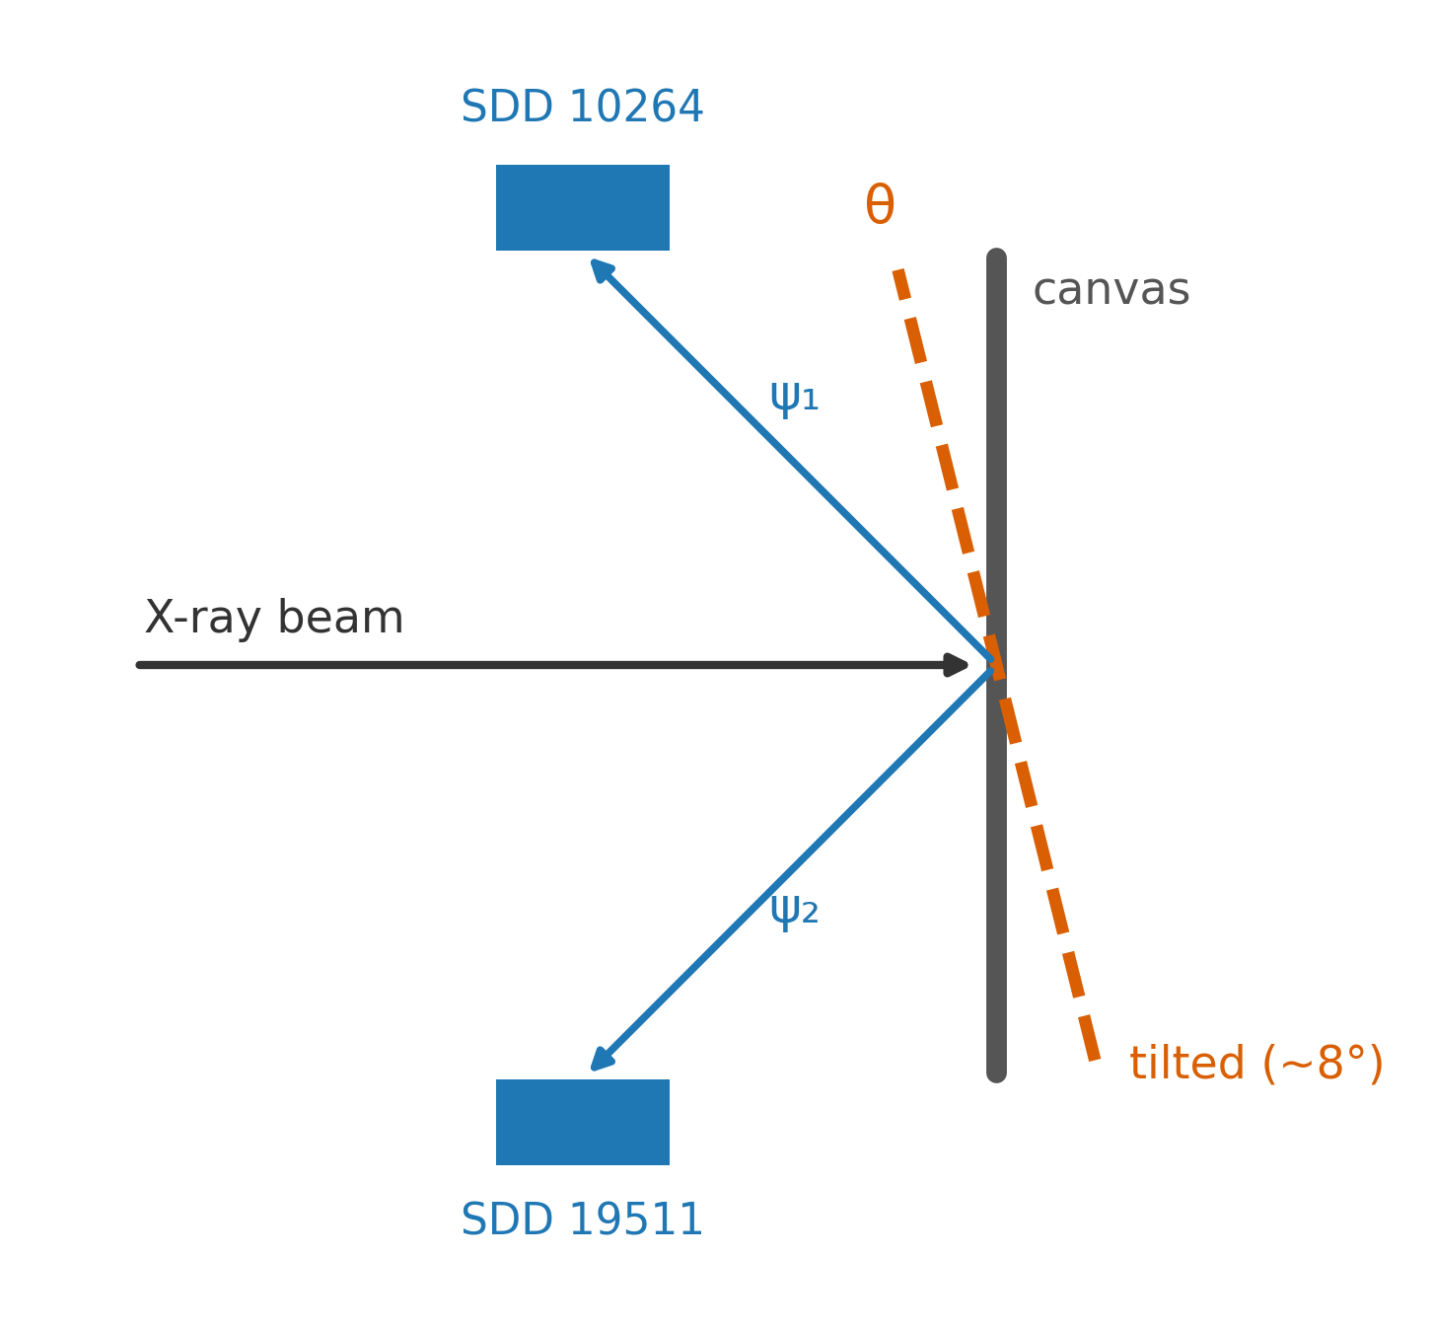
One tilted scan separates detector from geometry
Two SDD heads see the same spot from opposite take-off angles - their count ratio R(E) mixes a detector term with a geometric term.
Tilting the canvas moves only the geometric term: the photon exit paths through the paint change, the detectors do not.
A second, tilted scan therefore splits R(E): the detector part is tilt-invariant, the geometry part is tilt-dependent and energy-structured.
No calibration standards, no extra hardware - two routine scans of one painting.
Tilting moves the geometric term only.
Notes:
[0:30-1:30] Here is the idea. Our scanner has two detector heads, above and below the beam, so they see the same spot from opposite take-off angles. The ratio of their counts as a function of energy mixes two things we cannot separate from a single scan: the detectors' own response, and the geometry of the measurement. The trick is one extra scan with the canvas tilted forward by a few degrees. Tilting changes the paths the fluorescence photons travel through the paint to each detector — but the detectors themselves are untouched. So whatever changes between the two scans is geometry; whatever stays fixed is detector. Two routine scans of the same painting, and the ratio splits cleanly into a detector part and a geometric part.

Slide 3
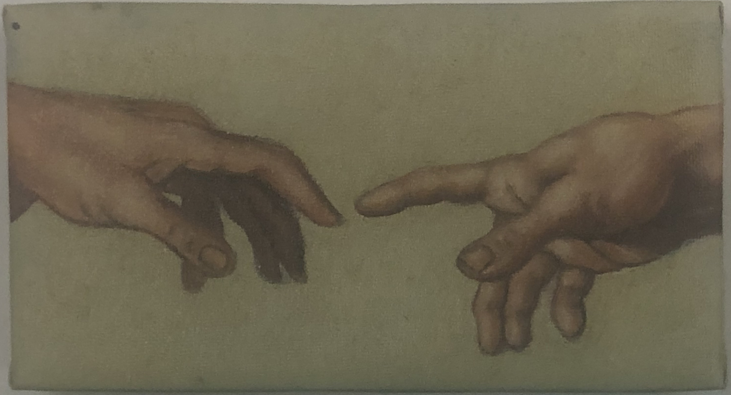
Two detectors, three scans, 7 200 pixels
2 detectors
Amptek X-123SDD heads - one above and one below the beam
3 scans
two frontal scans a week apart (repeatability) + one tilted scan (≤ 8°)
7 200 pixels
60 × 120 grid, 3.0 s dwell - 7 200 spectra per scan, per head
Mock-up canvas, Ars Mensurae MA-XRF scanner (40 kV / 50 µA).
All ratios are computed on the registered overlap of the scans (affine, NCC 0.965) - full-frame ratios carry a field-of-view artifact that can flip the tilt shift's sign.
Notes:
[1:30-2:00] The data: an Ars Mensurae scanner with two Amptek silicon-drift heads, scanning a mock-up canvas — the Creation of Adam hands — 60 by 120 pixels at three seconds per pixel, 7,200 spectra per scan. Three scans in total: two frontal scans a week apart, which give us the repeatability floor, and one tilted forward by up to eight degrees. Everything I show you is computed on the registered overlap of the scans, because full-frame ratios carry a field-of-view artifact.

Slide 4
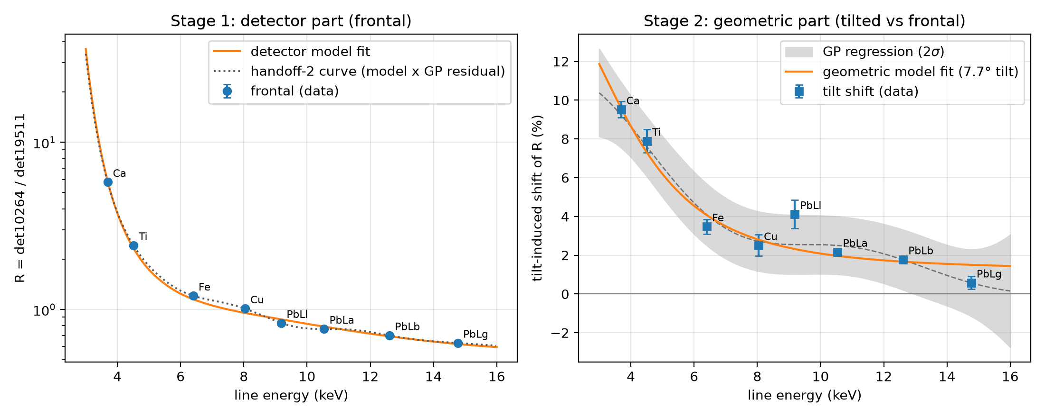
The two heads differ sixfold - and a physical model explains it
Points: measured on the registered overlap. Line: the physical model of each stage. Band: model-free GP fit, 2σ.
5.8 → 0.63
R from Ca Kα to Pb Lγ - a sixfold different signal from the same pigment
973 ± 2 µm
Be-equivalent absorber: 80–120× any entrance window - extra air path, not a window
+9.5 % → +0.6 %
tilt shift, Ca → Pb Lγ (24σ at Ca), monotonic - lever arm s = 0.53 ± 0.10
Notes:
[2:00-3:30] Here is the central result, in two stages. Stage one, the frontal scan: the measured ratio between the heads falls from 5.8 at calcium down to 0.63 at the lead L-gamma line. The same pigment, the same spot, gives the two detectors signals that differ by a factor of six — these channels are nowhere near interchangeable. A three-parameter detector model, the orange curve, reproduces this over two orders of magnitude. The fitted absorber is 973 microns beryllium-equivalent, plus or minus two. That is eighty to a hundred and twenty times thicker than any entrance window — so it is not a window; it is extra air path and collimation in front of the lower head. Stage two, the tilted scan: the tilt shifts the ratio by 9.5 percent at calcium — a twenty-four sigma effect — and the shift decays monotonically to half a percent at lead L-gamma. A thick-sample fluorescence model with antisymmetric take-off angles reproduces exactly this shape, and a model-free Gaussian-process fit agrees within one sigma. Detector and geometry, cleanly separated.

Slide 5
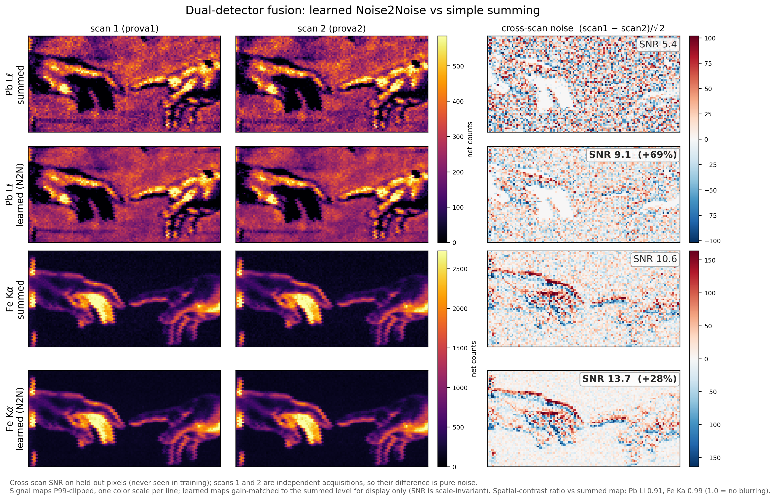
Learned fusion beats summing by 10–18 % SNR
The two channels are conditionally independent Poisson views of the same spot - Noise2Noise training needs no clean target.
1D U-Net with loss weights prescribed by the measured R(E): +17.7 % mean SNR on held-out pixels. Classical inverse-variance weighting: +0.9 %.
Six of eight lines gain: Pb Lℓ +69 %, Pb Lγ +33 %, Fe +28 %, Cu +17 %.
Ablation - the same network with an unweighted loss: −0.1 %. The gain is the measured variance structure, not the architecture.
Pb Lℓ and Fe Kα on pixels the network never saw: same signal, calmer noise. Right: the cross-scan difference.
Worth 39 % longer dwell time - for free.
Notes:
[3:30-5:00] Now — what is this separation good for? First: better fusion. The two channels are conditionally independent Poisson realizations of the same spot, which is precisely the setting for Noise2Noise training: each channel is the other's training target, no clean data needed. We train a small one-dimensional U-Net whose loss weights are prescribed by the measured ratio curve you just saw. The result: 17.7 percent mean SNR improvement over simple summing, on pixels the network never saw. For comparison, classical inverse-variance weighting gives less than one percent. On the right you see lead L-l maps: same signal, visibly calmer noise — plus 69 percent on that line. Six of eight lines gain. And here is the sentence I want you to remember: the identical network trained with an unweighted loss gains nothing — minus 0.1 percent. The gain is not the deep learning; it is the measured variance structure we feed it. In acquisition time this is worth 39 percent longer dwell — for free, from data you already have.

Slide 6
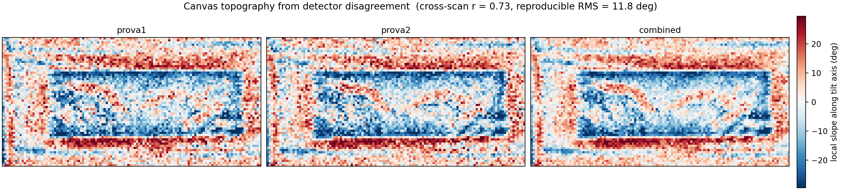
The discarded difference is also a relief map
Inverted through the measured tilt response, the per-pixel ratio residuals become repeated measurements of local surface slope - a relief map of the canvas from a single scan.
Local surface slope along the tilt axis, from one scan - the weave, the stretcher bar, the fabric deformation.
r = 0.73
cross-scan reproducibility of the relief map
88 %
of pixels consistent with pure geometry
χ²/dof = 0.85
goodness of fit; RMS ≈ 12° across eight lines
Notes:
[5:00-6:15] Second use — and this is my favourite slide. Once the detector part and the tilt response are measured, the per-pixel residuals of the ratio are no longer noise. Each of the eight emission lines becomes an independent measurement of the local surface slope at that pixel. Inverting them gives this: a relief map of the canvas, from a single scan — you can see the weave, the stretcher bar, the deformation of the fabric. It reproduces across scans with a correlation of 0.73, the fit quality is chi-squared per degree of freedom 0.85, and 88 percent of pixels are consistent with pure geometry. The difference everyone throws away is literally a picture of the canvas surface.

Slide 7
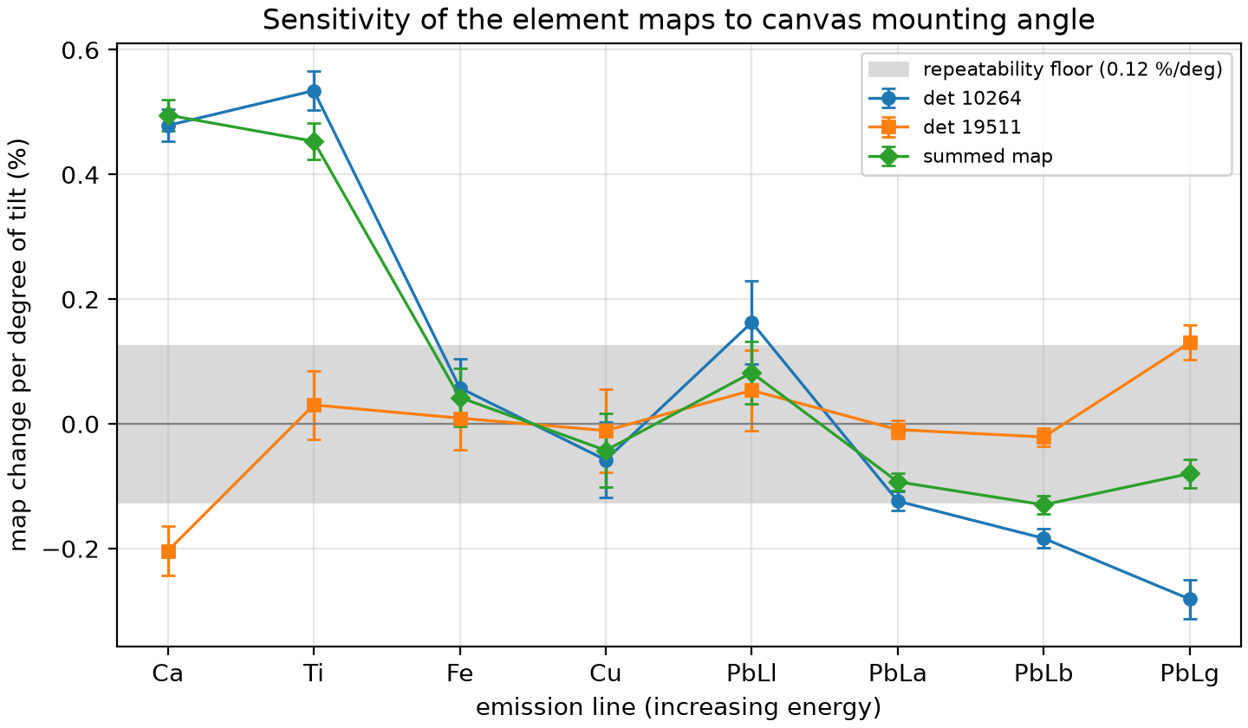
One degree of mounting error moves the maps
Element maps shift by up to 0.63 percentage points per degree of mounting error.
Ca +0.50 %/°, Ti +0.45 %/° - the light elements move most; Pb Lβ −0.13 %/° - exactly the energy order the model predicts.
Grey band: the repeatability floor from the two frontal scans. These shifts are lower bounds.
Mounting geometry belongs in the error budget of any quantitative MA-XRF campaign.
The light-element maps are the ones that move; the grey band is the repeatability floor.
Notes:
[6:15-6:45] There is also a warning in this data. One degree of error in how the canvas is mounted moves the element maps by up to 0.63 percentage points — calcium and titanium the most, lead barely at all — exactly the energy ordering the model predicts. The grey band is our repeatability floor, and these numbers are lower bounds. So mounting geometry belongs in the error budget of any quantitative MA-XRF campaign.

Slide 8
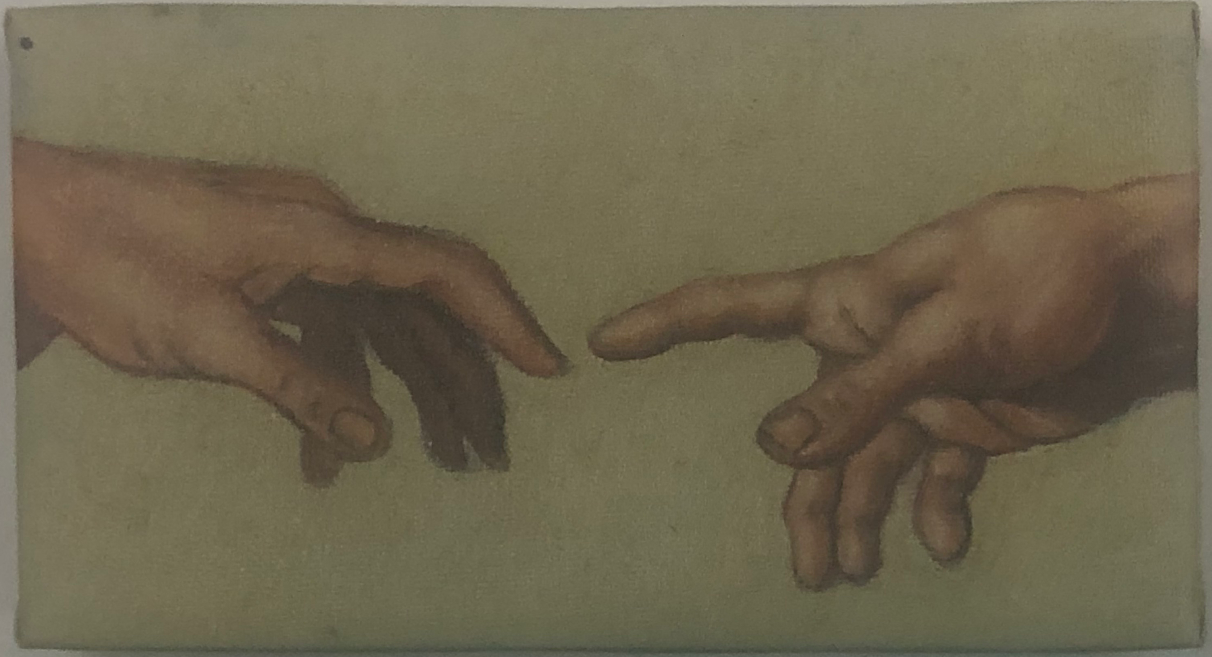
The difference between a scanner's two detectors - normally summed away - plus one tilted scan characterizes the instrument for free: detector response, acquisition geometry, canvas topography, and a learned fusion that beats summing by 10–18 % SNR.
Field MA-XRF scanners can characterize themselves from their own routine scans.
Come find us at the poster for the full story - code, data, and the complete analysis.
Research partially conducted at the Palace of Science, Miodrag Kostić Endowment. We thank Ars Mensurae for instrument access and the scans.
Notes:
[6:45-7:45] To sum up in one sentence: the difference between a scanner's two detectors — normally summed away — plus one tilted scan characterizes the instrument for free: detector response, acquisition geometry, canvas topography, and a learned fusion that beats summing by ten to eighteen percent in SNR. No standards, no extra hardware, no beam time lost — field scanners can characterize themselves from their own routine scans. Everything — the code, the data, and the full analysis — is at our poster, and we would love to talk. Thank you. [Aim to finish at 7:30-7:45.]

Slide 9
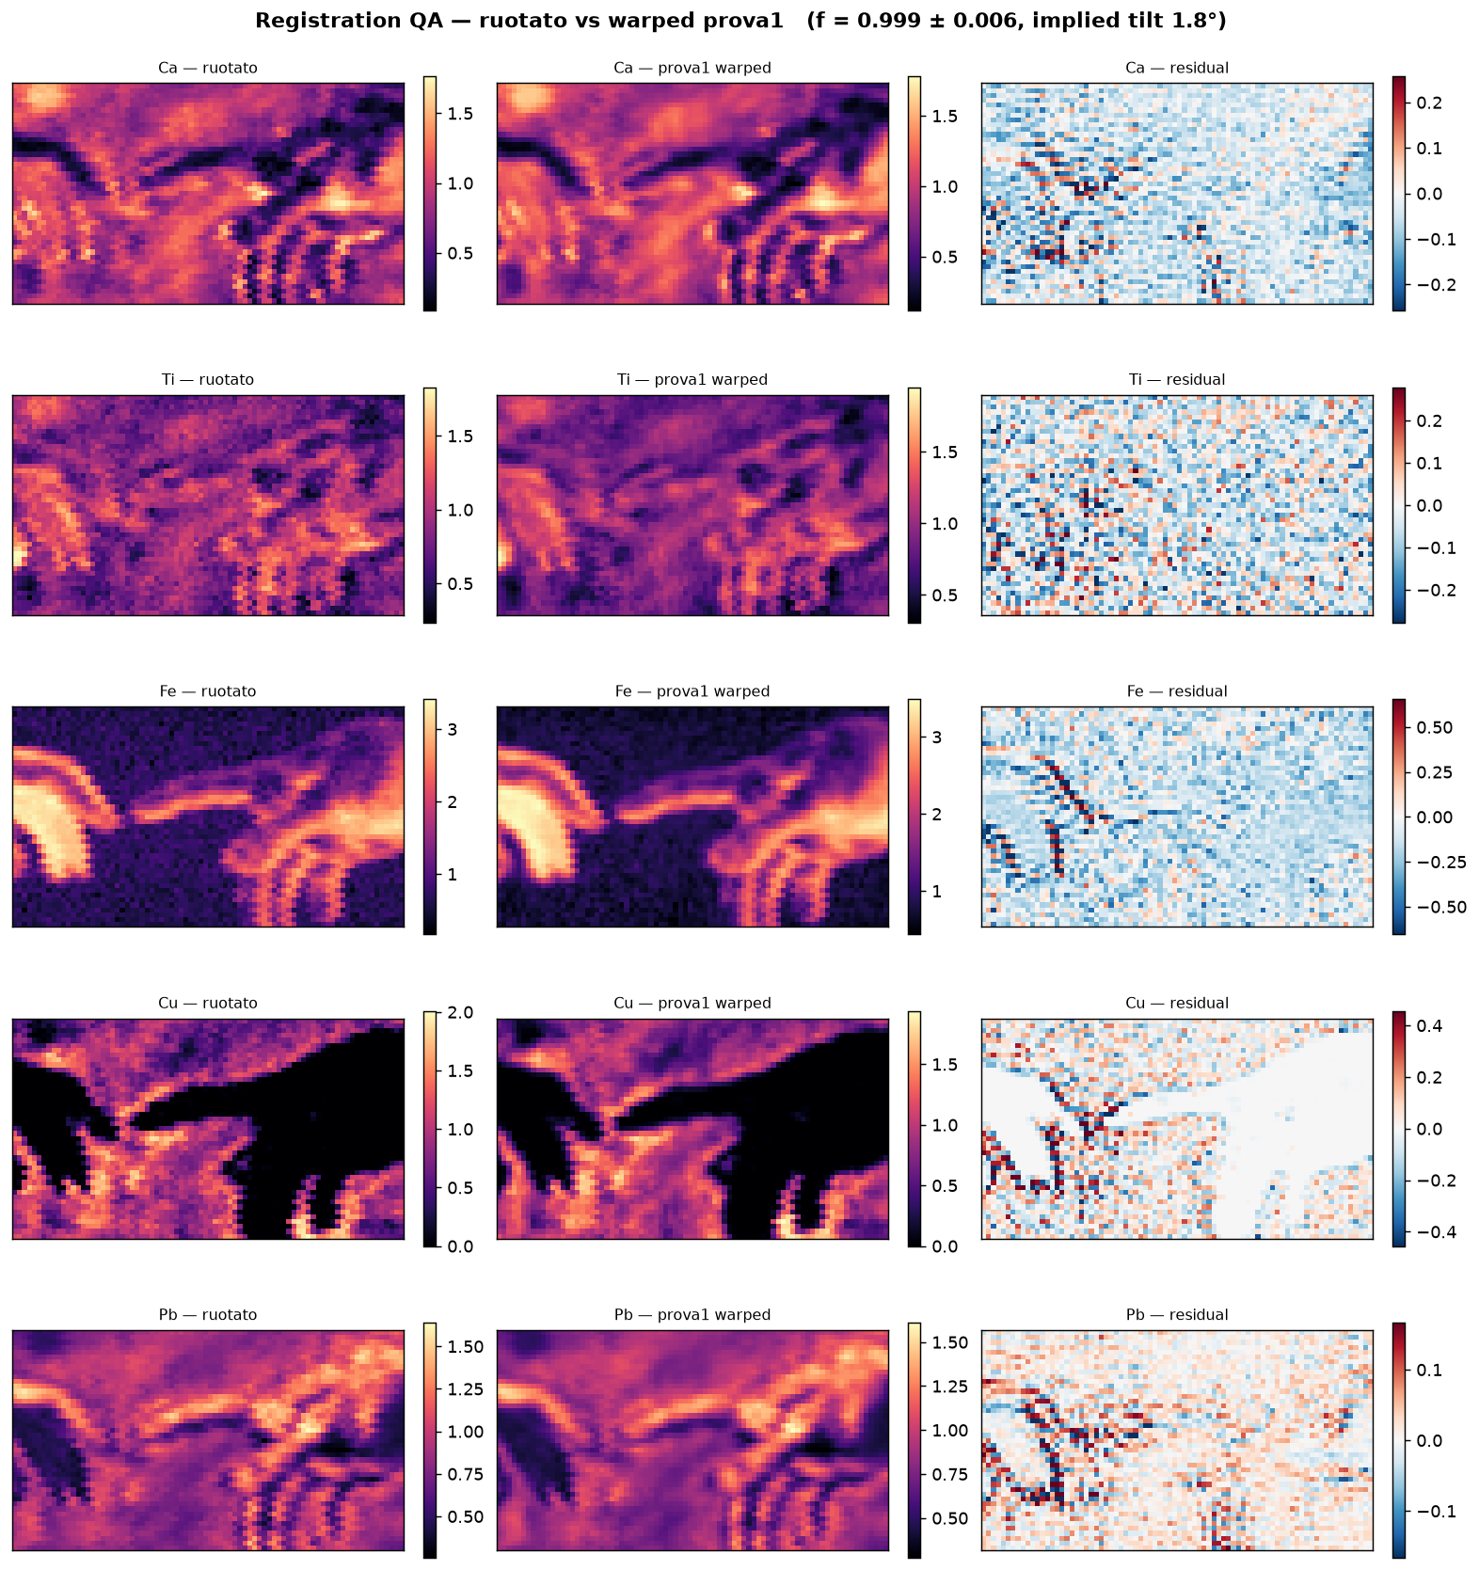
Why the ratio is not an artifact
All ratios are computed on the registered overlap of the two fields of view (affine registration, NCC 0.965).
Full-frame ratios mix in a field-of-view artifact large enough to flip the sign of the tilt shift - this is why registration is not optional.
Two frontal scans taken a week apart set the repeatability floor; every quoted shift is measured against it.
The flat-field non-uniformity correlates with the scatter-tail band (r = 0.86) - the residual pattern is physical, not processing.
Registration check: the two heads' fields of view.
Notes:
Backup for: 'Could the sixfold ratio or the tilt shift be an artifact?' Registered overlap, NCC 0.965; full-frame ratios can flip the sign; repeatability baseline from two frontal scans a week apart.

Slide 10
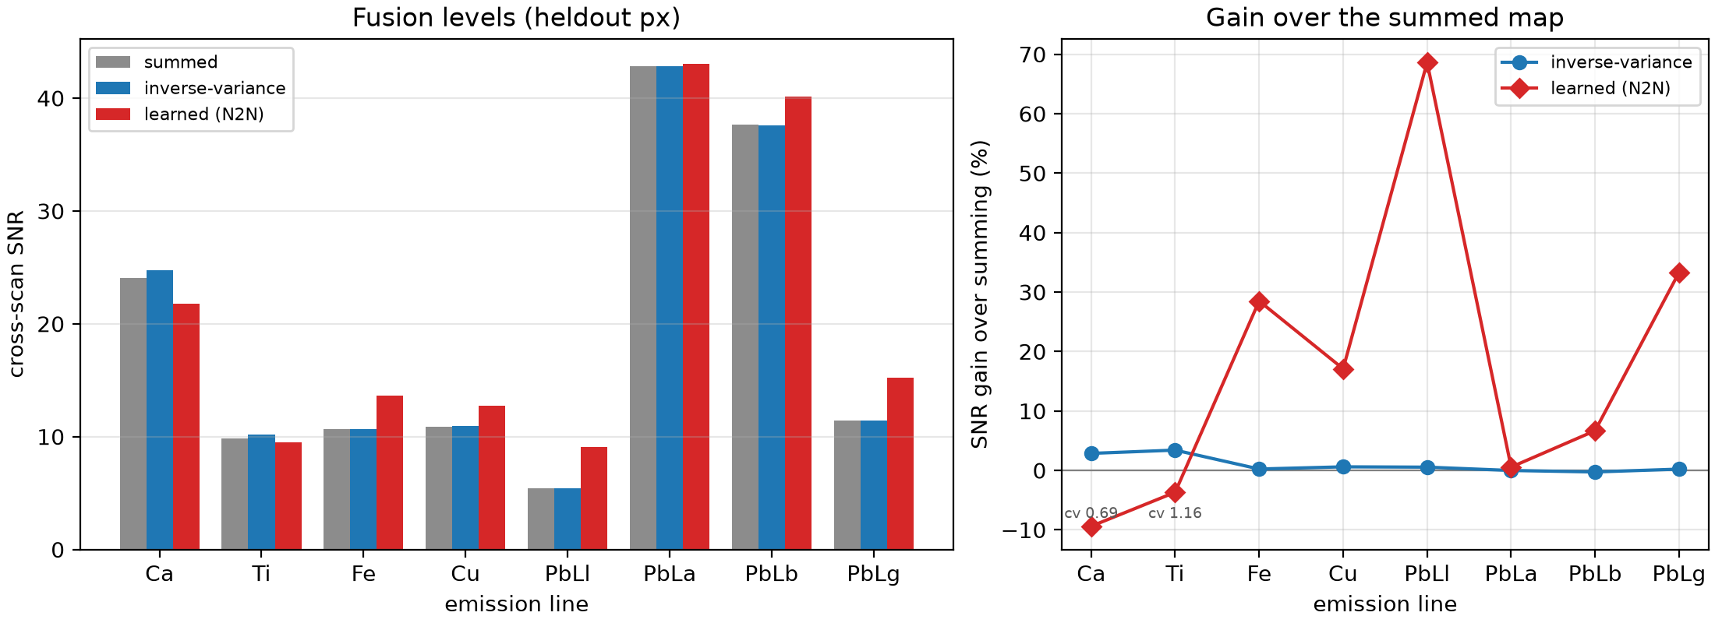
Per-line fusion gains - and why Ca and Ti stay on the sum
Six of eight emission lines gain; the two low-energy lines (Ca, Ti) show a level bias in the learned output.
For those two lines the fusion falls back to the plain sum - the method never degrades a map below simple summing.
Notes:
Backup for: 'Why do only six of eight lines gain?' Ca and Ti have a low-energy level bias, so they stay on the plain sum; the fallback guarantees the fusion never does worse than summing.

