Slide 1
Automated Chemical Vulnerability Assessment of Canvas Paintings from XRF Spectral Imaging Using Deep Learning and Foundation Models
Dimitrije Pešić · Janko Vukobratović · Aleksandra Stojanović · Giulia Ristori · Stefano Ridolfi · Maja Gajić-Kvaščev · Goran Kvaščev
University of Belgrade, School of Electrical Engineering · Ars Mensurae Rome · IDArtScience Rome · Vinča Institute of Nuclear Sciences
7,200
< 70 s
r > 0.98
0 labels
XRF spectra
end-to-end
reproducibility
training data
Science Conference 2026

Slide 2
Motivation
Why automate conservation risk assessment?
THE PROBLEM
XRF MACRO-SCANNING
OUR ANSWER
• Historical paintings degrade silently — damage often invisible until irreversible
• Pigments interact chemically: Cu greens corrode, Pb whites turn black, Fe catalyzes oxidation
• Traditional assessment: expert-driven, qualitative, does not scale to full surfaces
• Per-pixel elemental maps across entire painting surface
• 120 × 60 = 7,200 spectra at 3 s/pixel
• Non-invasive, no sampling required
• Problem: interpreting 7,200 spectra manually is impractical
• Fully automated pipeline
• Raw XRF → conservation-priority map
• Zero expert-labeled training data
• Under 70 s on a standard laptop
Key principle: preserve as much original material as possible → detect risk before it is visible

Slide 3
Pipeline Overview
Five stages · no labeled training data · <70 s end-to-end
1
2
3
4
5
Self-Supervised Denoising
Elemental Extraction
NMF Corroboration
Chemical Vulnerability Index
SAM Region Segmentation
1D U-Net Poisson splitting
→
5-pt calibration ROI + background sub.
→
K=5 components <5% recon. error
→
5 literature rules Geometric mean
→
13 regions Per-region CVI
INPUT: raw .mca spectra
OUTPUT: per-region risk report
U-Net inference
Extraction + NMF
CVI + metrics
SAM segmentation
28 s · 40%
10.5 s · 15%
3.5 s · 5%
28 s · 40%

Slide 4
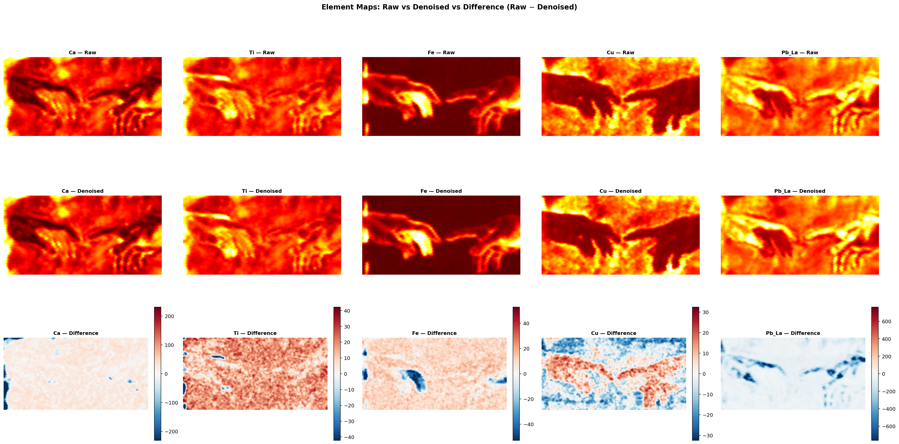
Spectral Analysis
Denoising → calibration → element maps → NMF corroboration
SELF-SUPERVISED DENOISING
• XRF counts follow Poisson statistics
• Noise2Self: Binomial-split spectrum into two halves (x, y)
• Train 1D U-Net to predict y from x → no clean reference needed
• 4-level encoder/decoder, ~1.66M params, PNLL loss
ELEMENTAL EXTRACTION
• 5-point linear calibration: E = 0.0292·c − 0.069 keV (R² > 0.9999)
• ROI integration + linear background from off-peak sidebands
• Spectral overlap corrections (Cu Kβ→Zn, Pb/As regression)
• As/Pb Lα overlap at ΔE = 0.007 keV — below detector FWHM
NMF (K=5) independently recovers the same 5 material groups — Pb, Ca/Fe, Cu, Ti, Compton — reconstruction error <5% → cross-validates physics-based extraction

Slide 5
Chemical Vulnerability Index (CVI)
Literature-grounded degradation risk, pixel-level
CVI(i,j) = max_k { w_k · √( A_k(i,j) · B_k(i,j) ) }
DEGRADATION RULES
ID
Mechanism
Elem.
w
• Geometric mean → high score only when BOTH incompatible elements co-occur
• Single-element rules (R2, R3): CVI_k = w_k · A_k
• All intensities percentile-normalised → CVI in [0, 1]
• Gaussian filter σ=1 px to suppress pixel-level noise
R1
TiO₂/CaCO₃ thermal mismatch
Ti / Ca
0.40
R2
Cu-based green pigment degradation
Cu
1.00
R3
Lead white darkening (PbS)
Pb
1.00
FOUR RISK ZONES
R4
Trapped moisture under TiO₂
Ti / Cu
0.60
Low <0.25
Moderate 0.25–0.50
Elevated 0.50–0.75
Critical ≥0.75
R5
Fe-catalyzed Pb oxidation
Fe / Pb
0.80
No action
Monitor
Intervene
Urgent
Sensitivity: ±15% weight perturbation → <8% change in mean CVI · top-decile ranking preserved in >92% of pixels

Slide 6
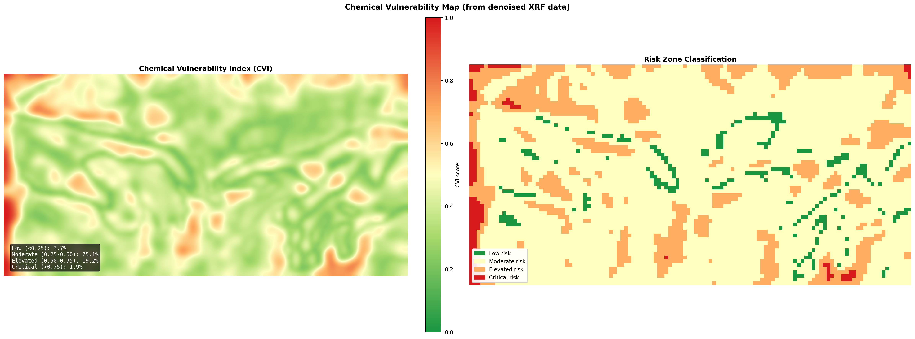
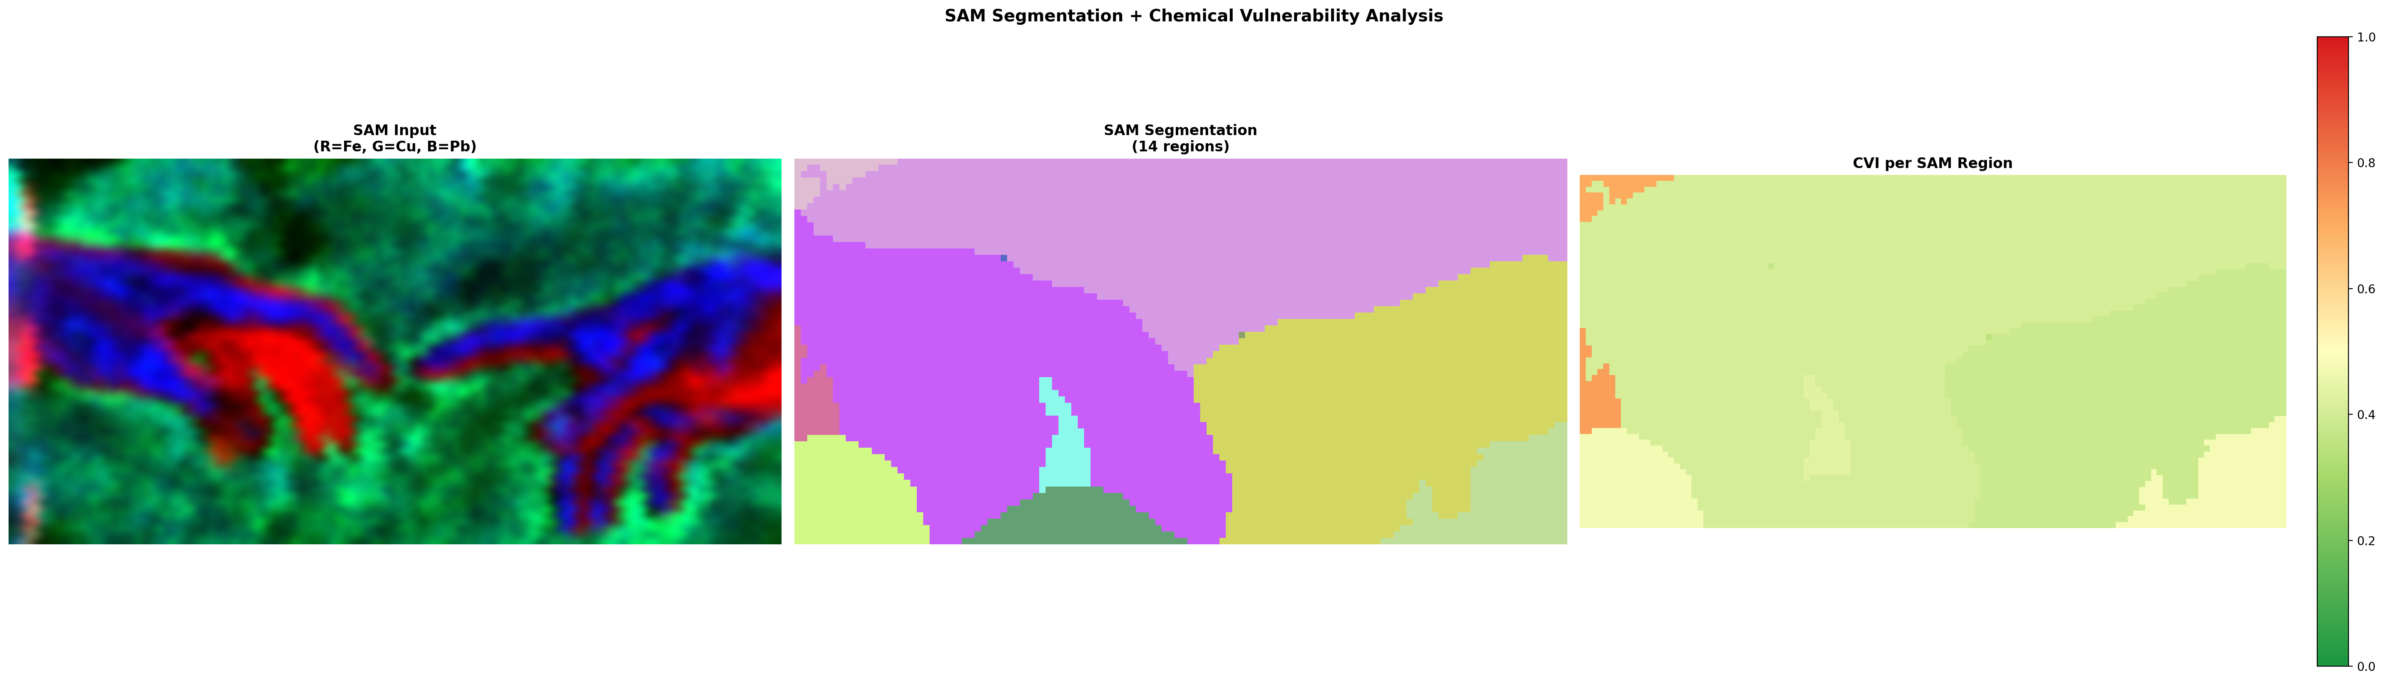
Results
Reproducibility · CVI distribution · SAM region analysis
SCAN REPRODUCIBILITY
CVI ZONE DISTRIBUTION
SAM REGION ANALYSIS
Two scans, 7 days apart, same conditions
13 regions auto-identified
Low
13.9%
Ca Kα
0.992
Pb-dominated
Fe Kα
0.993
Moderate
49.9%
max CVI 0.93 · mean 0.54
Urgent (R3 – Pb darkening)
Pb Lα
0.991
Cu Kα
0.983
Elevated
30.3%
Cu-dominated
max CVI 0.97 · mean 0.45
Ti Kα
0.982
Monitor (R2 – Cu degr.)
Critical
5.9%
Composite CVI (prova1 vs prova2)
W₁=0.0054
r=0.994
SSIM=0.982
R2 (Cu degradation) elevated on ~22% of pixels R3 (Pb darkening) on ~19% R5 traces figural contours
Ti/Cu overlap
mean CVI ≈ 0.45
Without denoising: W₁ +65%, SSIM −0.018 → U-Net improves stability but physics-based extraction is dominant source of agreement
Moisture entrapment (R4)

Slide 7
Further Work & Conclusions
Limitations and next steps
WHAT WE SHOWED
NEXT STEPS
• Fully automated XRF → conservation-priority map in <70 s
• No expert-labeled training data at any stage
• Cross-scan reproducibility r > 0.98 on all elements
• Composite CVI stable across scans (W₁ = 0.0054, SSIM = 0.982)
• 13 SAM regions with per-region risk summaries
• CVI critical zone: 5.9% of pixels flagged
Validate CVI against expert conservator assessments on real paintings with known degradation outcomes
Integrate NMF abundance maps as CVI inputs — capture material mixtures invisible to single-element thresholds
Extend to paintings with different conservation histories; adapt rule weights as needed
Resolve As/Pb Lα overlap (ΔE=0.007 keV) with higher-resolution detectors or deconvolution
PRINCIPAL LIMITATION
All validation is internal consistency on one mockup canvas — ground-truth comparison against conservator assessments on real paintings with documented degradation outcomes is required.
Build conservator-facing GUI/API — no Python expertise required
The contribution is the workflow itself: end-to-end automation of a procedure that traditionally requires extensive expert analysis.

