Slide 1
Geometry-resolved Characterization of a Dual-detector MA-XRF Scanner
Aleksandra Stojanović, Dimitrije Pešić, Janko Vukobratović, Giulia Ristori, Stefano Ridolfi, Maja Gajić-Kvaščev, Goran Kvaščev
University of Belgrade - School of Electrical Engineering · Ars Mensurae, Rome · IDArtScience, Rome · Vinča Institute of Nuclear Sciences / VINARH
EuCAIFCon 2026 - Heidelberg
Notes:
0:00-0:15
Good morning. I will show how a dual-detector MA-XRF scanner can be characterized - efficiencies, geometry, even the mounting angle - using nothing but routine scans of a painting.

Slide 2
Two detectors, one discarded signal
• MA-XRF scans a painting pixel by pixel; XRF lines give element maps (Ca, Fe, Pb, ...)
• Many scanners carry two SDD detectors; their signals are summed for signal-to-noise
• The difference between the two channels is treated as noise and thrown away
That discarded difference is a calibration signal.
Notes:
0:15-1:15
Set the scene: MA-XRF, two detectors, summing is standard practice. The premise of this work: the part everyone throws away carries quantitative information about the instrument itself. Everything that follows is extracted from that difference.

Slide 3
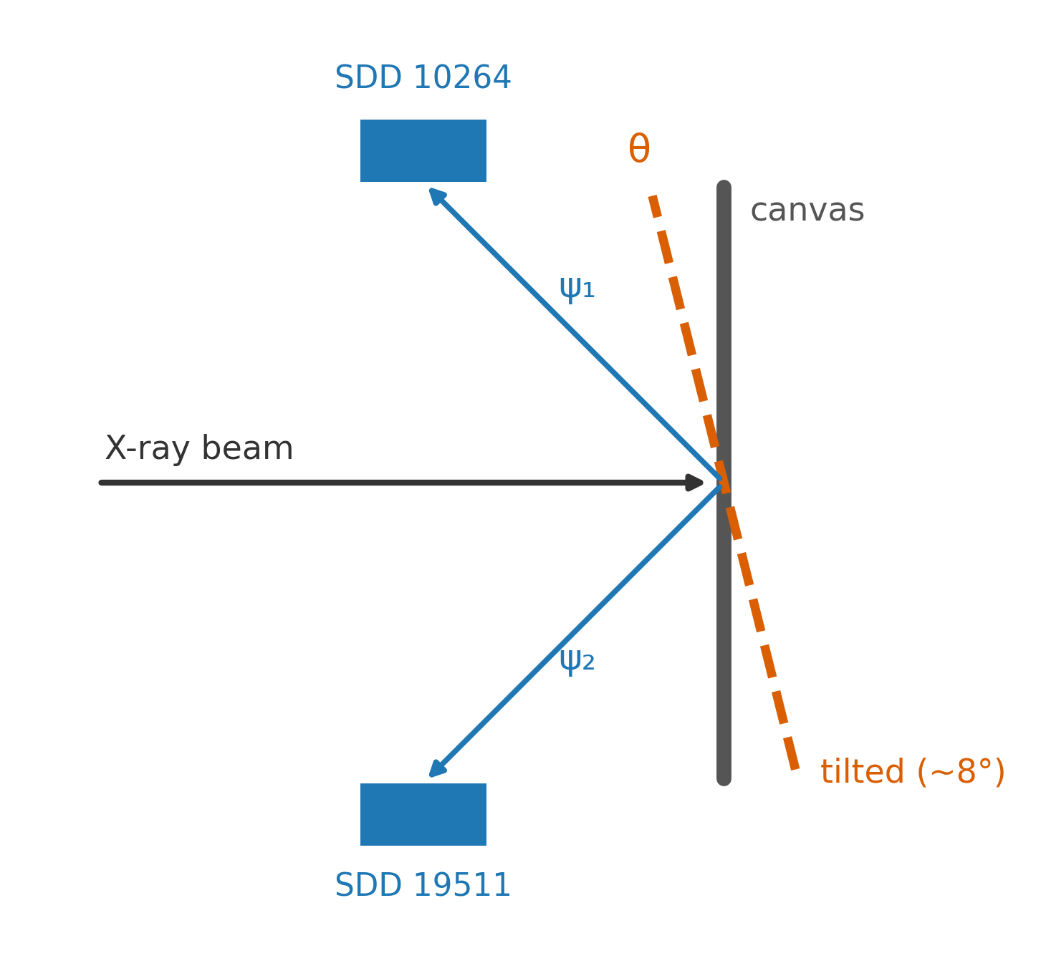
One extra tilted scan splits the physics
• Scan the same painting twice: frontal, and with the canvas tilted forward
• Tilting changes the photon paths to each detector - the detectors stay the same
• The per-element ratio R(E) = det1 / det2 then separates into:
– detector part - tilt-invariant (absorbers, Si thickness, gain)
– geometric part - tilt-dependent, energy-structured
• “with no dedicated calibration measurements”
Notes:
1:15-2:15
The one-slide method. The tilt is the control knob: it moves only the geometry. Comparing tilted vs frontal ratios cleanly separates detector properties from acquisition geometry. Quote the abstract: no dedicated calibration measurements - no reference targets, no monochromatic sources.

Slide 4
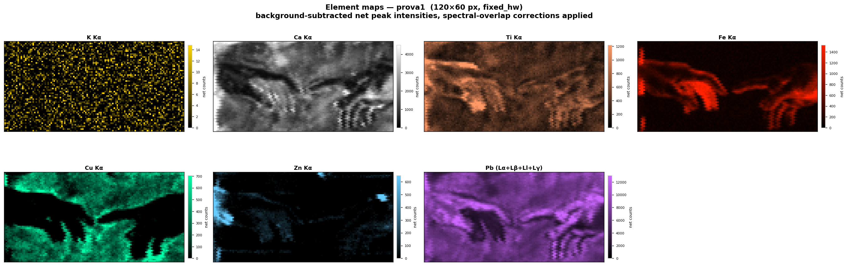
Instrument and data
• Canvas copy of the Creation of Adam; Ars Mensurae MA-XRF scanner, two SDDs (s/n 10264, 19511)
• Three scans: two frontal, 7 days apart (repeatability baseline), one tilted forward
• 8 usable lines from Ca Kα (3.7 keV) to Pb Lγ (14.8 keV); bootstrap uncertainties
Notes:
2:15-3:00
The test object is a canvas copy of the Creation of Adam - the element maps show the two hands. Three routine scans, nothing else. The two frontal scans give the repeatability floor; the tilted one is the geometry probe.

Slide 5
The two channels disagree - up to sixfold
line | E (keV) | R frontal | tilt shift | signif.
Ca Kα | 3.69 | 5.78 | +9.5 % | 24σ
Ti Kα | 4.51 | 2.42 | +7.9 % | 13.5σ
Fe Kα | 6.40 | 1.21 | +3.5 % | 9.2σ
Cu Kα | 8.04 | 1.01 | +2.5 % | 4.6σ
Pb Ll | 9.19 | 0.828 | +4.1 % | 5.6σ
Pb Lα | 10.54 | 0.765 | +2.2 % | 11.5σ
Pb Lβ | 12.61 | 0.699 | +1.8 % | 10.3σ
Pb Lγ | 14.77 | 0.630 | +0.6 % | 1.8σ
• Same pixels, same painting: the frontal ratio runs from 5.8 down to 0.63 across energy
• Frontal repeatability ≤ 1.4 % - the tilt moves the ratio up to 24σ above it
• The shift decays monotonically with energy, +9.5 % → +0.6 % - geometry, not drift
• Ratios from the registered overlap region only: a crop test showed full-frame ratios mix in a field-of-view artifact
• Four Pb lines share pixels and composition: a pure energy dependence
Notes:
3:00-4:15
Table 1 in one look. Two messages: the channels are far from interchangeable (6x at calcium), and tilting produces a highly significant, monotonically decaying energy pattern. Mention the crop test: restricting to the registered overlap removed a field-of-view artifact - that is why these are the trustworthy numbers. The four lead lines are the internal control - same pixels, same composition, only energy differs.

Slide 6
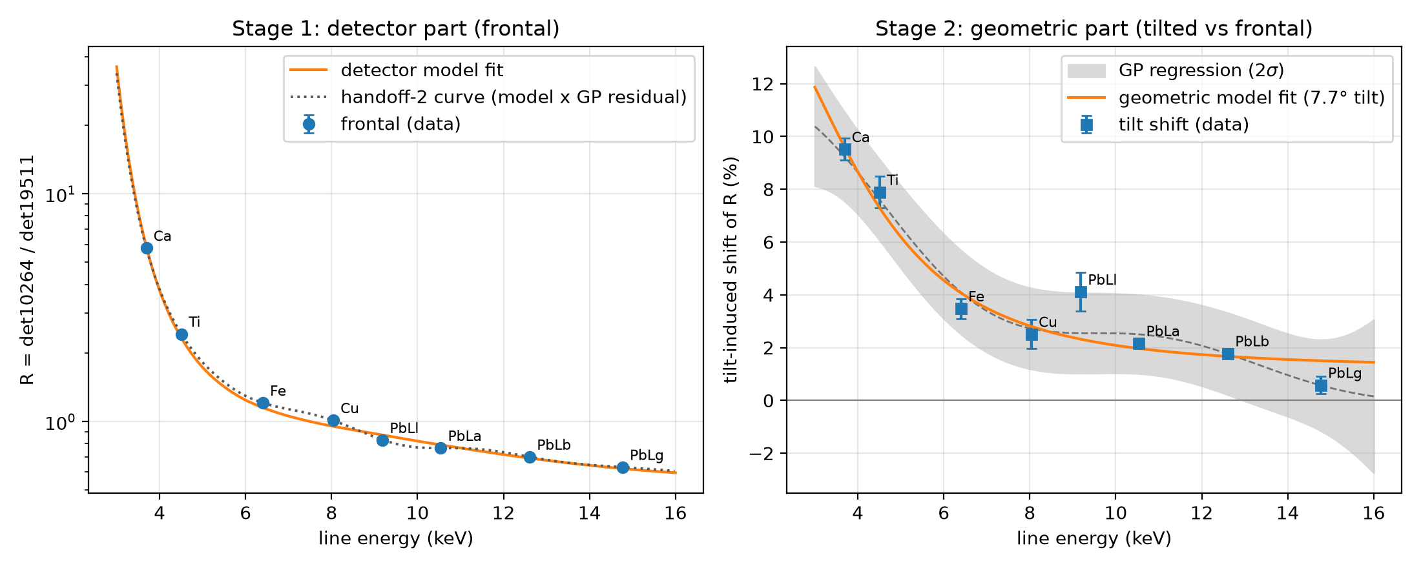
Stage 1 - what separates the detectors
• Three-parameter model: gain × differential absorber × Si-thickness ratio
• Reproduces R(E) over two orders of magnitude
• Fitted absorber: 973 ± 2 µm Be-equivalent - 40-100× a real SDD window
• ⇒ ≈15-20 cm extra air path / collimation in front of detector 19511
• An instrument diagnosis obtained from painting scans alone.
Notes:
4:15-5:15
The frontal curve is explained by detector properties alone. The surprise: the fitted low-energy absorber is the equivalent of a millimetre of beryllium - no window is that thick. It corresponds to 15-20 cm of air, so one detector must sit further away or behind a collimator. We learned that about the hardware without opening it. Manufacturer specs since received (X-123SDD family): nominal window 8-12.5 um Be and 500 um Si - the fitted reference matches the factory value; snout extenders up to 9 in exist, so a long-extender mounting of 19511 is the concrete candidate. Per-unit configuration still pending.

Slide 7
Stage 2 - what the tilt reveals
• Tilt shift of R: monotonic positive decay, +9.5 % at 3.7 keV → +0.6 % at 14.8 keV
• Thick-sample fluorescence model; the tilt moves the effective take-off angles
• Lever arm s = 0.53 ± 0.10 ⇒ take-off shift 4.1° ± 0.8° at this tilt
• Gaussian-process check (no physics inside): same shape, model within 1.1σ
• ⇒ the shape lives in the data, not in the model
Notes:
5:15-6:15
The tilt-dependent part follows textbook fluorescence geometry. With a single tilt the individual take-off angles are not identifiable - what is, is how fast they move: about half a degree per degree of tilt. The grey band is a GP regression that knows no physics; the physical model stays inside it everywhere.

Slide 8
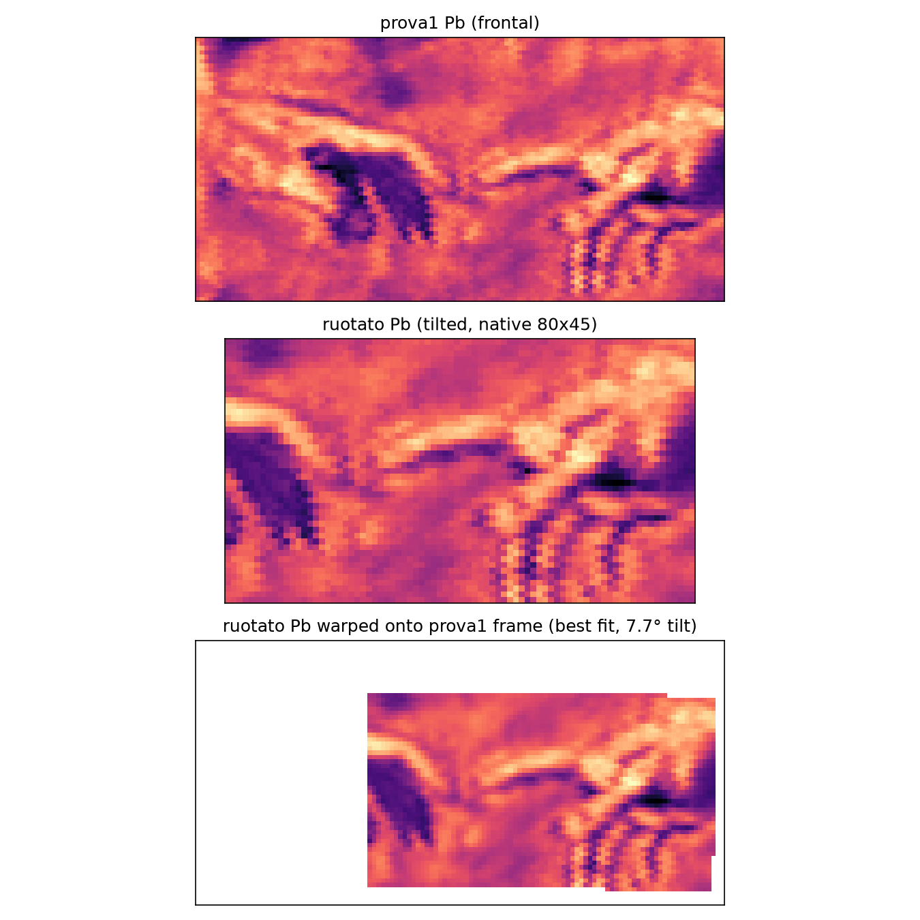
The scan measures its own geometry
• A forward tilt compresses the image vertically by cos θ
• Register tilted ↔ frontal with independent x/y scales: sy/sx = 1/cos θ - the unknown step sizes cancel
• θ = 7.7° ± 1.0° ± 1.8° - an upper bound (θ ≲ 8°)
• A no-tilt control pair returns “5.3°”: foreshortening at this angle sits near the resolution floor
• Bonus: two “identical” frontal sessions differ by 0.43 % in scale - a measured positioning drift
Notes:
6:15-7:15
The mounting angle was never recorded - and it turns out we never needed it. The tilt compresses the image vertically, and the scan step sizes cancel in the scale ratio, so the angle falls out of registration: about 8 degrees. Be upfront: a control pair with no tilt returns five degrees, so we quote it as an upper bound until the instrument builder confirms. The precision floor itself is a result: it is the positioning drift between two nominally identical sessions.

Slide 9
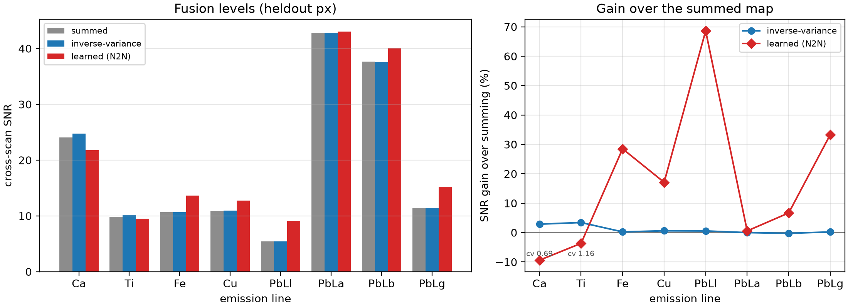
What the characterization buys
fusion benchmark: cross-scan SNR on held-out pixels
• Flat-field map: RMS ≈ 9 %, reproduced across scans (r = 0.70) - and it is the scatter-artifact geometry (r = 0.86)
• Mounting-error price list: 0.50 %/° (Ca), 0.45 %/° (Ti), ≤ 0.13 %/° (Pb) - lower bounds
• Fusion: inverse-variance +0.9 % - the null is a finding (Poisson-limited channels); learned N2N +17.7 % mean SNR (six lines from Fe up, Pb Ll +69 %; Ca/Ti kept on the sum)
• Canvas relief from one scan: local-slope map from the per-pixel ratio residuals, reproducible at r = 0.73 and tilt-law consistent (chi2/dof 0.85)
Notes:
7:15-7:45
Everything here reuses the earlier numbers. The flat-field is reproducible and is literally the scatter-artifact geometry - one acquisition story. The weighting null is itself a finding: the channels are Poisson-limited, no scalar reweighting can win. The learned fusion goes beyond scalars: two detectors are two noise realizations of the same spectrum - Noise2Noise, no clean targets - and it gains 17.7 percent on pixels it never trained on. We quote it only where the absolute level is preserved; Ca and Ti stay on the sum. If asked: validation MSE does not rank these models like map SNR does - MSE rewards shrinking to the mean; hence the contrast guard.

Slide 10
Conclusions
• Detector difference + one tilted scan = geometry-resolved characterization, with no dedicated calibration measurements
• Per-element efficiency ratios (5.8 → 0.63); detector vs geometry separated: take-off response 0.5°/°, matrix scale Ec ≈ 3.6 keV
• Self-supervised fusion of the two channels: +17.7 % SNR over summing on held-out pixels
• The data self-report their geometry: tilt ≲ 8°, session drift 0.43 %, flat-field = the artifact geometry
• Data and code: github.com/JankoVukobratovic/VincaInternship
Notes:
7:45-8:00
One sentence to leave with: the signal everyone throws away is enough to characterize the instrument - including the angle nobody wrote down - and, once characterized, the two channels fuse into a better measurement than their sum. Thank you; happy to take questions.

Slide 11
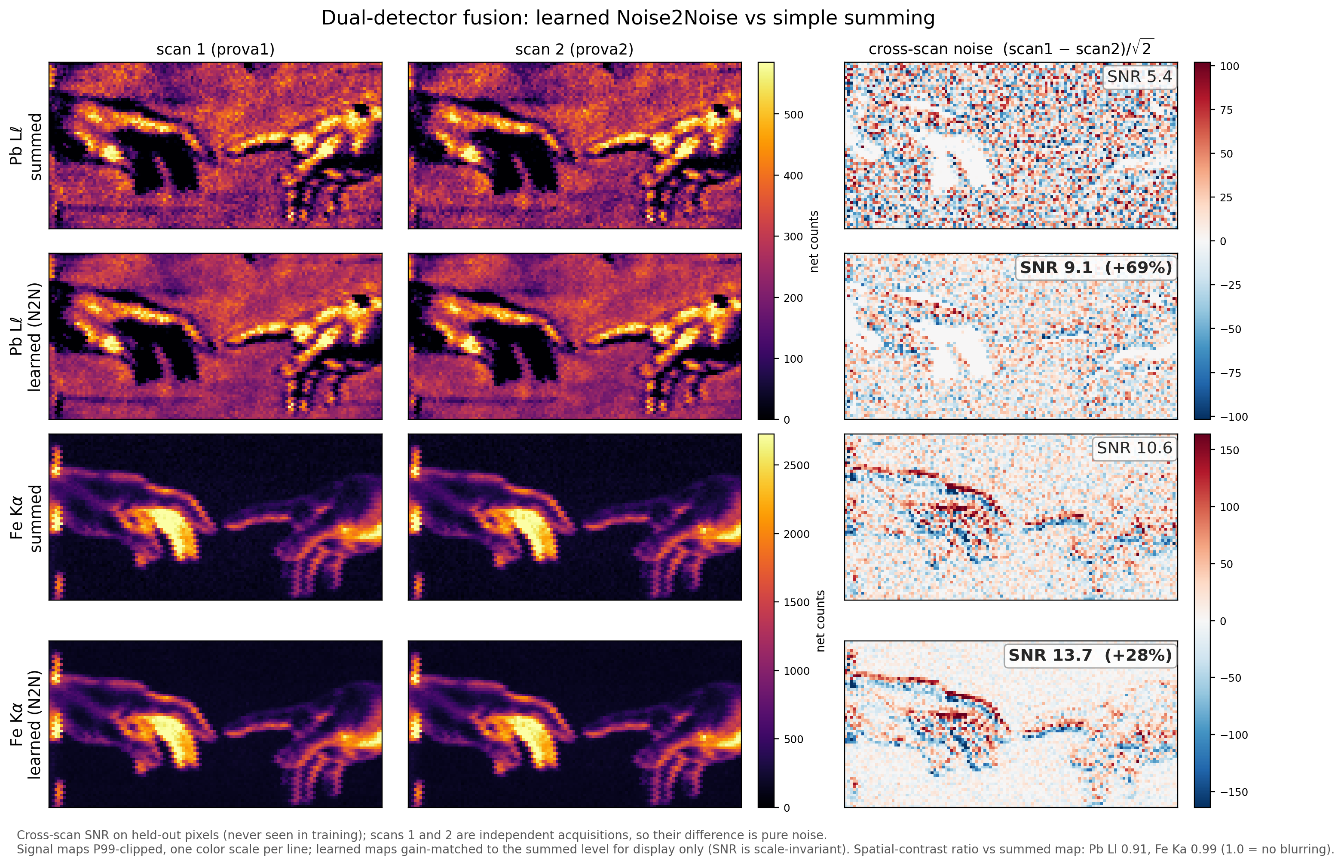
Backup - fusion seen on the maps
cross-scan noise panels: summed vs learned, held-out SNR annotated
Notes:
BACKUP - not part of the 8:00. If asked how the fusion gain looks in practice: same signal structure, visibly calmer noise panels; Pb Ll 5.4 to 9.1, Fe 10.6 to 13.7 on pixels the network never trained on. Contrast guard cv = 0.91-0.99: not blurring.

Slide 12
Backup - why not the individual take-off angles?
• Fitting both take-off angles directly returns ~1e5-degree uncertainties: with a single tilt the shift is first-order in the RESPONSE, second-order in the asymmetry
• Identifiable: the lever arm s = 0.53 ± 0.10 deg/deg - how fast the effective angles move per degree of tilt
• With the builder-confirmed mean take-off angle psi, the per-detector effective angles follow as psi ± s·theta (pending confirmation)
• Same story for the tilt angle itself: foreshortening at 7.7 deg sits near the registration floor (a no-tilt control pair returns “5.3 deg”) - hence the upper bound
Notes:
BACKUP - not part of the 8:00. Use if the abstract-vs-talk difference on viewing angles comes up: the abstract promised per-detector angles; with one tilt only the response is identifiable, and the per-detector values need the nominal head geometry from the instrument builder. Status: the builder sent tube settings (40 kV, 50 uA), 2 cm working distance and a spec sheet - but for s/n 10791, not our units; per-detector mounting is still requested.

