Slide 1
VAE
Pointnet Style

Slide 2






VAE-Model Architecture Encoder
MLP
$$μ ∈ ℝ^{Z}$$
Projection
$$\overset{⃑}{g}$$
MLP
$$\log{σ^{2}} ∈ ℝ^{Z}$$
$$ℝ^{Nx3}$$
$$ℝ^{H}$$
Pointcloud
Global Feature
$$≈N\left(0, I\right)$$
Conv(1x1)
Conv(1x1)
Conv(1x1)
Encoder

Slide 3




VAE - Model Architecture Decoder
$$μ ∈ ℝ^{Z}$$
Upsample
Linear
ResBlock
Upsample
Linear
ResBlock
z $∈$ $ℝ^{Z}$
$$\log{σ^{2}} ∈ ℝ^{Z}$$
$$ℝ^{Nx3}$$
Pointcloud
Decoder

Slide 4
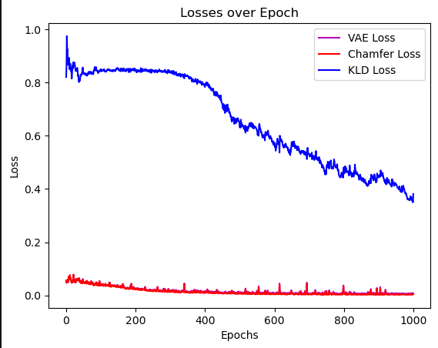
Training with 1000 Epochs
Keeps decreasing, convergence not reached
While vae loss stays low
Low chamfer and vae loss
also very stable

Slide 5
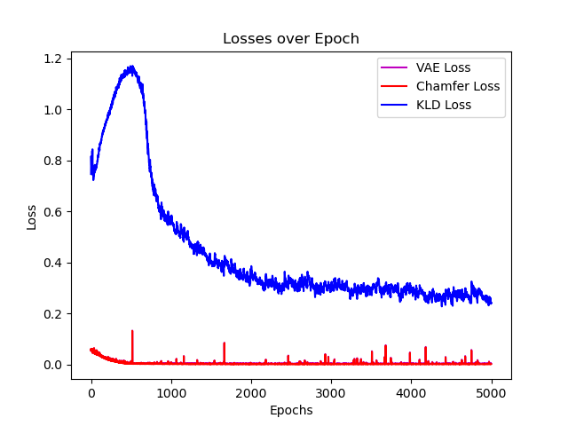
Training with 5000 Epochs

Slide 6
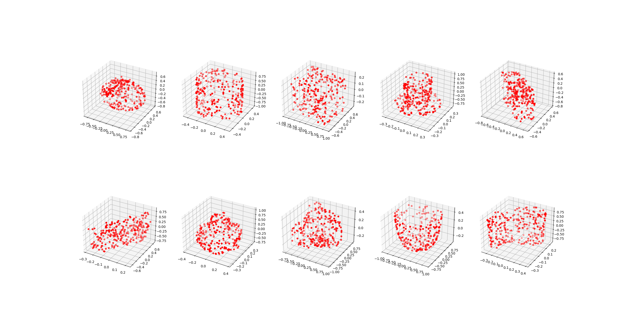
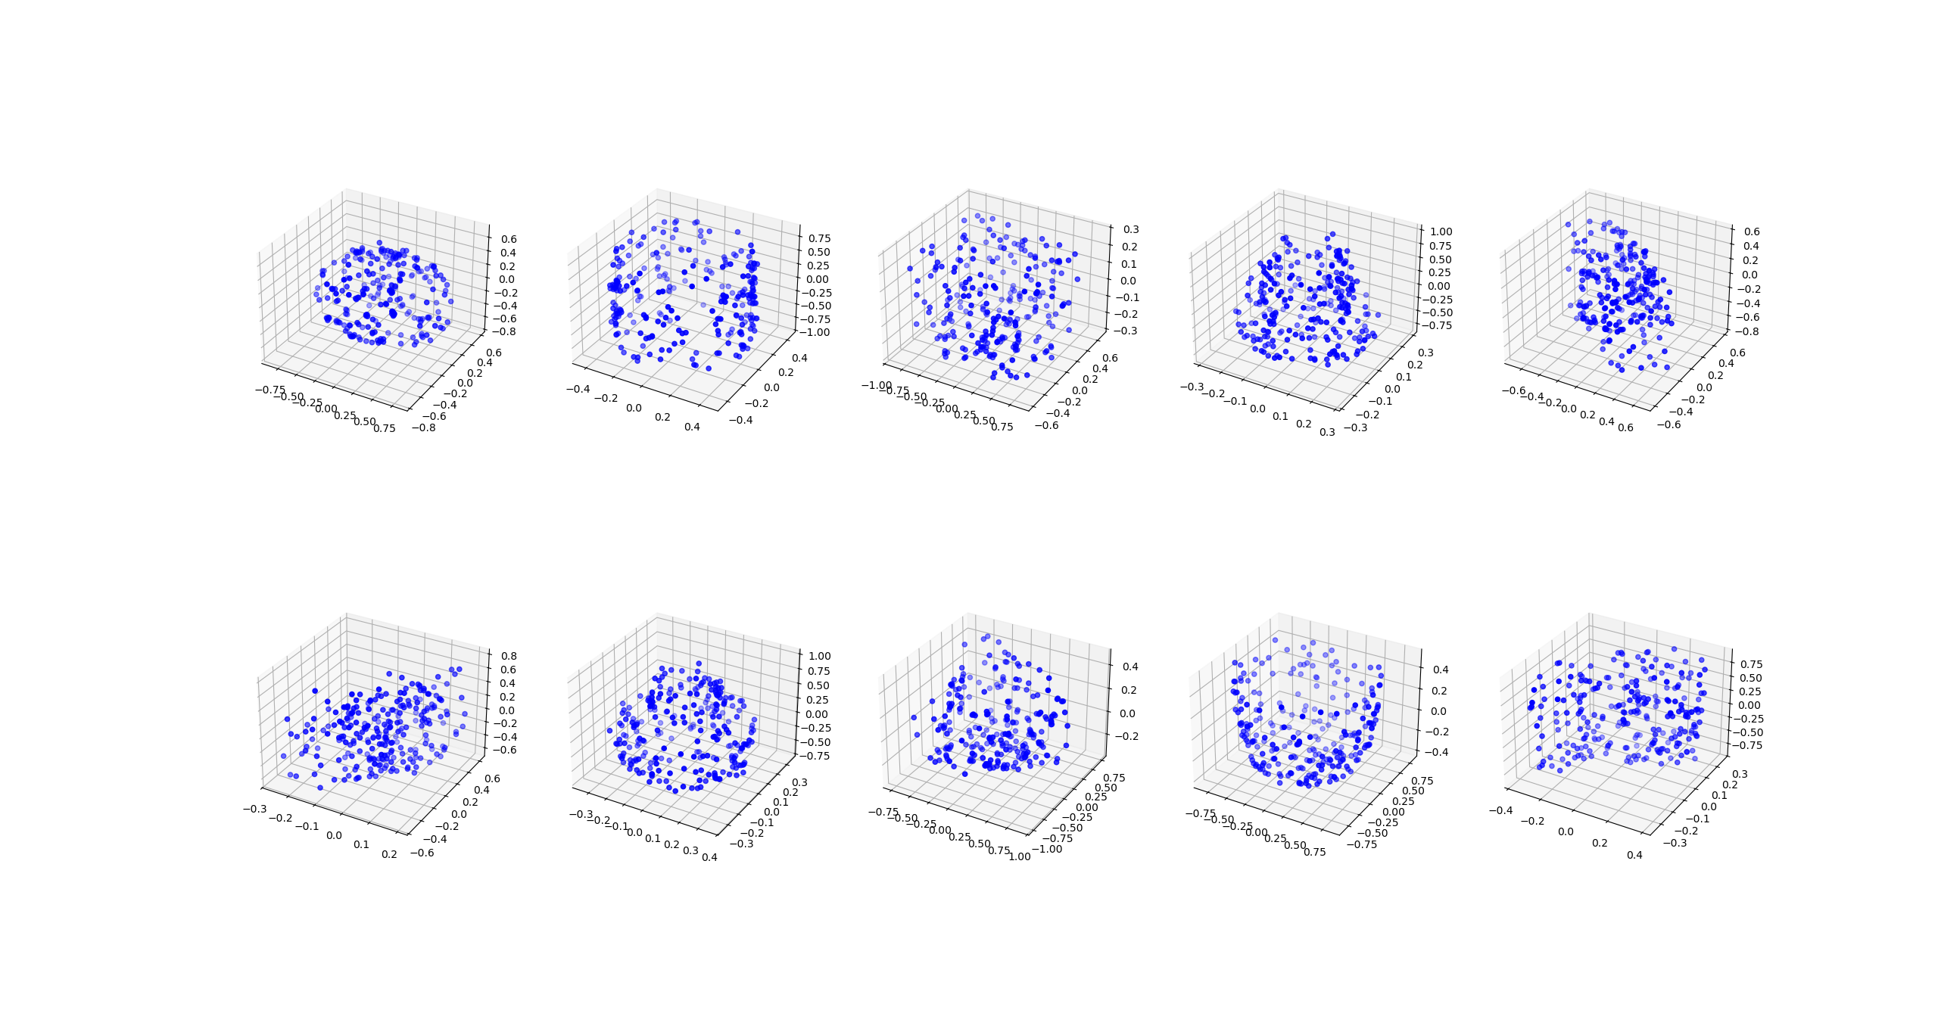
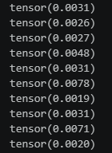
Comparing predicted vs target Pcs 1000 Epochs
Target
Predicted

Slide 7
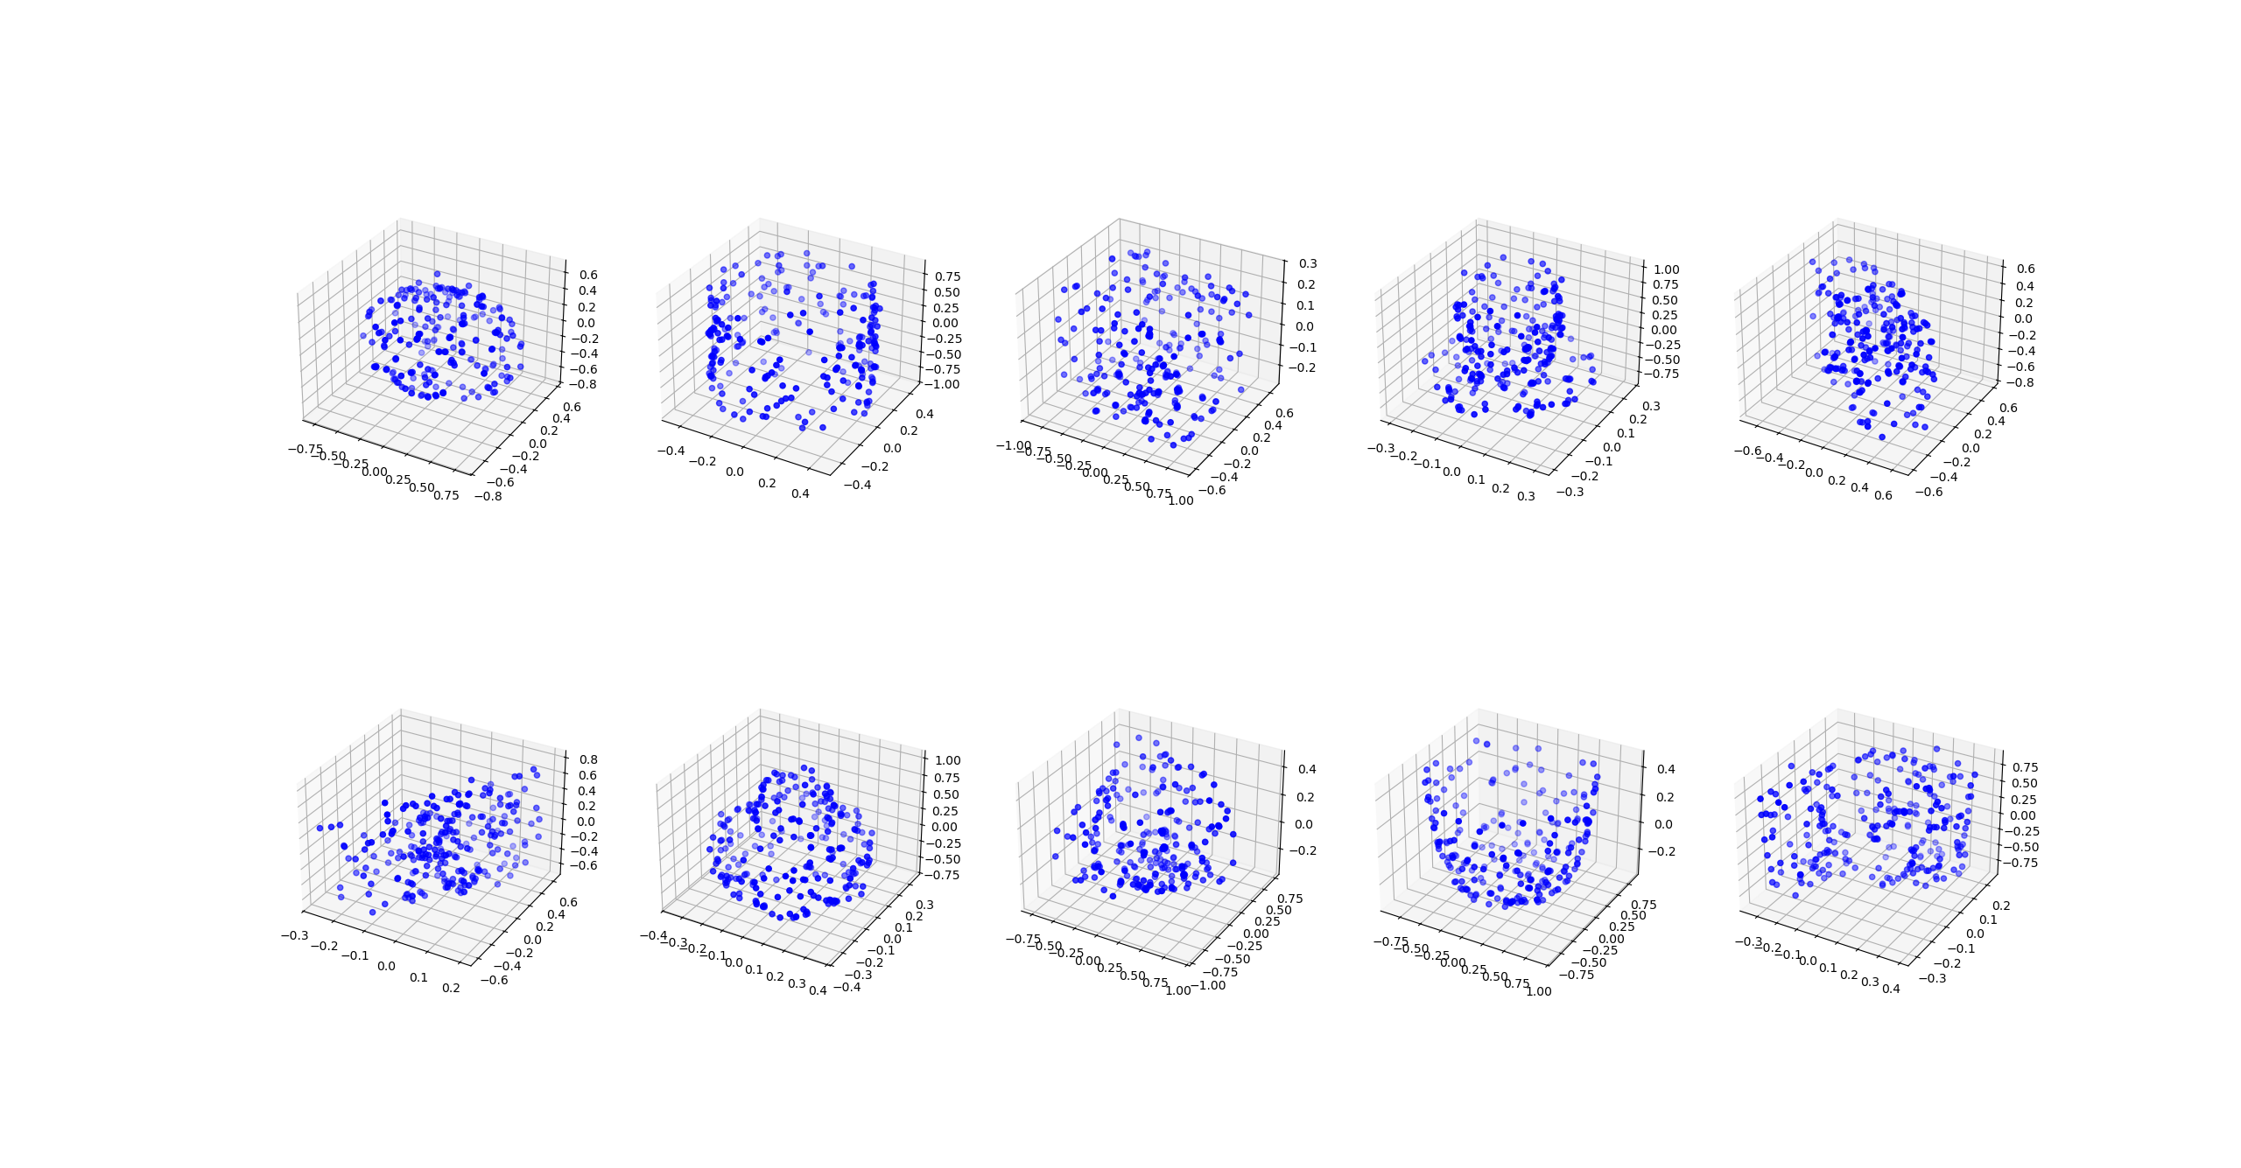
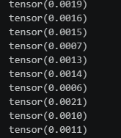
Comparing predicted vs target Pcs 1000 Epochs

Slide 8
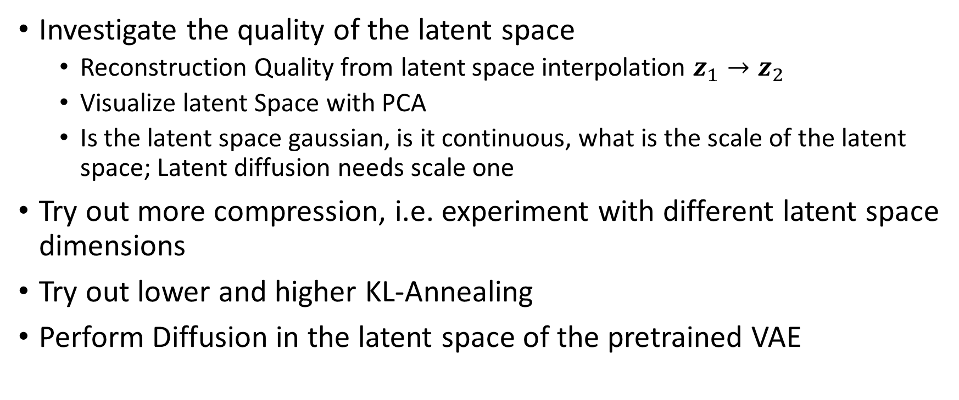
Future Research
Investigate the quality of the latent space
Reconstruction Quality from latent space interpolation $z_{1}→z_{2}$
Visualize latent Space with PCA
Is the latent space gaussian, is it continuous, what is the scale of the latent space; Latent diffusion needs scale one
Try out more compression, i.e. experiment with different latent space dimensions
Try out lower and higher KL-Annealing
Perform Diffusion in the latent space of the pretrained VAE

