Slide 1
Generating Point Clouds from Grasps Milestones
Christian Yankacar and Nikola Jankulovic

Slide 2
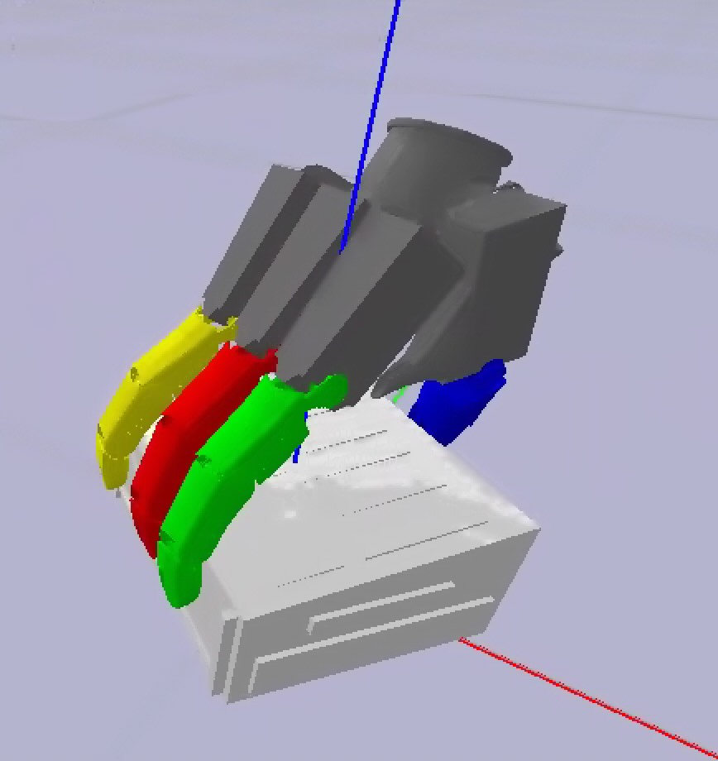
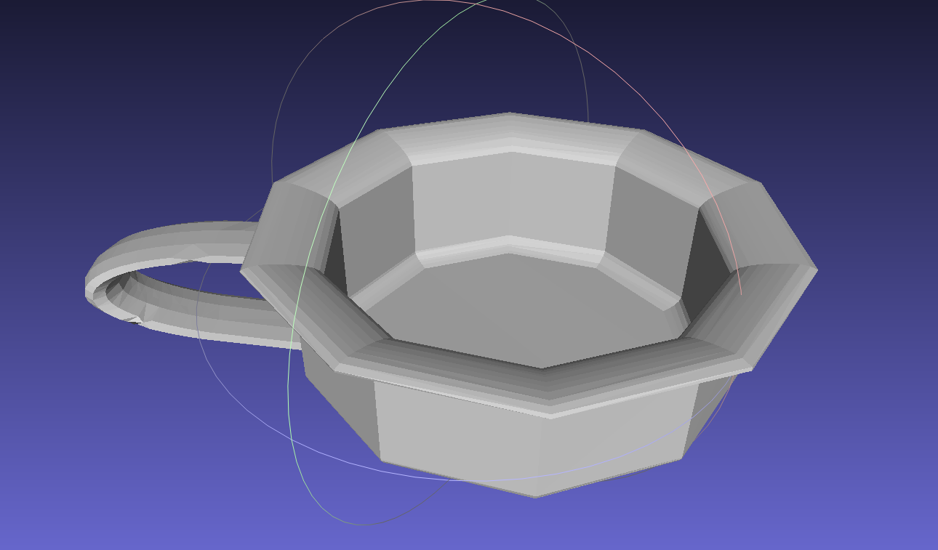
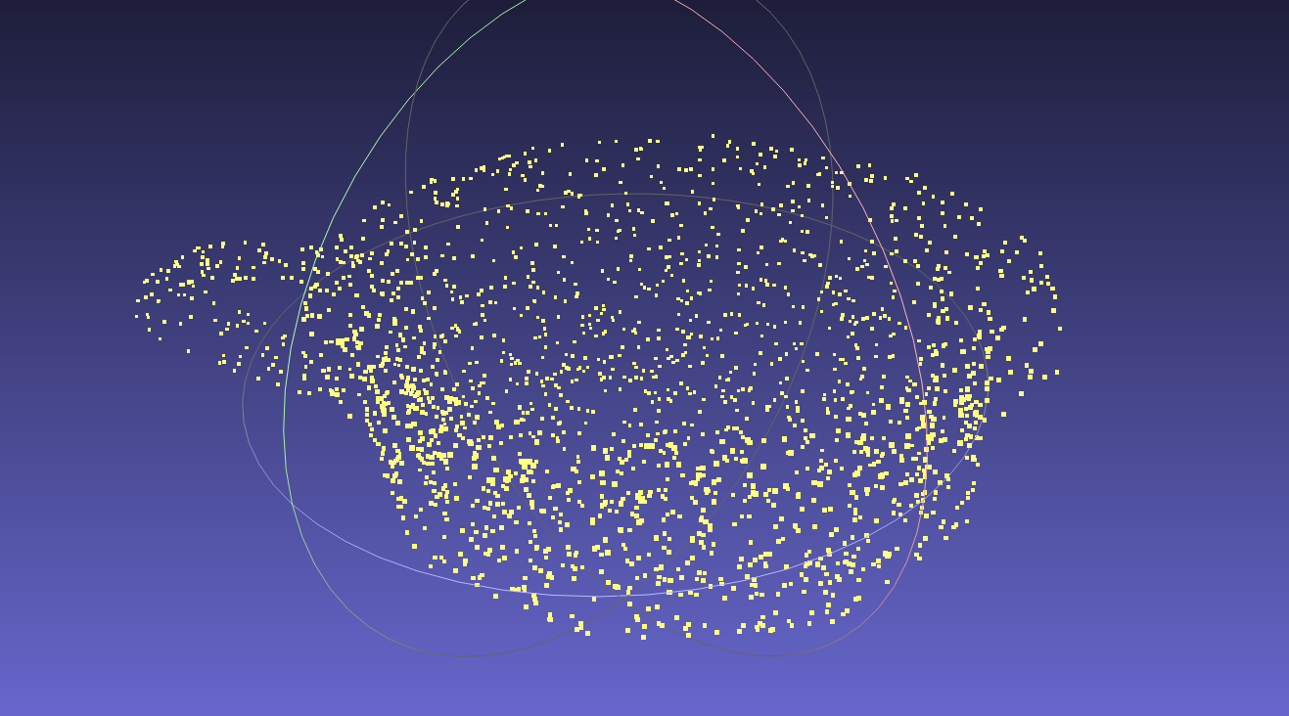



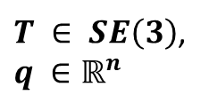
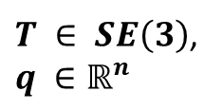
Problem Definition
Given Data
Training Data
$$+$$
Sample Point Cloud
$$+$$
Grasp
Object Mesh
Point Cloud
$${x∈ℝ}^{N×3}$$
Grasp
$T ∈ SE\left(3\right)$,
$$q ∈ℝ^{n}$$
$T ∈ SE\left(3\right)$,
$$q ∈ℝ^{n}$$
Deep Learning Pipeline
Diffusion Model
Postprocessing

Slide 3










Diffusion-Autoencoder
Pointnet Encoder
Pointwise Decoder
$$μ$$
Reparame-trization
$$z$$
$$x_{0}$$
$$N\left(x_{t−1}|μ_{θ}\left(x_{t},z,t\right),β_{t}I \right)$$
$$σ^{2}$$
$$ℒ_{KL}\left\{q_{Φ}||N\left(0,I\right)\right\}$$
Model learns reverse Markov Chain
$$x_{t}$$
$$t\sim \left\{1, 2, 3, …,T\right\}$$
After T steps
$$x_{0}∈ℝ^{N×3}$$
Autoencoder
$$x_{t}=N\left(x_{t}| \sqrt{β_{t}−1}{ x}_{t−1},β_{t}I \right)$$
Can be defined as a forward Markov Chain

Slide 4
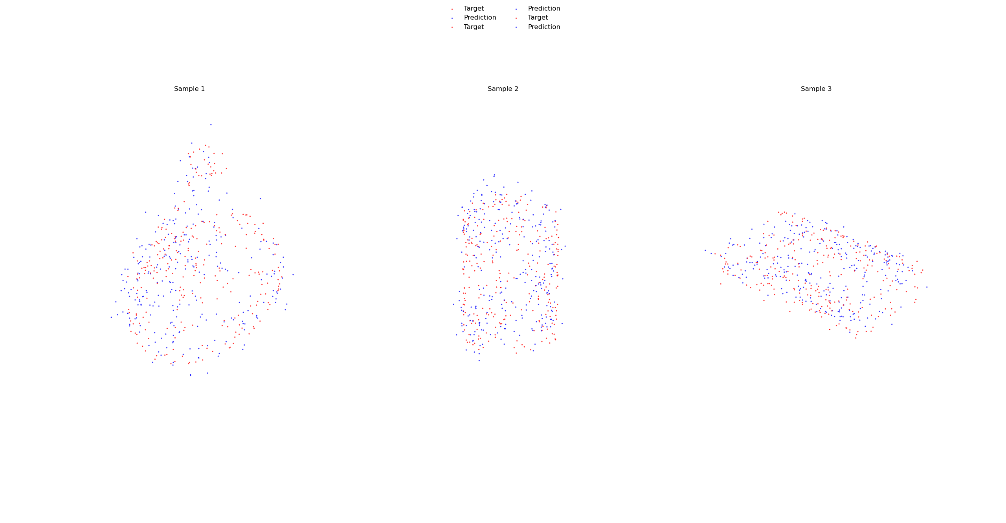
Autoencoder Predicted Point Clouds 256 Points end-to-end
predicted
target
Sample 1
Sample 2
Sample 3
Chamfer Distance
0.0248
0.02
0.0168

Slide 5
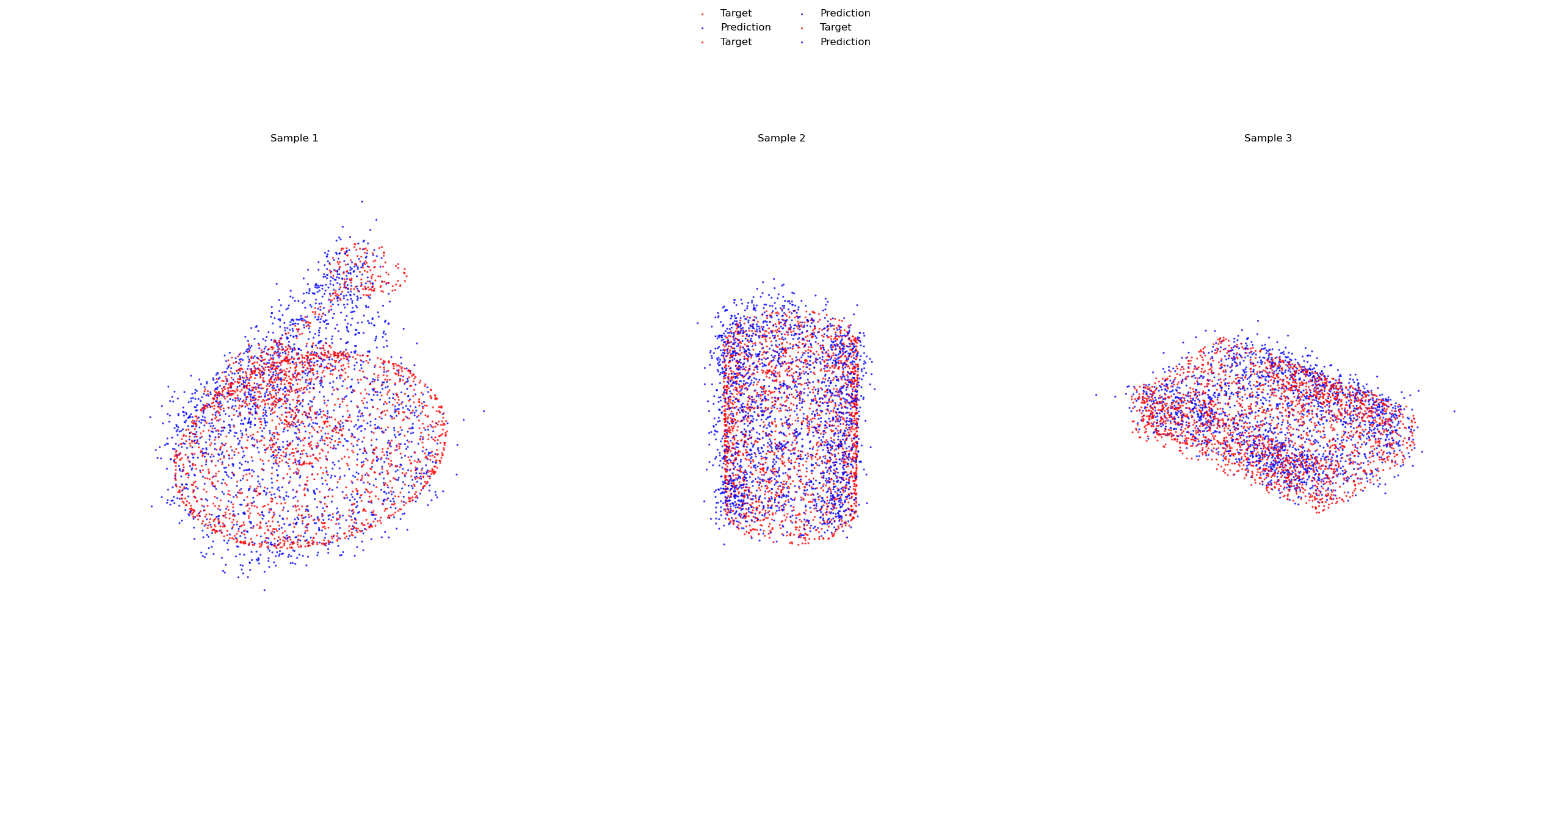
Autoencoder Predicted Point Clouds 2048 Points end-to-end
predicted
target
Sample 1
Sample 2
Sample 3
Chamfer Distance
0.0141
0.0116
0.0088

Slide 6
Autoencoder with Pretrained Encoder
predicted
target
Sample 1
Sample 2
Sample 3
Chamfer
Distance
0.0056
0.0039
0.0050

Slide 7







VAE Architecture
Self-supervised training
Pointnet
Encoder
Resnet
decoder
$$μ$$
Reparametrization
$$x$$
$$z$$
$$\hat{x}$$
$$σ^{2}$$
$$ℒ_{KL}\left\{q_{Φ}||N\left(0,I\right)\right\}$$
$$ℒ_{CD}\left\{x,\hat{x}\right\}$$
Conditioning Loss on Latent Space
Chamfer for Reconstruction works better than MSE on Point Clouds
$$ℒ_{Total}={ℒ_{CD}\left\{x,\hat{x}\right\}+β_{KL}ℒ}_{KL}\left\{q_{Φ}||N\left(0,I\right)\right\}$$
$β_{KL}$: KL-Annealing increases linearly during training until a predefined upper bound

Slide 8
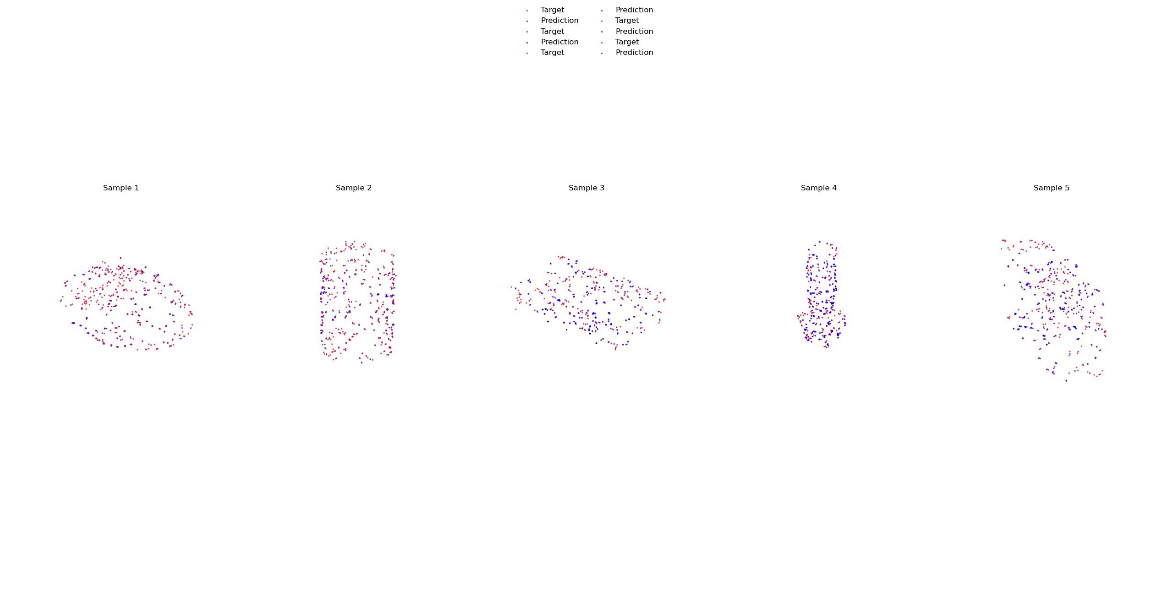
Comparing predicted vs target PCs
predicted
target
Sample 1
Sample 2
Sample 3
Sample 4
Sample 5
Chamfer
Distance
0.0019
0.0016
0.0015
0.0007
0.0013
Best reconstructions yet, but VAEs known for bad scaling properties to large data sets
Not as flexible as Diffusion-Autoencoder, number of points fixed

Slide 9

Outlook
Native Diffusion conditioned on Grasps
Test the limits of the VAE
How many shapes can the VAE learn
How accurate are the reconstructions when trained on more shapes
Grasp conditioned Diffusion-Autoencoder
Diffusion
Diffusion
$$z$$
Diffusion

Slide 10






VAE-Model Architecture Encoder
MaxPool
MLP
$$μ ∈ ℝ^{Z}$$
Projection
$$\overset{⃑}{g}$$
$$ℝ^{H}$$
MLP
$$\log{σ^{2}} ∈ ℝ^{Z}$$
$$ℝ^{Nx3}$$
Pointcloud
Global Feature
$$≈N\left(0, I\right)$$
Conv(1x1)
Conv(1x1)
Conv(1x1)
Encoder

Slide 11




VAE - Model Architecture Decoder
$$μ ∈ ℝ^{Z}$$
Upsample
Linear
ResBlock
Upsample
Linear
ResBlock
z $∈$ $ℝ^{Z}$
$$\log{σ^{2}} ∈ ℝ^{Z}$$
$$ℝ^{Nx3}$$
Pointcloud
Decoder

Slide 12
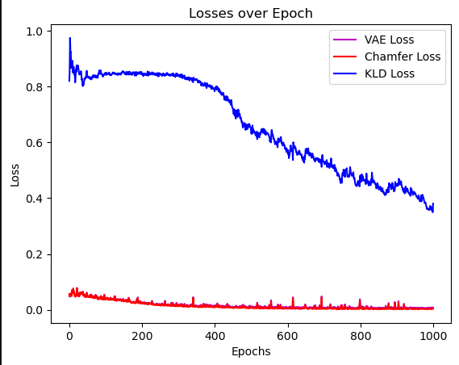
Training with 1000 Epochs
Keeps decreasing, convergence not reached
While vae loss stays low
Low chamfer and vae loss
also very stable

Slide 13
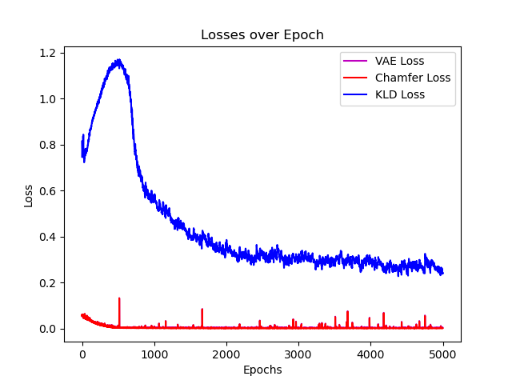
Training with 5000 Epochs
KLD Loss saturating

Slide 14
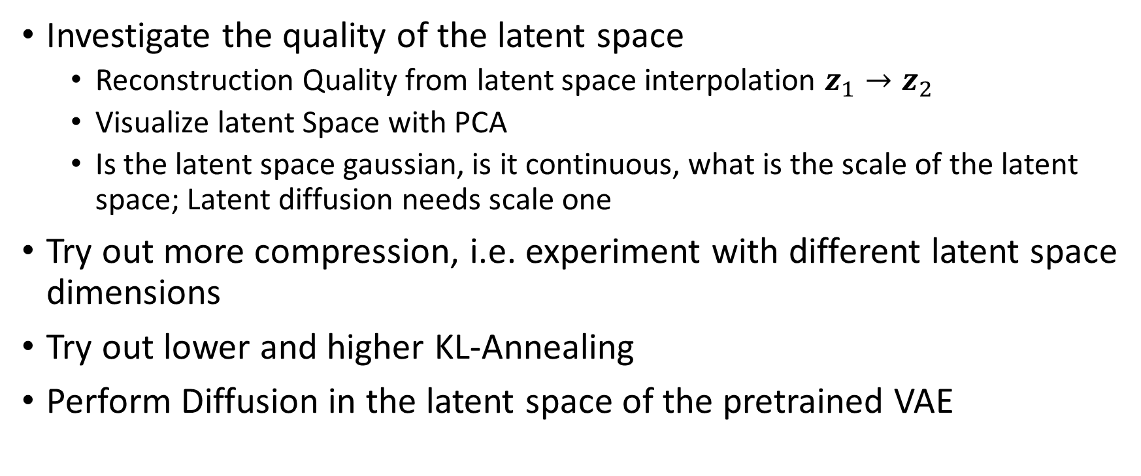
Future Research
Investigate the quality of the latent space
Reconstruction Quality from latent space interpolation $z_{1}→z_{2}$
Visualize latent Space with PCA
Is the latent space gaussian, is it continuous, what is the scale of the latent space; Latent diffusion needs scale one
Try out more compression, i.e. experiment with different latent space dimensions
Try out lower and higher KL-Annealing
Perform Diffusion in the latent space of the pretrained VAE

