Slide 1
The Signature-based Model for Early Detection of Sepsis from ICU Data
James Morrill, Andrey Kormilitzin, Sam Howison, Terry Lyons

Slide 2



Introduction
Early Prediction of Sepsis from Clinical Data

Slide 3
The Data: Features
40 total features consisting of:
8 Vitals Signs – Heart Rate, Temperature, MAP, …
28 Laboratory Values – FiO2, Lactate, Bilirubin, …
6 Demographics – Age, Gender, Hospital Unit, …

Slide 4
The Data: 3 Unique Hospitals
A
B
C

Slide 5
The Data: 3 Unique Hospitals
A1
B1
A
B
C
C
A2
B2

Slide 6
The Data: 3 Unique Hospitals
Validation
A1
B1
C
Training
A2
B2

Slide 7
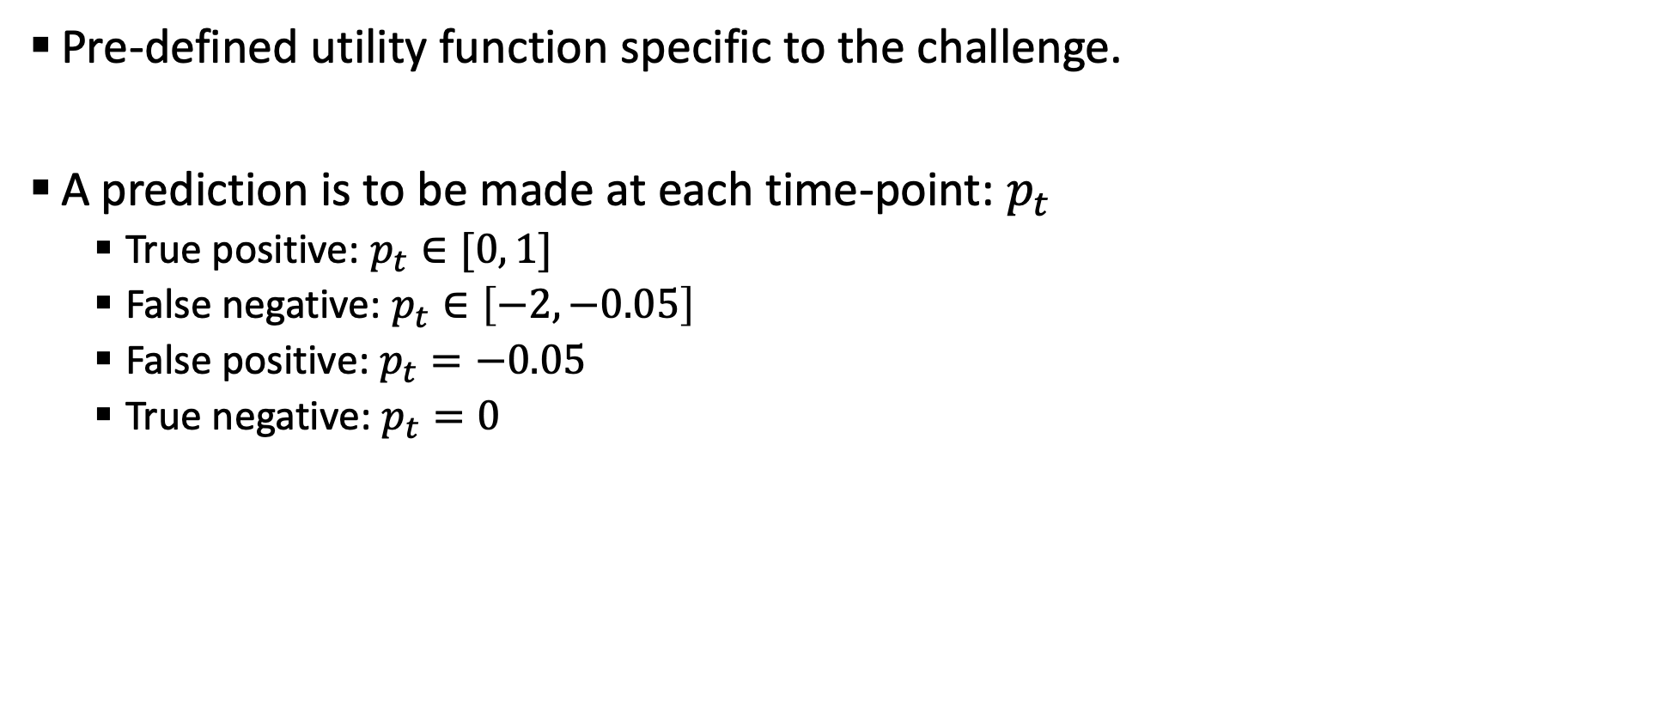
Scoring
Pre-defined utility function specific to the challenge.
A prediction is to be made at each time-point: $p_{t}$
True positive: $p_{t}∈[0, 1]$
False negative: $p_{t}∈\left[−2, −0.05\right]$
False positive: $p_{t}=−0.05$
True negative: $p_{t}=0$

Slide 8
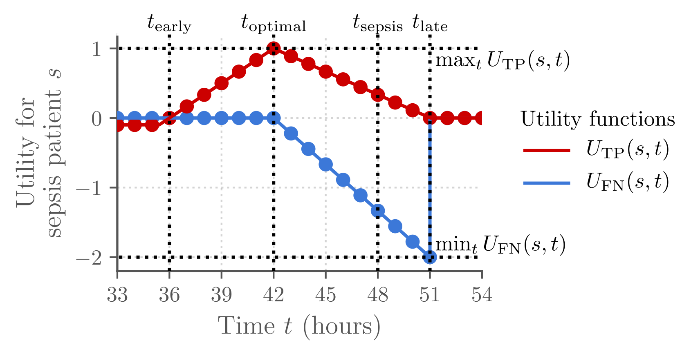
Scoring

Slide 9
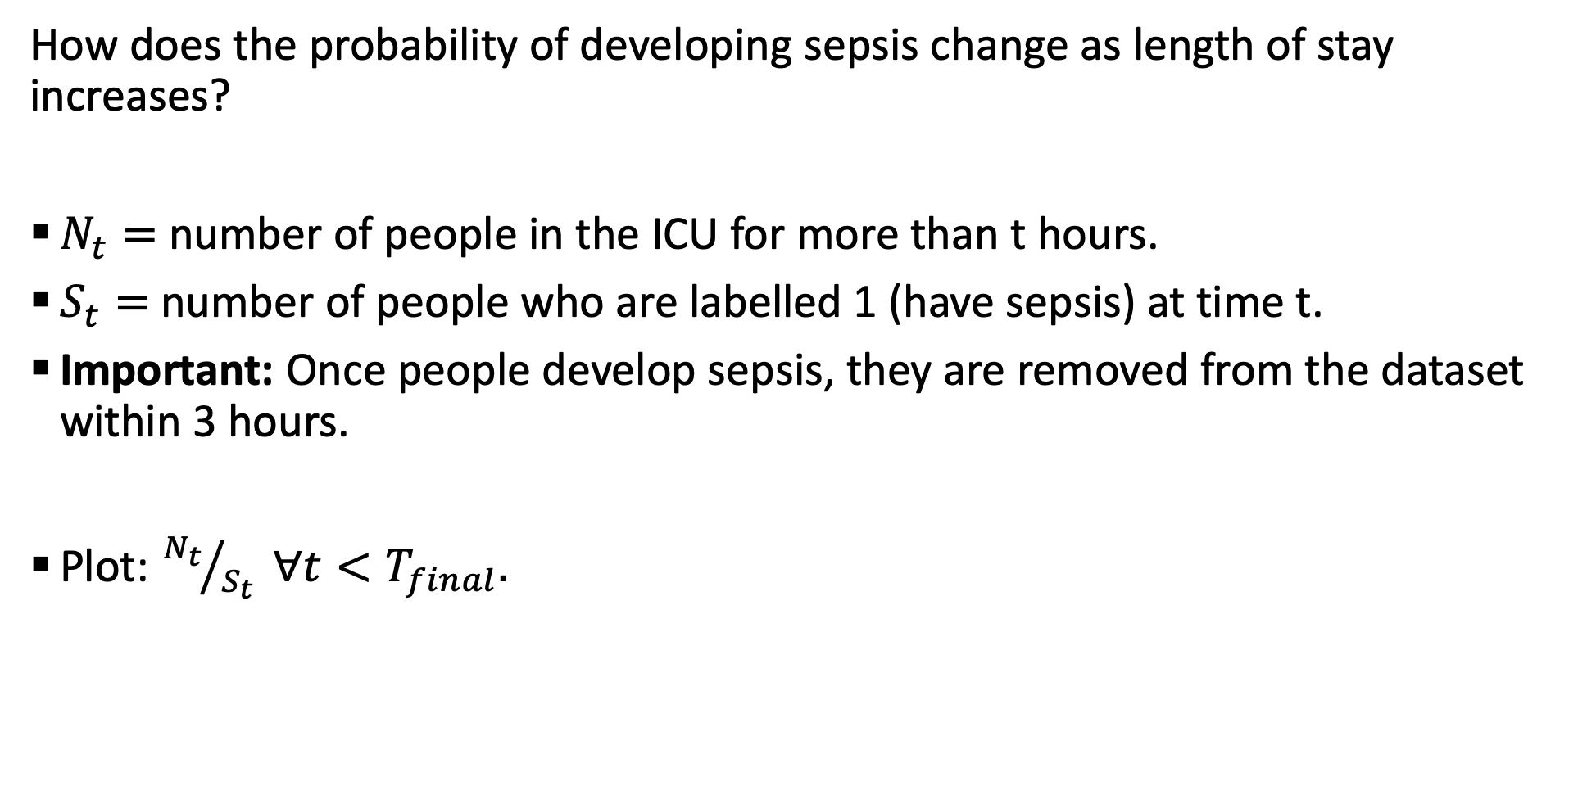
Occurrence of Sepsis is a Stationary Process
How does the probability of developing sepsis change as length of stay increases?
$N_{t}=$ number of people in the ICU for more than t hours.
$S_{t}=$number of people who are labelled 1 (have sepsis) at time t.
Important: Once people develop sepsis, they are removed from the dataset within 3 hours.
Plot: ${N_{t}}/{S_{t}} ∀t<T_{final}.$

Slide 10
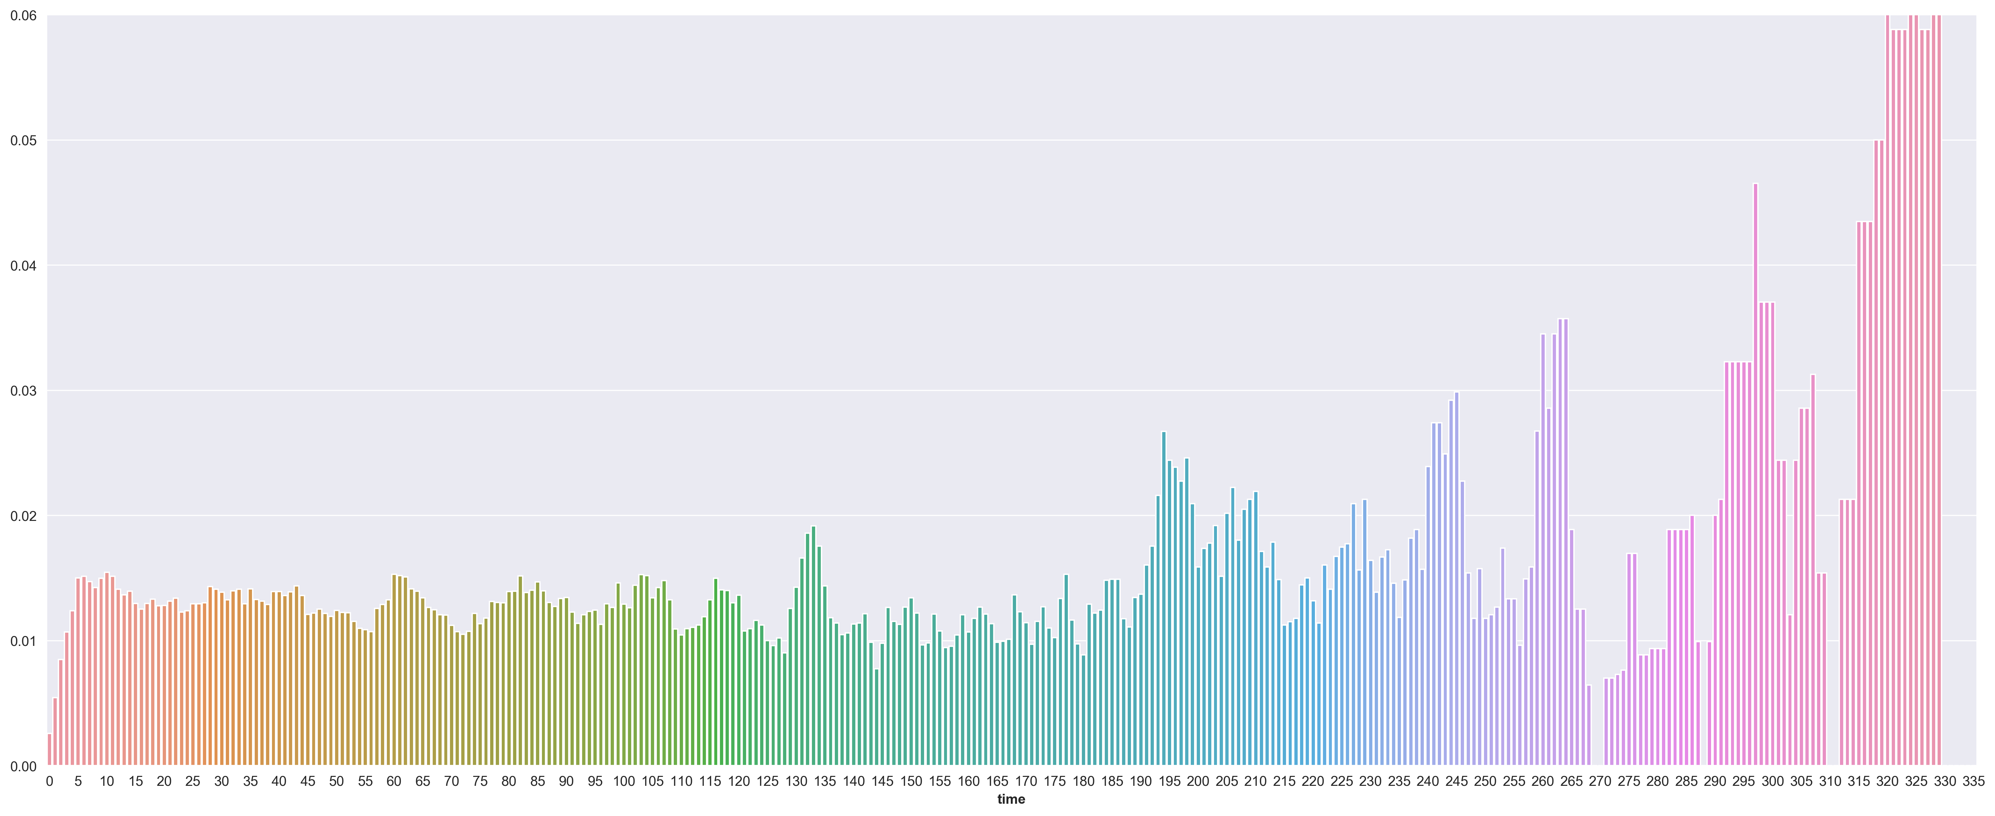
Occurrence of Sepsis is a Stationary Process

Slide 11
Plotting the Number With Sepsis from those that Develop
We consider only those who develop sepsis ‘eventually’
Plot the number of people from this group who have not yet developed it
If sepsis is stationary, we expect a constant rate of ‘uptake’
This would result in an exponential distribution

Slide 12
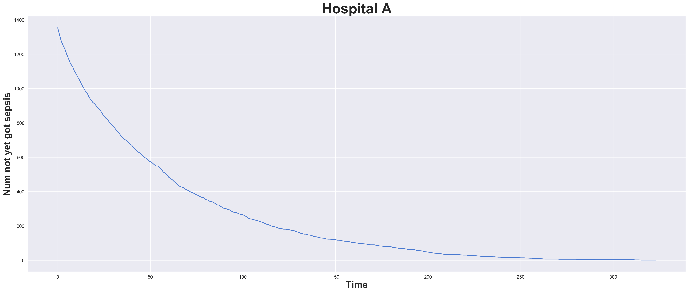
Sepsis Development in Hospital A

Slide 13
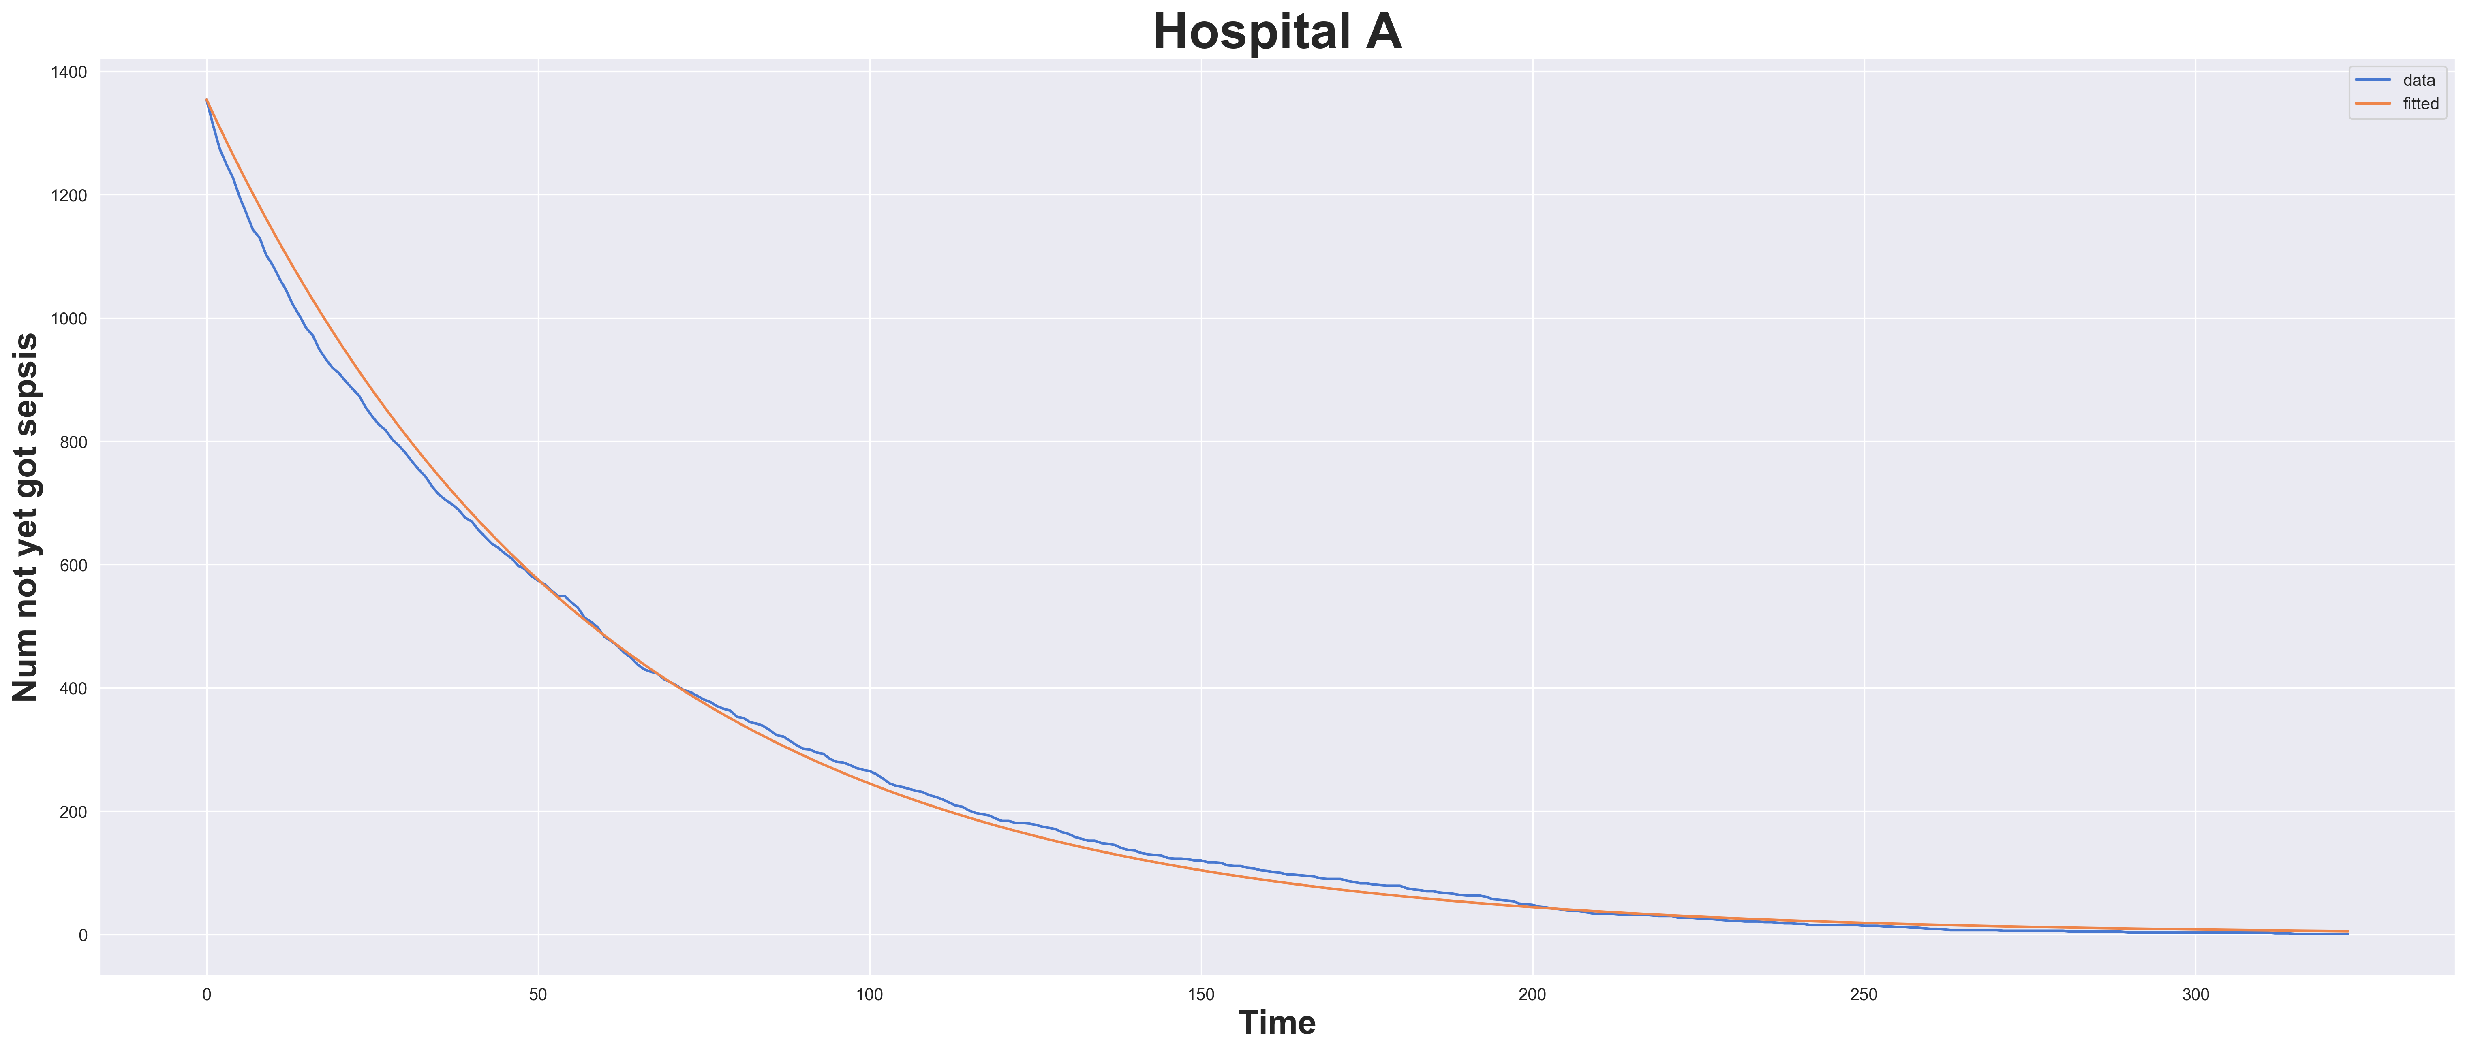
Exponential Fit to Hospital A Data

Slide 14
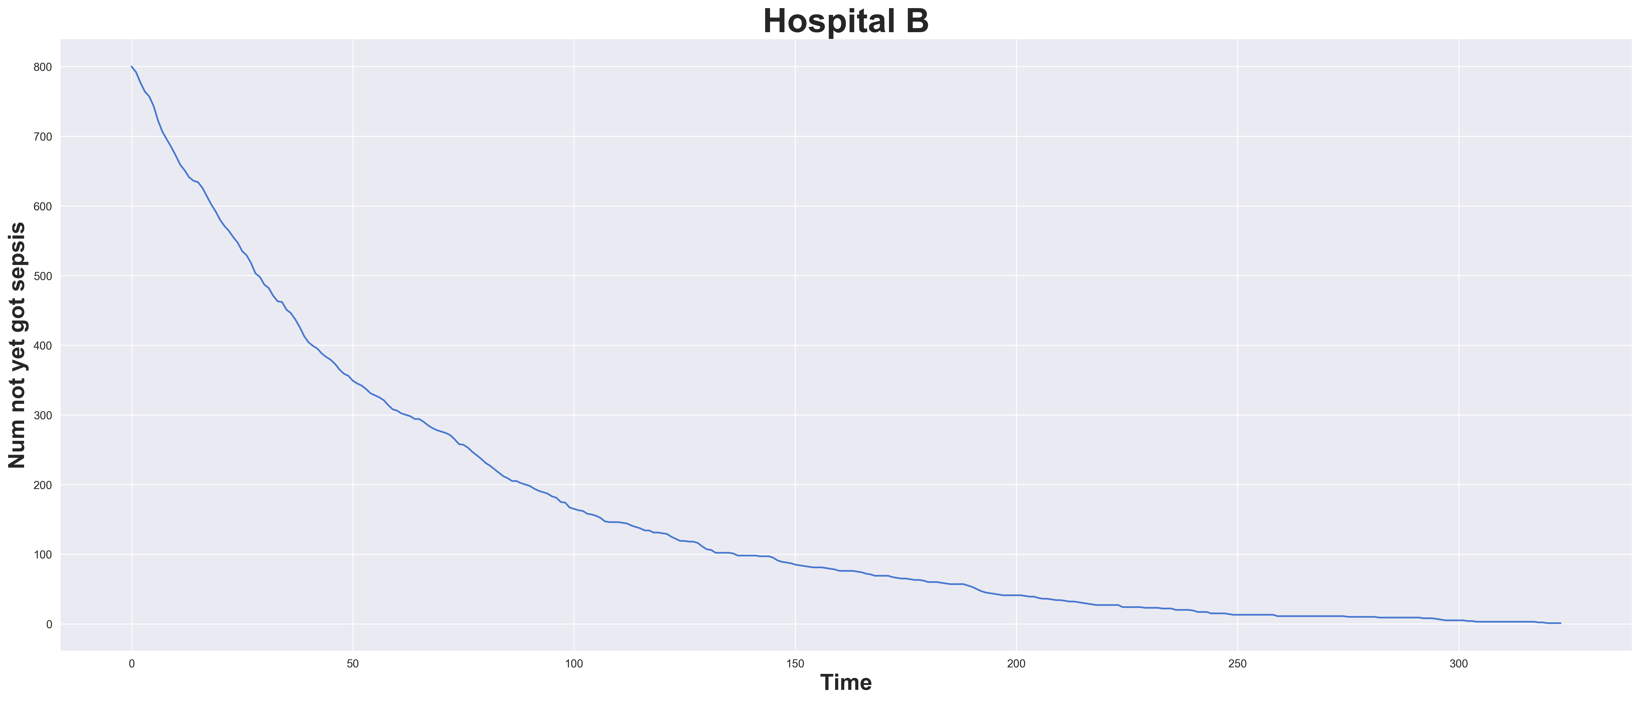
Sepsis Development in Hospital B

Slide 15
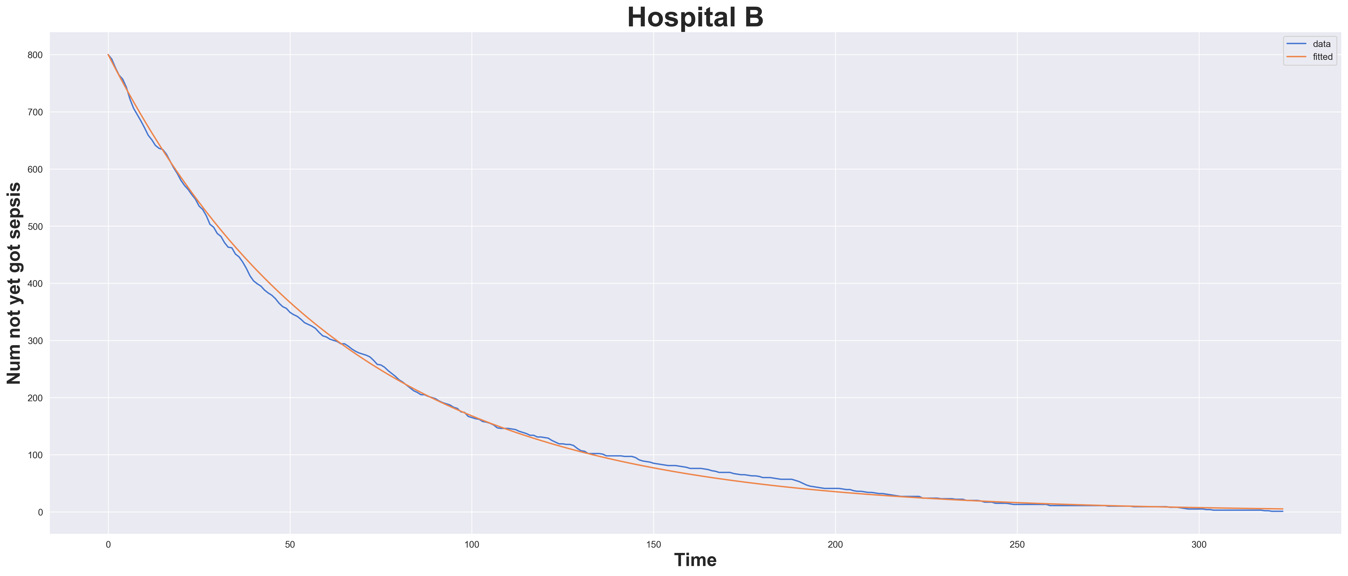
Exponential Fit to Hospital B Data

Slide 16
Diagnosis is Important Information
If you are in for heart failure, it is likely that is all you are in for, and sepsis development becomes unlikely
Variables can indicate such conditions and thus help to separate out two groups
Usually the diagnosis is not known at admission time
Cases where the diagnoses are known would be important to include

Slide 17
Sepsis Occurs (somewhat) Randomly
People enter the ICU, some of these are susceptible to sepsis
These people develop sepsis at an approximately constant rate
This rate will vary between hospitals
It may depend on cleanliness, hospital policy, patient demographics and so on

Slide 18
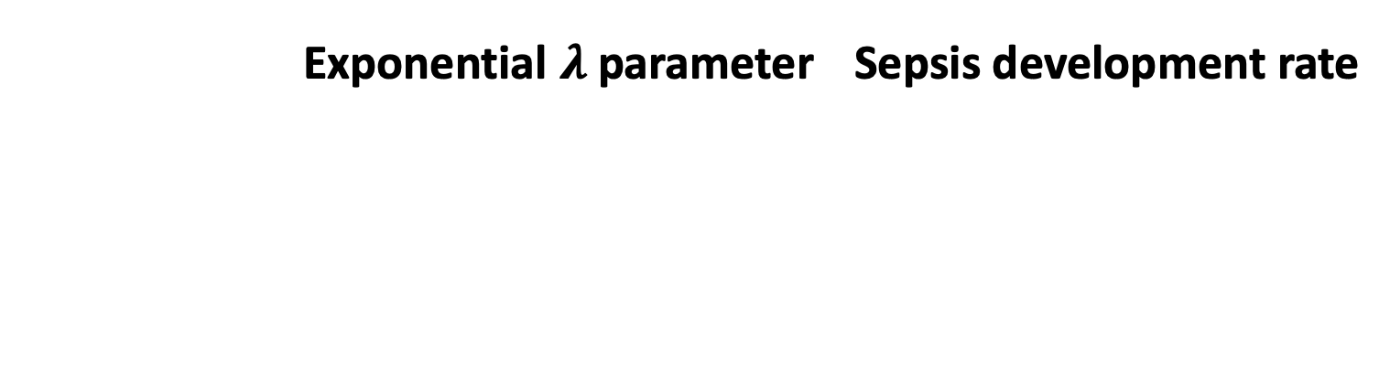
Fitted Parameters $⇒$ Rate of Sepsis
 | Exponential $λ$ parameter | Sepsis development rate

Slide 19
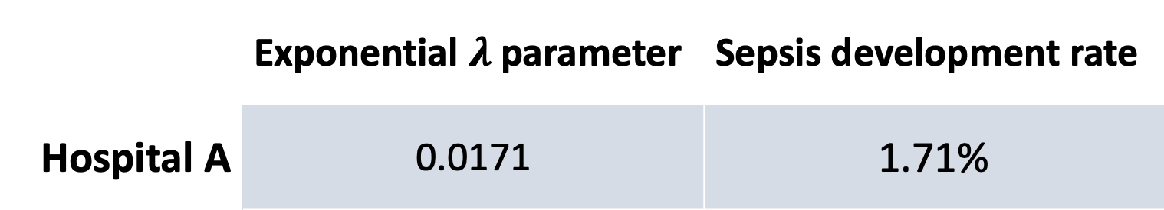
Fitted Parameters $⇒$ Rate of Sepsis
 | Exponential $λ$ parameter | Sepsis development rate
Hospital A | 0.0171 | 1.71%

Slide 20
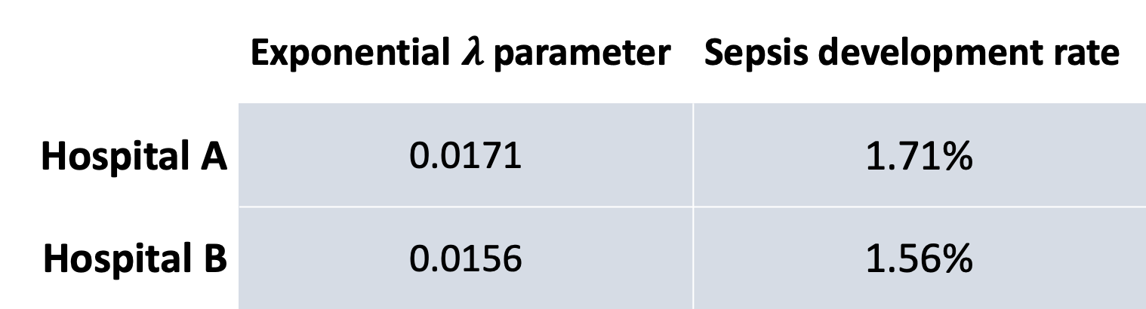
Fitted Parameters $⇒$ Rate of Sepsis
 | Exponential $λ$ parameter | Sepsis development rate
Hospital A | 0.0171 | 1.71%
Hospital B | 0.0156 | 1.56%

Slide 21
Methodology: Relabelling
Scores are given according to the pre-defined utility function
Relabel the binary labels to account for the value of score one gets in prediction
Time | Utility Score |  | Final Label
 | 0 | 1
0 | 0.00 | -0.05 | -0.05
1 | -0.22 | 0.89 | 1.11
2 | -0.44 | 0.78 | 1.22
3 | -0.67 | 0.67 | 1.33
4 | -0.89 | 0.56 | 1.44

Slide 22
Additional Hand-Crafted Features
Feature Name | Description
ShockIndex | Ratio of heart rate to systolic blood pressure (HR/SBP)
BUN/CR | Bilirubin / creatinine ratio
PartialSOFA | Partial recreation of the SOFA score
SOFA Deterioration | Binary marker of deterioration
Min vitals | Min value each vital sign takes over some look-back window
Max vitals | Max value each vital sign takes over some look-back window
Num measurements | The number of measurements taken of each lab value over some lookback window

Slide 23
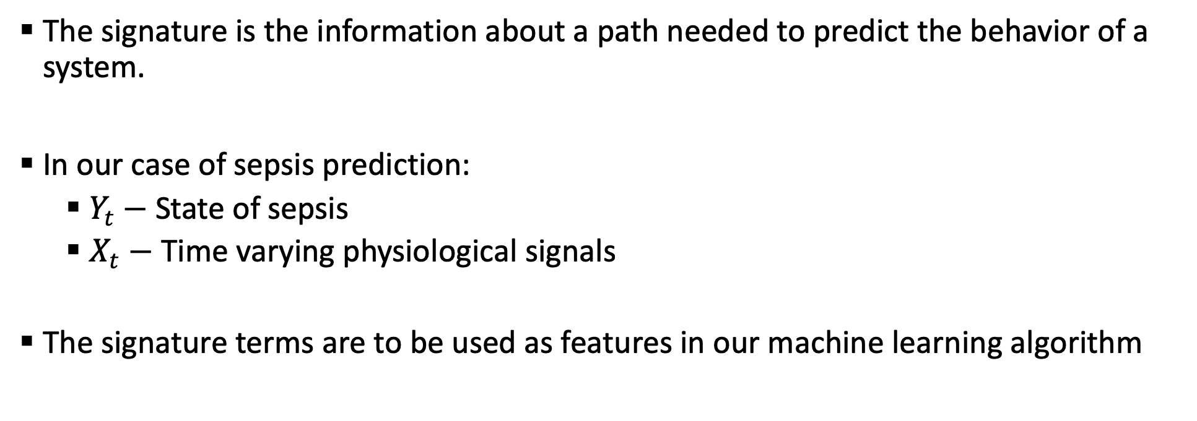
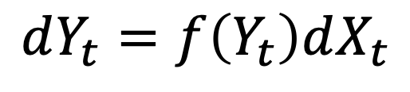
The Signature of a Path
An infinite sequence of numbers that completely characterizes a path
Used in the theory of controlled differential equations,
$$dY_{t}=f\left(Y_{t}\right)dX_{t}$$
The signature is the information about a path needed to predict the behavior of a system.
In our case of sepsis prediction:
$Y_{t}−$ State of sepsis
$X_{t}−$ Time varying physiological signals
The signature terms are to be used as features in our machine learning algorithm

Slide 24
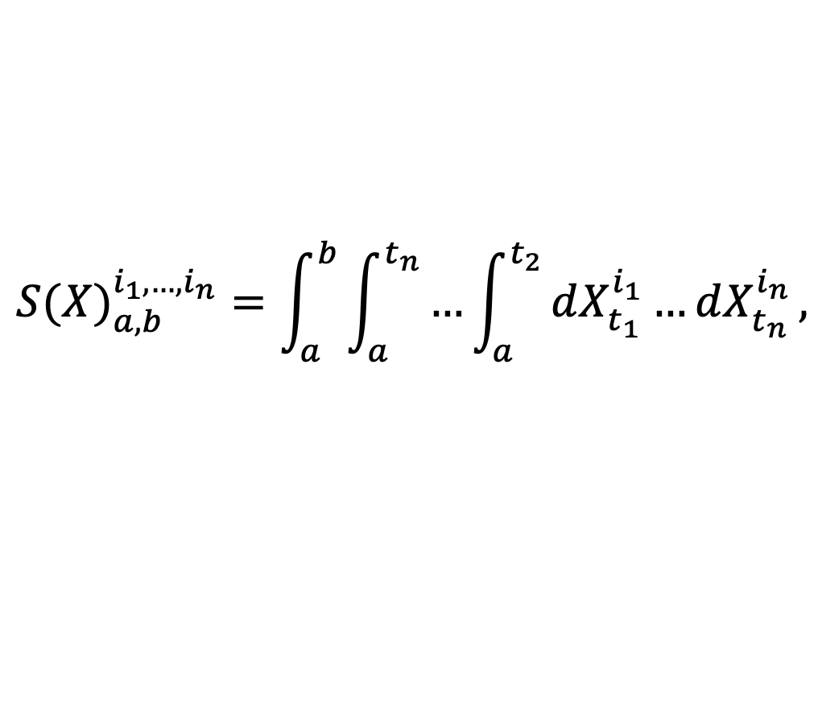
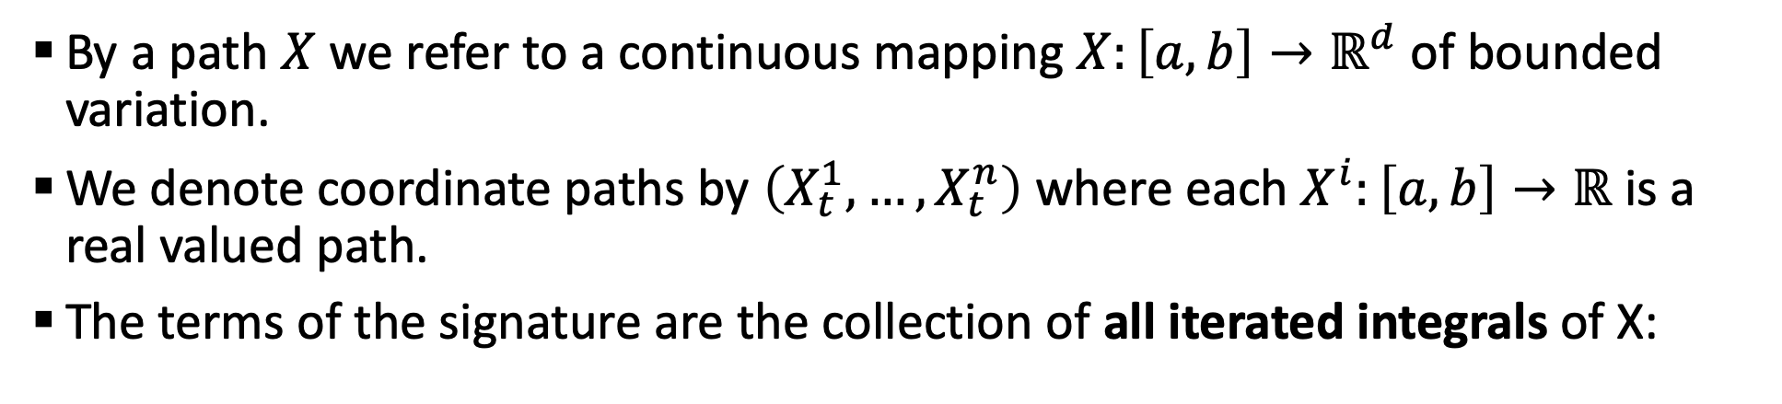
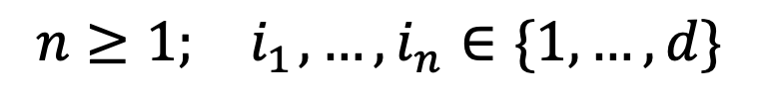
The Signature of a Path
By a path $X$ we refer to a continuous mapping $X:\left[a, b\right]→ℝ^{d}$ of bounded variation.
We denote coordinate paths by $\left(X_{t}^{1},…,X_{t}^{n}\right)$ where each $X^{i}:\left[a, b\right]→ℝ$ is a real valued path.
The terms of the signature are the collection of all iterated integrals of X:
$${S(X)}_{a,b}^{i_{1},…,i_{n}}=\int_{a}^{b}{\int_{a}^{t_{n}}{…\int_{a}^{t_{2}}{dX_{t_{1}}^{i_{1}}…dX_{t_{n}}^{i_{n}}},}}$$
$$n≥1;{ i}_{1},…,i_{n}∈\{1,…,d\}$$
We truncate to some order, these will be the features used in our machine learning algorithms

Slide 25
Model Training process
Include initial 40 features
Optimized hyperparameters:
Features extracted
Look-back windows
Signature columns
Signature transformations
Signature orders
The choice of model is also optimized in the process, LGBM was found to be the best performer in nearly all cases
Augment with hand-crafted and signature features
Train an LGBM regressor using a 5-fold CV
Optimize hyperparameters
Optimize the regression threshold to determine 0 or 1 output to maximize the utility score on the training fold
Evaluate the model utility on the out-of-sample fold
Select and submit the model with the highest 5-fold averaged utility

Slide 26
Benefit of the Signature Terms
Features | Averaged Utility Score
Time only | 0.282
Original 40 features only | 0.389
Hand-crafted features included | 0.418
Hand-crafted features and signatures included | 0.430
The Signature uncovers information not found from more standard time-series feature extraction methods.

Slide 27
Official Challenge Results
Rank | Team Name | Utility Score
1 | Can I get your Signature? | 0.360
2 | Sepsyd | 0.345
3 | Separatrix | 0.339
4 | FlyingBubble | 0.337
5 | CTL-Team | 0.337
‘Can I get your Signature’ officially ranked 1st of 105 teams that took part in the official phase of the challenge
There is a significant difference in score between 1st and 2nd place

Slide 28
Generating Actionable Decisions
We wish to create clinically actionable information to physicians to help make decisions inside hospitals
Given the regression output, set a threshold that, once exceeded, will mark a patient ‘at risk’ of developing sepsis
This can be achieved with an AUC of 0.868

Slide 29
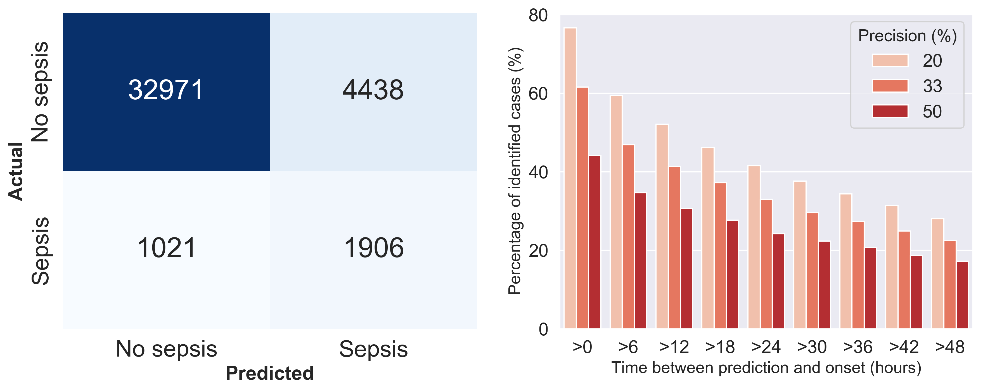
Generating Actionable Decisions

Slide 30
Predictions are Not Made in the 6 Hour Window
Optimal was defined as 6 hours before the occurrence of sepsis
Our model often detects sepsis much further in advance, regularly over 24 hours
This again suggests our hypothesis of susceptibility:
The model seems to be filtering out low risk cases
This is more of a risk-stratification model as opposed to one predicting sepsis occurrence
The usefulness of this should be determined by clinicians, a threshold can be set to achieve clinically meaningful sensitivity and specificity

