Slide 1
Context Models and Context-awareness
Slides adopted from Melanie Hartmann, Gerhard Austaller

Slide 2
Why use context?
Humans use context for adapting their behavior to the current situation (e.g. time of day, location, people they are with)
Goal:
Applications, environments, … that reduce cognitive load of users
How:
Proactivity
Setup environment according to user’s preferences or usage history
Auto-completion of forms (location, time in timetable)
Reminders
Search and filter information according to the user’s current needs
Avoid interrupting the user in inappropriate situations
Smart environments
Turn devices on/off, start applications, … depending on location, time, situation (lecture, meeting, home cinema, …)
Discover and use nearby interaction devices
Notes:
Variables used to represent the state of environment.

Slide 3
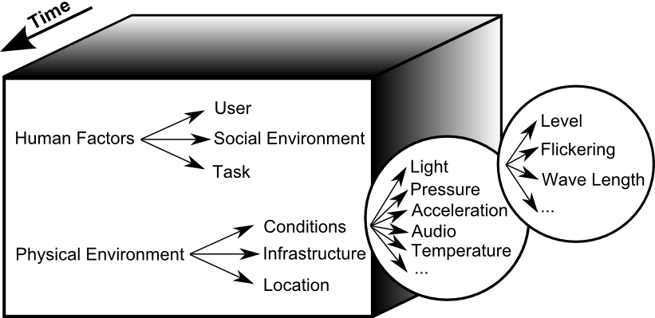
What is context?
Context:
...location, identities of nearby people and objects.
...time of day, season, temperature.
...user‘s emotional state, focus of attention, his tasks
...environment the user and computer know about
...state of the computer surroundings

Slide 4
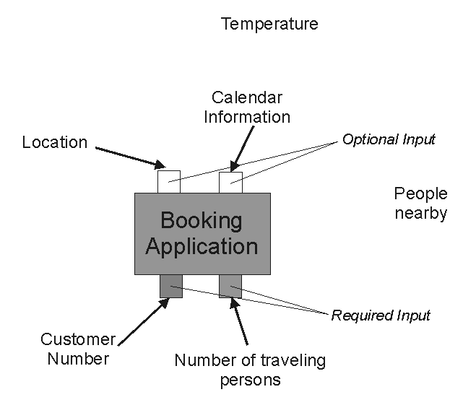
What is Context?
What information can be used by a computer to enhance the interaction with it ➔ what IS Context?
Many definitions exist, but none is commonly accepted
Example: (Train) booking application
Customer number, booking details are required and must be provided by the user
Location, time are required and can be automatically derived from context information
There is additional context information (temperature, …) not relevant for the application

Slide 5
Definition by Enumeration
[Chen Kotz 2000]

Slide 6
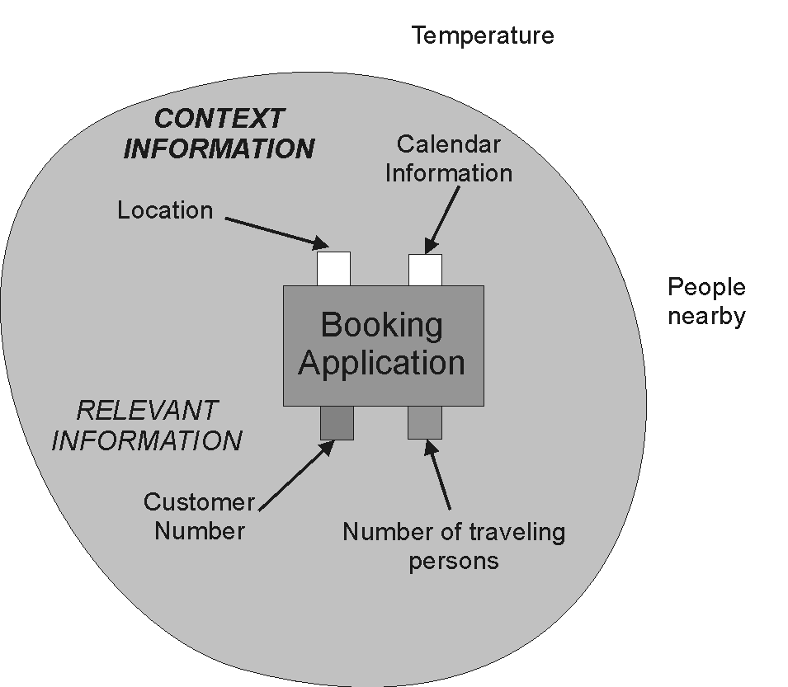
Definition by Relevance
Most prominent definition by Dey et al (2001):
“Context is any information that can be used to characterize the situation of an entity. An entity is a person, place, or object that is considered relevant to the interaction between a user and an application, including the user and applications themselves”
[Dey 2001]

Slide 7
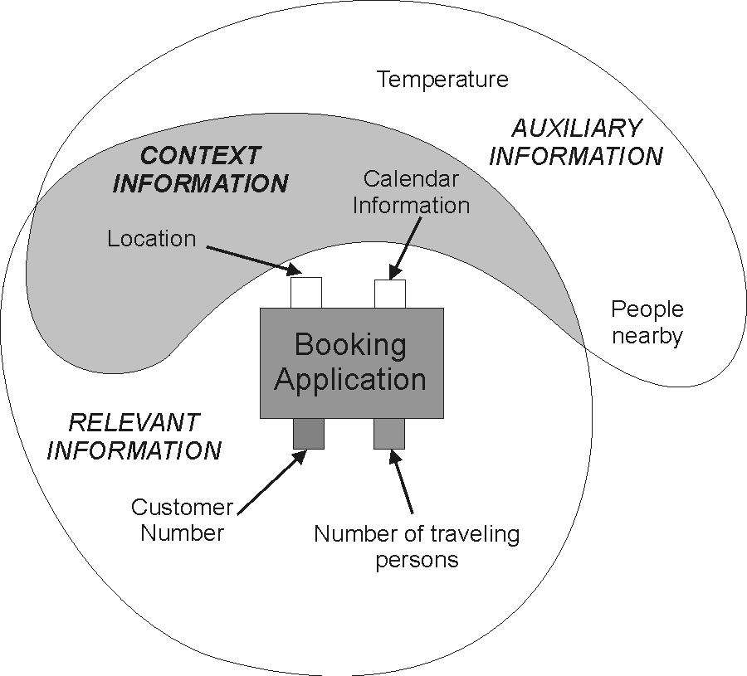
Definition by Functionality and Relevance
Context characterizes the actual situation in which the application is used. This situation is determined by information which distinguishes the actual usage from others, in particular characteristics of the user (her location, task at hand, etc) and interfering physical or virtual objects (noise level, nearby resources etc).
Thereby, we only refer to information as context that can actually be processed by an application (relevant information), but that is not mandatory for its normal functionality (auxiliary information).
context information = relevant and auxiliary

Slide 8
Features of Context-Aware Applications
Presentation of information and services to a user
Automatic execution of a service for a user
Tagging of context to information to support later retrieval
Adaptation of application’s behavior and appearance
Adapted from [Dey 2001]
Notes:
Context-aware application does something with the context
That something can be
presentation [how to show the information, eg google maps]
Automated execution [changing behavior of when user goes at some place]
Tagging [give name to an information and then use it in a different app]
Adaptation [changing behavior of app]

Slide 9
Features: Presentation
Present information to the user relevant in his current situation
Only refers to WHICH information is presented (not HOW → Adaptation)
Examples:
Tourist Guides
ContextPhone [Raento 2005]: present context information for the user’s contacts (like location, people nearby, phone use activity)

Slide 10
Features: Execution
If context changes according to condition in IF-THEN rules services are automatically executed
Example:
PARCTAB System [Adams 1993]: every room has a virtual workspace for exchanging information between persons present in the room. Mobile devices of a user entering the room are automatically bound to the workspace.

Slide 11
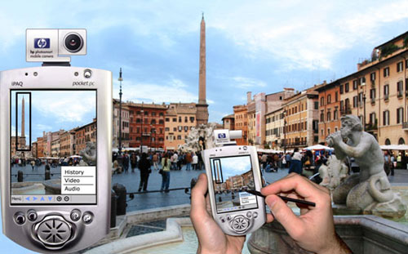
Features: Tagging
Associating contextual information to data, to improve later retrieval
Can be performed automatically or initiated by the user
Example:
CybreMinder [Dey 2000b]: Notes can be associated with current context information. Notes are later delivered to user as soon as associated context matches current situation

Slide 12
Features: Adaptation
Adapt behavior and how information is presented to given context
bHealthy
https://www.youtube.com/watch?v=oCcS5LNOwto

Slide 13
Difficulties in using context
Context information differ from traditional information sources in following properties:
Context is gathered from heterogeneous sources
Context is dynamic
Context is error-prone
Context-aware applications have to consider following factors
Scalability: the application should be able to cope with a multitude of different sensors and users
Robustness: stability and reliability of results, ability to adapt to new situations, resistance to frequent changes in the environment, to component failure, and to disturbing factors like noise

Slide 14
How to build a context-aware application
Design process can be defined as follows
Specification: What context-aware behavior should be implemented? Which context is required for that purpose?
Acquisition: Which sensors can be used to retrieve this context?
→ Context Sources
Delivery and Reception: How is the context represented, managed and exchanged?
Context Models
Access Mechanisms
→ Context Storage and Management
Action: Which actions should be taken corresponding to the captured context?

Slide 15
Context Sources
Sensed context
query physical sensors or applications (virtual sensors)
Examples: temperature, outlook entries
Inferred or derived context
combining context data to gain new information (“higher level context”)
Examples: Activity (e.g. “being in a meeting”), symbolic location (e.g. “S202|A124”)
John@lunchbreak
Time: 12:00
John leaves office
Context Type | Sensors | Examples
Sensed context | Physical sensors | Temperature
 | Virtual sensors | Outlook
Inferred Context | Logical Sensors | Activity

Slide 16
Context Models
Context data must be represented in machine readable form to enable application to use it
Context model defines exchange of context information
Context model has to provide a useful set of attributes for each context data (type, value, timestamp, source…), ideally it addresses how to cope with incompleteness and ambiguity of context information
Existing Context Models can be classified by means of the data structure they use for exchanging context information:
Key-Value Model
Markup Scheme Model
Object-oriented Model
Logic-based Model
Ontology-based Model
ContextFSM
Notes:
16

Slide 17
Key-Value Model
Simplest model
Describes context as a set of attributes
Easy to manage
Missing structural information
Often used in service frameworks for describing the capability of a service
Example:
Room = A12
ID = 44
Notes:
How to represent context aware model. Simplistic is key-value representation.

Slide 18
Markup Scheme Model
Example:
<Location confidence=”80%”>
<Room>A12</Room>
<ID>44</ID>
</Location>
Hierarchically structured
Consisting of markup tags with attributes and content
Allow type and range checking for numerical values
Typically used for modeling profiles, e.g. as extensions for CC/PP (Composite Capabilities / Preferences Profile) or UAProf (User Agent Profile)
Notes:
Using an XML representation.

Slide 19
Ontology Based Model
Ontology consists of concepts, properties, relations and axioms
Provides uniform way to specify a model’s core concept
Facilitate sharing knowledge between by defining a common vocabulary
Example: CONON [Wang 2004] defines a common upper ontology to capture general features and several domain or application specific ontologies mapped to it
Example:
loc:ID
loc:Room
type
type
“44“
name
value
“A12“
loc:id44
located in
loc:A12
confidence
80%
Notes:
Graphical way to represent context information. Grouping nodes in a graph.

Slide 20
Object Based Model
Example:
Location
Room = A12
ID = 44
Confidence = 80%
Allows encapsulation and reuse of parts of the model
Entities and relations modeled as objects
Processing/reasoning done by “widgets”
Representation of context, e.g., by Object-Role Modeling
“Typed” relation between classes → fact types
Instances are called facts

Slide 21
Logic Based Model
Example:
locatedAt(“44”, “A12”, 80%)
Formal system based on facts, expressions and rules
Context information is added, updated, deleted from logical system
Logical system infers new context information depending on the specified rules
Mathematic properties useful for applications in the area of artificial intelligence
Does not contain straightforward representation of quality meta-information
Notes:
An example would be functional programming like LISP or Node.js, Lambda Calculus

Slide 22

System Model
System is described as a set of continuous and discrete variables
$n_{c}$ continuous variables, $v_{i}∈R$
$n_{d}$ discrete variables, $d_{i}∈kZ$ for some $0<k<1$
$n_{p}$ set of system parameters, $p_{i}∈S,$set of strings

Slide 23






Context
Context is a specific set of valuations of the system variables
Bipartite mapping between the variable set and the valuation set
$$G$$
$$M$$
$$R$$
$$n_{c}$$
Z
$$n_{d}$$
S
$$n_{s}$$

Slide 24
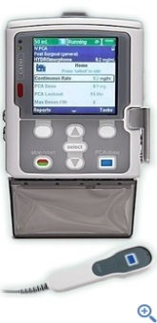

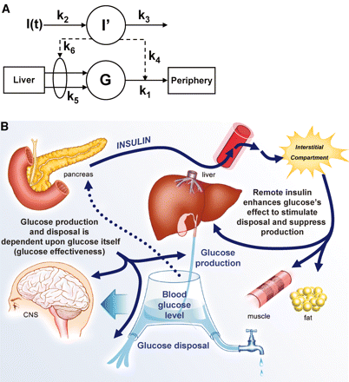
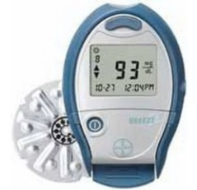
Example
Artificial Pancreas: Closed loop control system
Human in the loop
Artificial pancreas control algorithm
Activity schedule
Moving around in a random fashion including outdoors and indoors excursions
Artificial pancreas software
Infusion pump
Human body
Risks: Hyper and hypo glycemia
Glucose insulin interaction models
Glucosemeter

Slide 25


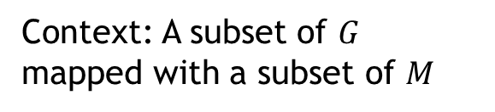

Contexts in AP operation
System Variables
Continuous variables (CV):
Blood glucose levels, insulin infusion
Discrete variables (DV):
Bolus request levels, Wireless radio power levels
System parameters (SP):
Control algorithms, Location of user (indoors, outdoors)
Home Context
$$G$$
$$M$$
Blood glucose levels,
insulin infusion
Context: A subset of $G$ mapped with a subset of $M$
CV
$$R$$
Bolus
Radio Power
100 U, 200 U,300 U
Context changes are caused by random occurrences of changes in the environment or events.
DV
1dB, 2 dB, 5dB, ----
Control Algo
Location
AlgoA, AlgoB, AlgoC
SP
Indoors, outdoors

Slide 26
Context Analysis
How does the system evolve as context changes?
Context change means changes in the mapping
In a given mapping, the system evolution can be governed by dynamics such as differential equations
As the mappings change the dynamics also change

Slide 27
Challenges to context analysis
Environmental changes due to context has long term effects on system dynamics
Often the effects of context change are not memory-less
Hence have to analyze each context change sequence individually
Potentially exponential number of sequences
1500
Indoor, Outdoor, Indoor
Outdoor, Outdoor, Indoor
1000
500
Drug concentration ug/l
0
0
0.5
1
1.5
2
2.5
3
3.5
4
4.5
5
Time in minutes

Slide 28
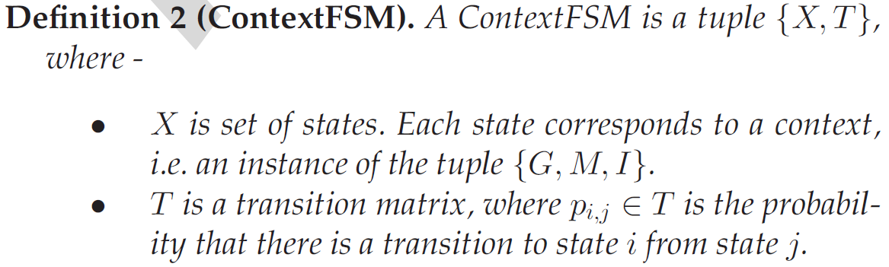
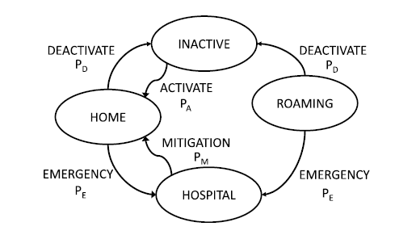
Solution: Randomized analysis
Contexts and their changes can be represented using a state based model

Slide 29
Accessing Context
Two ways of getting informed of context data:
Queries: request context information
Event Subscription: the actual applications are notified every time a specified event occurs
Consider Privacy and Security concerns, for example by
Specifying domain dependent policy rules for access control
Allowing the user to control the access to his context data Example: LLC (Localized Location Computation): entity computes his location on his own

Slide 30
Context Storage and Management
Context storage and management
Specify a well-defined interface for accessing the context data
Answer queries and notify the actual applications of context changes
Maintain a context history or at least a context buffer
Provide a discovery services for the various context sources
Context Management Models
Widget
Networked Services
Blackboard Model

Slide 31
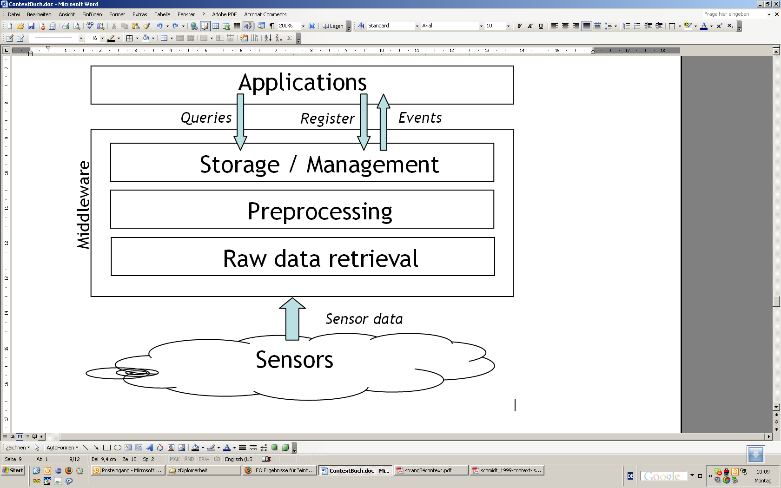
Context Middleware
Facilitate the development of context-aware applications by separating the detection and usage of context data ➔ use a reusable and extensible middleware for the detection
Most middleware approaches use an architecture with the following layers

Slide 32
Context Middleware
Raw data retrieval
use drivers for querying physical sensors and APIs for querying virtual sensors
Preprocessing
Interpret and reason over context information by using:
Context aggregation / fusion: combine context values, cope with sensing conflicts
Context filtering: filter unnecessary data
Context interpretation: combine context data with static information (e.g. turn absolute coordinates into symbolic like “S202/A124”)
Storage and Management
Manages gathered data and offers public interface to the client applications
Answers queries and notifies interested applications about events
Stores the context history

Slide 33
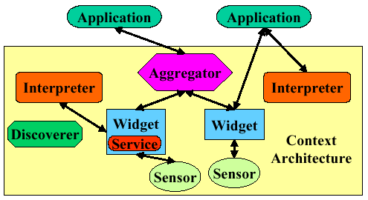
Example: Context Toolkit
Developed by Dey et al. 2001 [Dey 2001b]
Consists of context widgets and an infrastructure hosting the widgets
Offers several software components for context acquisition to facilitate the software development:
Context widgets: collect context information from sensors
Context services: perform action on behalf of an application (e.g. sending an email)
Context interpreters: convert context between different representations
Context aggregators: combine data from several widgets and interpreters
Discoverers: maintain registry of available widgets

Slide 34
Dealing with Uncertainty
Has to be handled in three areas:
Sensing context information
Inferring context information
Using context information
How to determine uncertainty of sensed context
can be reported by sensor (e.g. biometric authentication devices give a measure for the confidence in reported data)
Specify a relevance function to take freshness of context data into account, because validity of context data decreases with increasing difference to the acquisition event
How to determine uncertainty of inferred context
Most widely used reasoning strategies are probabilistic and fuzzy logic and Bayesian networks
How to use uncertain context information
Specify required confidence level (e.g. for authentication)
Only regard the context value with maximum probability as valid

