Slide 1
Mobile programming
CSE 535 Lecture 2

Slide 2
Integrated Development Environment
Android phone platform uses:
  Eclipse
  Android Development Tools (ADT) plug-in
  Software Development Kit (SDK) tools include all the classes
  Platform tools include classes specific to phones
  Emulator
Windows phone platform uses:
  Microsoft Visual Studio Express
  SDK + Emulator
Apple phone platform uses:
  iOS IDE (only available for MACs)
  Xcode IDE
  iOS SDK
  Simulator

Slide 3
Programming Languages
Android
Windows Phone
iPhone
Platform specific compilers
Can test applications in emulator
Download the executable to the phone
Runtime code analysis
  Keep phone connected to the development platform
  Android Dalvik Debug Monitor Server (DDMS)
Java
Visual C#
Objective C

Slide 4
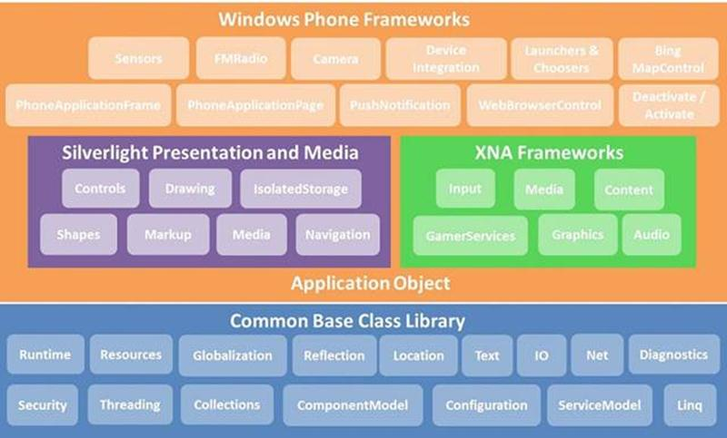
Windows Architecture - proprietary

Slide 5
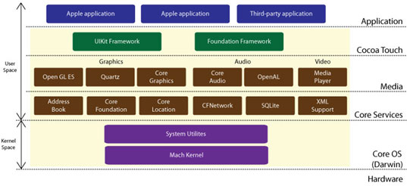
Apple iOS Architecture - proprietary

Slide 6

Android “Open Source” Architecture

Slide 7
Android Fundamentals

Slide 8
Goal
Understand applications and their components
Concepts:
  activity,
  service,
  broadcast receiver,
  content provider,
  intent,
  AndroidManifest

Slide 9
Application Components
Activities – visual user interface focused on a single thing a user can do
Services – no visual interface – they run in the background
Broadcast Receivers – receive and react to broadcast announcements
Content Providers – allow data exchange between applications

Slide 10
Activities
Basic component of most applications
Most applications have several activities that start each other as needed
Each is implemented as a subclass of the base Activity class

Slide 11
Activities – The View
Each activity has a default window to draw in (although it may prompt for dialogs or notifications)
The content of the window is a view or a group of views (derived from View or ViewGroup)
Example of views: buttons, text fields, scroll bars, menu items, check boxes, etc.
View(Group) made visible via Activity.setContentView() method.

Slide 12
Intents
An intent is an Intent object with a message content.
Activities, services and broadcast receivers are started by intents. ContentProviders are started by ContentResolvers:
  An activity is started by Context.startActivity(Intent intent) or Activity.startActivityForResult(Intent intent, int RequestCode)
  A service is started by Context.startService(Intent service)
  An application can initiate a broadcast by using an Intent in any of Context.sendBroadcast(Intent intent), Context.sendOrderedBroadcast(), and Context.sendStickyBroadcast()

Slide 13
Shutting down components
Activities
  Can terminate itself via finish();
  Can terminate other activities it started via finishActivity();
Services
  Can terminate via stopSelf(); or Context.stopService();
Content Providers
  Are only active when responding to ContentResolvers
Broadcast Receivers
  Are only active when responding to broadcasts

Slide 14
Android Manifest
Its main purpose in life is to declare the components to the system:
<?xml version="1.0" encoding="utf-8"?>
<manifest . . . >
<application . . . >
<activity android:name="com.example.project.FreneticActivity"
android:icon="@drawable/small_pic.png"
android:label="@string/freneticLabel"
. . . >
</activity>
. . .
</application>
</manifest>

Slide 15
Intent Filters
Declare Intents handled by the current application (in the AndroidManifest):
<?xml version="1.0" encoding="utf-8"?>
<manifest . . . >
<application . . . >
<activity android:name="com.example.project.FreneticActivity"
android:icon="@drawable/small_pic.png"
android:label="@string/freneticLabel"
. . . >
<intent-filter . . . >
<action android:name="android.intent.action.MAIN" />
<category android:name="android.intent.category.LAUNCHER" />
</intent-filter>
<intent-filter . . . >
<action android:name="com.example.project.BOUNCE" />
<data android:mimeType="image/jpeg" />
<category android:name="android.intent.category.DEFAULT" />
</intent-filter>
</activity>
. . .
</application>
</manifest>
Shows in the Launcher and is the main activity to start
Handles JPEG images in some way

Slide 16
Services
Does not have a visual interface
Runs in the background indefinitely
Examples
  Network Downloads
  Playing Music
  TCP/UDP Server
You can bind to a an existing service and control its operation

Slide 17
Services (1)
Run in the background
  Can continue even if Activity that started it dies
  Should be used if something needs to be done while the user is not interacting with application
    Otherwise, a thread is probably more applicable
  Should create a new thread in the service to do work in, since the service runs in the main thread
Can be bound to an application
  In which case will terminate when all applications bound to it unbind
  Allows multiple applications to communicate with it via a common interface
Needs to be declared in manifest file
Like Activities, has a structured life cycle

Slide 18
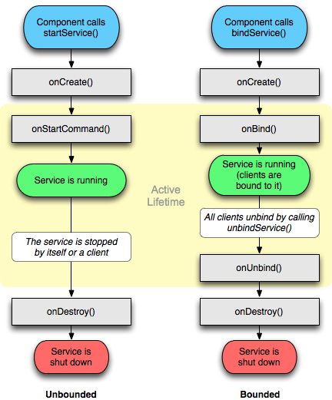
Services (2)

Slide 19
Broadcast Receivers
Receive and react to broadcast announcements
Extend the class BroadcastReceiver
Examples of broadcasts:
  Low battery, power connected, shutdown, timezone changed, etc.
  Other applications can initiate broadcasts

Slide 20
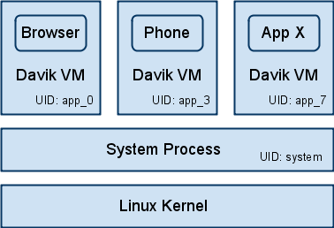
Interaction between applications
  Application Sandbox
    Each application runs within its own UID and VM
    Default privilege separation model
    Instant security features
      Resource sharing
        CPU, Memory
      Data protection
        FS permissions
      Authenticated IPC
        Unix domain sockets
    Place access controls close to the resource, not in the VM
Notes:
richc

Slide 21
Content Providers
Makes some of the application data available to other applications
It’s the only way to transfer data between applications in Android (no shared files, shared memory, pipes, etc.)
Extends the class ContentProvider;
Other applications use a ContentResolver object to access the data provided via a ContentProvider

