Slide 1
Crime Data Analysis
By Janmaya Kumar Jena

Slide 2
Contents :
Objectives
Overview Of Data
Crime Frequency
Crime hotspots
Arrests
District vs Arrest count
According to the primary type crime count
Location Description vs crime count
Conclusion
Scope of Improvements

Slide 3
Below are the insights and observations :
Crime Frequency
Crime hotspots
Arrests
District vs Arrest count
According to the primary type crime count
Location Description vs crime count

Slide 4
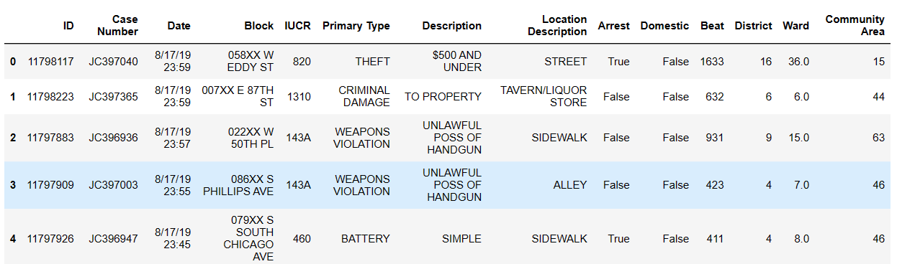
Overview Of Data:
Data Rows
161942
Data Columns
14
Crime Year
2019

Slide 5
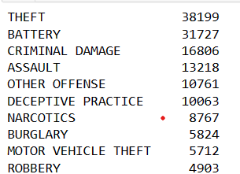
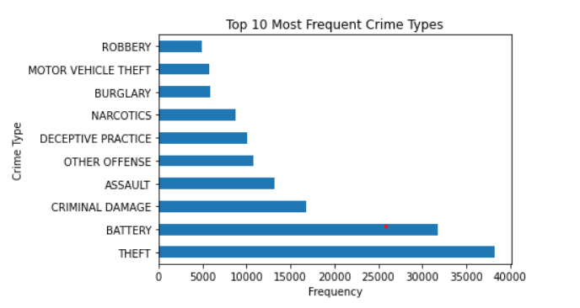
Crime Frequency:
The below chart represents different types of crime corresponding to their number
Theft comes in the first place and battery in second place, While robbery is the least crime compared to others

Slide 6
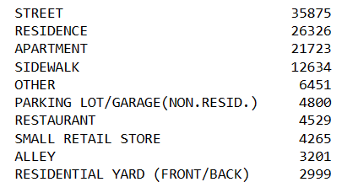
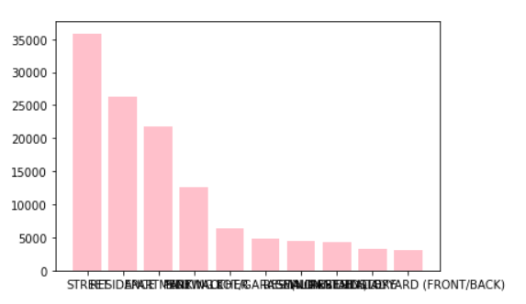
Crime hotspots:
After analyzing the data on crime hotspots, the highest crime happened in streets and the lowest crime happened in residential yards and allay areas. also a residence, apartment, and sidewalk more than 30% of crime in this location.

Slide 7
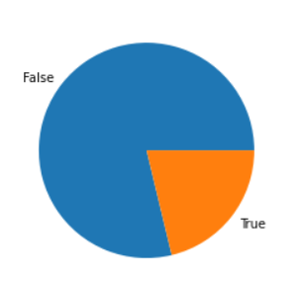

Arrests:
Out of 161366 cases, only 34270 case person are arrested for the guilty.
Arrested rate is 25%
Not arrested
Total 161366
Arrested

Slide 8
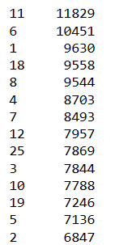
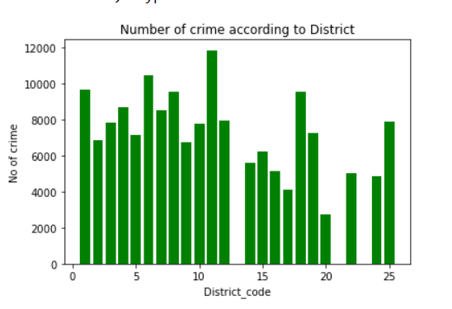
District vs Arrest count :
After doing the analysis we find that District Code 11 has more cases registered as compared to other districts.
The second position is held by district code 6.
As compared to other districts 5 and 2 are fewer cases.

Slide 9
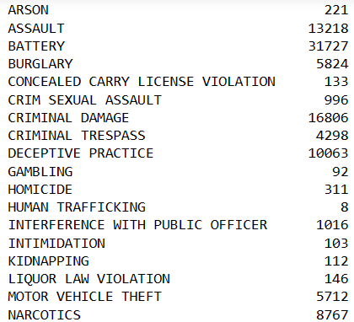
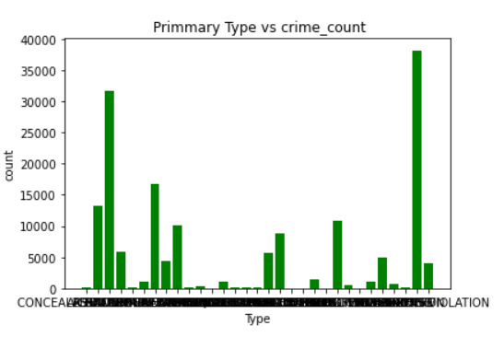
According to the primary type crime count :
We analyze the primary type data and find that there are more cases in the
Battery and assaults
Also here I found that human trafficking is fewer case registers as compared to other primary type

Slide 10
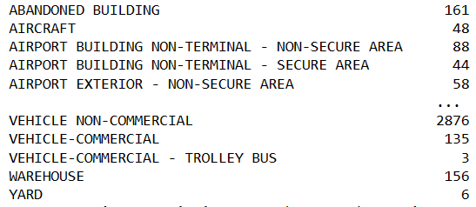
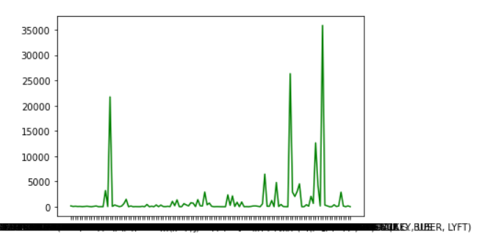
Location Description vs crime count :
Here I found that according to the location, type count the crime and represent in a line graph and here we clearly found that in the vehicle non-commercial category, more cases have happened

Slide 11
Conclusion :
Theft comes in the first place and battery in second place, While robbery is the least crime compared to others
Arrested rate is 25%
In the street the is more than 30% of crime has happened.
We analyze the primary type data and find that there are more cases in Battery and assaults
Residents, apartments, and sidewalks have more than 30% of crime in this location.

Slide 12
Way to decrease the crime rate :
In the district where most cases happened, we should appoint more police to avoid crime to this district.
In my point of view, the arrest rate is less so if we increase the arrest rate then it will create a scariness so people will afraid to do such kind of crime.
We should install cameras where people’s movement is very less and also initiate the alarms to find the person immediately.
In the street, there are more than 30% of cases happened so we need to send some patrolling teams to closely monitor those streets.

Slide 13


