Slide 1

Exploring the Music Sales Database :
By Janmaya Kumar Jena

Slide 2

Contents :
Objective
Understanding database
Overview of database
Insights and observation
Conclusion
Scope of improvement

Slide 3
Objectives :
Who is the senior most employee based on job title?
Which countries have the most Invoices?
What are the top 3 values of the total invoice?
Which city has the best customers?
Who is the best customer?
Find the email, first name, last name, & Genre of all Rock Music listeners.
Write all the track names that have a song length longer than the average song length.
Let's invite the artists who have written the most rock music in our dataset.
Find how much amount spent by each customer on artists.
We want to find out the most popular music Genre for each country.
Write a query that determines the customer that has spent the most on music for each country.

Slide 4
Understanding Database :
This database contains the music industry data. There are 11 tables present in this
database. We tried to understand the relationship between all the tables and follow
the ER diagram, how the tables are being connected with each other. here we found
each table contains one primary key and a foreign key. So using the common attributes
I was able to join the tables based on the requirement.
For analysis, we required all the tables but I here I frequently use these tables like the
customer, Employee, invoice, track, invoice line.
Data loading is one of the challenges I faced because three tables were not in the proper
format, So I was not able to import the data then I did some basic data cleaning to make
It is the proper format.

Slide 5
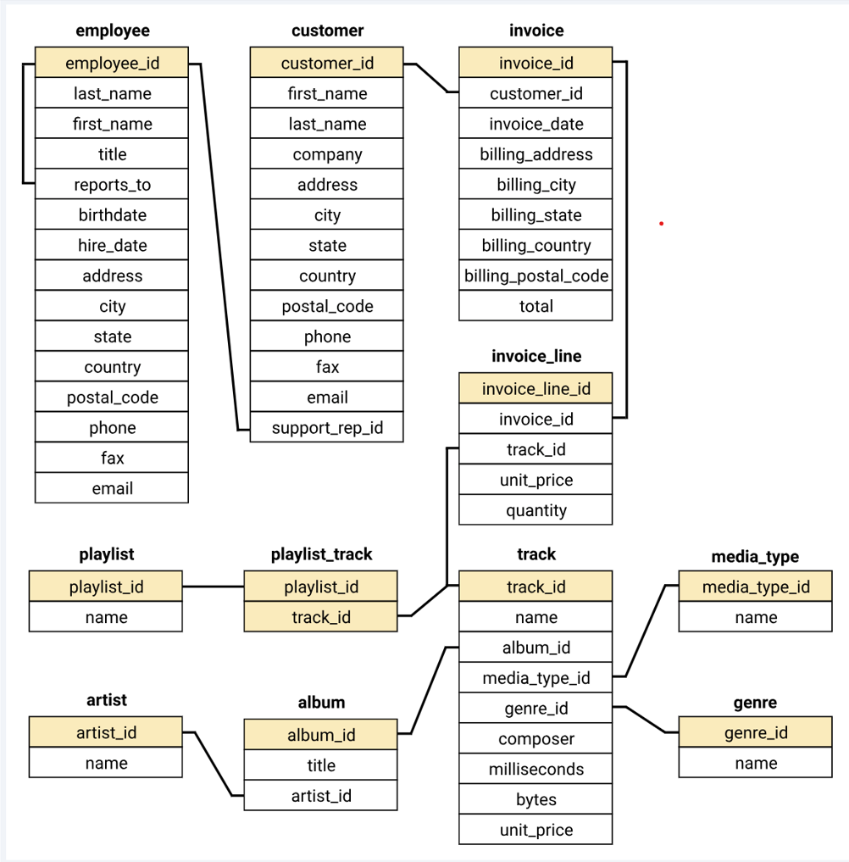
Overview Of Database (ER Diagram):

Slide 6
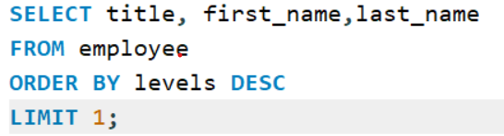
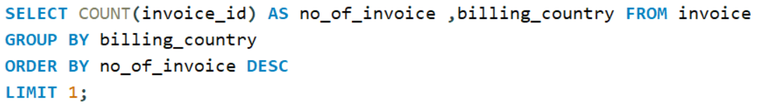
Insights :
1. Who is the senior most employee based on job title?
Output:
Title | First name | last-named
Senior General Manager | Mohan | Madan
2. Which countries have the most Invoices?
Output:
no_of_invoice | billing country
131 | USA

Slide 7
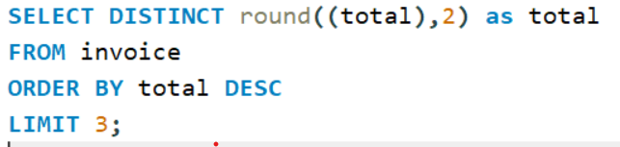
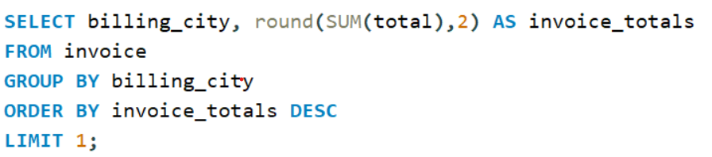
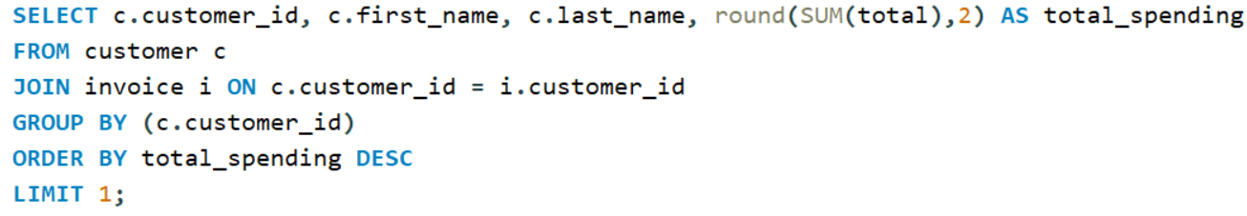
3. What are the top 3 values of the total invoice?
Output:
total
23.76
19.8
18.81
4. Which city has the best customers?
Output:
billing city | invoice total
Prague | 273.24
5. Who is the best customer?
Output:
customer_id | first name | last_name | total_spending
5 | FrantiÅ¡ek | WichterlovÃ¡ | 144.54

Slide 8
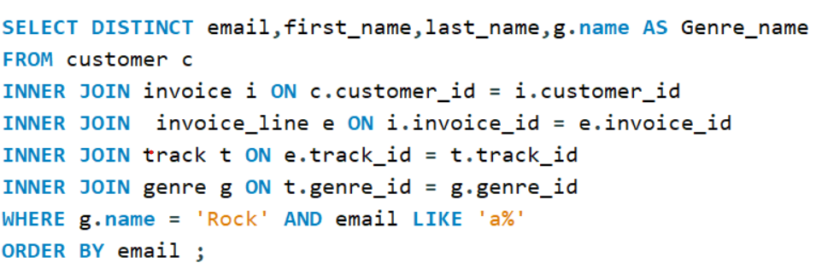
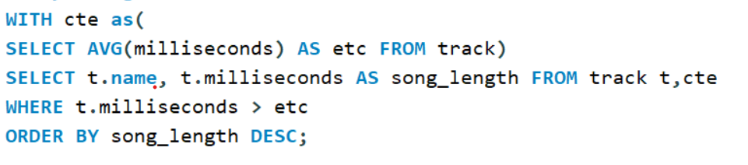
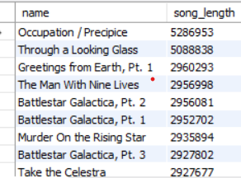
6. Write a query to return the email, first name, last name, & Genre of all Rock Music listeners.
Output:
email | first_name | last_name | genre
aaronmitchell@yahoo.ca | Aaron | Mitchell | Rock
alero@uol.com.br | Alexandre | Rocha | Rock
astrid.gruber@apple.at | Astrid | Gruber | Rock
7. Return all the track names that have a song length longer than the average song length.
Output:

Slide 9
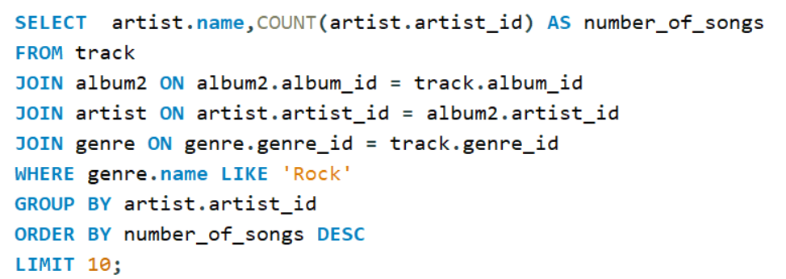
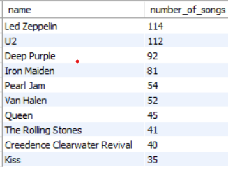
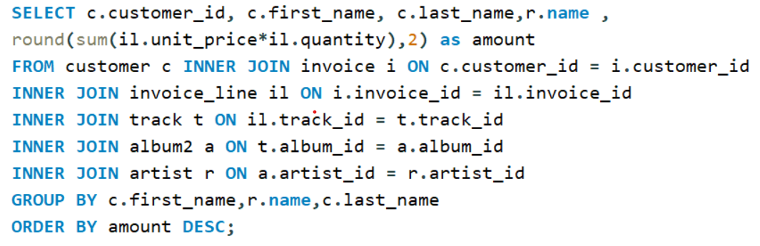
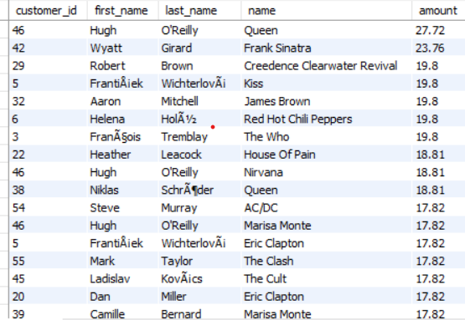
8. Let's invite the artists who have written the most rock music in our dataset.
Output:
9. Find how much amount spent by each customer on artists.
Output:

Slide 10
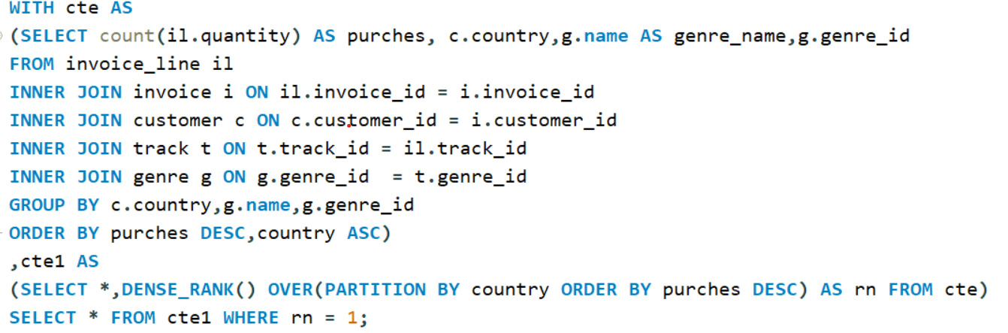
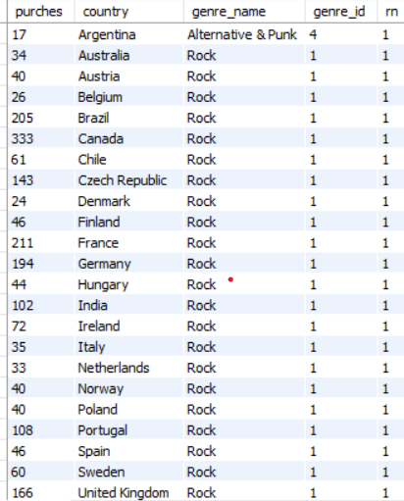

10. We want to find out the most popular music Genre for each country.
Output:

Slide 11
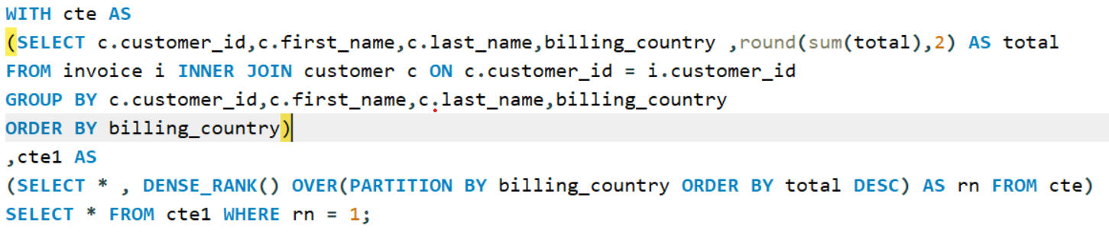
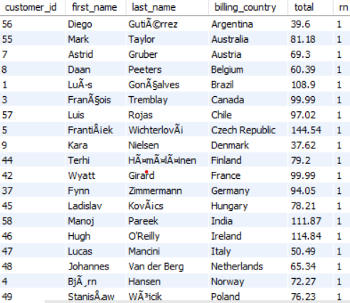

11. Write a query that determines the customer that has spent the most on music for each country.
Output:

Slide 12
Conclusion :
Within this dataset, Mohon Madan is recognized as a senior employee.
Prague stands out as the top city in terms of purchasing songs compared to other cities.
Fantiajek is acknowledged as the all-time best customer within the dataset.
The rock genre emerges as the top revenue-generating genre when compared to other genres within the dataset.
From a song length perspective, it is evident that people tend to prefer songs with average
durations that are neither too long nor too short.
More than 30% of the total sales in the dataset are attributed to the rock genre, indicating its
high demand and contribution to overall revenue.
Additionally, it is evident that other genres in the dataset are not performing as strongly
as the rock genre

Slide 13
Scope of Improvements :
To increase engagement and sales in genres other than rock, we can focus on improving the interest in non-rock genres.
We want to do genre-specific promotion
We want artist collaboration
Also, create the customer segmentation as the respective segment we want to give some offers and benefit so they attract and buy more song.
Feedback also plays a major role in this industry, so if we create a team, collect the feedback, and work accordingly, we will see the revenue grow up.
To improve sales in countries with lower performance, we can direct our focus toward targeted strategies and initiatives.

Slide 14


