Slide 1

Hotel Booking Cancelation Analysis :
By Janmaya Ku. Jena

Slide 2

Contents :
Data Understanding
Insights and observation
Suggestion

Slide 3
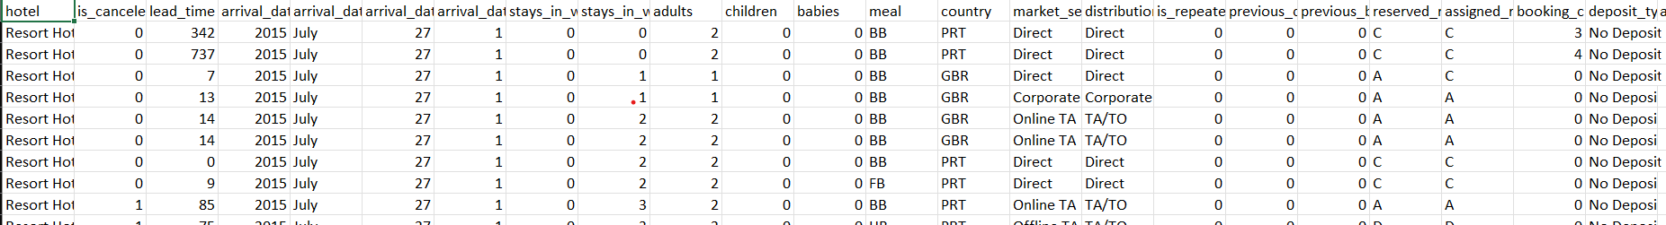
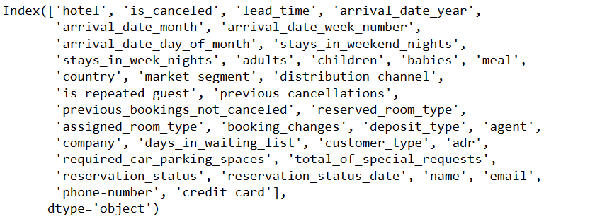
Data Understanding :
Columns Names :

Slide 4
Business Problem :
In the past few years, both urban hotels and resort hotels have been grappling with notably elevated rates of booking cancellations. This trend has given rise to a host of challenges for each type of hotel, including diminished revenue streams and suboptimal utilization of hotel room capacities. Consequently, the foremost objective for both hotels is to curtail these cancellation rates, aiming to bolster their operational efficiency and revenue generation. Our role involves furnishing sound business advice to effectively tackle this issue.
This report primarily delves into an examination of the patterns of hotel booking cancellations, alongside an exploration of extraneous factors that do not significantly impact their core business and annual revenue generation.

Slide 5
Assumptions :
1 . No unusual occurrences between 2015 and 2017 will have a substantial impact on the data used.
2. The information is still current and can used to analyze a hotel’s possible plans in an efficient manner.
3. There are no unanticipated negatives to the hotel employing any advised technique.
4. The hotels are not currently using any suggested solution.
5. The biggest factor affecting the effectiveness of earning income is booking cancellation.
6. Cancellation results in vacant rooms for the booked length of time.
7. Clients make hotel reservations the same year they make cancellations.
Research Question:
What are the variables that affect hotel reservation cancellations?
How can we make a hotel reservation cancellation better?
How will hotels be assisted In making pricing and promotional decisions?

Slide 6
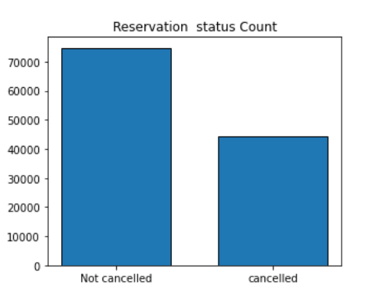
Analysis and finding :
Reservations Status Counts :
The provided bar graph illustrates the proportion of reservations that have been canceled compared to those that have been upheld. Evidently, a substantial portion of reservations remains unaffected by cancellations. Notably, approximately 37% of clients have chosen to cancel their reservations, a factor that exerts a significant influence on the financial performance of the hotels.

Slide 7
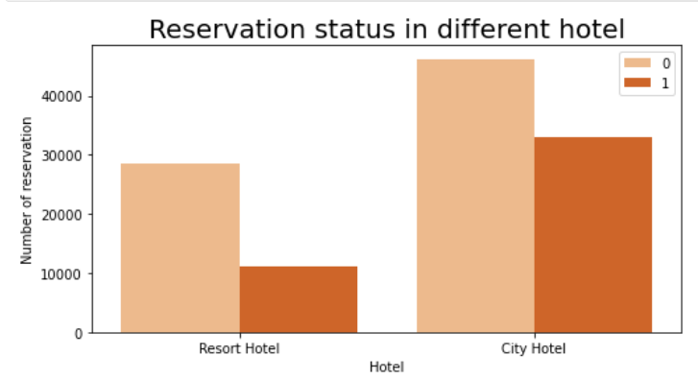

Reservation Status In Different Hotels:
In contrast to resort hotels, city hotels exhibit a higher volume of bookings. This disparity in booking rates could potentially stem from the premise that resort hotels command relatively higher pricing than their urban counterparts.

Slide 8
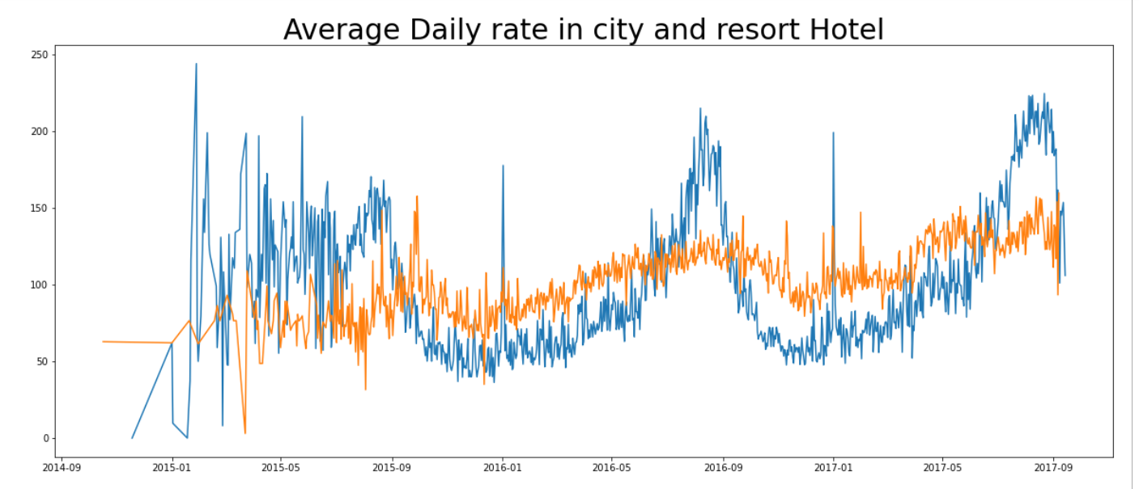
Average Daily Rate In City And Resort Hotel :
The provided line graph depicts fluctuations in the average daily rates between city hotels and resort hotels. On specific days, the average daily rate for city hotels falls below that of resort hotels, and this trend persists on various other days as well. It is worth noting that weekends and holidays often correspond to an increase in the rates charged by resort hotels.

Slide 9
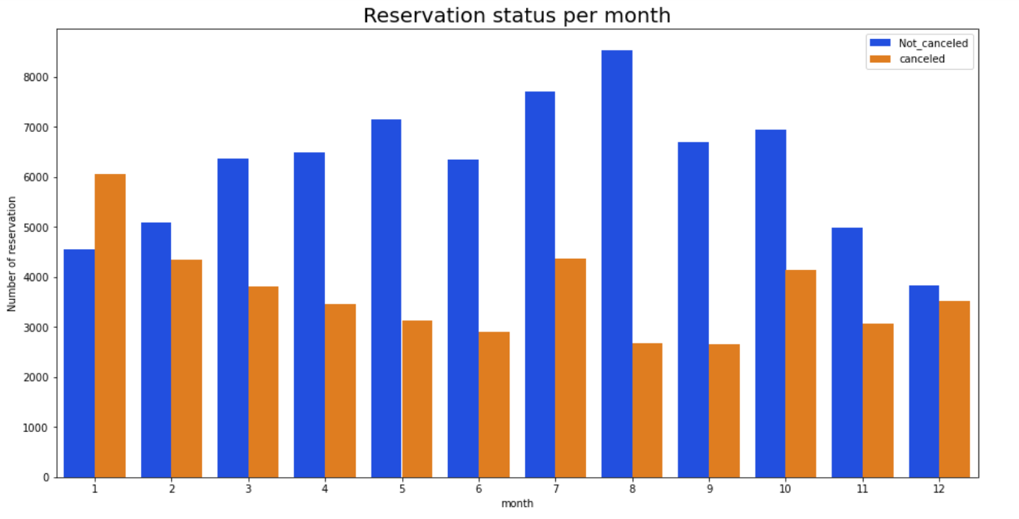
Reservation Status Per Month :
We have created a grouped bar graph to examine the months characterized by the highest and lowest levels of reservations, categorized by their reservation status. It is apparent from the graph that both confirmed reservations and canceled reservations peak in the month of August. Conversely, January stands out as the month with the highest count of canceled reservations.

Slide 10
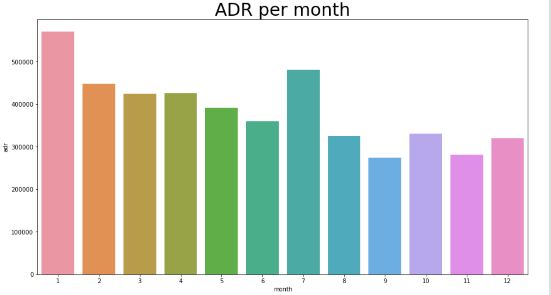
ADR per Month :
The presented bar graph clearly illustrates a trend where cancellations are more prevalent during periods of higher pricing and notably less frequent when prices are at their lowest. This pattern indicates a strong correlation between the cost of accommodation and the propensity for cancellations, suggesting that the cancellation behavior is primarily driven by the affordability of the lodging.

Slide 11
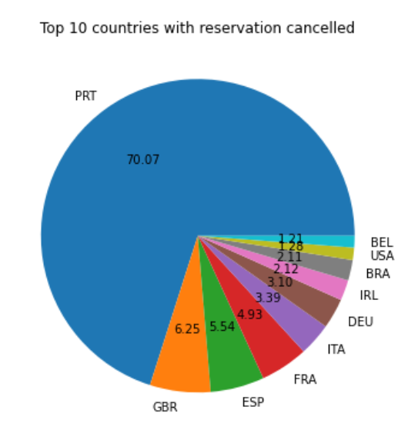
Top 10 Countries With Reservation Cancelled :
Let's now shift our focus to identifying the country that exhibits the highest count of reservation cancellations. Topping the list is Portugal, emerging as the nation with the most substantial number of cancellations.

Slide 12
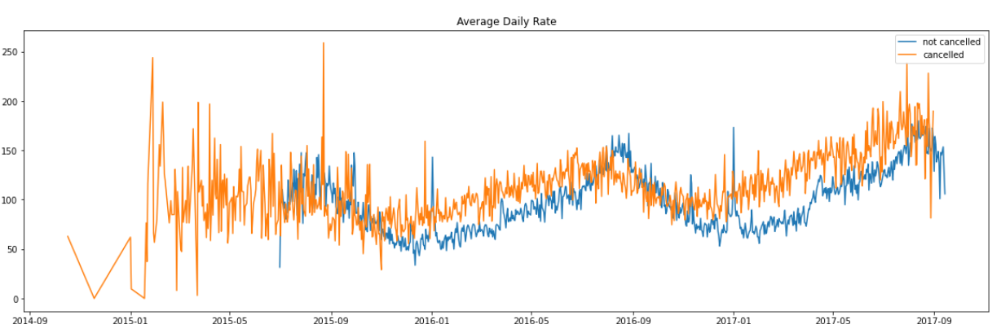
Price VS Cancellation and Cancellation :
The graph provides clear evidence that reservations tend to be canceled when the average daily rate surpasses the threshold at which reservations remain unaffected. This observation reaffirms all the preceding analyses, underscoring the direct relationship between higher prices and an increased likelihood of cancellations.

Slide 13
Suggestions :
The correlation is evident: as prices increase, so do the rates of cancellations. To mitigate the risk of reservation cancellations, hotels could concentrate their efforts on refining their pricing strategies. One effective approach could involve tailoring rates for specific hotels in accordance with their respective locations. Moreover, offering consumer-friendly discounts could be an advantageous strategy to consider.
The proportion of cancellations to successful reservations is notably greater in resort hotels compared to city hotels. Consequently, a potential remedy could involve resort hotels implementing judicious discounts on room rates during weekends or holidays. This approach aims to incentivize bookings and minimize cancellations, thereby enhancing overall guest satisfaction and revenue generation.
3. During the month of January, hotels have the opportunity to initiate promotional campaigns or marketing endeavors with sensible pricing adjustments. This strategic approach can be instrumental in augmenting their revenue, especially considering that January registers the highest incidence of cancellations.
Enhancing the caliber of both hotel facilities and services, particularly in the context of Portugal, presents an avenue for diminishing the cancellation rate. This proactive measure holds the potential to foster a more favorable guest experience and consequently curtail the frequency of reservation cancellations.

Slide 14


