Slide 1


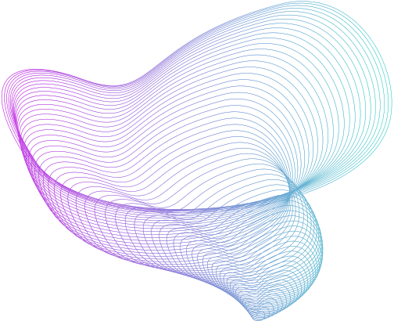
The Quantified Self Chat

Slide 2
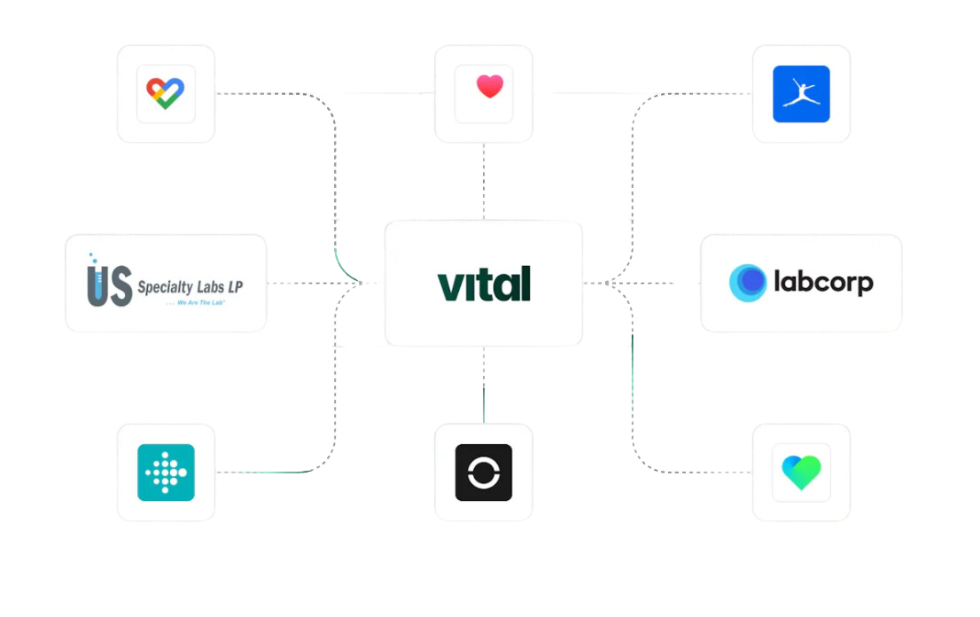
The Quantified self chat connects to your health apps and gives you insights which can help you to optimize your life
Quantified
Self Chat

Slide 3
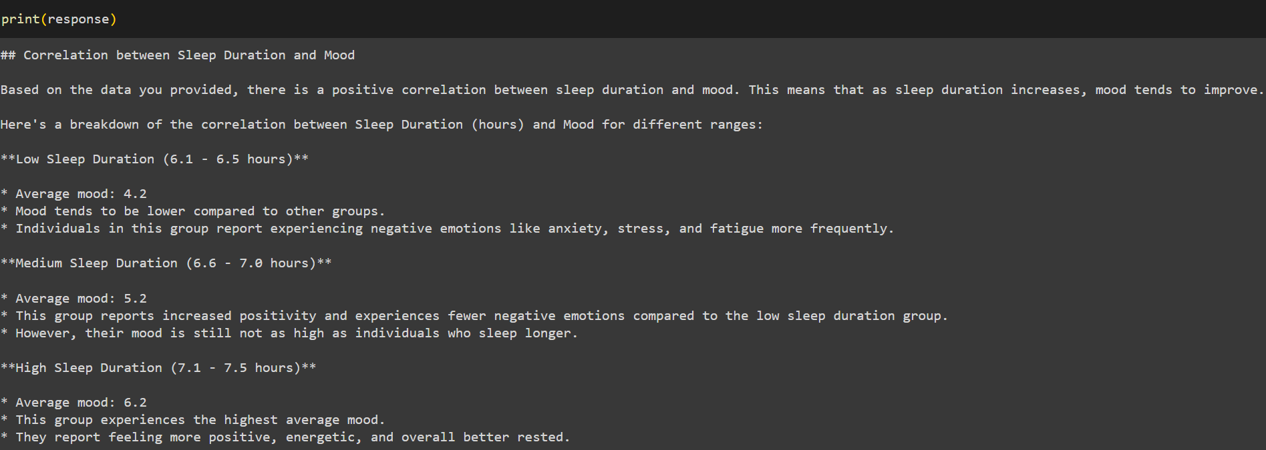

Slide 4
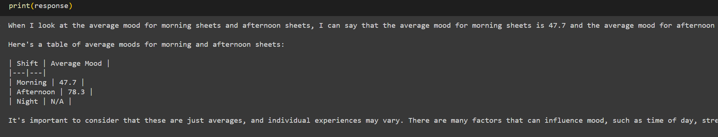

Slide 5
Use Cases
Correlate average wake-up time with mood -> Determine optimal wake-up time.
Analyze how alcohol consumption's effect on sleep quality -> Understand how alcohol affects sleep.
Assess weather's impact on mood -> Decide if traveling to Florida during winter is advisable.
Examine the relationship between types of exercise and mood -> Identify the best sport to stick with.

Slide 6
Scaling
Aggregating data from more apps, not only wellness relate, such as Productivity trackers, to-do lists apps, Calendar, locations.
Keeping accountability by sharing insights and statistics with friends.
Revenue Model
Monthly subscription for personal use.
Hospitals to optimize nurses rest, and reduce worn-out
Tech companies to let employees improve their productivity.

