Slide 1
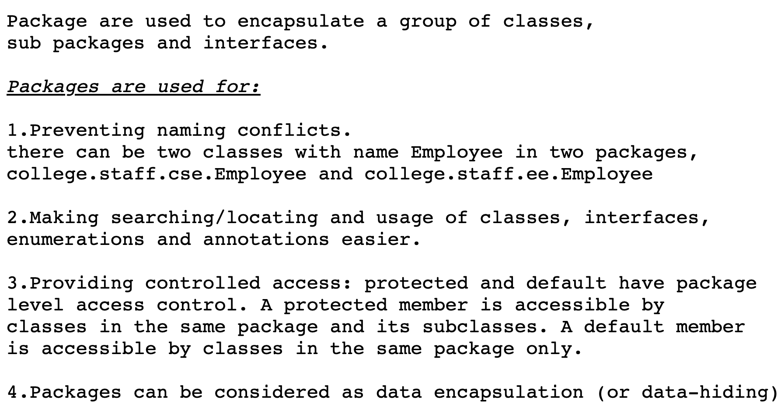
Packages in Java

Slide 2
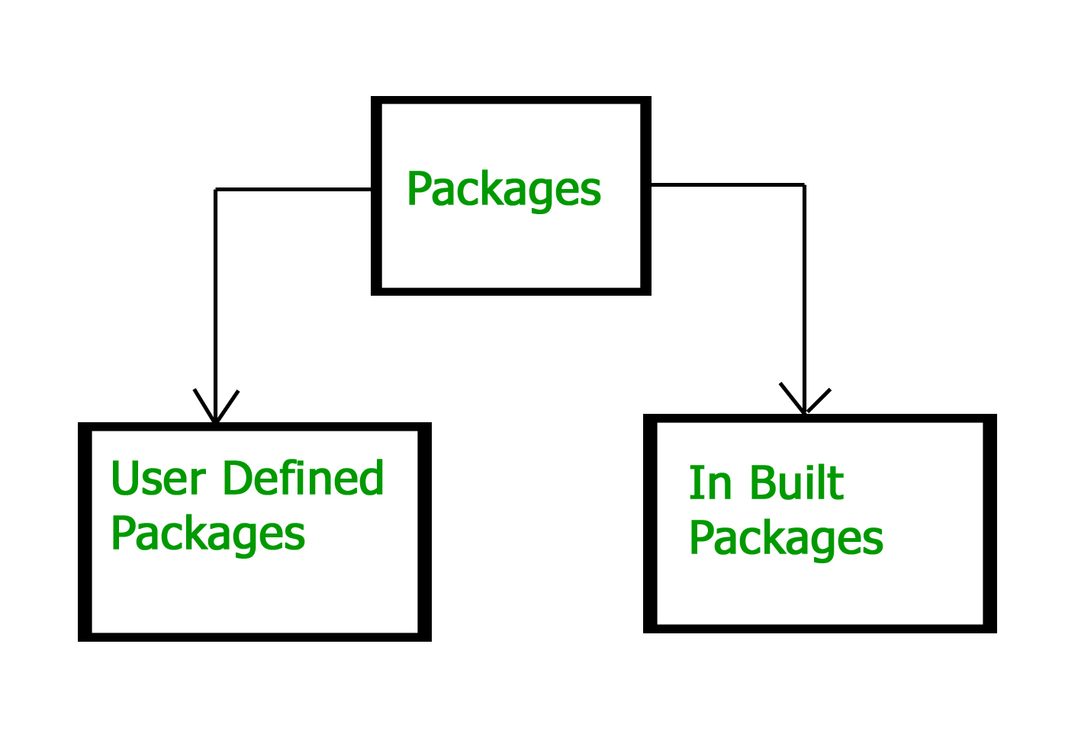
Types Of Packages in Java

Slide 3
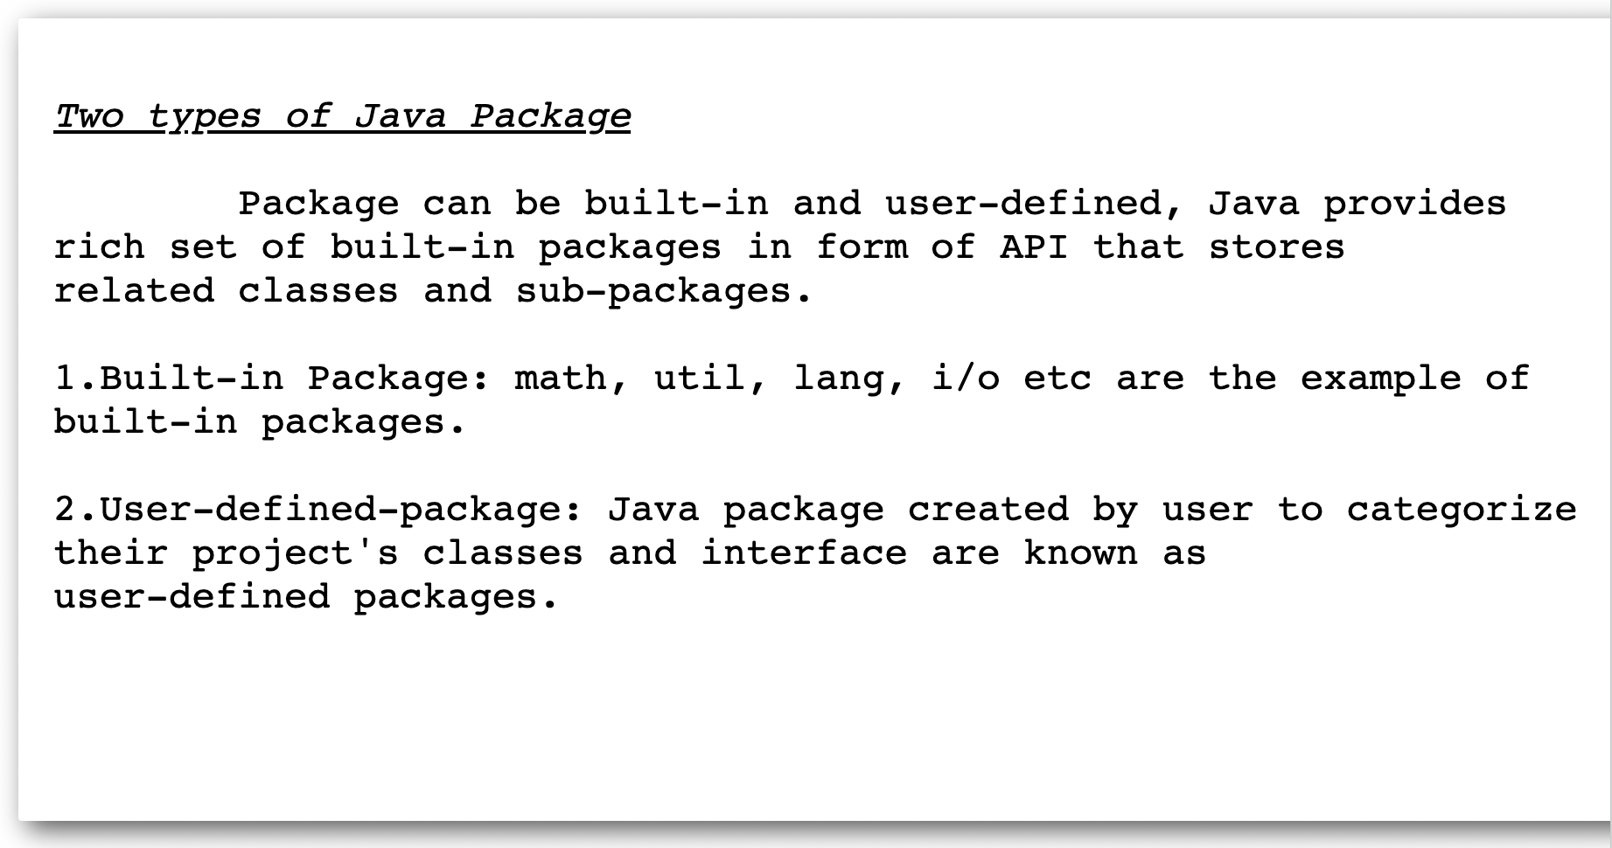
Types Of Packages in Java

Slide 4
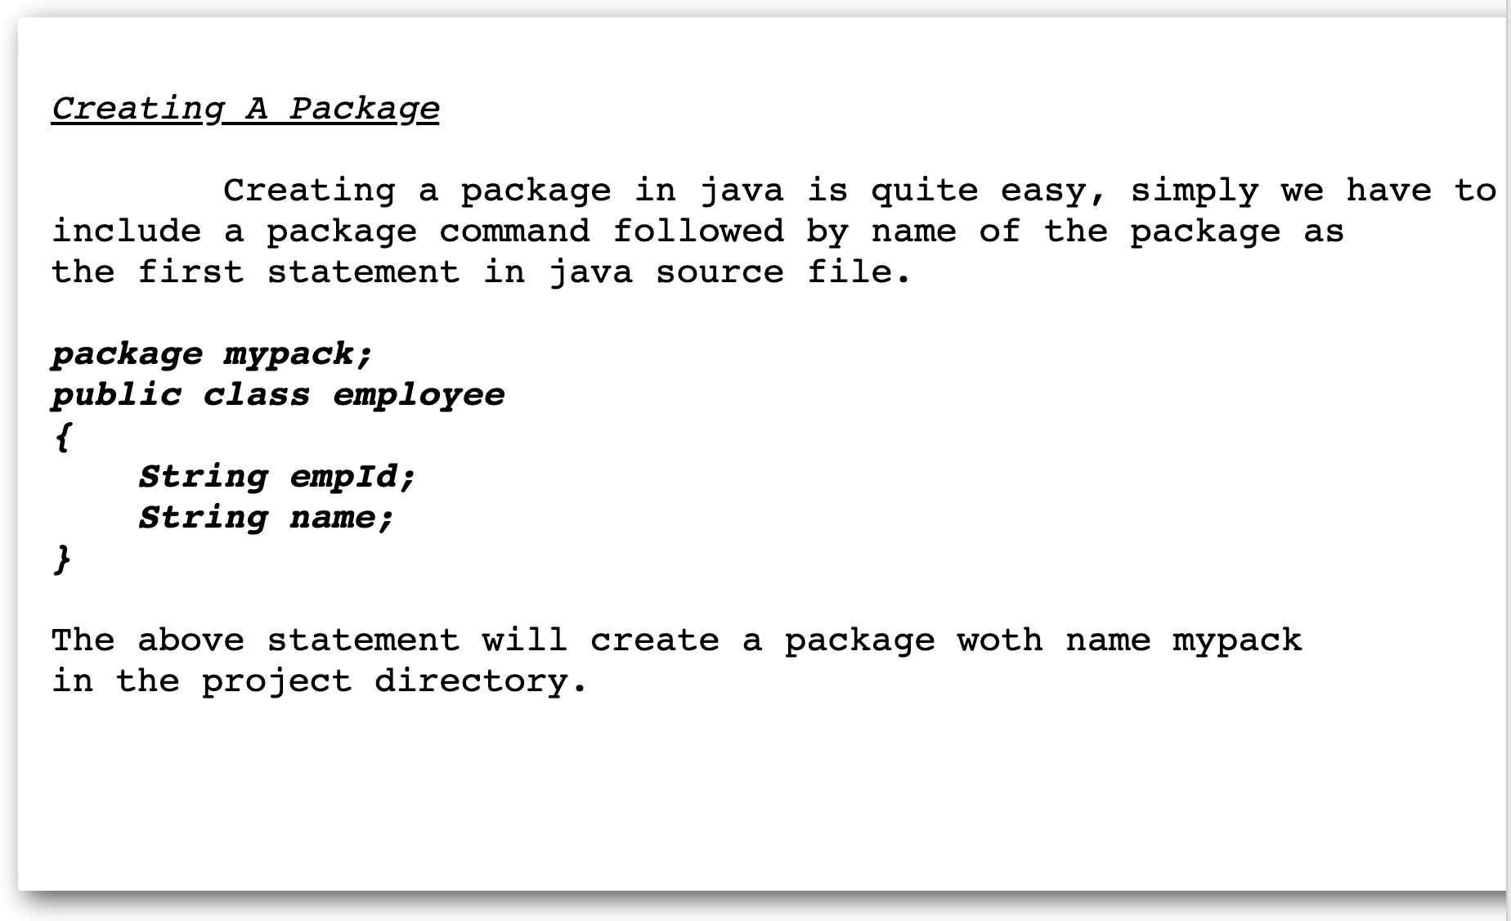
Create A Packages in Java

Slide 5
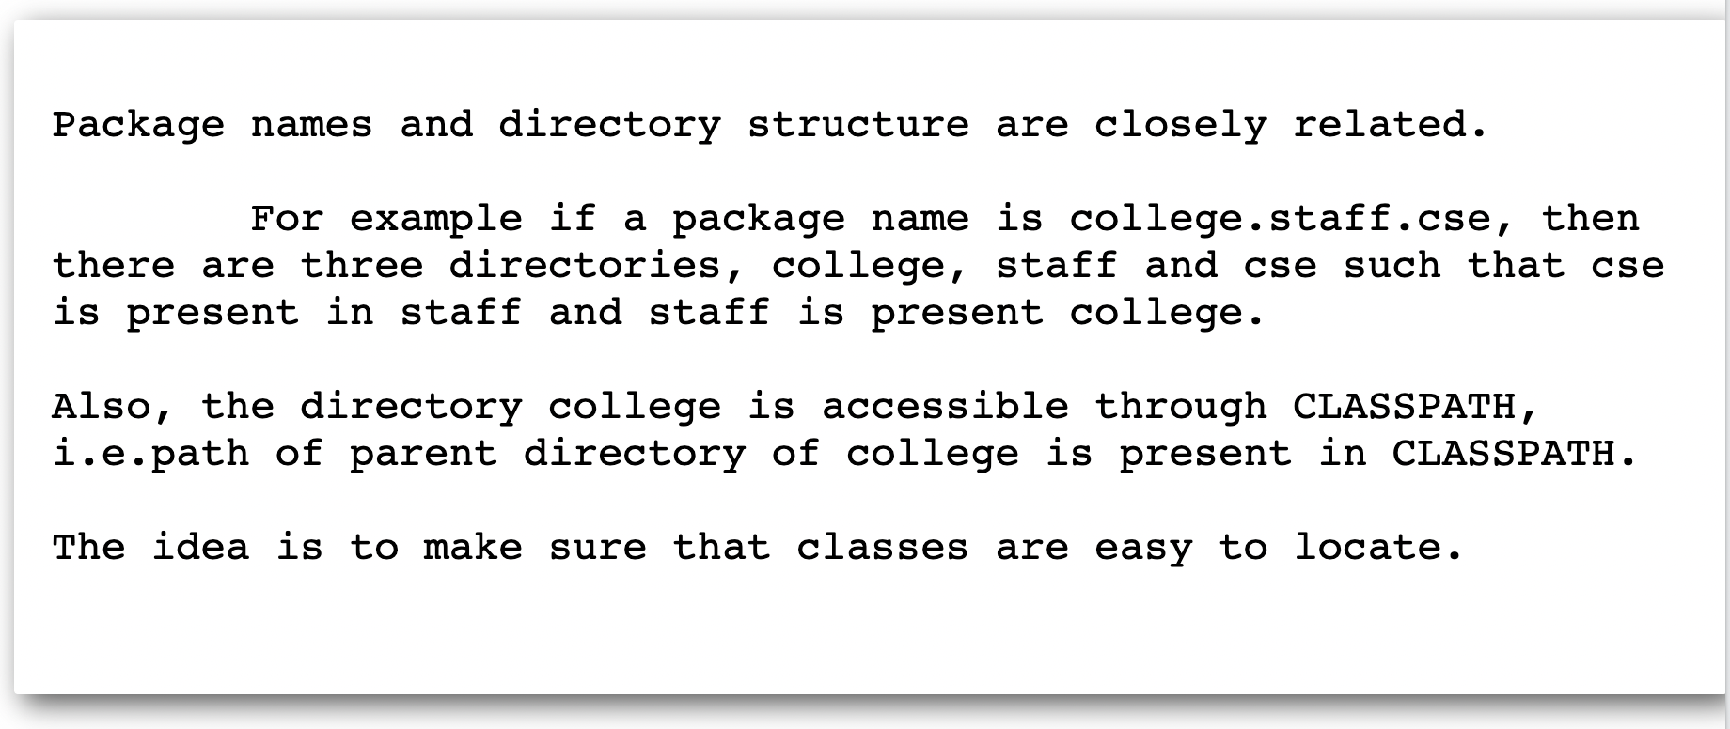
Naming A Package

Slide 6
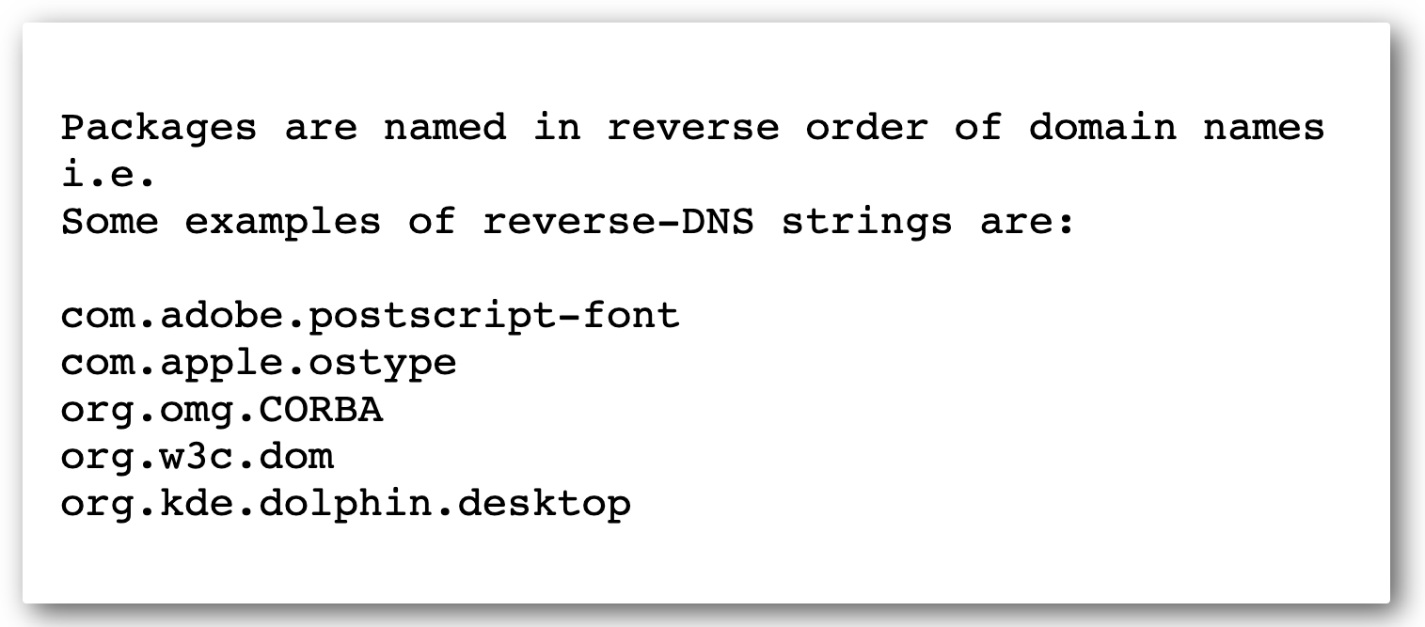
Naming Convention Of A Package

Slide 7
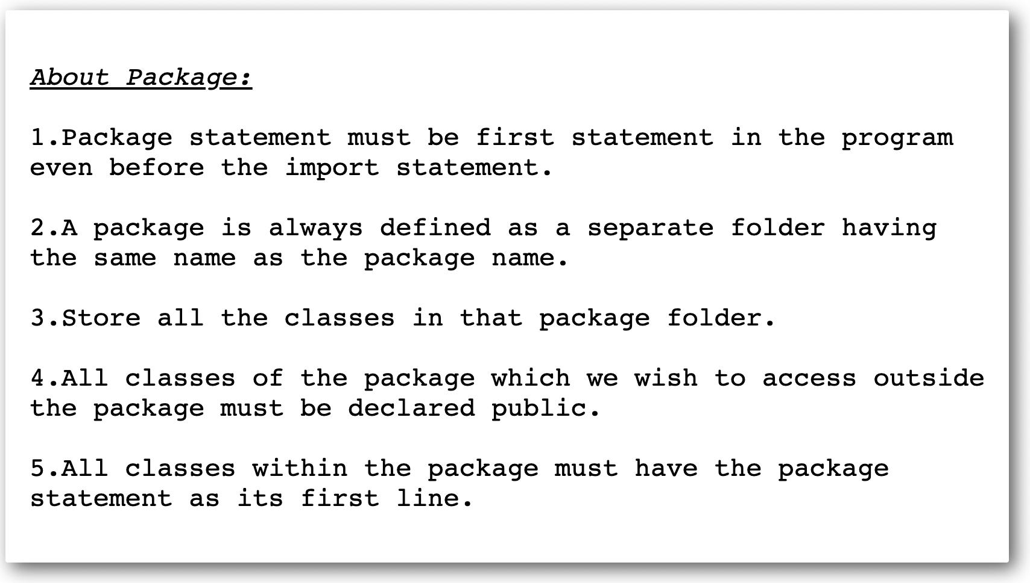
Some Points About Package To Know:

Slide 8
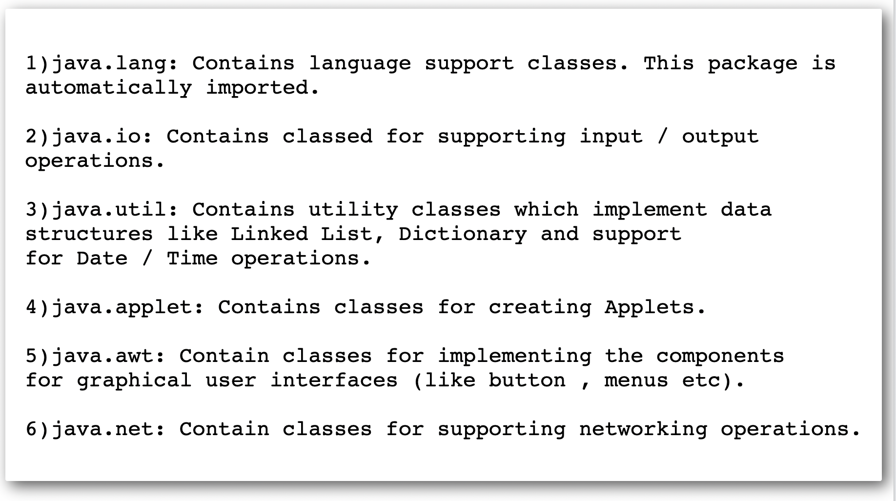
Built In Packages In Java

Slide 9
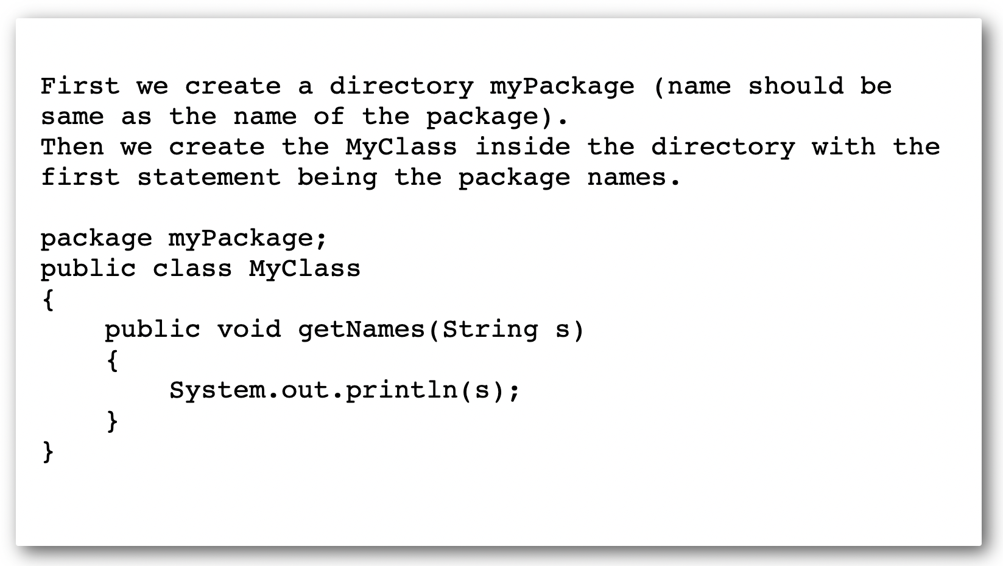
How To Create An User Defined Packages In Java

Slide 10
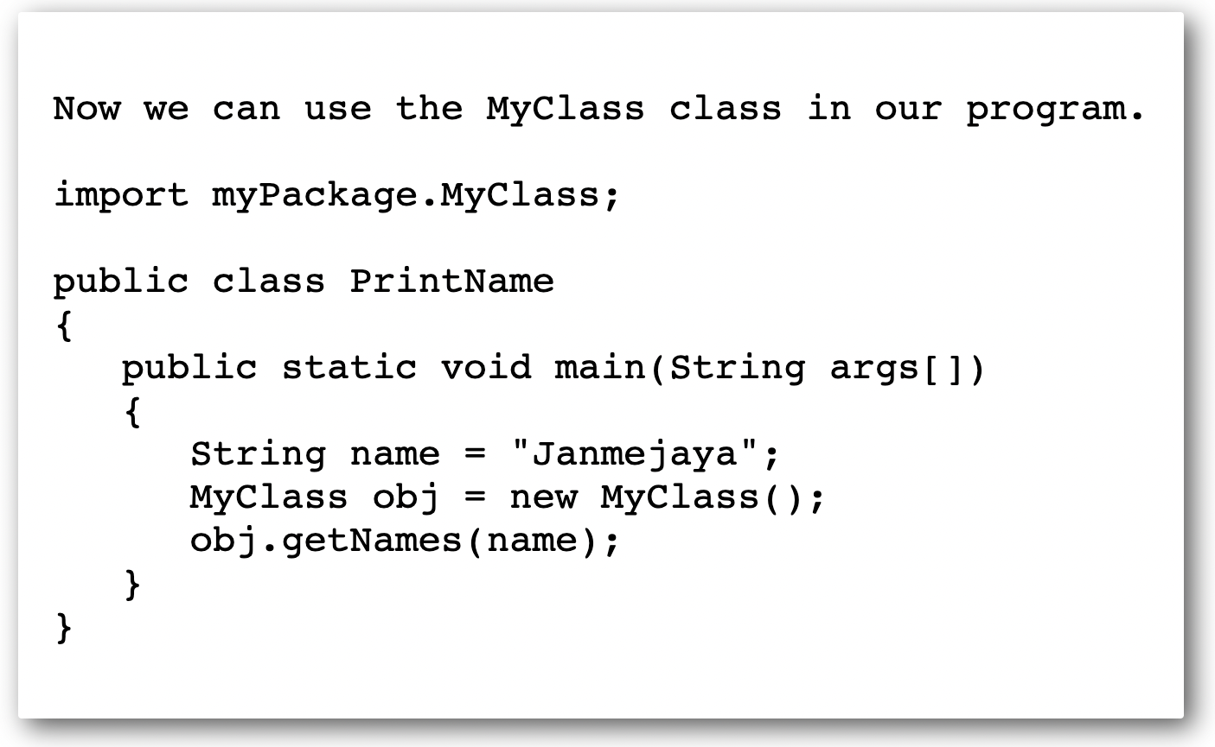
Import An User Defined Package In Java

Slide 11
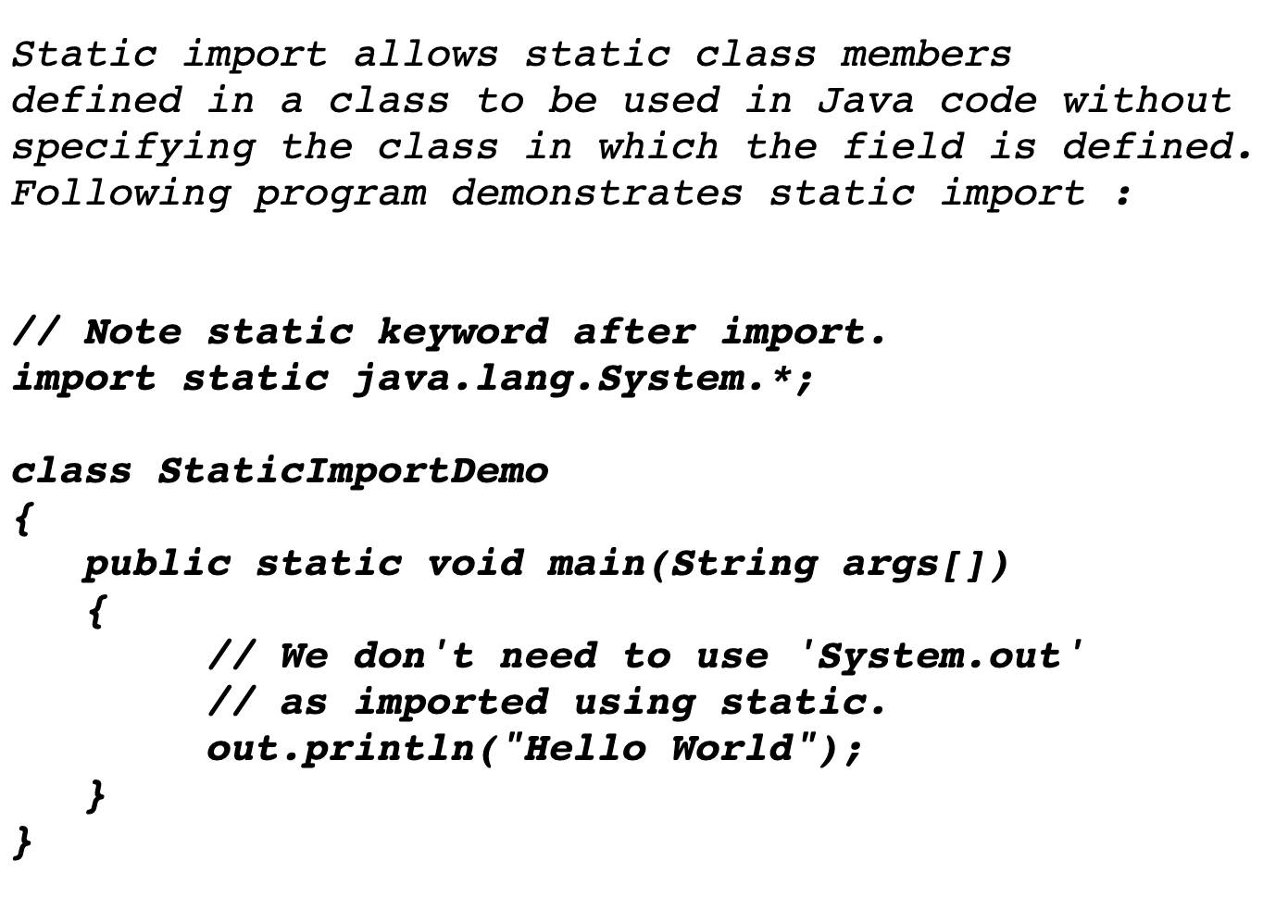
Static Import In Java

Slide 12
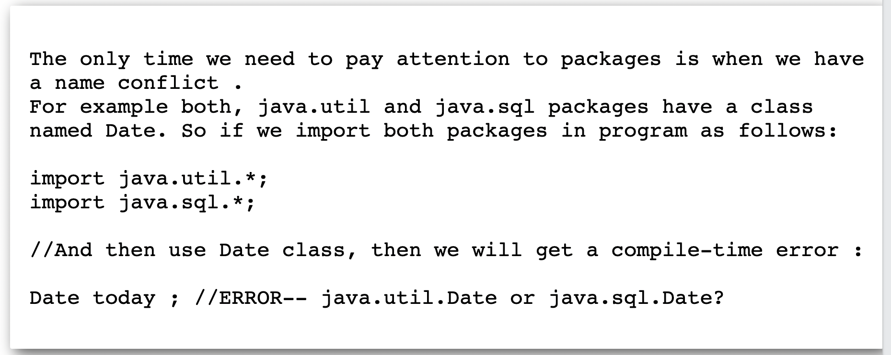
Naming Conflict In Package In Java

Slide 13
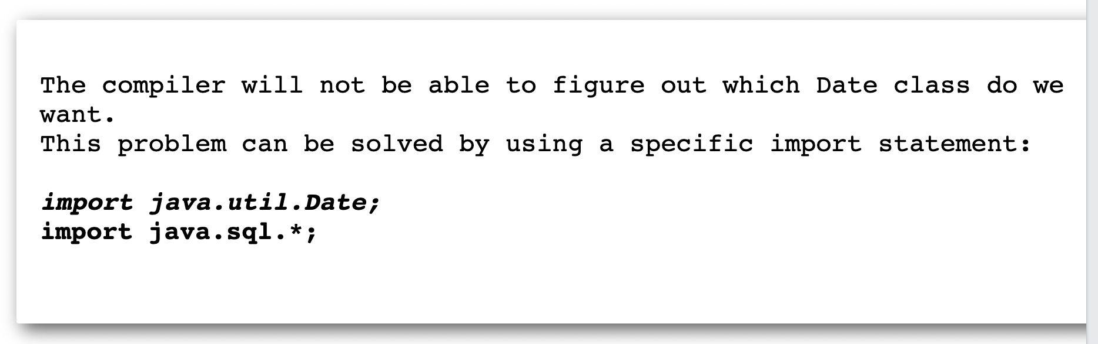
Resolve Naming Conflict

Slide 14
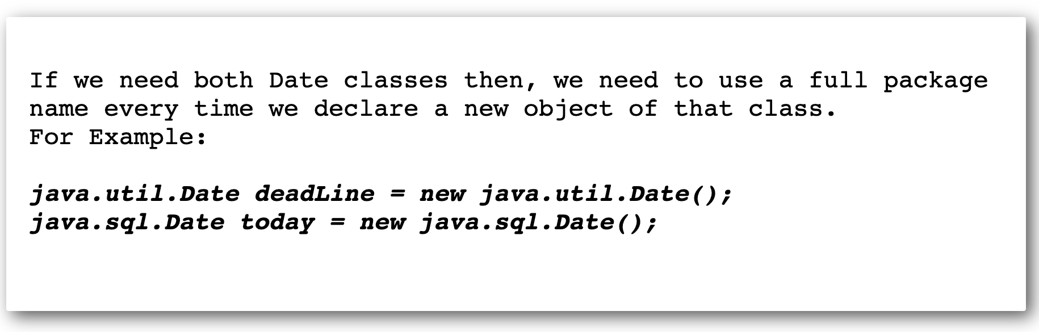
Resolve Naming Conflict

