Slide 1



  CYCLISTIC BIKE-SHARE ANALYSIS
  Presented by: Mohammad Usman Ali
  Last Updated: 9/1/2025

Slide 2




  Business Task Statement
The objective of this analysis is to identify key behavioral differences between annual members and casual riders of Cyclistic bikes in order to develop data-driven marketing strategies that will increase the conversion of casual riders into annual members.

Slide 3

  Overview of the data
  Data Source: Cyclistic trip history (public dataset by Motivate International Inc.)
  Time Period: January 2025 - December 2025
  User Types:
  Membership Riders
  Casual Riders
  Rideable Types:
  Electronic bikes
  Classic bikes

Slide 4
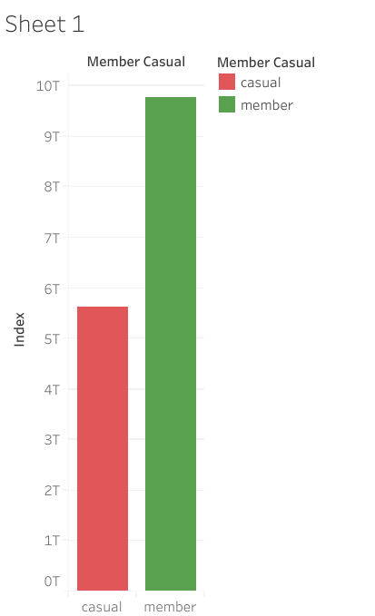
  Analysis Overview
Insights:
  Almost 50% more membership users

Slide 5
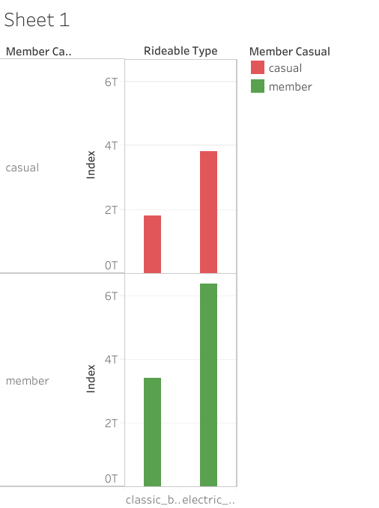


  Rideable types usage
Insights:
  Electric bike usage in more for both members and casual riders
Electric Bikes

Slide 6
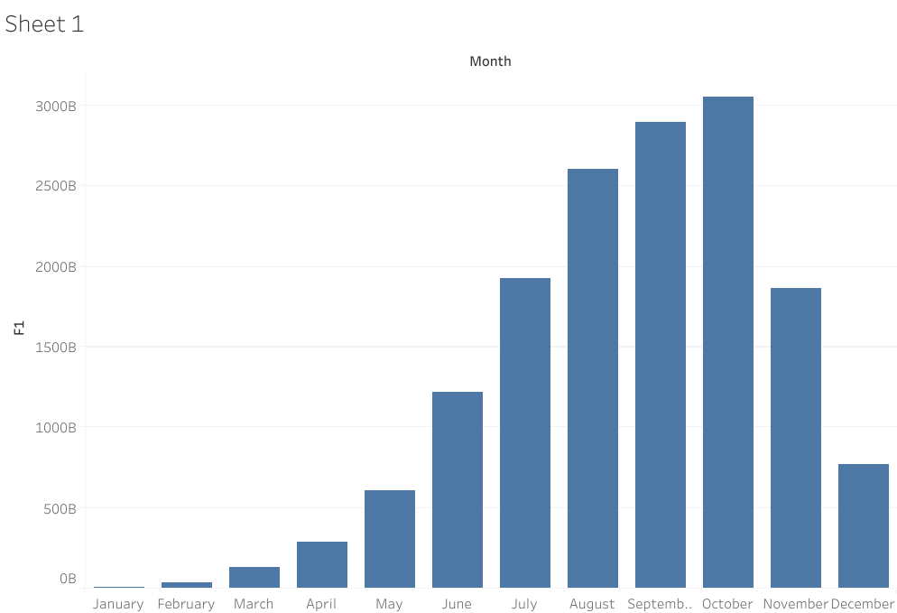
  Month wise analysis
Insights:
  Rides peak around warmer months
  Most usage is seen in october
  Best time to advertise

Slide 7
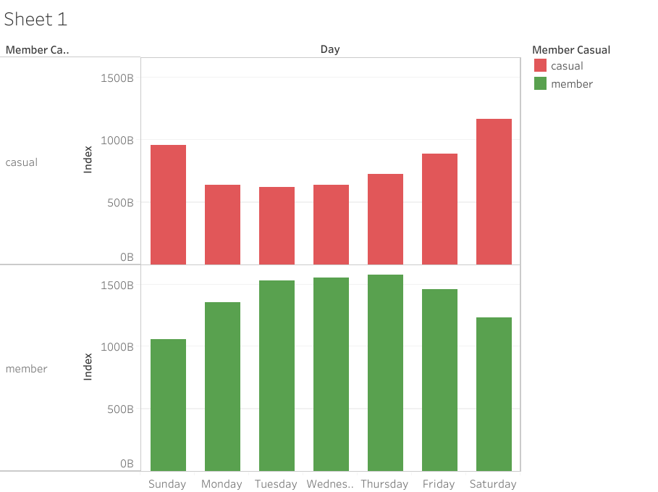
  Day wise Analysis
Insights:
  Members are more active during work days
  Casuals are more active during weekend

Slide 8
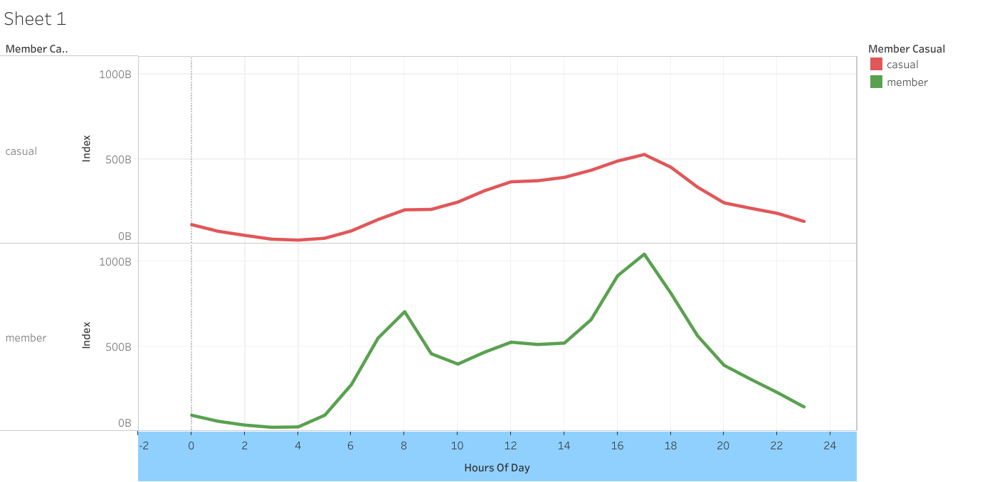
  Hour-based ride usage during the day
5 PM
8 AM

Slide 9
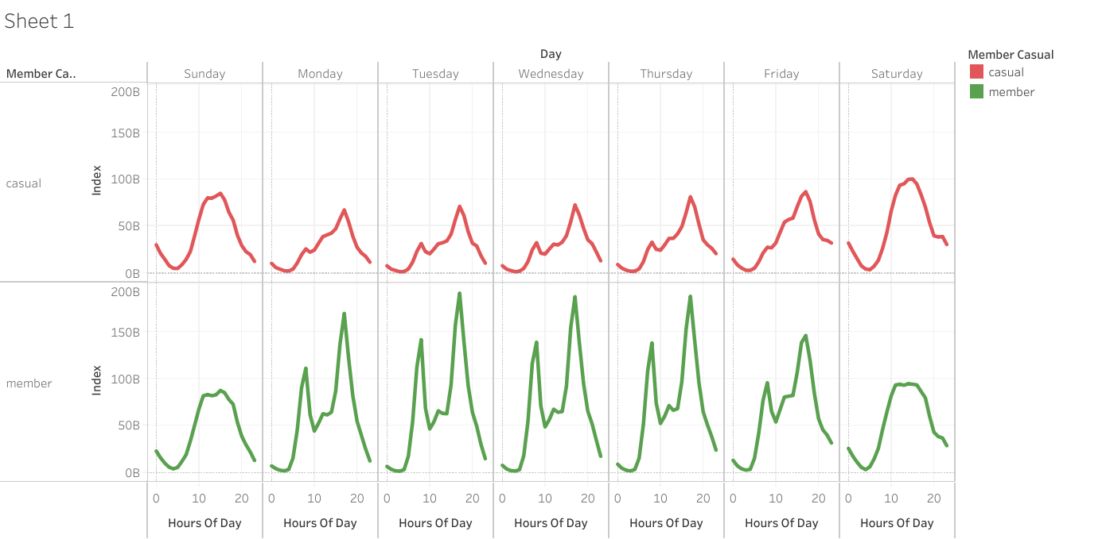
  Hourly ride usage during a full week

Slide 10
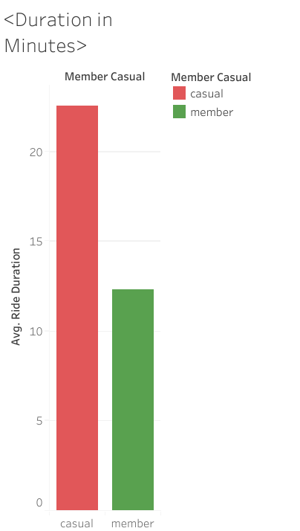
  Ride Duration
Insights:
  Casual riders ride for longer durations.

Slide 11

  Key Insights and findings
  Membership riders use the bikes to commute to work
  Casual riders use the bikes on weekends
  Weekdays usage of casual riders is seen during the evening time
  Majority of riders prefer electric bikes over classic bikes
  Weekend usage of both members and casuals are similar
  Casual riders ride for longer duration as compared to members

Slide 12

  Reccomendations
  01.
  02.
  03.
Offer Seasonal or quarter year (4 month) memberships, and packages for weekend rides in annual membership.
Offer beneficial packages for members, who ride longer then 20 minutes or rides that start between 12 PM and 5 PM.
Start Advertising around May till November,
Advertise Seasonal memberships and ride packages offered in annual membership.

Slide 13
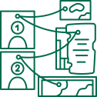
  Conclusion
Cyclistic should focus on converting longer duration and evening casual riders by targeting their recreational behavior with digital campaigns that highlight convenience, savings, and lifestyle benefits of annual membership as well as by providing other membership plans.

