Slide 1
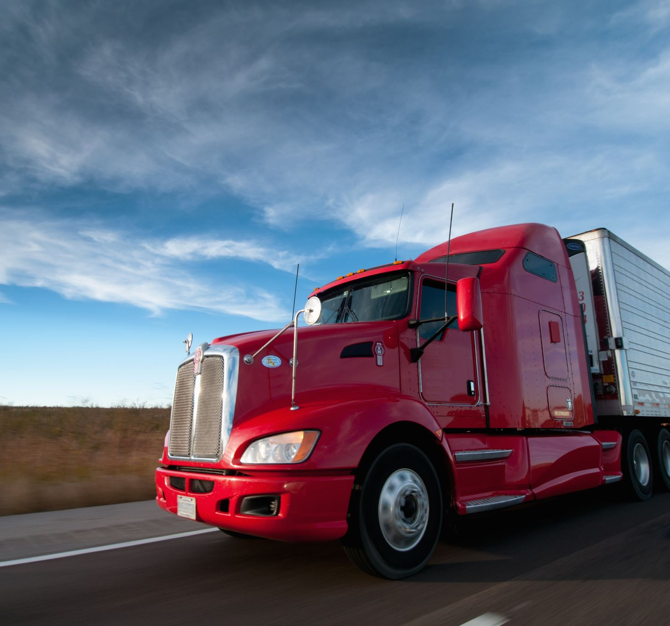
Truck Dashers Europe
Module: M431
By
Jann and Janis

Slide 2
Team

Slide 3
What went well?
Working as a Team
The work with Unity

Slide 4
Table of contents
Team
What went well?
Game / Project
What is our game about?
Gameplay
The star of our game
Technical

Slide 5
Game / Project

Slide 6
What is our game about?
Driving a Truck in a Sovietish kind World.
Find the Destination Point.

Slide 7
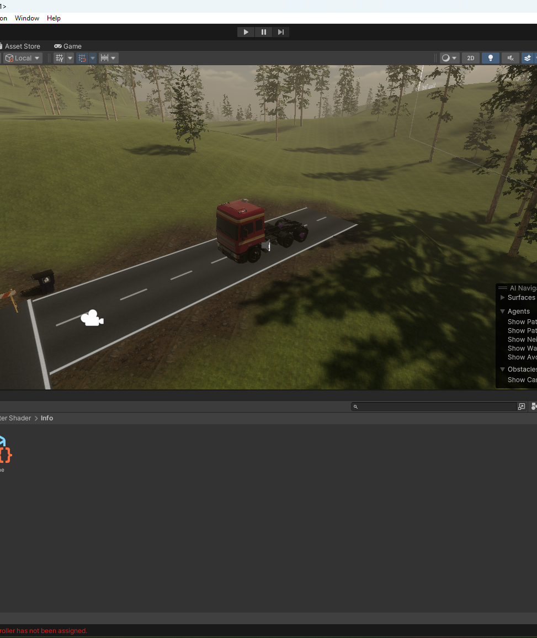
Gameplay
You can drive in a Hilly, green, Forest Map
As seen in the Screenshot →
You can Drive a Truck that feels realistic.
Realistic gearbox ratio
Realistic Suspension
Realistic Handling

Slide 8
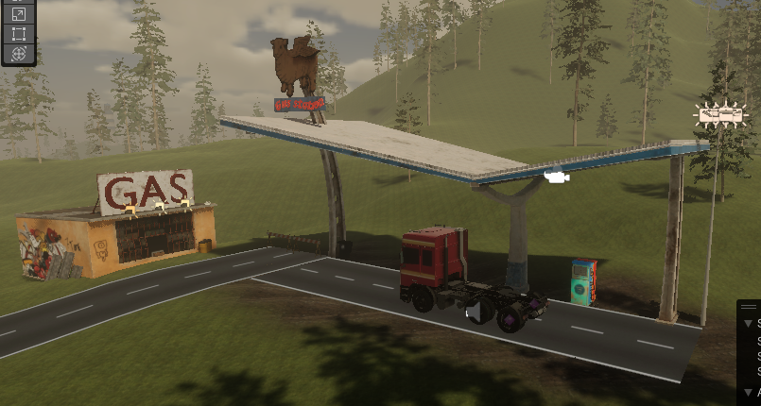
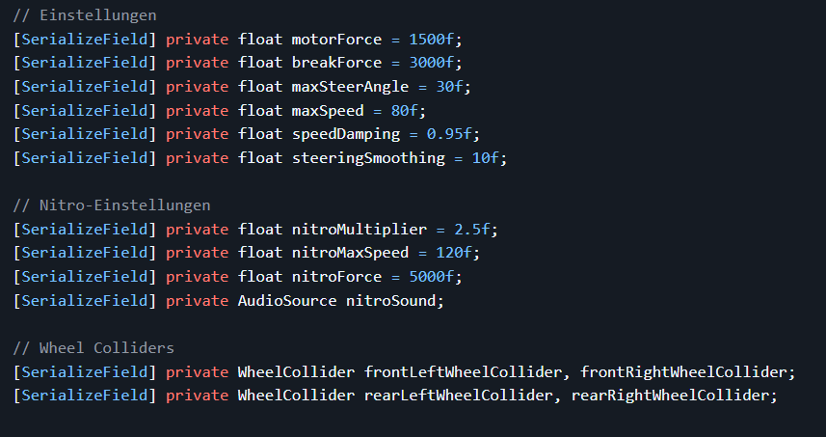
Our star of the Game: Truck
The truck has been tweaked with a lot of sliders as seen in the “blue” screenshot.
We put a lot of care and time into its handling and feeling overall.

Slide 9
Technical
5 Assets Dowloaded
Unity Engine
Speedometer
Distance-o-meter
228 Lines of Code

