Slide 1
School of Electronic and Electrical Engineering
FACULTY OF ENGINEERING
ELEC5882M
Week 28 Summary
Junnan Liu
201715540
el23jl2@leeds.ac.uk
Notes:
- Summary of last week:
- Last week, [neuroidss/FreeEEG32-beta: as FreeEEG32 plus alpha1.5 test passed, FreeEEG32 project changed to beta version (github.com)](https://github.com/neuroidss/FreeEEG32-beta?tab=readme -ov-file) After a thorough understanding of related projects, we are ready to first use Myoware2.0 to simulate the functions of our development board.

Slide 2
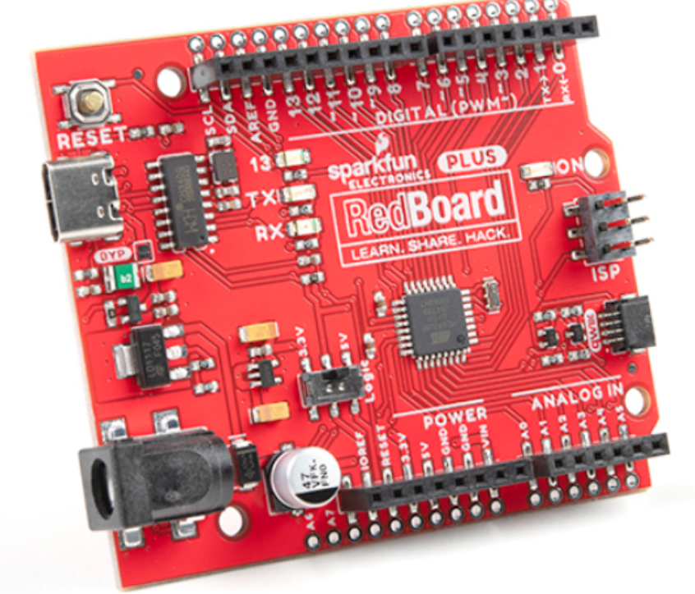
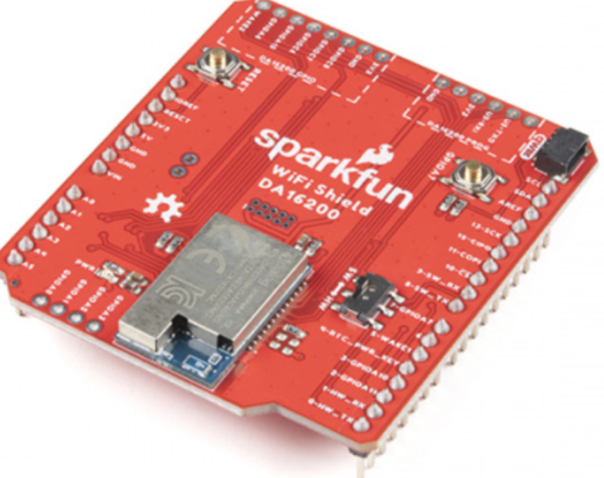
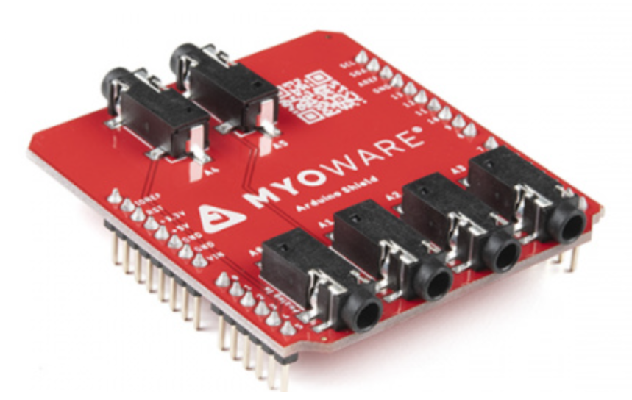
Notes:
- Although our board SparkFun RedBoard Plus can realize direct connection between two boards through MyoWare 2.0 Arduino Shield, since RedBoard Plus does not have WiFi or Bluetooth function, we subsequently purchased a ULP WiFi DA16200 R3 extended version and used two SparkFun RedBoard Plus The expansion hole on the side is soldered for connecting the MyoWare 2.0 Arduino Shield

Slide 3
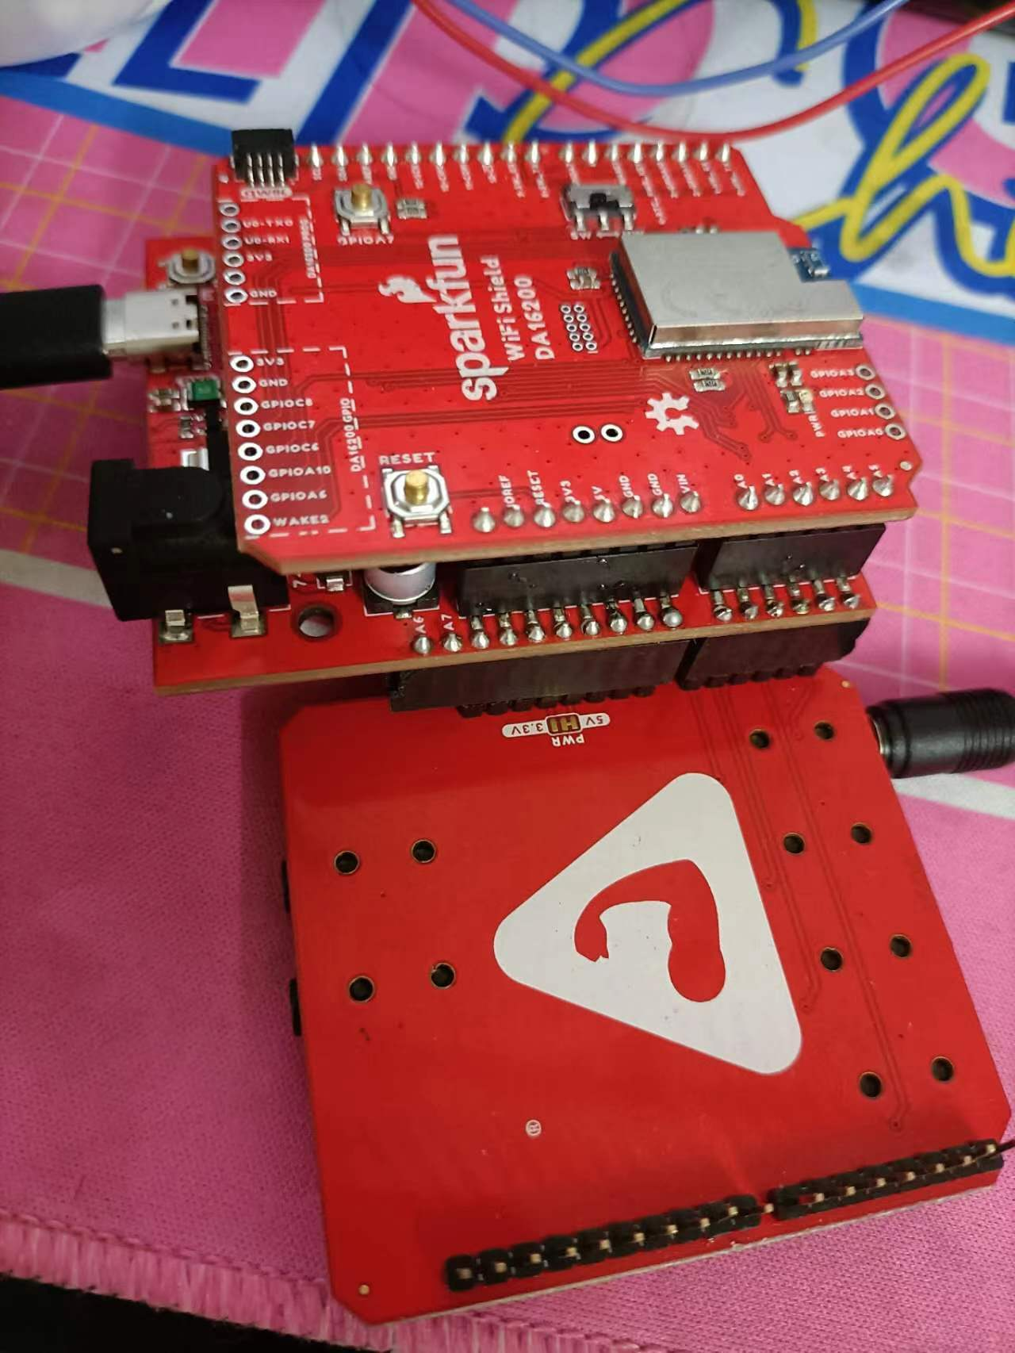

Slide 4
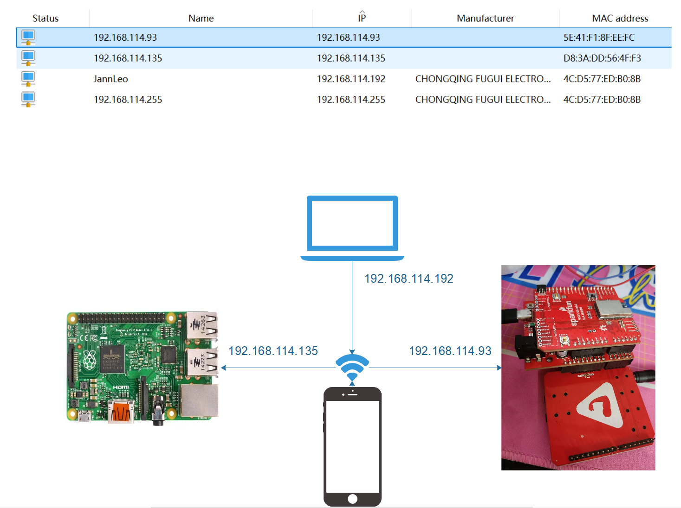

Slide 5
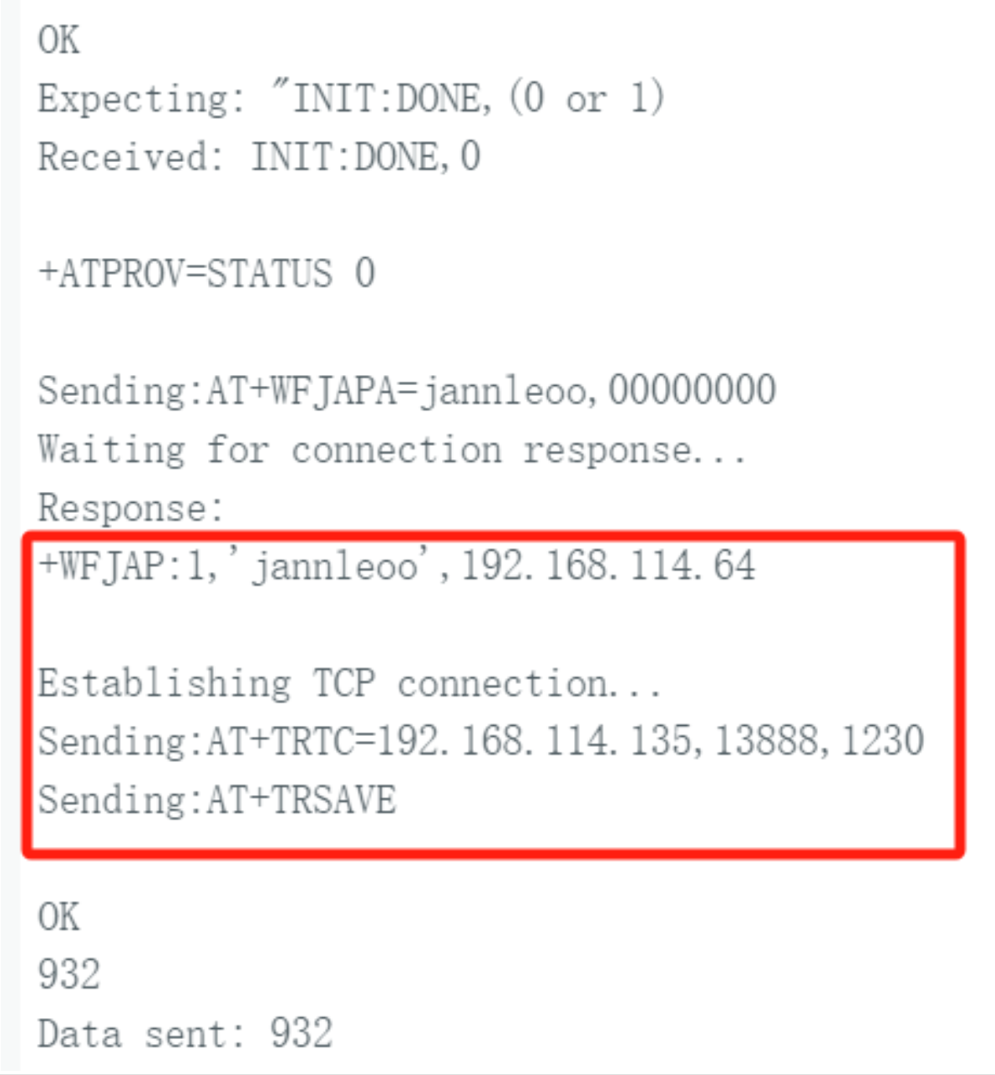
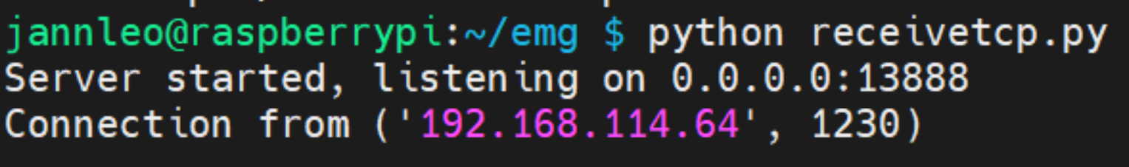

Slide 6
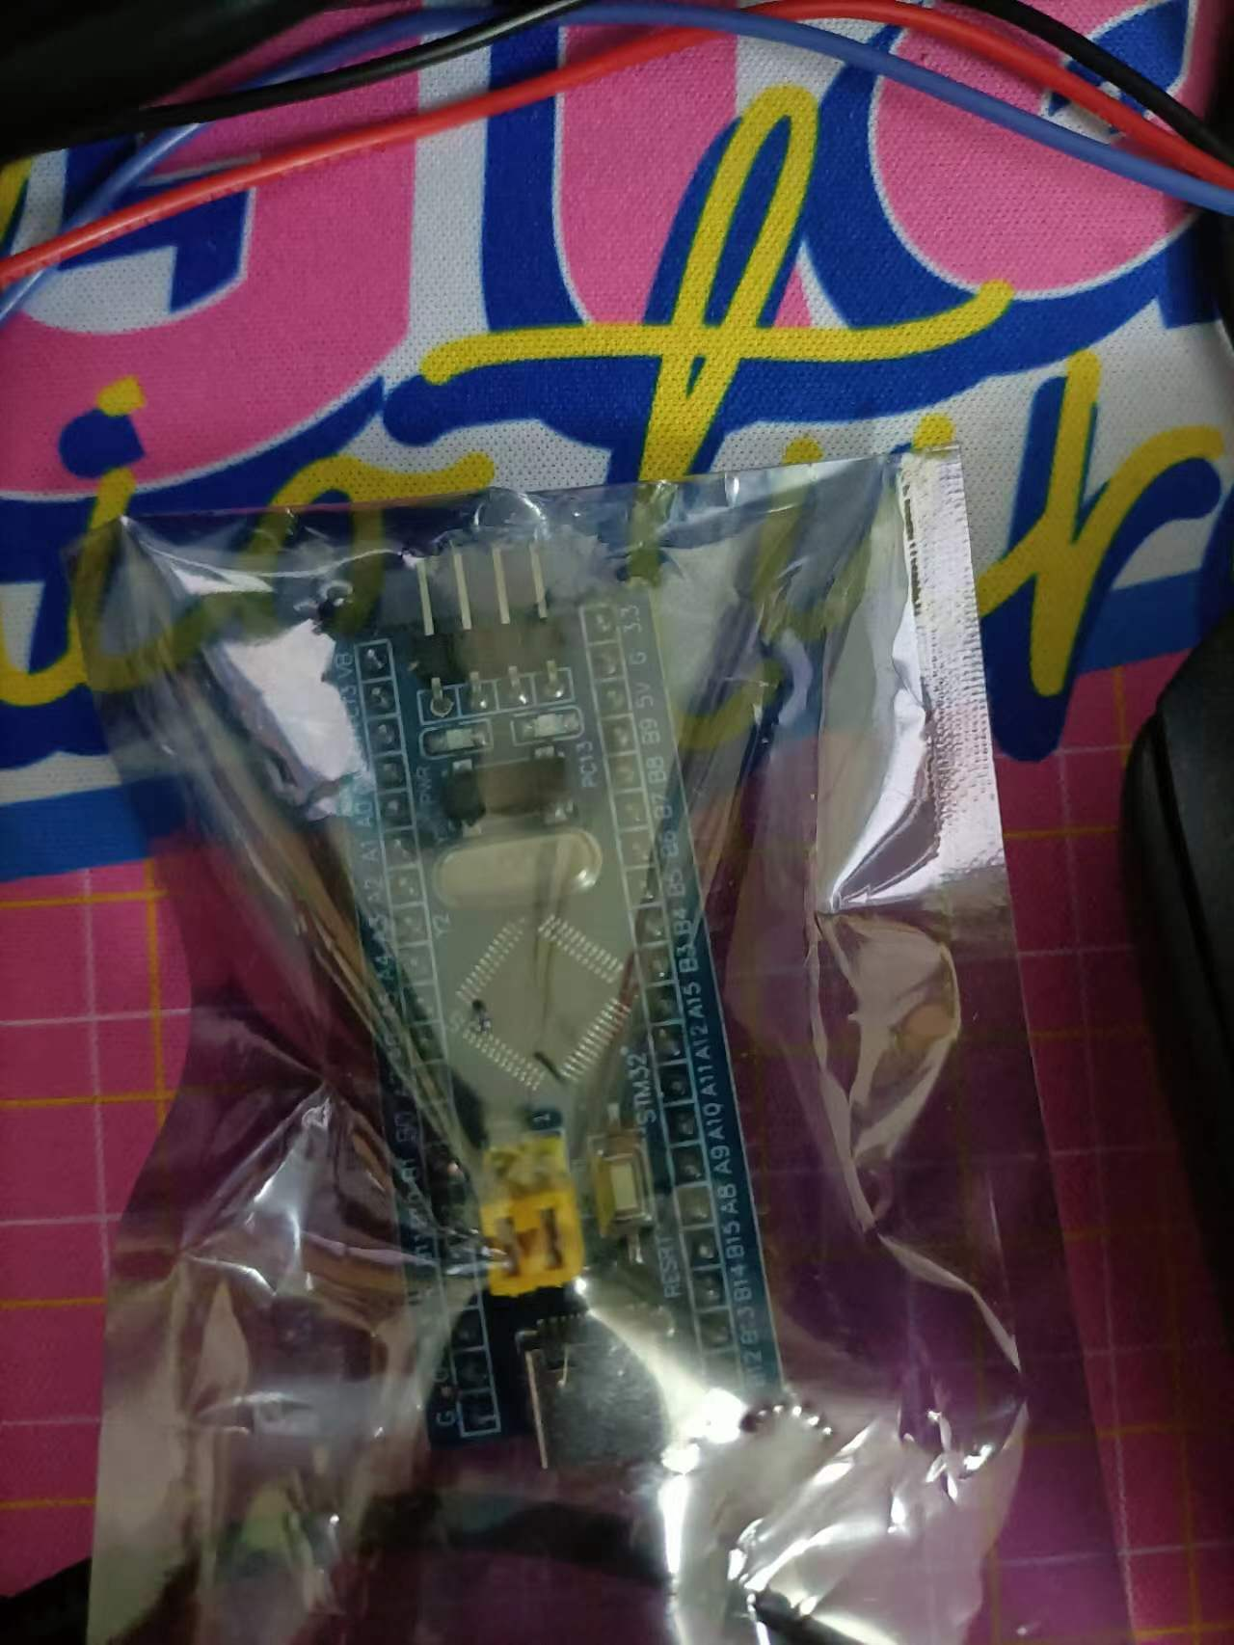
Next Week Plan
1. Solve the problem of TCP data transmission and complete the wireless transmission of STM32

