Slide 1
School of Electronic and Electrical Engineering
FACULTY OF ENGINEERING
ELEC5882M
Title (should relate to content)
Student Name
Student Number
Email address

Slide 2
Suitable title
Bullets points summarising content / project point.
Try not to include too many.
Avoid copying text from other sources, i.e. papers, reports etc.
Should be address in your presentation.
Include references¹ where necessary.
[1] McLaughlan, et al. Aim to include references on the relevant slide if showing figure, finding and data from other sources.

Slide 3
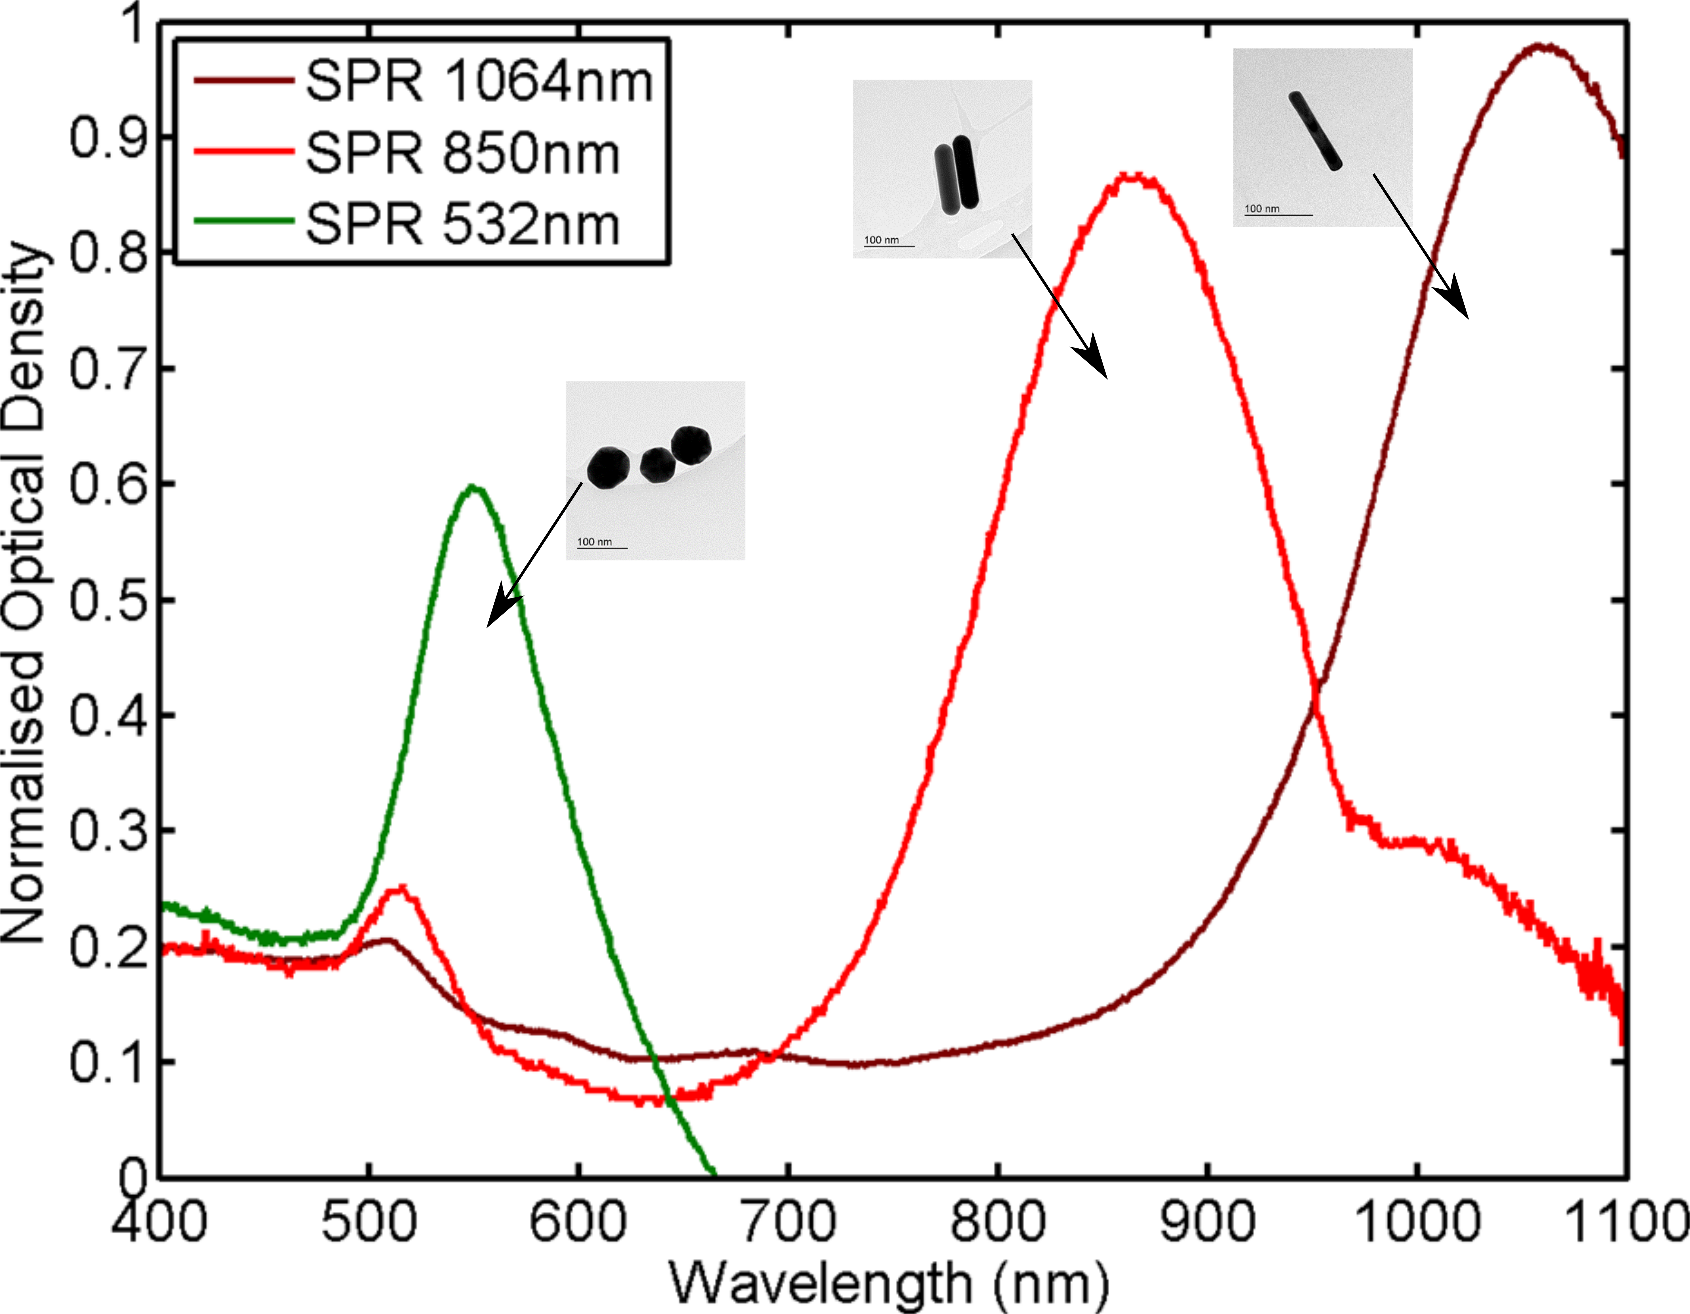
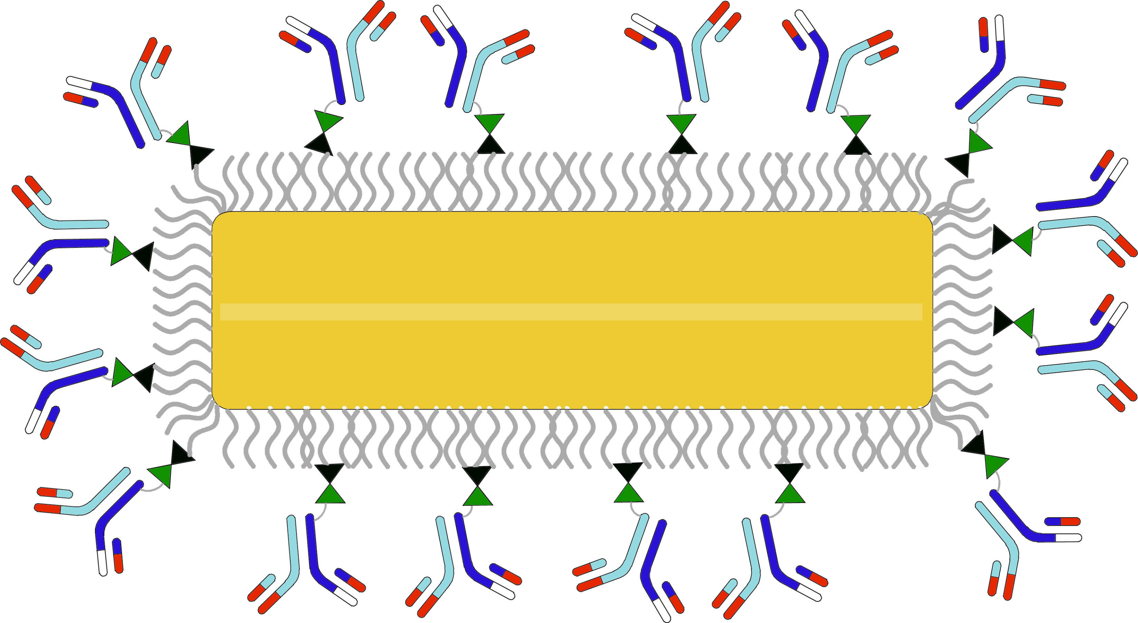
Presenting data/figures
Ensure that figures are readable and meaningful, if their generated you, or from papers.
Neutravidin-Boitin linkage
polymer coating
monoclonal anti-human EGFR IgG1
10x67 nm gold nanorod (AuNR)

