Slide 1
数据库原理与实践
Database Systems-
Principle and Practice

Slide 2
Relational Algebra
Chapter Outline:
3.1 Relational Algebra(RA)
3.2 Simple and Complex Queries using RA
3.3 Structure Query Language(SQL)
3.4 Creating SQL Database and Tables
3.5 Selecting Data
3.6 Data Insertion、Updating and Deletion
An Introduction to Database System

Slide 3
Relational Algebra
What is relational algebra?
Relational algebra is a collection of operations that are used to manipulate the entire set of relations. The output of any relational algebra operation is always a relation.
What are the Operations?
  Set operations like union, intersection, difference, and Cartesian product.
  Selection, Projection, and Joining.

Slide 4
Union (∪)
The result of this operation, i.e. R ∪ S, is a relation that includes all tuples that are either in R or in S or in both. Duplicate tuples will not appear in the output.
Formally: R ∪ S = { t | t ∈ R or t ∈ S }
Union Compatibility: Let R and S are two relations with attributes (A1, A2, …, An) and (B1, B2, ….., Bn) respectively. If R and S are to be unioned, it should satisfy the following two rules:
Rule 1: The relations R and S must have the same degree.
Rule 2: The domain of the ith attribute of R and the domain of the ith attribute of S must be same.
dom(Ai) = dom(Bi), where, 1 ≤ i ≤ n.

Slide 5
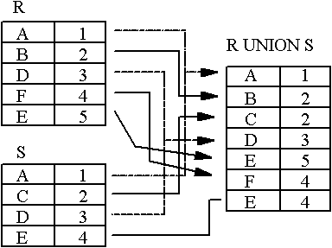
Example
An Introduction to Database System

Slide 6
Relational Difference (-)
Like union, the relational difference operator also requires its operands to be of the same type.
Format: R - S
Formally: R - S = { t | t ∈ R and t ∉ S}
Semantics: Given two relations R and S of the same type, the difference between those two relations, R- S, is the relation containing all tuples of R that do not appear in S.
An Introduction to Database System

Slide 7
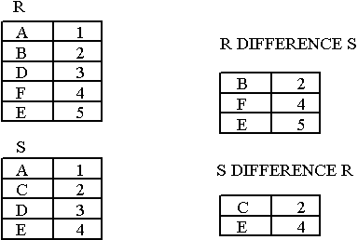
Example
Notice that Difference has a directionality to it, e.g. R-S and S-R are not the same thing.
An Introduction to Database System

Slide 8
Intersection(∩)
The expression R ∩ S returns all tuples that appear in both the relations R and S.
Like union and difference, the relational intersection operator requires its operands to be of the same type.
Formally: R ∩ S = { t | t ∈ R and t ∈ S}
Derivation from existing operators:
R ∩ S = R - (R - S) = S – (S - R)
An Introduction to Database System

Slide 9
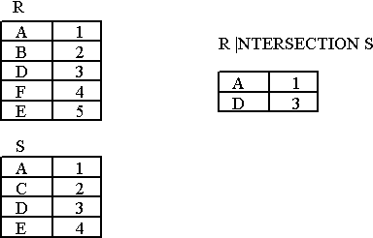
Example
An Introduction to Database System

Slide 10
Cartesian Product (×)
The Cartesian product or cross-product is a binary operation that is used to combine two relations. Assuming R and S as relations with n and m attributes respectively, the Cartesian product, R × S can be written as,
R (A1, A2, …, An) × S (B1, B2, …, Bm)
The result of the above set operation is,
Q (A1, A2, …, An, B1, B2, …, Bm)
Where,
Degree (Q) = n + m
count(Q) = Number of tuples in R * Number of tuples in S.

Slide 11
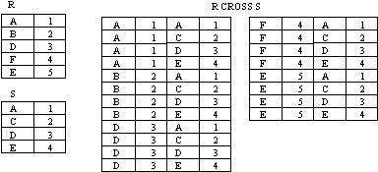
Example
An Introduction to Database System

Slide 12
Special Relational Operations-Sample Relations
Figure 3.5 Student
SSN | SNAME | GPA | AGE | DEPARTMENTID
2007001003 | CHENGLICHONG | 3.33 | 20 | 31
2007001005 | ZHONGWEILONG | 3.62 | 20 | 33
2007001006 | WUYUANLANG | 4.01 | 20 | 33
2006001001 | LUOZI | 3.12 | 20 | 34
2006001002 | GUOHUAXIAN | 3.21 | 21 | 34
2006001004 | LELINGBING | 3.75 | 21
2007002001 | ZHUJIANGUO | 3.05 | 19
An Introduction to Database System

Slide 13
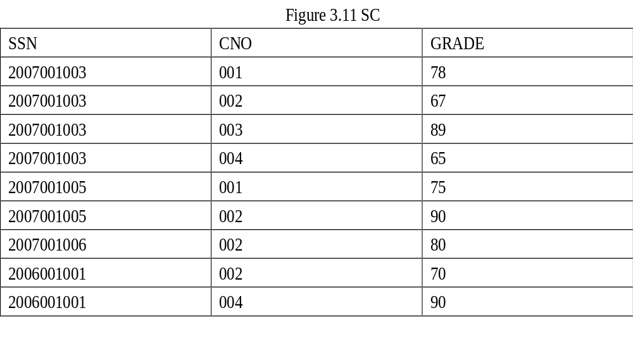
An Introduction to Database System

Slide 14
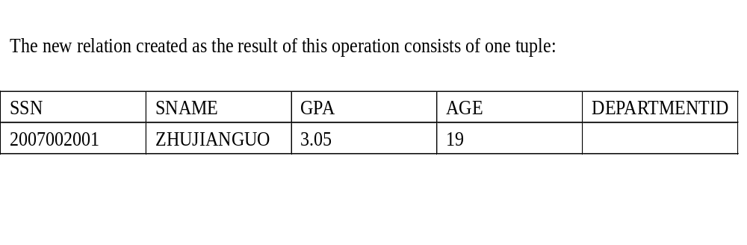
The SELECT operation (σ)
The select operation retrieves a subset of tuples in a relation that satisfy a selection condition.
σ_{<selection-condition>} (Relation)
Query-1: Find the students whose age is 19.
σ

Slide 15
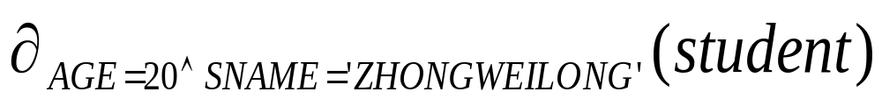
The SELECT operation (σ)
Query-2: Select tuples (rows) of the student relation where the AGE is 20 and Name is ZHONGWEILONG, we could write:
An Introduction to Database System

Slide 16
One of the interesting properties of the selection operation is that it is commutative. Therefore, all the expressions shown below are equivalent,
  σ_{condition-1} (σ_{condition-2} (R))
  σ_{(condition-1 AND condition-2)} (R)
  σ_{condition-2} (σ_{condition-1} (R))

Slide 17

The Projection Operation (π)
The projection operation is used to select only few columns from a relation.
π_{<attributes>} (Relation)
Query-3: List the age of all the students.
π_{age}(student)
π

Slide 18
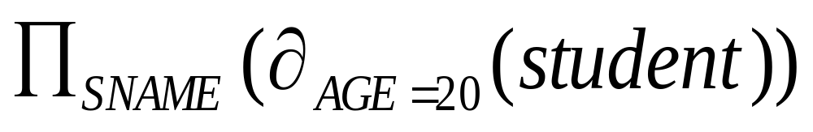
Select and Project
We can perform these operations on the relations resulting from other operations. To get the names of students having the AGE as 20, we write:
An Introduction to Database System

Slide 19
Join (∞)
Join (∞)
    Theta Join
  EquiJoin
    Natural Join
    Left Outer Join
    Right Outer Join
    Full Outer Join

Slide 20
Join (∞)
Format: R ∞ join-condition S
Semantics: Return all tuples in R × S which satisfy the join condition.
Derivation from existing operators:
R ∞ _{join-condition} S = σ_{join-condition}(R × S)
Format of join condition:
R.A op S.B
R.A1 op S.B1 and R.A2 op S.B2 . . .

Slide 21
Theta Join
R ∞ S
C＜E
R S
A B B C
a b b c
d b c d
b c a d
A
R.B
C
S.B
E
a₁
b₁
5
b₂
7
a₁
b₁
5
b₃
10
a₁
b₂
6
b₂
7
a₁
b₂
6
b₃
10
a₂
b₃
8
b₃
10

Slide 22
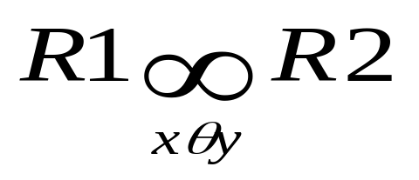
Equijoin (∞ )
A join is called an equijoin if only equality operator is used in all join conditions.
The general form for this kind of join is,
  <Join_condition> must always have = operator

Slide 23
Equijoin
R S R ∞R.B = S.B S
A B B C A R.B S.B C
a b b c a b b c
d b c d d b b c
b c a d b c c d
Most joins in practice are equijoins.

Slide 24
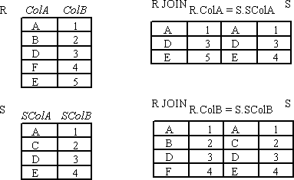
Example
An Introduction to Database System

Slide 25
Natural Join (*)
When we omit the condition during joining of two relations, then it is called as natural join (*):
Let relations R1 has attributes(x1,x2,x3,M) and R2 has attributes(y1,y2,y3,y4,y5,M) respectively. That is ,the M attribute is common to the two relations. Then the natural join of R1 and R2 is a relation with heading(x1,x2,x3,M, y1,y2,y3,y4,y5) and body consisting of all tuples that the duplicated attributed M are removed.

Slide 26
Example
B
E
b₁
3
A
B
C
b₂
7
a₁
b₁
5
b₃
10
a₁
b₂
6
a₂
b₃
8
b₃
2
a₂
b₄
12
b₅
2
R
S

Slide 27

Natural Join
R ∞ S
A
B
C
E
a₁
b₁
5
3
a₁
b₂
6
7
a₂
b₃
8
10
a₂
b₃
8
2

Slide 28
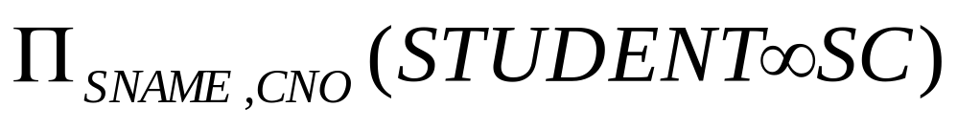
Example
To find all students name and selected courses NO, we need student and SC relations
1.
2. We can rewrite the previous query as:
An Introduction to Database System

Slide 29
Outer Joins (Special Case of EquiJoin)
Usually, only a subset of tuples of each relation will actually participate in a join, i.e. only tuples that match with the joining attributes. Tuples of a relation not participating in a join are called dangling tuples.
How do we keep dangling tuples in the result of a join? Use null values to indicate a no-join situation.
There are three types of outer joins
  - left outer join
  - right outer join and
  - full outer join.

Slide 30
Left outer-join
R1 R2 is similar to a natural join but keep all dangling tuples of R1.
Right Outer-Join
R1 R2 is similar to a natural join but keep all dangling tuples of R2.
Outer Join (full outer-join)
R1 R2 is similar to a natural join but keep all dangling tuples of both R1 and R2.
The advantages of outer join is to take the union of tuples from two relations that are not union compatible.

Slide 31
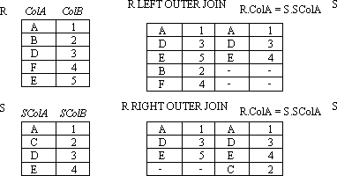
Example:LEFT OUTER JOIN, RIGHT, OUTER JOIN
An Introduction to Database System

Slide 32
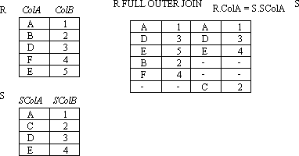
Example:FULL OUTER JOIN
An Introduction to Database System

Slide 33
Division
Not supported as a primitive operator, but useful for expressing queries like: Find students who have taken all courses.
Precondition: in A/B, the attributes in B must be included in the schema for A. Also, the result has attributes A-B..
Notes:
13

Slide 34
R
÷
S

Slide 35
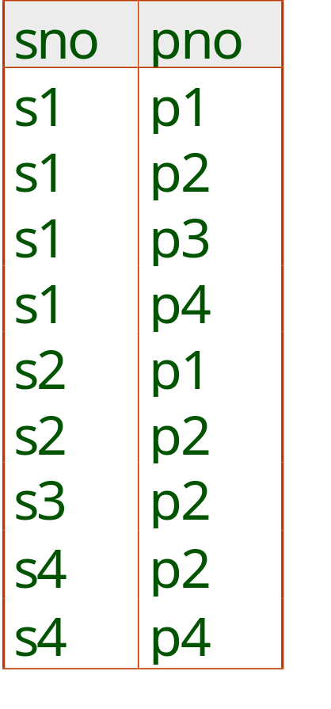
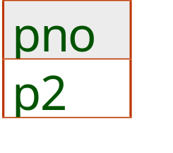
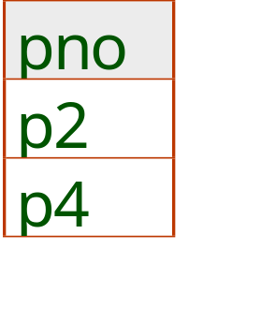
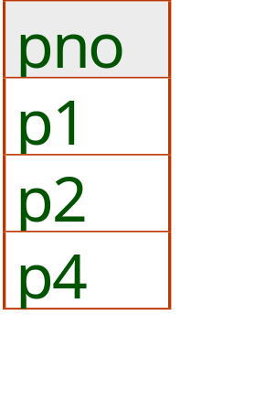
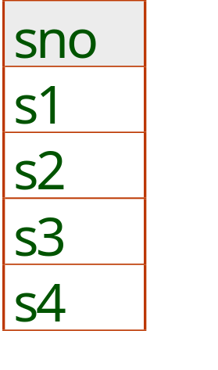
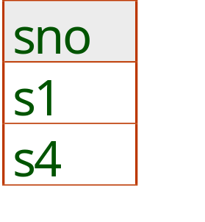
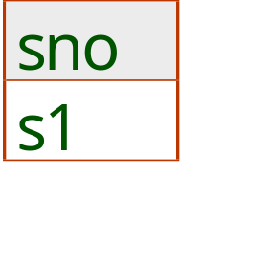
Examples of Division A/B
B1
B2
B3
A
A/B1
A/B2
A/B3
Notes:
14

Slide 36
Another Example
Another example is: Suppose we want to find all the students who have selected all courses (See Figure 3.19 Course Table ) provided by the school.
CNO | CNAME | CREDIT
001 | Math | 3
002 | Multimedia | 3
003 | Computer network | 4
004 | Software engineering | 4
005 | Bioinformatics | 3
An Introduction to Database System

Slide 37
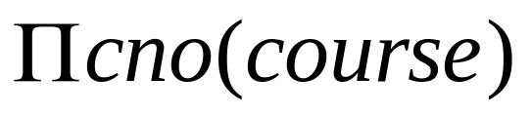
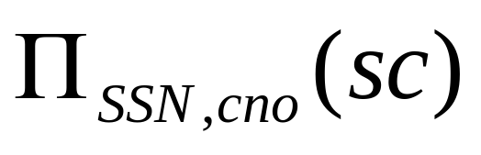
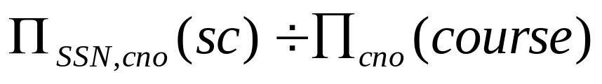
We can think of it as three steps:
1.We can obtain the NO. of all courses provided by the school by:
2.We can also find all SSN, cno pairs for which the student has selected courses by:
3.Now we need to find all students who selected all the courses. The divide operation provides exactly those students:
An Introduction to Database System

Slide 38
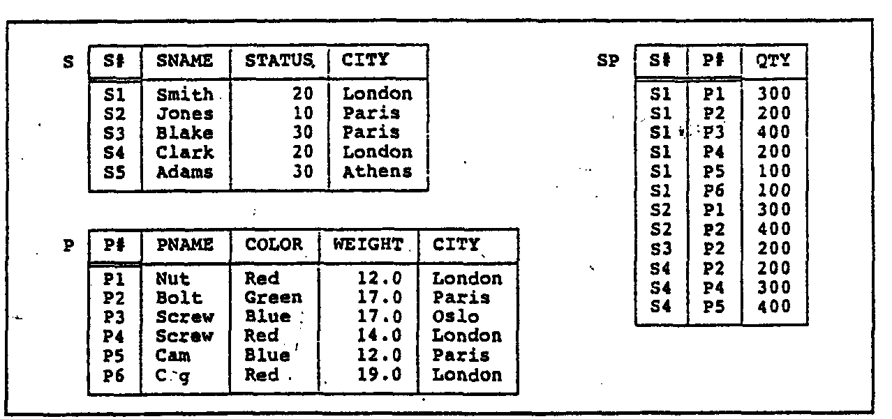
3.2 Simple and Complex queries using RA
An Introduction to Database System

Slide 39
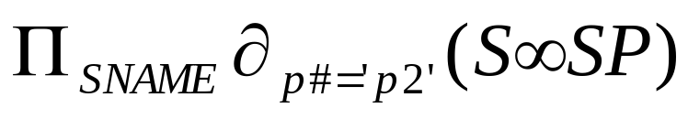
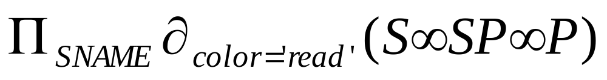
Example
Example 1: Get supplier names for suppliers who supply part P2:
Example 2:Get supplier names for suppliers who supply at least one red part:
An Introduction to Database System

Slide 40
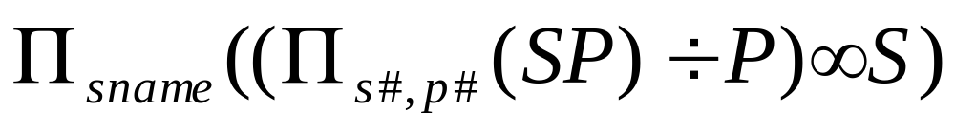
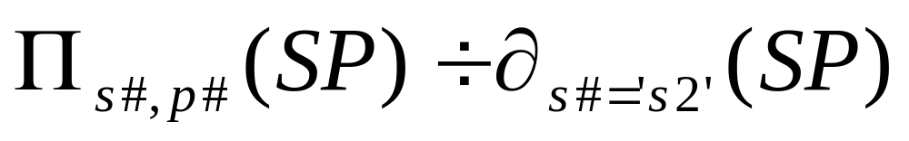
CON…
Example 3:Get supplier names for suppliers who supply all parts:
Example 4:Get supplier numbers for suppliers who supply at least all those parts supplied by supplier S2:
An Introduction to Database System

Slide 41
3.3 Structure Query Language (SQL)
Full name of SQL --- Structural Query Language
Old name --- SEQUEL (Structural English QUEry Language)
First developed at IBM's San Jose (now Almaden) Research Lab. in 1974.
Over 100 SQL-based products in the market.
E.g.: Oracle, Sybase, Ingres, Informix, DB2.
An Introduction to Database System

Slide 42
Cont…
The first SQL standard (SQL-86) was published in 1986 by ANSI. (about 100 pages).
SQL1 was also adopted by ISO in 1987.
A major revision made in 1989 (SQL-89).
The second SQL standard (SQL2) was announced in 1992. It has about 600 pages.
The third SQL standard (SQL3) is under discussion. Expected release time: 20??

Slide 43
Major Components of SQL
DDL --- Data Definition Language used to define tables.
DML --- Data Manipulation Language (Interactive DML, ISQL) used to manipulate data directly.
Embedded DML (Embedded SQL) which supports the manipulation of data from a program in a high-level programming language.
View Definition used to create different ways to look at a database.
Authorization (DCL).
Integrity Constraints which defines various constraints on the data.
Transaction Definition which defines which group of commands should be treated as an atomic command.

Slide 44
3.4.1 Defining Database
CREATE DATABASE
The SQL CREATE DATABASE statement is the SQL command that adds a new database.
A database is the outer container for other SQL objects: tables, columns, views, indexes, etc.
An Introduction to Database System

Slide 45
CON…
The SQL CREATE DATABASE statement is used as follows:
CREATE DATABASE <database_name>
Example: creates a new database named STUDENT_DB.
CREATE DATABASE STUDENT_DB
The CREATE DATABASE implementation and syntax varies substantially between different RDBMS implementations.
An Introduction to Database System

Slide 46
DROP DATABASE
The SQL DROP DATABASE statement is the SQL command that removes an existing database.
The SQL DROP DATABASE statement is used as follows:
DROP DATABASE <database_name>
The following example drops an existing database named STUDENT_DB.
DROP DATABASE STUDENT_DB
An Introduction to Database System

Slide 47
3.4.2 Defining tables and views
CREATE
  Create new objects (tables, views, etc.) in the database
ALTER
  Change the structure of an existing object
DROP
  Remove the object from the database, (all its data plus any reference to it in the data dictionary)

Slide 48
CREATE TABLE
The CREATE TABLE statement is used to create tables to store data.
Integrity Constraints like primary key, unique key, foreign key can be defined for the columns while creating the table.
An Introduction to Database System

Slide 49
CON...
The create table statement does exactly that:
CREATE TABLE <table name> (
<attribute name 1> <data type 1>,
...
<attribute name n> <data type n>);
The data types that you will use most frequently are VARCHAR or CHAR for variable or fixed length strings; numeric types such as NUMBER or INTEGER; and DATE or related types. Data type syntax is variable from system to system.
An Introduction to Database System

Slide 50
Example
If we have a table for recording students information, then the columns may include information such as student’s number(SSN), name(SNAME), birth date(BirthDate), depart number(DEPTNO).
  CREATE TABLE student
  (SSN NUMBER NOT NULL,
  SNAME CHAR(10) ,
  BirthDate DATE ,
  DEPTNO NUMBER);
Note that: The NOT NULL constraint enforces the field of SSN to always contain a value.
An Introduction to Database System

Slide 51
ALTER TABLE
The SQL ALTER TABLE command is used to modify the definition (structure) of a table by modifying the definition of its columns. The ALTER command is used to perform the following functions.
    1) Add, drop, modify table columns
    2) Add and drop constraints
    3) Enable and Disable constraints
An Introduction to Database System

Slide 52
ADD COLUMN
To add a new column
ALTER TABLE <tablename>
ADD (column_name datatype);
For Example: To add a column "Address" to the student table:
ALTER TABLE student ADD Address CHAR(30);
An Introduction to Database System

Slide 53
DROP COLUMN
To drop a column
ALTER TABLE table_name DROP column_name;
For Example: To drop the column "Address" from the student table:
ALTER TABLE student DROP Address;
An Introduction to Database System

Slide 54
MODIFY COLUMN
To modify a column
ALTER TABLE table_name MODIFY column_name datatype;
For Example: To modify the column Address in the student table:
  ALTER TABLE student
  MODIFY Address CHAR(50);
An Introduction to Database System

Slide 55
DROP TABLE
The DROP TABLE command allows you to destroy an existing table.
If we want to permanently remove the student table that we created:
DROP TABLE student
An Introduction to Database System

Slide 56
Using and Defining Views
Views provide users controlled access to tables
Base Table – table containing the raw data
Dynamic View
  A “virtual table” created dynamically upon request by a user
  No data actually stored; instead data from base table made available to user
  Based on SQL SELECT statement on base tables or other views

Slide 57
CREATE VIEW
The Syntax to create a view is
  CREATE VIEW view_name
  AS
  SELECT column_list
  FROM table_name [WHERE condition];
The SELECT statement is used to define the columns and rows that you want to display in the view

Slide 58
Example
To create a view on the student table the SQL statement would be like:
      CREATE VIEW view_student
      AS
      SELECT SSN, SNAME
      FROM student;
      Where SNAME LIKE ‘ZHANG%’
      With CHECK_OPTION
View has a name
CHECK_OPTION works only for updateable views and prevents updates that would create rows not included in the view

Slide 59
create table table1
(bm float
)
insert into table1 values(5000)
create view TestViewCheckOption
AS
select * from Table1 where Bm < 5003
with check option
update TestViewCheckOption set Bm = 5005
go
－－－执行结果
服务器: 消息 550，级别 16，状态 1，行 1
试图进行的插入或更新已失败，原因是目标视图或者目标视图所跨越的某一视图指定了 WITH CHECK OPTION，而该操作的一个或多个结果行又不符合 CHECK OPTION 约束的条件。

Slide 60
ALTER VIEW
By the ALTER VIEW Statement we can change the definition of a view. This statement is useful to modify a view without dropping it.
The general syntax of ALTER VIEW Statement is :
ALTER VIEW view_name [(column_list)] [WITH ENCRYPTION] AS select_statement [WITH CHECK OPTION]

Slide 61
Example
A one more column by the name of Address of student table.
ALTER VIEW view_student
AS
SELECT sno, sname,Address
FROM student;

Slide 62
DROP VIEW
For dropping a view you can use the DROP VIEW Statement.
The general syntax of DROP VIEW Statement is :
DROP VIEW view_name;
  When view is dropped but it has no effect on the underlying tables.
  After dropping a view if you issue any query that reference a dropped view then you get an error message.
  But dropping a table that reference any view does not drop the view automatically. You have to dropt the view explicitly.

Slide 63
Advantages of Views
Simplify query commands
Assist with data security (but don't rely on views for security, there are more important security measures)
Enhance programming productivity
Contain most current base table data
Use little storage space
Provide customized view for user
Establish physical data independence

Slide 64
Disadvantages of Views
Use processing time each time view is referenced
May or may not be directly updateable

Slide 65
Specifying constraints
Constraints offer the advantages of defining controls in one step during the table creation process (as defined by the SQL standards) and of simplifying the process to create those integrity controls.
Constraints can be specified when a table is created
  CREATE TABLE statement
  ALTER TABLE statement

Slide 66
NOT NULL Constraint
The NOT NULL constraint enforces a field to always contain a value. This means that you cannot insert a new record, or update a record without adding a value to this field.
The following SQL enforces the "SSN" column and the "SNAME" column to not accept NULL values:
CREATE TABLE student
    (SSN NUMBER NOT NULL,
    SNAME CHAR(10) NOT NULL ,
    BirthDate DATE ,
    DEPTNO NUMBER);

Slide 67
UNIQUE Constraint
The UNIQUE constraint uniquely identifies each record in a database table.
The following SQL creates a UNIQUE constraint on the "SSN" column when the "student" table is created:
    CREATE TABLE student
    (SSN NUMBER NOT NULL UNIQUE,
    SNAME CHAR(10) NOT NULL ,
    BirthDate DATE ,
    DEPTNO NUMBER);
Note that you can have many UNIQUE constraints per table, but only one PRIMARY KEY constraint per table.

Slide 68
PRIMARY KEY Constraint
The PRIMARY KEY constraint uniquely identifies each record in a database table.
A primary key must contain unique values and cannot contain NULL values.
Each table should have a primary key, and each table can have only ONE primary key

Slide 69
CON…
The following SQL creates a PRIMARY KEY on the " SSN " column when the " student " table is created:
    CREATE TABLE student
    (SSN NUMBER PRIMARY KEY,
    SNAME CHAR(10) NOT NULL ,
    BirthDate DATE ,
    DEPTNO NUMBER);

Slide 70
CON…
To allow naming of a PRIMARY KEY constraint, and for defining a PRIMARY KEY constraint on multiple columns, use the following SQL syntax:
    CREATE TABLE student
    (SSN NUMBER NOT NULL,
    SNAME CHAR(10) NOT NULL ,
    BirthDate DATE ,
    DEPTNO NUMBER,
    CONSTRAINT pk_studentNo PRIMARY KEY (SSN, SNAME)
    );

Slide 71
FOREIGN KEY Constraint
A foreign key is a referential constraint between two tables. The foreign key identifies a column or a set of columns in one (referencing) table that refers to a set of columns in another (referenced) table.
The columns in the referencing table must be the primary key or other candidate key in the referenced table.
The values in one row of the referencing columns must occur in a single row in the referenced table.
A row in the referencing table cannot contain values that don't exist in the referenced table

Slide 72
Example
To create a SC table,SC(ssn,cno,grade)，the primary key is (ssn, cno) .
    CREATE TABLE SC(
    ssn NUMBER,
    cno NUMBER,
    Grade NUMBER,
    Primary key (ssn , Cno),
    FOREIGN KEY(ssn ) REFERENCES student(ssn ),
    FOREIGN KEY(Cno) REFERENCES Course(Cno))

Slide 73
CHECK Constraint
The CHECK constraint is used to limit the value range that can be placed in a column.
  CREATE TABLE student
  (SSN NUMBER PRIMARY KEY CHECK (SSN >0),
  SNAME CHAR(10) NOT NULL ,
  BirthDate DATE ,
  DEPTNO NUMBER);

Slide 74
DEFAULT Constraint
The DEFAULT constraint is used to insert a default value into a column. The default value will be added to all new records, if no other value is specified.
      CREATE TABLE student
      (SSN NUMBER PRIMARY KEY CHECK (sno >0),
      SNAME CHAR(20) NOT NULL ,
      BirthDate DATE ,
      DEPTNO NUMBER DEFAULT 00);

Slide 75
CON…
The DEFAULT constraint can also be used to insert system values, by using functions like GETDATE():
    CREATE TABLE SC
    (
    CNO NUMBER NOT NULL,
    SSN NUMBER NOT NULL,
    GRADE NUMBER,
    TakeCourseDate date DEFAULT GETDATE(),
    PRIMARKY KEY(SSN,CNO)
    FOREIGN KEY (SSN) REFERENCES student(SSN)
    )

Slide 76
ALTER TABLE ADD CONSTRAINTS
Add constraints to an existing table by using the ALTER TABLE statement. The following example adds a pk_employee primary key constraint on an student table:
ALTER TABLE employee
ADD CONSTRAINT pk_student PRIMARY KEY (SSN)
You can add the primary or unique key constraint into an existing table only when there are no duplicate rows in the table.

Slide 77
CON…
Drop constraints in an existing table by using the ALTER TABLE statement. The following example drops the pk_student primary key constraint in the student table:
    ALTER TABLE student
    DROP CONSTRAINT pk_student

Slide 78
Creating indexes
Indexes can be created against a table to make searches more efficient.
A book index allows you to find information without having to read through the whole book.
A database index enables the database application to find data quickly without having to scan the whole table.

Slide 79
CON…
For example, if users of your application often search against the name field then that field is a great candidate for an index.
the CREATE INDEX command:
    CREATE INDEX index_name
    ON table_name (column_name)
Example
    CREATE INDEX StudentIndex
    ON student (SNAME)

Slide 80
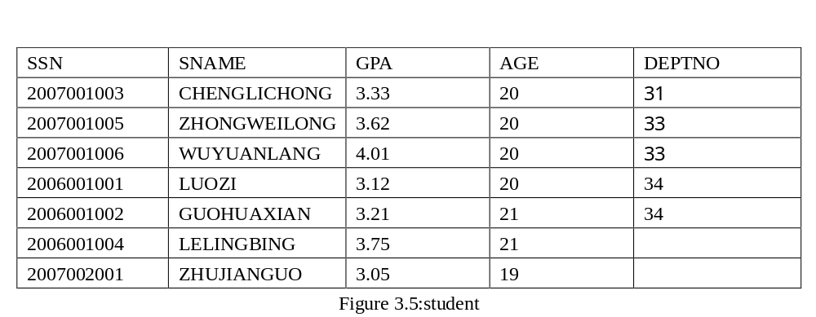
3.5 Selecting Data

Slide 81
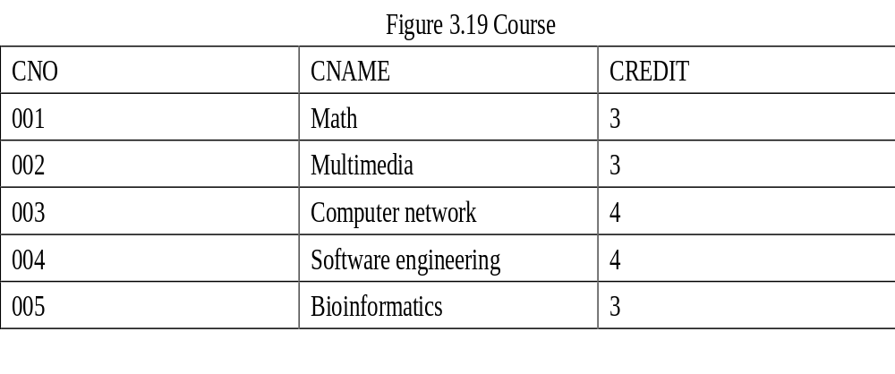

Slide 82


Slide 83
Queries: SELECT Statement
The basic SELECT statement has three clauses: SELECT ,FROM and WHERE.
SELECT: Specify the table columns that are retrieved
FROM : Specify the tables accessed.
WHERE: Specify which table rows are used.
The WHERE clause is optional; if missing, all table rows are used. An asterisk ("*") can also be used to specify that the query should return all columns of the queried tables.

Slide 84
CON…
The full syntax of the SELECT statement is complex as follows:
    SELECT select_list
    FROM table_source
    [ WHERE search_condition ]
    [ GROUP BY group_by_expression ]
    [ HAVING search_condition ]
    [ ORDER BY order_expression [ ASC | DESC ] ]

Slide 85
CON…
The SELECT clause lists what columns to return.
The FROM clause which indicates the table(s) from which data is to be retrieved.
The WHERE clause specifies which rows to retrieve.
The GROUP BY clause groups rows sharing a property so that an aggregate function can be applied to each group. The WHERE clause is applied before the GROUP BY clause.
The HAVING clause selects among the groups defined by the GROUP BY clause. Because it acts on the results of the GROUP BY clause, aggregation functions can be used in the HAVING clause predicate.
The ORDER BY clause specifies an order in which to return the rows. Without an ORDER BY clause, the order of rows returned by an SQL query is undefined.

Slide 86
Single Table
1)．Retrieve specific columns, all rows
(1)Retrieve specific columns
  The query retrieves a subset of columns and all rows from a table.
[Example 1]
Find the SSN, SName and GPA of all students
  select SSN, SName, GPA
  from Student

Slide 87
CON…
(2)Retrieve all columns, all rows
The query retrieves all columns and rows from a table
[Example 2]
  Query all the information of all the students.
  Select * from Students
Or
  select SSN, SName, GPA,AGE,DEPTNO
  from Student

Slide 88
CON…
(3)Retrieve calculated columns
The query retrieves some columns by computing.
[Example 3]
Query the name and the birthday of students.
  Select SName,2011-AGE
  From Student

Slide 89
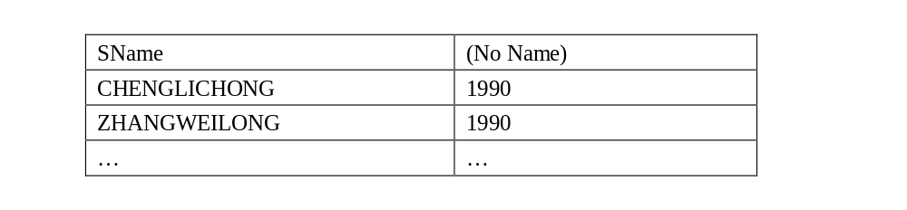
CON…
The results will be shown in Fig.21:
Figure 21 Query Result of Example 3

Slide 90
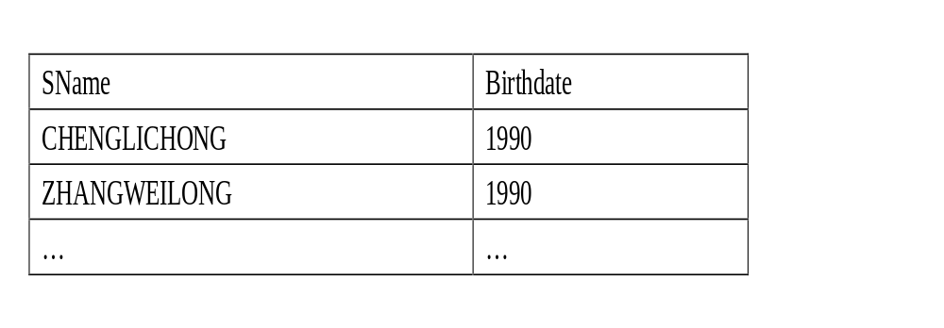
Alias
[Example 4]
Select SName,2011-AGE as Birthdate
From Student
The results will be shown in Fig.21:

Slide 91

CON…
(4)Use of Distinct
The DISTINCT keyword can be used to return only distinct (different) values.
[Example 5]
If we list the AGE of all students from the above table.
Select AGE
From Student

Slide 92

CON…
[Example 6]
Rewriting the query as:
    SELECT DISTINCT AGE
    From Students
We get the result table shown in Fig.23 with the duplicates eliminated.

Slide 93
2). Row selection (where clause)
The SQL WHERE clause is used to select data conditionally, by adding it to already existing SQL SELECT query.
There are six basic search conditions as follows:
Comparison
Range
Set membership
Pattern match
Null
Compound comparison

Slide 94
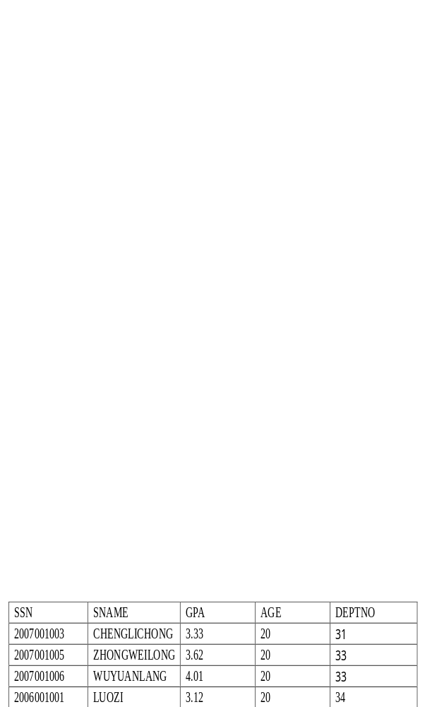
Comparison search condition
[Example 7]
If we want to select all students from our database table, having AGE ‘20’ we need to use the following SQL syntax:
    Select * from Student where AGE=20

Slide 95
Range search condition (BETWEEN /NOT BETWEEN)
The SQL BETWEEN… AND keywords define a range of data between 2 values. The 2 values defining the range for SQL BETWEEN clause can be dates, numbers or just text.
[Example 8]
If we want list all students with a GPA between 3 and 3.5.
    Select *
    From student
    Where GPA BETWEEN 3 AND 3.5
    Any members of students with a GPA of 3 or 3.5 would be included in the result.

Slide 96
[Example 9]
We would use the negated version to retrieve any members of students with a GPA outside between 3 and 3.5 as:
    Select *
    From student
    Where GPA NOT BETWEEN 3 AND 3.5

Slide 97
Set membership search condition(IN/NOT IN)
The set membership search condition IN allows you to specify multiple values in a WHERE clause.
It tests whether a data value matches one of a list values.
[Example 10]
We want to select the students with an AGE equal to 19 or 20 in the table above.
    Select * from student
    Where AGE IN (19, 20)

Slide 98
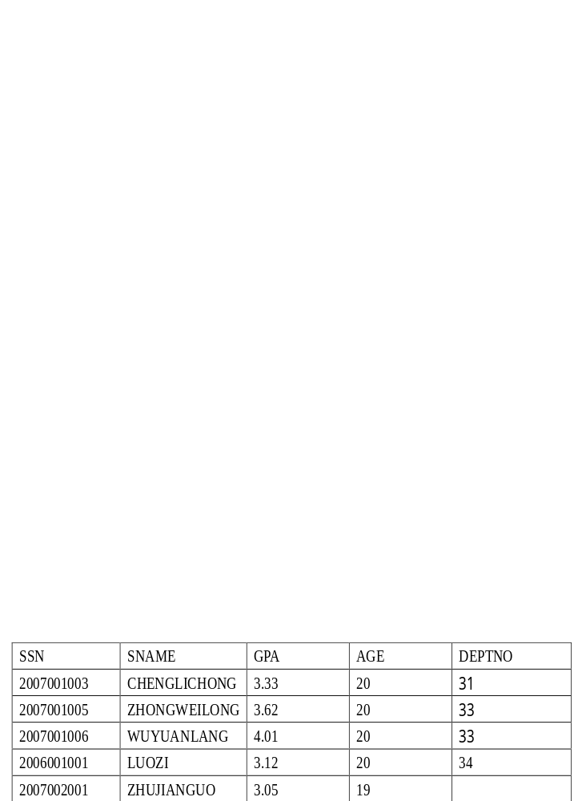
Figure 25 Query Result of Example 10
The operator NOT IN can be used to check for data values that don’t lie in a specific list of values.

Slide 99
Pattern match search condition(LIKE/NOT LIKE)
The LIKE operator allows you create a SQL query that performs inexact pattern matching through the use of wildcard characters.
The % wildcard matches zero or more characters of any type.
The _ wildcard matches exactly one character of any type.

Slide 100
CON...
[Example 11]
To match all strings that begin with the word 'zhang', you would use the pattern 'zhang%':
    SELECT SNAME
    FROM STUDENT
    WHERE SNAME LIKE 'zhang%';

Slide 101
CON...
[Example 12]
To match all strings that end with 'ZHANG', the pattern would look like: '%zhang':
    SELECT SNAME
    FROM STUDENT
    WHERE SNAME LIKE '%zhang';

Slide 102
CON...
[Example 13]
To match all strings where the word 'zhang' occurs somewhere: '%zhang%':
    SELECT SNAME
    FROM STUDENT
    WHERE SNAME LIKE '%zhang%';

Slide 103
CON...
[Example 14]
To match strings with that begin with ‘zhang’ consisting of exactly eight characters
SELECT SNAME
    FROM STUDENT
    WHERE SNAME LIKE 'zhang _ _ _’;

Slide 104
CON...
[Example 15]
To match strings that there are must be exactly four characters in the string, the END of which must be an ‘g’
    SELECT SNAME
    FROM STUDENT
    WHERE SNAME LIKE ' _ _ _g’;

Slide 105
CON...
[Example 16]
To match strings that there are at least one character between 'a' and 'c' .
SELECT SNAME
    FROM STUDENT
    WHERE SNAME LIKE 'a_%c';
If the search strings can include the wildcards(%,_) itself, we can use an escape character to represent the wildcards.
For example, to match the string ‘20%’, we can use :
Like ‘20#%’ ESCAPE ‘#’

Slide 106
NULL search condition
The operator NULL means the data value for the column is unknown or not available.
NULL is not synonymous with
zero (numeric or binary value)
a zero-length string,
blank (character value)

Slide 107
CON...
Suppose that the "DEPTNO" column in the "STUDENT" table is optional. This means that if we insert a record with no value for the " DEPTNO " column, the " DEPTNO " column will be saved with a NULL value.
We can select only the records with NULL values in the " DEPTNO " column by using the IS NULL operator:
[Example 17]
    SELECT * FROM student
    WHERE DEPTNO IS NULL

Slide 108
CON...
[Example 18]
If we select only the records with no NULL values in the " DEPTNO " column, we will have to use the IS NOT NULL operator:
    SELECT * FROM student
    WHERE DEPTNO IS NOT NULL

Slide 109
Compound search condition
The AND & OR operators are used to filter records based on more than one condition.
The AND operator displays a record if both the first condition and the second condition is true.
The OR operator displays a record if either the first condition or the second condition is true.

Slide 110
CON...
[Example 19]
If we want to select only the persons with AGE equal to "20" AND GPA greater than "3", we use the following SELECT statement:
    SELECT *
    FROM student
    WHERE AGE=20 AND GPA>3

Slide 111
Sorting Results (Order by Clause )
SQL ORDER BY clause is used to sort the result-set by a specified column or more columns.
[Example 20]
If we want to sort our Users table by the GPA column, we have to use the following ORDER BY SQL statement:
    SELECT * FROM student
    ORDER BY GPA
If you want to sort the records in a descending order, you can use the DESC keyword.

Slide 112
CON...
[Example 21]
Now we want to select all the persons from the table above, however, we want to sort the students descending by age.
SELECT *
    FROM student
    ORDER BY AGE DESC

Slide 113
SQL Aggregate Functions
SQL aggregate functions are used to sum, count, get the average, get the minimum and get the maximum values from a column or from a sub-set of column values.
COUNT
AVG
MAX
MIN
SUM

Slide 114
COUNT function
The COUNT function counts the number of rows in a table, or the number of distinct values for a given column. It can operate, therefore, at the column or row level.
[Example 22]
To count the number of students’ names in the Student table :
    SELECT COUNT(SNAME)
    FROM Student

Slide 115
CON...
[Example 23]
To count the number of distinct students’ names represented in the students table, issue the following:
    SELECT COUNT(DISTINCT SNAME)
    FROM Student
The keyword DISTINCT is not considered an argument of the function. It simply specifies an operation to be performed before the function is applied. When DISTINCT is coded, duplicate values are eliminated.
If DISTINCT is not specified, then ALL is implicitly specified. ALL also can be explicitly specified in the COUNT function. When ALL is specified, duplicate values are not eliminated.

Slide 116
AVG function
The AVG function computes the average of the values for the column or expression specified as an argument. This function operates only on numeric arguments.
[Example 24]
The following example calculates the average GPA of the students table:
    SELECT AVG(GPA)
    FROM Student

Slide 117
CON...
[Example 25]
If you want to get the average GPA for a particular set students you can do it this way:
    SELECT AVG(GPA)
    FROM Student
    WHERE DEPTNO=’33’

Slide 118
MIN function
The MIN function returns the smallest value in the specified column or expression.
[Example 26]
To retrieve the smallest GPA given to any student, issue this SQL statement:
    SELECT MIN(GPA)
    FROM Student

Slide 119
CON...
The MAX function returns the largest value in the specified column or expression.
[Example 27]
The following SQL statement determines the largest GPA :
    SELECT MAX(GPA)
    FROM Student

Slide 120
CON...
[Example 28]
It returns the highest GPA belongs to a student in DEPTNO 32:
    SELECT MAX(GPA)
    FROM student
    WHERE DEPTNO=’32’

Slide 121
SUM function
The accumulated total of all values in the specified column or expression are returned by the SUM column function.
[Example 29]
For example, the following SQL statement calculates the total GPA for the students:
    SELECT SUM(GPA)
    FROM Student

Slide 122
GROUP BY
The GROUP BY statement is used in conjunction with the aggregate functions to group the result-set by one or more columns.
SQL GROUP BY Syntax
SELECT column_name, aggregate_function(column_name)
    FROM table_name
    WHERE column_name operator value
    GROUP BY column_name

Slide 123
CON...
[Example 30]
Want to find the average grade of each student.
    SELECT Avg(grade)
    FROM SC
    GROUP BY SSN

Slide 124
HAVING Clause
The HAVING clause was added to SQL because the WHERE keyword could not be used with aggregate functions.
SQL HAVING Syntax:
  SELECT column_name, aggregate_function(column_name)
  FROM table_name
  WHERE column_name operator value
  GROUP BY column_name
  HAVING aggregate_function(column_name) operator value

Slide 125
CON...
[Example 31]
Now we want to find if any of the students have an average grade of more than 81.
    SELECT Avg(grade)
    FROM student
    GROUP BY SSN
    HAVING Avg(grade)>81

Slide 126
CON...
[Example 32]
Now we want to find if the students "2007001006" or "2006001001" have an average grade of less than 81.
    SELECT SSN,Avg(grade)
    FROM student
    WHERE SSN='2007001006' OR SSN =2006001001
    GROUP BY SSN
    HAVING Avg(grade)<81

Slide 127
Some rules for the aggregate functions
1). An aggregate function must be specified for an explicitly named column or expression.
2). Each aggregate function returns only one value for the set of selected rows.
3). If you apply an aggregate function to one column in a SELECT statement, you must apply column functions to any other columns specified in the same SELECT statement, unless you also use the GROUP BY clause.
4). Use GROUP BY to apply an aggregate function to a group of named columns. Any other column named in the SELECT statement must be operated on by an aggregate function.

Slide 128
CON...
5). When using the AVG, MAX, MIN and SUM functions on nullable columns, all occurrences of NULL are eliminated before applying the function.
6). You can use the DISTINCT keyword with all aggregate functions to eliminate duplicates before applying the given function. DISTINCT has no effect, however, on the MAX and MIN functions.
7). You can use the ALL keyword to indicate that duplicates should not be eliminated. ALL is the default.
8). An aggregate function can be specified in a WHERE clause only if that clause is part of a sub query of a HAVING clause. Additionally, every column name specified in the expression of the aggregate function must be a correlated reference to the same group.

Slide 129
Multiple Tables
SQL allows us to query multiple tables in one SELECT-FROM-WHERE statement.
The SELECT and WHERE can refer to the attributes of any of the tables once we list each table in the FROM clause.
ANSI standard SQL specifies four types of JOINs: INNER, OUTER, LEFT, and RIGHT.
a table (base table, view, or joined table) can JOIN to itself in a self-join.

Slide 130
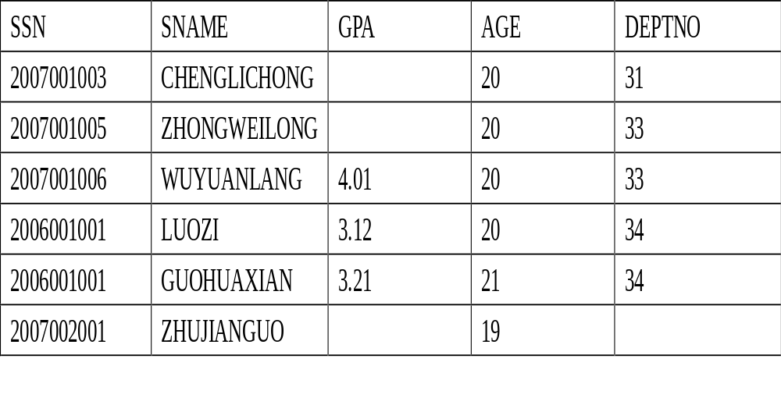
CON...

Slide 131
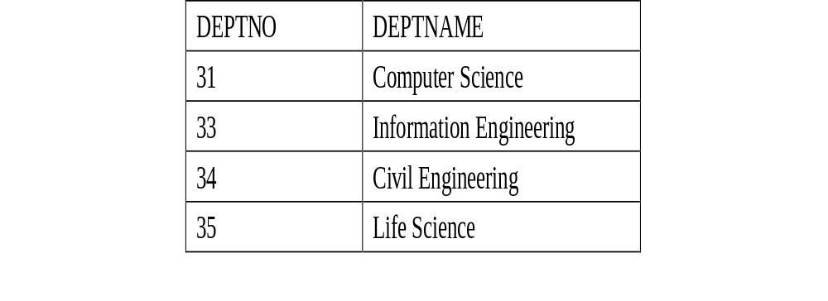
CON...
Note: The " Life Science " Department currently has no listed students. Also, student " ZHUJIANGUO " has not been assigned to any Department yet.

Slide 132
INNER JOIN
Inner join creates a new result table by combining column values of two tables (A and B) based upon the join-predicate.
The query compares each row of A with each row of B to find all pairs of rows which satisfy the join-predicate.
When the join-predicate is satisfied, column values for each matched pair of rows of A and B are combined into a result row.

Slide 133
CON...
The "implicit join notation" simply lists the tables for joining (in the FROM clause of the SELECT statement), using commas to separate them.
It specifies a cross-join, and the WHERE clause may apply additional filter-predicates (which function comparably to the join-predicates in the explicit notation).

Slide 134
CON...
[Example 33]
The following example shows a query using the inner join statement:
    SELECT *
    FROM student, department
    WHERE student.DeptID = department.DeptID

Slide 135
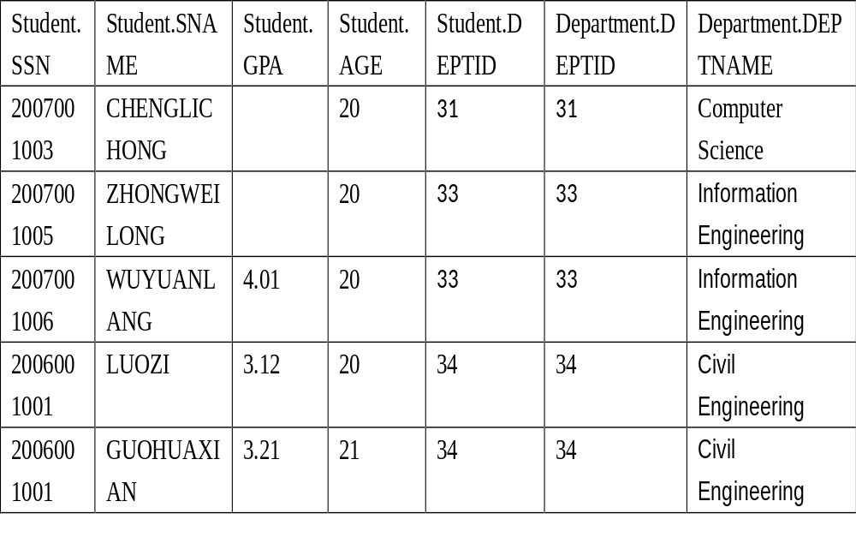
CON...

Slide 136
OUTER JOIN
The OUTER JOIN clause differs from the standard JOIN clause (also known as the INNER JOIN clause) in that rows are returned even when there are no matches through the JOIN critieria.
LEFT OUTER JOIN
RIGHT OUTER JOIN
FULL OUTER JOIN

Slide 137
LEFT OUTER JOIN
Select all the rows from the first table listed after the FROM clause, no matter if they have matches in the second table.
[Example 33]
If we slightly modify our last SQL statement to:
SELECT *
    FROM student LEFT OUTER JOIN department ON student.DEPTID = department.DEPTID

Slide 138
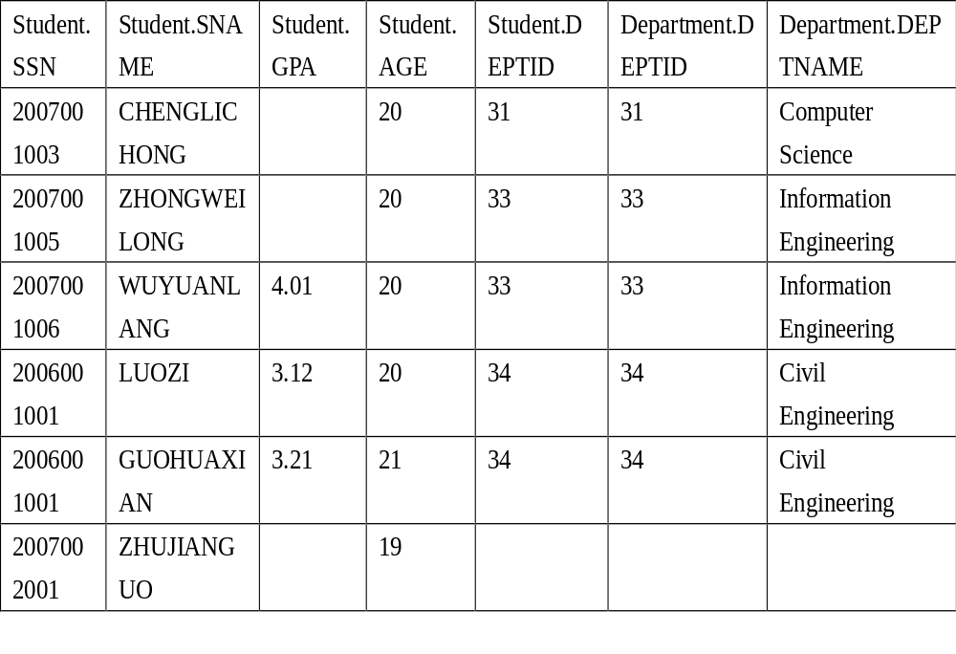
CON...

Slide 139
RIGHT OUTER JOIN
The RIGHT OUTER JOIN returns all rows from the second table.
[Example 34]
For example, this allows us to find each student and his or her department, but still show departments that have no student.
    SELECT *
    FROM student RIGHT OUTER JOIN department
    ON student.DEPTID = department. DEPTID;

Slide 140
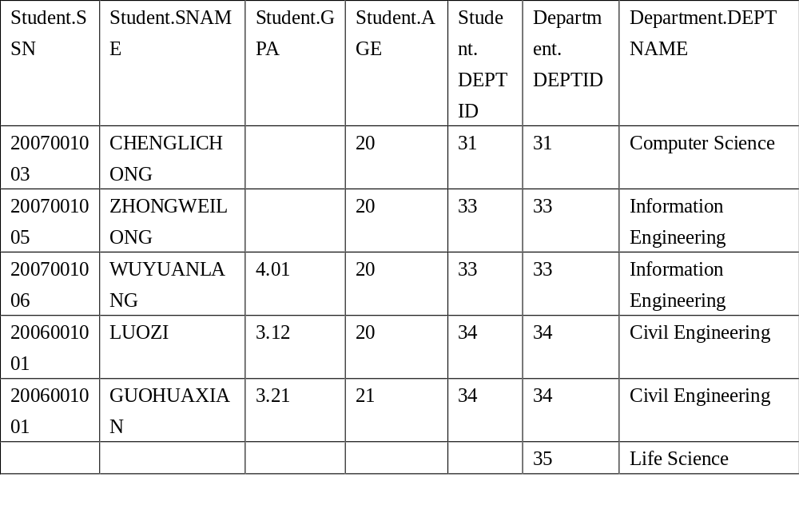
CON...

Slide 141
FULL OUTER JOIN
A full outer join combines the effect of applying both left and right outer joins.
[Example 35]
To see each student who is in a department and each department that has an student, but also see each student who is not part of a department and each department which doesn't have an student.
SELECT *
FROM student FULL OUTER JOIN student
ON student.DEPTID = department.DEPTID;

Slide 142
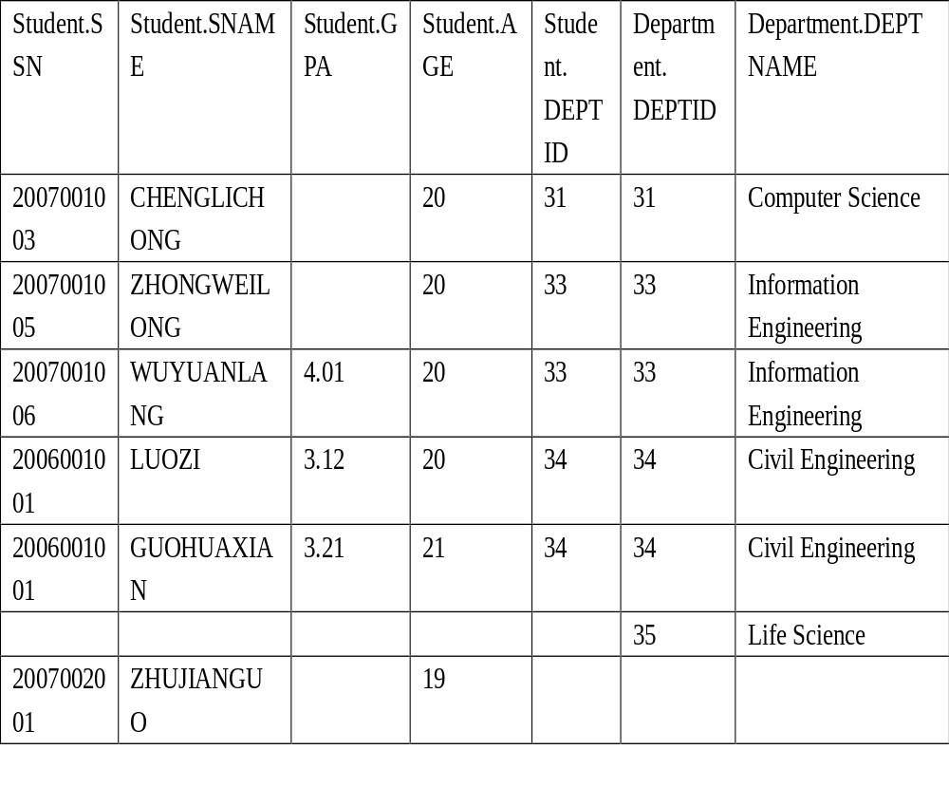

Slide 143
Alias
Table names can be abbreviated in order to simplify what is typed in with the query.
[Example 36]: Find the names and GPAs of all students who take CourseA.
select SName, GPA
from Students s, SC e, Courses c
where cname= 'CourseA'
and s.SSN = e.SSN
and e.Course_no = c.Course_no
s, e and c are (relational) tuple variables (aliases, correlation names) for relations Students, Enrollment and Courses.
Tuple variables can be used to simplify query specification and save time.
Tuple variables are also useful when tuples from the same relation need to be compared.

Slide 144
JOIN A TABLE TO ITSELF
[Example 37]: Find all pairs of students who have the same GPA.
select s1.SSN, s2.SSN
from Students s1, Students s2
where s1.GPA = s2.GPA
and s1.SSN < s2.SSN

Slide 145
Cont…
[Example 38]: Find the names of all students whose GPA is higher than CHENSHI 's GPA.
select s1.SName
from Student s1, Student s2
where s2.SName = 'CHENGSHI'
and s1.GPA > s2.GPA

Slide 146
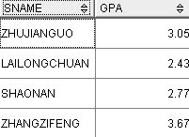
JOIN THREE TABLES
[Example 39]Find the names and GPAs of all students who take database systems.
select SName, GPA from Student, sc, Course
where cname= `DBS‘ and Student.ssn = sc.ssn and sc.cno= Course.cn

Slide 147
Exercises
1、 Find the oldest and most young students in the department of computer science.
Select max(sage), min(sage)
from student,dept where
student.deptno=dept.deptno
And deptname=‘computer science’
2、Find the name and age of the oldest student in the department of computer science.
Select sname
from student,dept where student.deptno=dept.deptno and deptname=‘computer science’
and sage=(select max(age) from student,dept where student.deptno=dept.deptno and deptname=‘computer science’ )
An Introduction to Database System

Slide 148
3、Select the number of students and the best grade of each course.
Select cno,count(*),max(grade)
From sc
Group by cno
An Introduction to Database System

Slide 149
4、Select the NO. and the total grade of the students whose total grade is more than 200.
Select sno, sum(grade) from sc
group by sno
having sum(grade)>200
An Introduction to Database System

Slide 150
5、Select the courses that were selected by none students. List the courses’ NO. and names.
Select c.cno,cname
from course c left join sc on c.cno=sc.cno where sc.cno is null
An Introduction to Database System

Slide 151
6、Select the names, courses NO. and grade of the students whose grade is more than 80.Show the result by descendent order on grade.
Select sname,cno,grade
From student,sc
Where student.ssn=sc.ssn
And grade >80
Order by grade desc
An Introduction to Database System

Slide 152
7.select the name,job and date of hire of the employees in department 20(format the hiredate column using a picture MM/DD/YY).
Select ename “employee”,job, to_char(hiredate,’MM/DD/YY’) “HireDate”
From emp
Where deptno=20

Slide 153
8. Use a picture to format hiredate as DAY(day of the week),MONTH(name of the month),DD(day of the month) and YYYY(year).
Select to_char(hiredate,’DAY,MONTH,DD,YYYY’ ) “HireDate”
From EMP

Slide 154
9.Which employees were hired in March?
Select ename “Employee”,hiredate
From emp
Where to_char(hiredate,’MON’)=‘3月’

Slide 155
10.Show the weekday of the first day of the month in which each employee was hired.
Select ename “employee”,hiredate,to_char(trunc(hiredate,’month’),’day’)
From emp

Slide 156
Trunc function
1 trunc用于对值的截断。用法有两种：sysdate=2010-10-20
1) trunc(NUMBER)截断数字:trunc(n1,n2),n2表示要截断到哪一位。也可为负数，如：
trunc(19.85)——>19; trunc(19.85,1)——>19.8;
2) trunc(DATE)截断日期
截取今天：trunc(sysdate,‘dd’)或trunc(sysdate)——》2012-03-24
截取本周第一天：trunc(sysdate,‘d’)——》2012-3-18
截取本月第一天：trunc(sysdate,‘mm')——》2012-3-1
截取本年第一天：trunc(sysdate,‘y')——》2012-1-1

Slide 157
last_day and next_day
last_day求一个日期所在月的最后一天
next_day(日期,'sun|mon|..|fri|sat')从日期后的下一天开始找，如果与相应的星期满足，则返回满足条件的日期。
求一个月的最后一天
SQL> select last_day(sysdate) from dual;
下一个星期一的日期
SQL> select next_day(sysdate,'mon') from dual;
下个月的第一个星期五
SQL> select next_day(last_day(sysdate),'fri') from dual

Slide 158
11.Show details of employee hiredates and the date of their first payday.(paydays occur on the last Friday of each month)(plus their names)

Slide 159
Set Operation :Union Intersect & Minus
SQL supports three set operations: union, intersect, minus
Union compatibility is required.
Consider the following two relations:
      G_Students(ssn, Name, GPA, GRE, Dept_Name)
      Instructors(ssn, Name, Office, Salary, Dept_Name)

Slide 160
Union
[Example 40]: Find the names of those people who are either select lesson 21001001 or lesson 22003002
(select SName from student
where ssn=any (select ssn from sc
where cno=21001001) )
union
(select SName from students
where ssn=any (select ssn from sc
where cno=22003002) )

Slide 161
Cont…
union removes duplicate rows.
union all keeps duplicate rows.

Slide 162
Set Operation: Intersect
[Example 41]: Find the names of those people who select lesson 21001001 and lesson 22003002
(select SName from student
where ssn=any (select ssn from sc
where cno=21001001) )
intersect
(select SName from student
where ssn=any (select ssn from sc
where cno=22003002) )

Slide 163
Set Operation: Minus
[Example 42]: : Find the names of those who select lesson 21001001 but has not select the lesson 22003002
(select SName from student
where ssn=any (select ssn from sc
where cno=21001001) )
minus
(select SName from student
where ssn=any (select ssn from sc
where cno=22003002) )

Slide 164
Set Operation: IN & NOT IN
[Example 43]: : Find all students who are 20, 21, or 19 years old.
select * from Student
where Age in (19, 20, 21)
NOT IN is the opposite of IN.

Slide 165
Sub queries
A subquery is a SELECT statement that is nested within another SQL statement.
Return any number of values
Can be found in, the column list of a SELECT statement, a FROM, GROUP BY, where,HAVING clauses of a SQL statement.

Slide 166
CON…
[Example 48]
To find the names of every student who studies in the same department as a person called Jones .
SELECT SNAME
    FROM student
    WHERE DEPTNO =
    (SELECT DEPTNO
    FROM student
    WHERE SNAME = 'JONES')

Slide 167
CON…
Or as a join statement, like this:
  SELECT e1. SNAME
  FROM student e1,student e2
  WHERE e1. DEPTNO = e2. DEPTNO AND e2. SNAME = 'JONES'

Slide 168
CON…
[Example 49]: Find the names of all students who take at least one course titled ‘multimedia’.
select sName
from Student s, SC e
where s.ssn = e.ssn and e.cno in
(select cno from Course
where Cname = ' multimedia')

Slide 169
Non Nested Equivalent
The previous query is equivalent to:
(1)
  select SName
  from Student s, sc e, Course c
  where s.ssn = e.ssn
  and e.cno= c.cno and c.cname =‘multimedia'

Slide 170
Cont…
(2)
select SName
from Student where ssn in
        (select ssn from sc
        where Cno in
        (select Cno from Course
        where cname = multimidea'))

Slide 171
comparison-operator:
ALL -- the comparison must be true for all returned values.
ANY -- The comparison need only be true for one returned value.
IN may be used in place of = ANY.
NOT IN may be used in place of != ALL.

Slide 172
Other set comparison operators:
<some, <=some, >=some, =some, <>some, >any, <any, <=any, >=any, =any, <>any, >all, <all, <=all, >=all, =all, <>all
some and any have identical meaning.
=some is equivalent to in
<>some is not equivalent to not in.
<>all is equivalent to not in.
Let x = a and S = {a, b}.
Then x <>some S is true but x not in S is false.
x <>all S is also false.

Slide 173
Definition of Some Clause
0
(5 < some
5
) = true
(read: 5 < some tuple in the relation)
6
0
(5 < some
5
) = false
0
(5 = some
) = true
5
0
(5 ≠ some
5
) = true (since 0 ≠ 5)
(= some) ≡ in
However, (≠ some) ≡ not in

Slide 174
CON…
Find the names of all students that have greater gpa than some female students.
select sname
from student
where gpa> some
(select gpa
from student
where sex = ‘female')

Slide 175
Definition of all Clause
0
(5 < all
5
) = false
6
6
(5 < all
) = true
10
4
(5 = all
) = false
5
4
(5 ≠ all
) = true (since 5 ≠ 4 and 5 ≠ 6)
6
(≠ all) ≡ not in
However, (= all) ≡ in

Slide 176
CON…
Find the names of all students that have greater gpa than all female students
select sname
from student
where gpa> all
(select gpa
from student
where sex = ‘female')

Slide 177
Cont…
=
<>或!=
<
<=
>
>=
ANY
IN
--
<MAX
<=MAX
>MIN
>= MIN
ALL
--
NOT IN
<MIN
<= MIN
>MAX
>= MAX

Slide 178
Cont…
[Example 50]: : Find the names of those students who are 18 or younger and whose GPA is higher than the GPA of some students who are 20 or older.
select sName from Student
where Age <= 18 and GPA >some
(select GPA from Student
where Age >= 20)

Slide 179
[example 51] Find the names and age of students in other departments that have smaller age than any a student in the department 33.
    SELECT Sname，Sage
    FROM Student
    WHERE Sage < ANY (SELECT Sage
    FROM Student
    WHERE deptid= ' 33 ')
    AND deptid <> ' 33 ' ;

Slide 180
[example 51']：Using aggregate function to implement [example 50]
SELECT Sname，Sage
FROM Student
WHERE Sage <
(SELECT MAX(Sage)
FROM Student
WHERE deptid= ' 33 ')
  AND deptid <> ' 33’;

Slide 181
[example 51] Find the names and age of other departments that have smaller age than all the students in the department 33
  SELECT Sname，Sage
  FROM Student
  WHERE Sage < ALL
  (SELECT Sage
  FROM Student
  WHERE deptid= ' 33 ')
  AND deptid <> ' 33’;

Slide 182
[example 51’] Aggregate function
SELECT Sname，Sage
FROM Student
WHERE Sage <
(SELECT MIN(Sage)
FROM Student
WHERE deptid= ' 33 ')
AND deptid <>' 33 ’;

Slide 183
Correlated Query
Definition: If some attributes of a relation declared in the from clause of an outer query are referenced in the where clause of an inner query, then the two queries are said to be correlated, and the inner query is called a correlated inner query.

Slide 184
Exists and not Exists
exists ( ) is true if the set ( ) is not empty.
exists ( ) is false if the set ( ) is empty.
not exists ( ) is true if the set ( ) is empty.
not exists ( ) is false if the set ( ) is not empty.

Slide 185
Exists
[Example 52]: Find all students who take at least one course.
select * from Student s
where exists
(select * from sc
Where ssn= s.ssn)

Slide 186
Cont…
The previous query is equivalent to:
(1) select s.*
from Student s, sc e
where s.SID = e.SID
select * from Student
where ssn in
(select ssn from sc)

Slide 187
EXISTS
[Example 53]:
Find the names of all students who has select a Course with CNO=1.
SELECT Sname
FROM Student
WHERE EXISTS
(SELECT *
FROM SC
WHERE SSN = Student.SSN AND Cno=1)；

Slide 188
Using of Jonning table:
  SELECT Sname
  FROM Student, SC
  WHERE Student.Sno=SC.Sno AND
  SC.Cno= '1';

Slide 189
CON…
[Example 54]:
Find the names of all students who has NOT select a Course with CNO=1.
SELECT Sname
FROM Student
WHERE NOT EXISTS
(SELECT *
FROM SC
WHERE SSN = Student.SSN AND Cno=1)；

Slide 190
[例]找出每个学生超过他选课课程平均成绩的课程号
Select sno,cno
From sc x
Where grade>=(select avg(grade)
From sc y
Where y.sno=x.sno)

Slide 191
[例]找出每个学生超过该选课课程平均成绩的课程号
Select sno,cno
From sc x
Where grade>=(select avg(grade)
From sc y
Where y.cno=x.cno)

Slide 192
Cont…
Evaluation of correlated queries: for each tuple in the outer query, evaluate the inner query once.
The scoping rule of attribute names:
select ... from R1, ..., Rk where ...
(select ... from S1, ..., Sm
where S1.A = R2.B and C = D and ... )
(1) If attribute C is not an attribute in S1, ..., Sm, and C is an attribute in some Ri, then C = Ri.C.
(2) If C is in both Sj and Ri, then C = Sj.C.

Slide 193
Cont…
[Example 55]: Find all students who do not take 21003001.
    select * from Student s where not exists
    (select * from sc
    where ssn= s.ssn
    and Cno = '21003001.')
    This query is equivalent to:
    select * from Student where ssn not in
    (select ssn from sc
    where Cno = '21003001.')

Slide 194
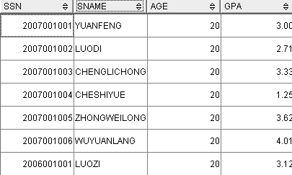

Slide 195
[Example 56]:
Find the names of all students who study in the same department with a student with sname= ‘liucheng’ .
  SELECT ssn，Sname，DEPTNO
  FROM Student S1
  WHERE EXISTS
  SELECT *
  FROM Student S2
  WHERE S2.DEPTNO = S1.DEPTNO AND
  S2.Sname = ‘ liucheng '；

Slide 196
Cont…
[Example 57]: Find all the students who take all courses
select * from Student s
where not exists
(select * from Course c
where not exists
(select * from sc
where ssn= s.ssn
and Cno = c.Cno))

Slide 197
Cont…
[Example 58] : Find the names and GPAs of those students who take all courses taken by a student with SID = 2006002001.
select Name, GPA from Student s
where not exists
(select * from Course c
where Cno in
(select Cno from sc
where ssn= 2006002001) and not exists
(select * from sc e
where ssn=e.ssn and Cno =
c.Cno))

Slide 198
Cont…
[Example 58’]:
SELECT Name, GPA
FROM student SX
WHERE NOT EXISTS
(SELECT *
FROM SC SCY
WHERE SCY.Ssn = 2006002001 AND
NOT EXISTS
(SELECT *
FROM SC SCZ
WHERE SCZ.Ssn=SX.Ssn AND
SCZ.Cno=SCY.Cno))；

Slide 199
DML modifying contents
INSERT allows insertion of records into a table
UPDATE updates existing rows in a table
DELETE removes unwanted rows from a table

Slide 200
Insert
INSERT INTO emp (empno, ename, job, mgr, hiredate, sal, comm, deptno)
VALUES(7500, 'CAMPBELL', 'ANALYST', 7566, ‘1992-3-5', 24500,0, 40);

Slide 201
CON…
[EXAMPLE] Find each department with average age, and put the results into the database.
1. CREATE TABLE Deptage
(Sdept CHAR(15) /* depart name*/
Avgage SMALLINT)； /*average age*/
2. INSERT
INTO Deptage(Sdept，Avgage)
SELECT Sdept，AVG(Sage)
FROM Student
GROUP BY Sdept；

Slide 202
Update Command
1)UPDATE emp SET comm = 0;
To give a 15% raise to all Analysts and Clerks in department 20 :
UPDATE emp
SET sal = sal* 1.15
WHERE (job = 'ANALYST' OR job = 'CLERK')AND deptno = 20;

Slide 203
CON…
Increase all students with GPA over 3.5 by 6%, all other students receive 5%.
  update student
  set gpa= gpa∗ 1.06
  where gpa> 3.5
  update student
  set gpa = gpa ∗ 1.05
  where gpa ≤ 3.5

Slide 204
Delete command
i.e. To remove from EMP all sales staff who made less than 100 commission last month enter:
DELETE FROM emp
WHERE job = 'SALESMAN'
AND comm < 100;
To delete everything in a table :
DELETE FROM <tablename>;

Slide 205
CON…
Delete the record of all students with gpa below the average at the school.
delete from student
where gpa< (select avg (gpa)
from student)
  Problem: as we delete tuples from student, the average gpa changes
  Solution used in SQL:
  1. First, compute avg gpa and find all tuples to delete
  2. Next, delete all tuples found above (without recomputing avg or retesting the tuples)

Slide 206
某关系数据库:
R（Rno,Rname,Sex,AGE）表示读者
B(Bno,Bname,Writer,Publisher) 表示书籍
RB（Rno,Bno,Date）表示借阅，Date为应还日期。
分别用关系代数和SQL表示以下查询：
（1）列出”人民出版社”所出版的书名和作者。
（2）列出有书籍超期未还的读者姓名，书名，应还日期。
（3）列出借阅“毛泽东”所有书籍的读者姓名。
2.建立视图Female,反映女性读者的姓名和年龄。
3.写出建R和RB的SQL语句。

Slide 207
Scalar Functions of DB2
Scalar functions are applied to a column or expression and operate on a single value.
The result of a scalar function is a transformed version of the column or expression being operated on.
The transformation of the value is based on the scalar function being applied and the value itself.

Slide 208
Cont…
TRUNCATE or TRUNC
Converts the first numeric argument by truncating it to the right of the decimal place by the integer number specified in the second numeric argument.
SELECT TRUNC(3.014015,2)
FROM SYSIBM.SYSDUMMY1;
This SQL statement returns the number 3.010000, because the second argument specified that only 2 significant digits are required. The rest was truncated.

Slide 209
Cont…
ROUND
Rounds the first numeric argument to the number of places specified in the second argument.
UPPER or UCASE
Converts a character string into all uppercase characters
LOWER or LCASE
Converts a character string into all lowercase characters.

Slide 210
Cont…
SUBSTR
Returns the specified portion of a character column from any starting point to any ending point.
SNAME is a CHAR(20) column in sample table STUDENT. When SNAME has the value ‘ZHONGWEILONG’:
Function: Returns:
-----------------------------------
SUBSTR(SNAME,2,3) -- 'HON'
SUBSTR(SNAME,2) -- ' HONGWEILONG'
SUBSTR(SNAME,2,12) -- ' HONGWEILONG ' followed by one blank
SUBSTR(SNAME,13) -- a zero-length string
SUBSTR(SNAME,13,4) -- four blanks

Slide 211
Cont…
LTRIM
The LTRIM function removes blanks or hexadecimal zeros from the beginning of a string expression.
RTRIM
The RTRIM function removes blanks or hexadecimal zeros from the end of a string expression.

Slide 212
Cont…
CHAR
The CHAR function returns a fixed-length character string representation of the argument .
SELECT CHAR(CURRENT DATE)
CURRENT DATE is a DATE type which displays current date time of the system server. When it represents the date 15 March 2011, the example returns the string value '3/15/2011’ in character string .

Slide 213
Cont…
CONCAT
The CONCAT function combines two compatible string arguments.
[Example ]
Using sample table DSN8910.EMP, concatenate column FIRSTNME with column LASTNAME. Both columns are defined as varying-length character strings.
SELECT CONCAT(FIRSTNME, LASTNAME)
FROM DSN8910.EMP;

Slide 214
Cont…
WEEK
The WEEK function returns an integer in the range of 1 to 54 that represents the week of the year. The week starts with Sunday, and January 1 is always in the first week.
DAY
The DAY function returns the day part of a value. If the argument is a date, timestamp, or string representation of either, the result is the day part of the value, which is an integer between 1 and 31

Slide 215
Cont…
DATE
The DATE function converts a value representing a date to a DB2 date. The value to be converted can be a DB2 timestamp, a DB2 date, a positive integer, or a character string.
MONTH
The MONTH function returns the month part of a value. If the argument is a date, timestamp, or string representation of either, the result is the month part of the value, which is an integer between 1 and 12.

Slide 216
Cont…
TIME
The TIME function Converts a value representing a valid time to a DB2 time. The value to be converted can be a DB2 timestamp, a DB2 time, or a character string.
YEAR
The YEAR function returns the year part of a value that is a character or graphic string. The value must be a valid string representation of a date or timestamp.

