Slide 1
How to Extract a Signal Buried in Noise

Slide 2

Effect of Adding Noise
Speech
Speech plus White Noise

Slide 3
Power Spectral Density (PSD) of a Signal, S_{xx}(f)
0

Slide 4
Power Spectral Density (PSD) of the Speech Signal
ACTUAL SPEECH (POWER) SPECTRUM
120
100
Spectrum of speech
AMPLITUDE
80
60
40
20
0
0
500
1000
1500
2000
2500
3000
3500
4000
FREQ IN HZ

Slide 5
Where Speech and Noise PSDs Don’t Overlap
SPECTRUM FOR NOISY SPEECH
120
100
Spectrum of speech
AMPLITUDE
80
60
Spectrum of ‘HP’ noise
40
20
0
0
500
1000
1500
2000
2500
3000
3500
4000
5000
6000
FREQ IN HZ

Slide 6
Where Speech and Noise PSDs Do Overlap
SPECTRUM FOR NOISY SPEECH
120
SPECTRUM FOR NOISY SPEECH
120
SPECTRUM FOR NOISY SPEECH
120
100
Spectrum of speech
100
Spectrum of speech
100
Spectrum of speech
AMPLITUDE
AMPLITUDE
AMPLITUDE
80
80
80
60
Spectrum of ‘BP’ noise
60
Spectrum of ‘HP’ noise
60
Spectrum of ‘white’ noise
40
40
40
20
20
20
0
0
500
1000
1500
2000
2500
3000
3500
4000
0
0
500
1000
1500
2000
2500
3000
3500
4000
0
0
500
1000
1500
2000
2500
3000
3500
4000
FREQ IN HZ
FREQ IN HZ
FREQ IN HZ
(a) BP Noise: Recover some of the signal with a BS filter.
(b) HP Noise: Recover some of the signal with a LP filter.
(c) White Noise: Cannot do anything, or can we?

Slide 7
Speech Buried in Wideband White Noise

Slide 8
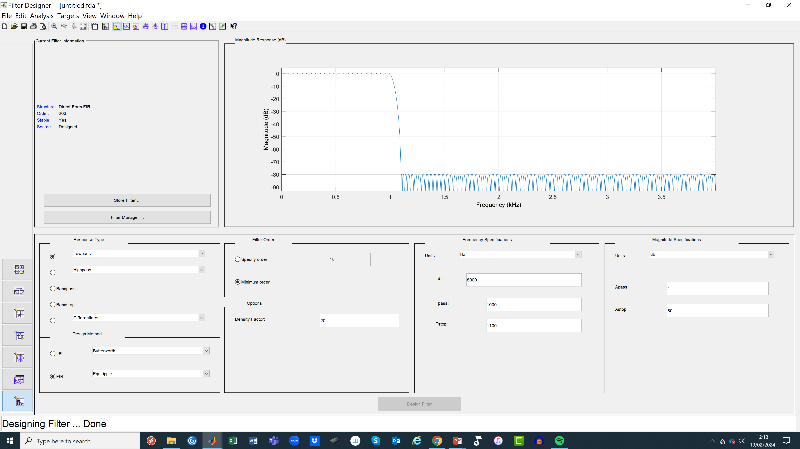
Use “filterDesigner.m” to Design LPF

Slide 9
FIR LPF Coefficients h(n)

Slide 10
Speech Buried in HPF White Noise
LPF with Fc=1000Hz

Slide 11
Speech Buried in Strong HPF White Noise
LPF with Fc=1000Hz

Slide 12
BE CAREFUL WITH SNR
Speech
Speech plus White Noise

Slide 13
DO NOT GET TOO FIXATED ON SNR!

Slide 14
Extracting Data from Noise
Random Bits
f
−
3
−
2
−
1
0
1
2
3
T
T
T
T
T
T

Slide 15
Estimate the Transmitted Bits if Noise is HP
Clearly we need a LPF to remove the noise which is HP in nature. A choice of a LPF with a cutoff of 2kHz is fine to capture most of the spectrum of the data, but other choices could work as well.

Slide 16
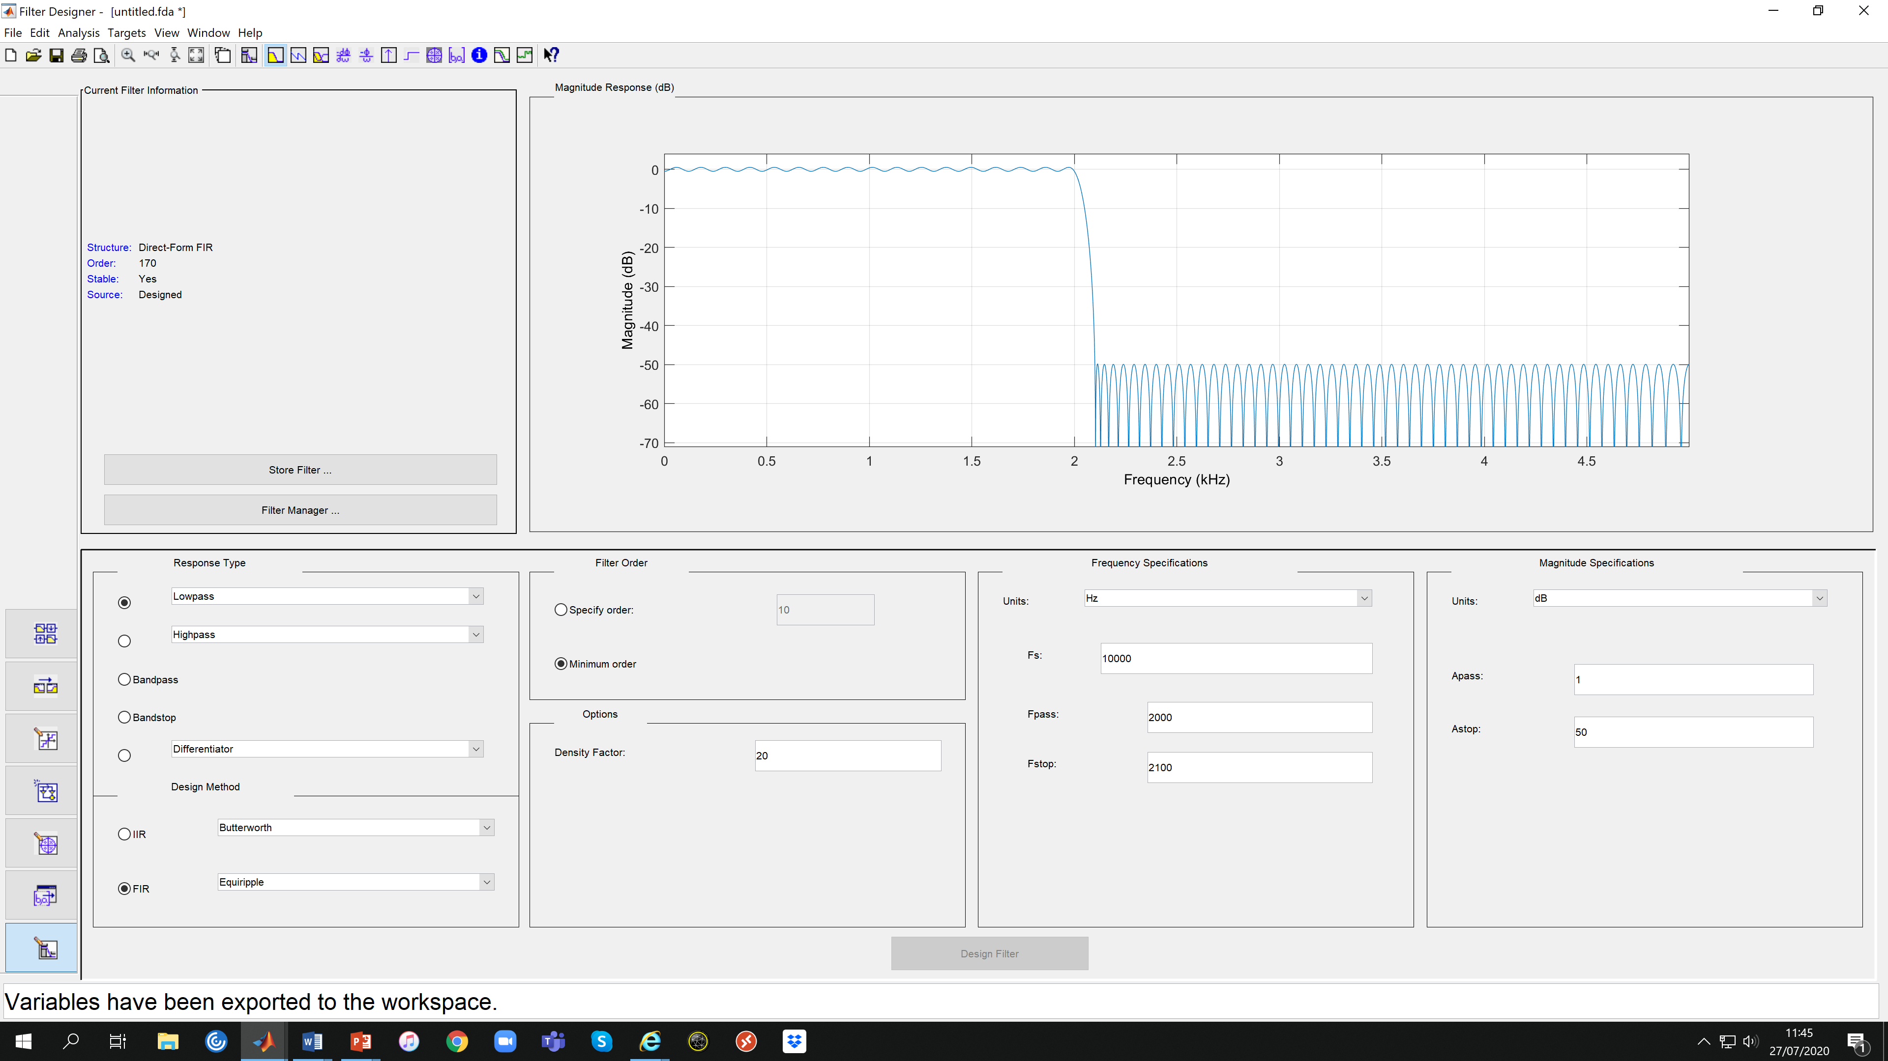
Design a LPF with Fc=2kHz

Slide 17
FIR LPF Coefficients h(n)

Slide 18
Noise is Mostly Removed
The transmitted bit sequence is [1 0 0 1 1 1 0 1 0 1]
The transmitted bit rate is 10bps.

Slide 19
What is the Optimum Filter to Reduce the Effect of Noise in General?

